Slide 1
Stock Price Forecasting and Risk Estimation
TEAM 5
Team Members
Huaqian Yuan
Jongtaek Lee
Ashley Rabanales
Jiawei Tang
April 19th, 2023
Notes:
Thao

Slide 2

Agenda:
Data Pre-processing & Exploratory analysis
Results and Evaluation
Problem Statement and Objective
Algorithms, Analysis, and Implementations
Conclusions
Group Member Contributions
Notes:
Charanya

Slide 3
Problem Statement and Objective

Slide 4
Problem Statement & Objective
Background: Investors are always looking for ways to maximize their returns while minimizing their risks. Accurate prediction of future stock prices and estimation of risk measures are crucial for making informed investment decisions.
Data: historical stock prices data in IT, automotive and banking sectors.
Aim: Develop effective and robust models and techniques for stock price forecasting and risk measures estimation that can provide accurate and reliable predictions and help investors make informed decisions.

Slide 5
Problem Statement & Objective​
Stock price forecasting
Use time series models like ARIMA model to analyze the historical data of stock prices to identify patterns and trends.
Use machine learning model like Random Forest to train algorithms that can predict future stock prices.
The combination of two models can improve the accuracy of stock price predictions.
Evaluate stock price predictions by MSE, MAE and RMSE.
Estimate risk measures
Calculate monthly log return and fit to AR/GARCH model, then predict one-step-ahead log return.
Utilize the return distribution to estimate risk measures like VaR. (estimates the maximum amount of loss that could be incurred on a stock investment within a given confidence interval)
Based on the VaR, adjust the portfolio risk by reducing or increasing the exposure to certain assets.
​

Slide 6
Data
Preprocessing and
Exploratory
Analysis

Slide 7
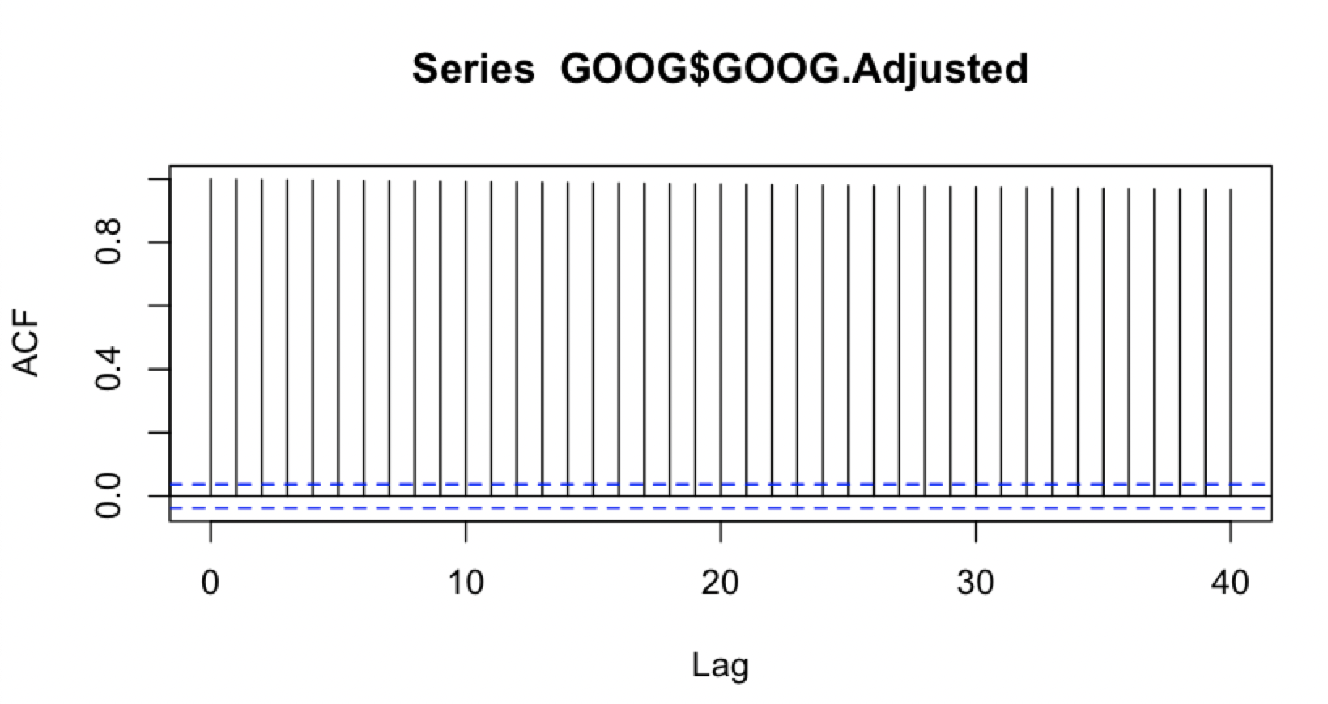
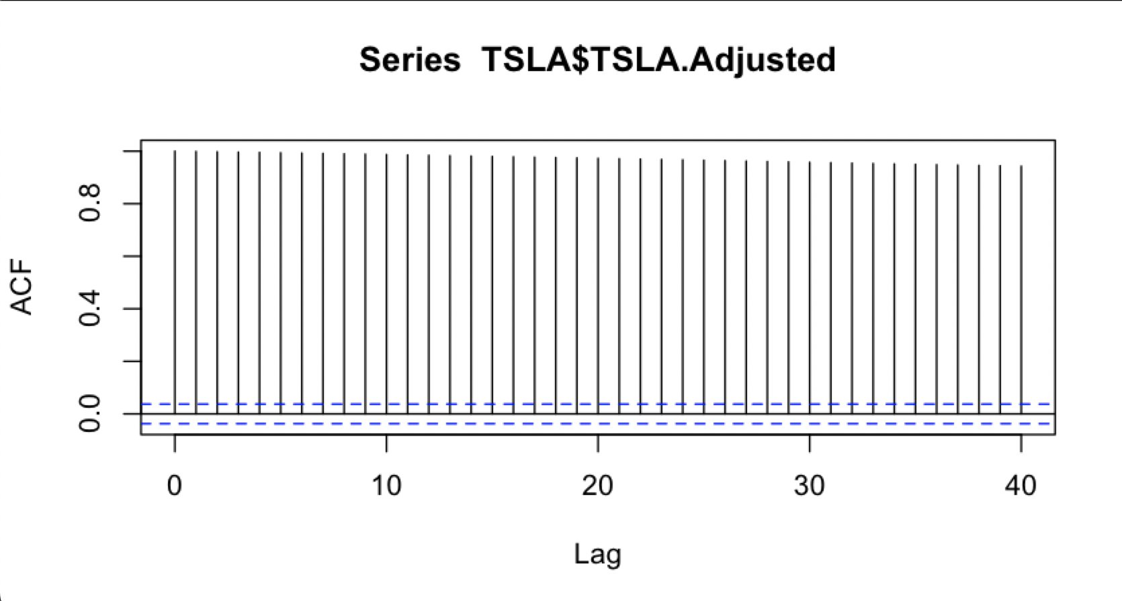
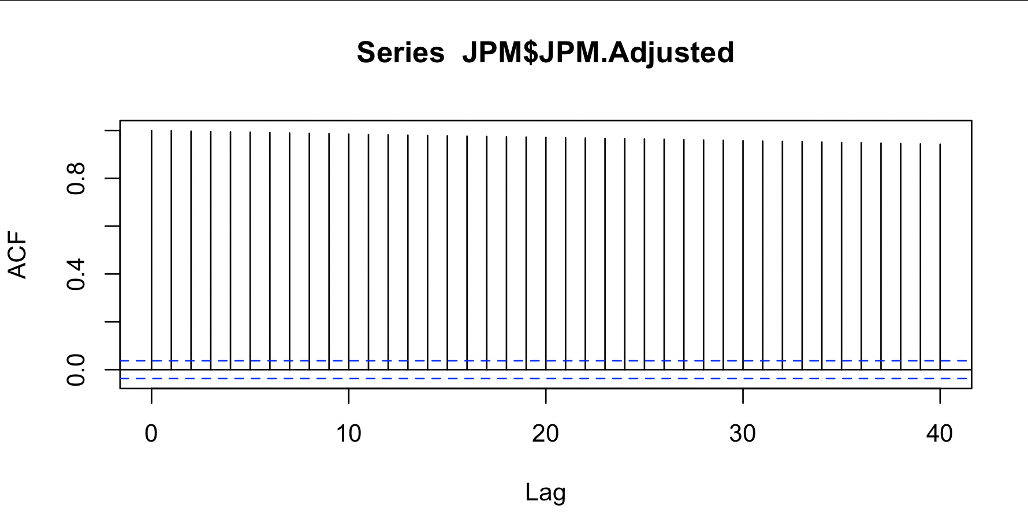
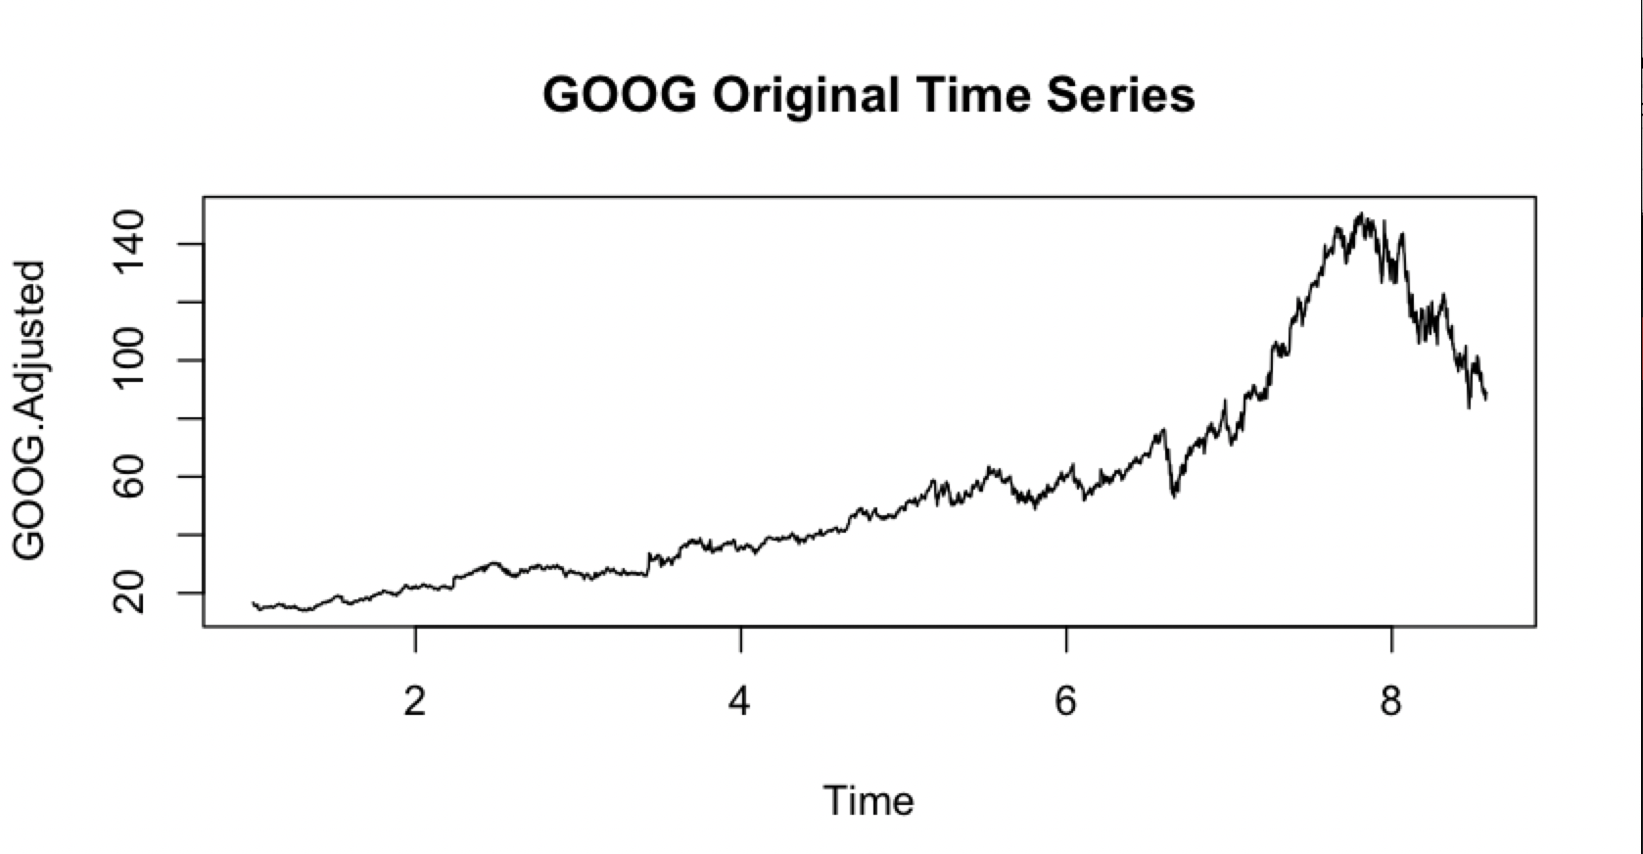
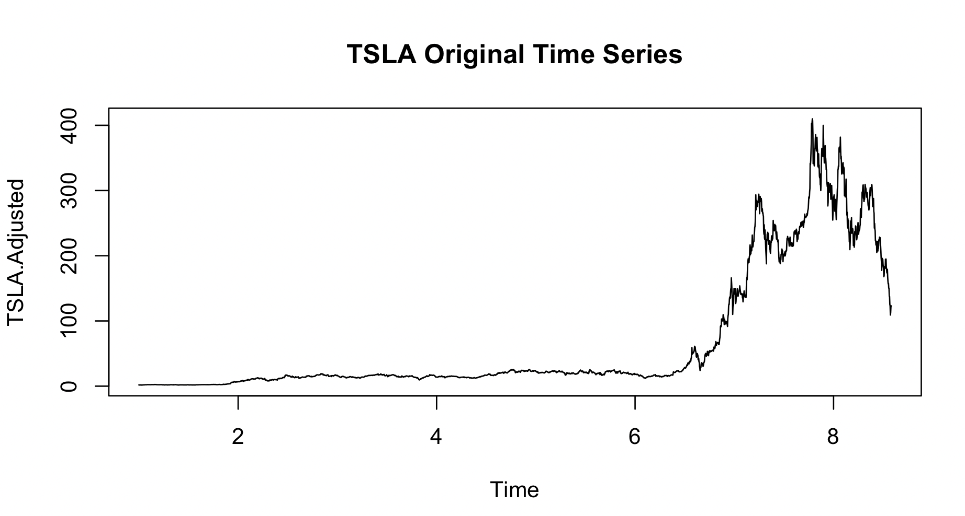
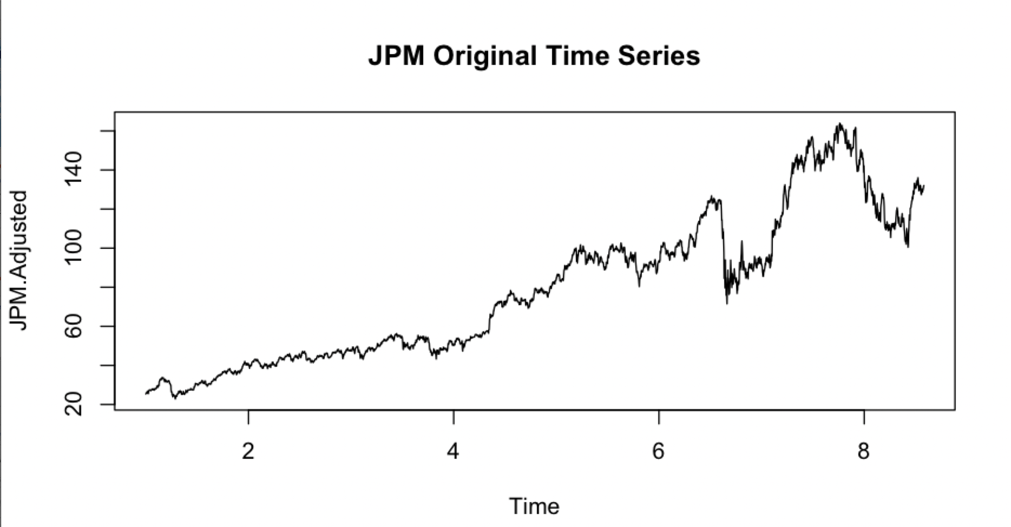
Stock Price Forecasting – ACF and Original Time Series
GOOGLE
TELSA
JPM (CHASE)

Slide 8
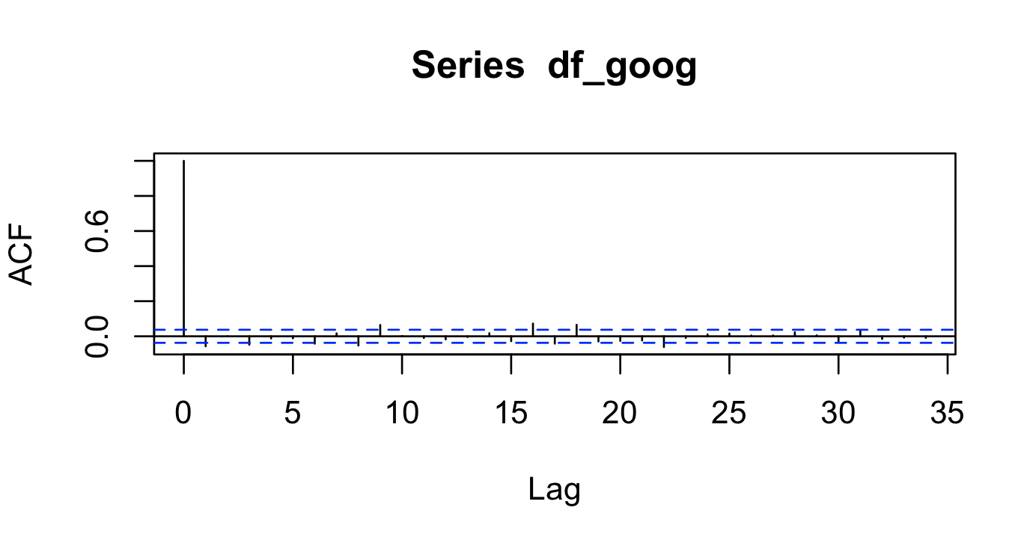
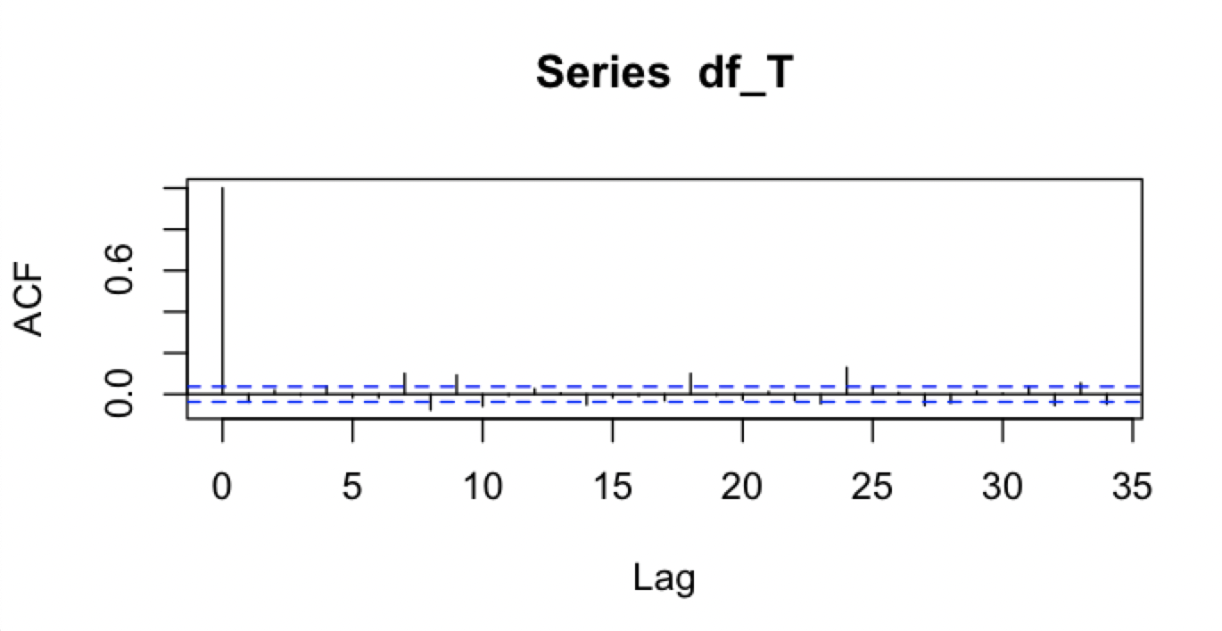
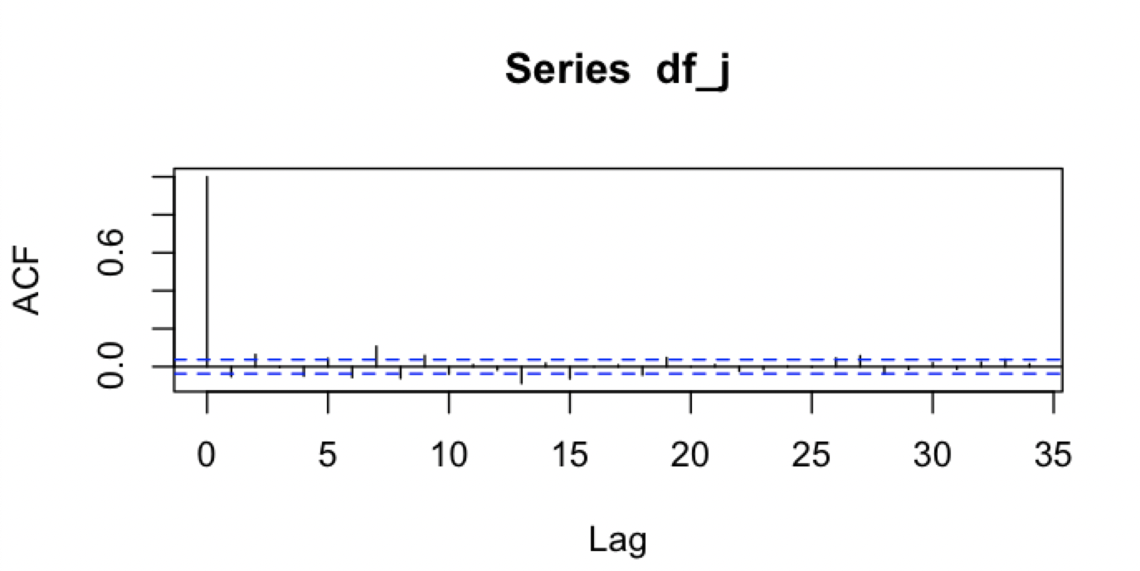
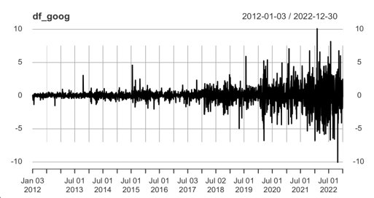
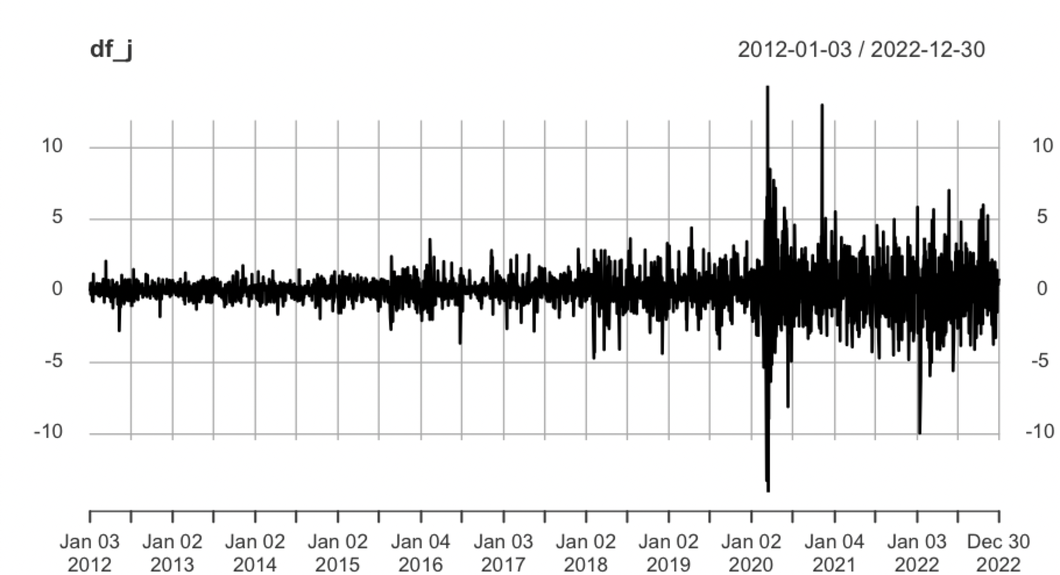
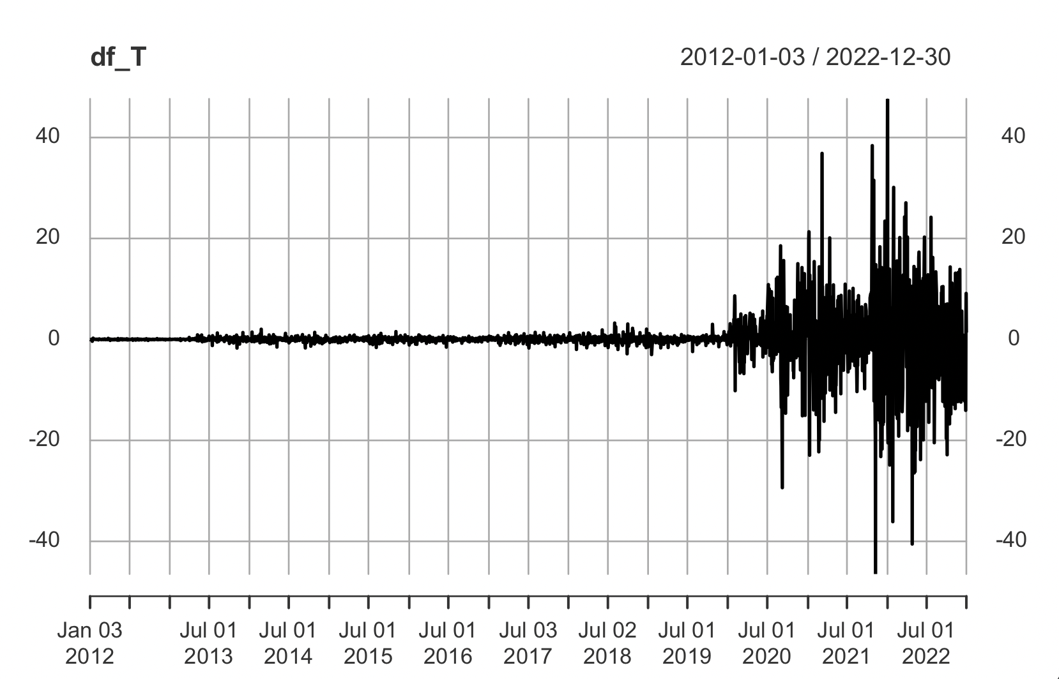
Stock Price Forecasting – Detrend by difference
GOOGLE
TELSA
JPM (CHASE)

Slide 9
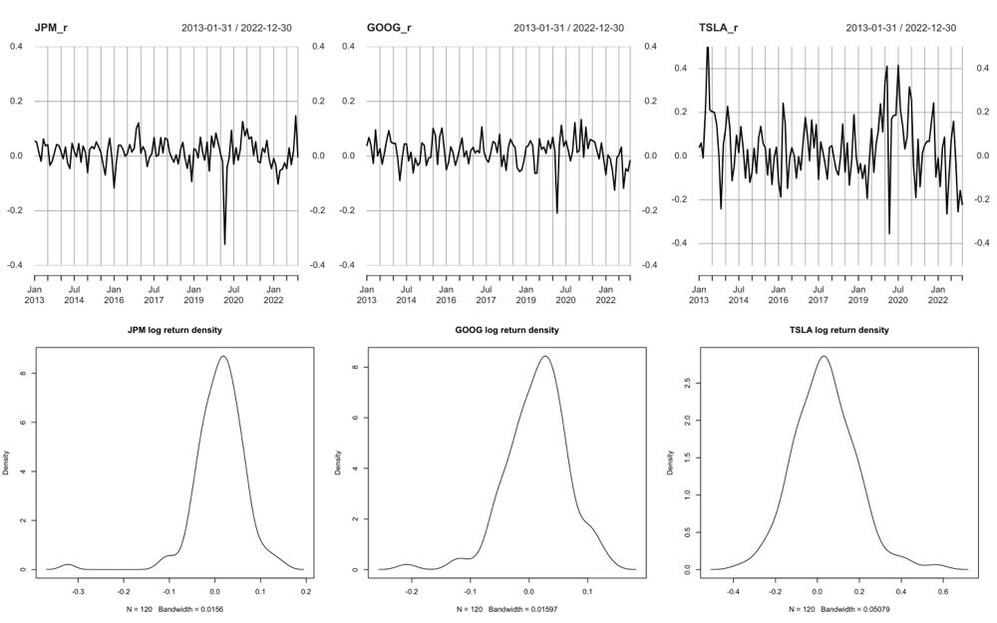
Risk Estimation – Monthly Log Return
Notes:
To determine whether it is necessary to model time dependence and volatility of log returns, we can look at the properties of the data itself. If the data exhibits strong autocorrelation, seasonality, or cyclicality, then it is likely that modeling time dependence and volatility will be important. Additionally, if the data exhibits significant changes in volatility over time, then it may be necessary to model these changes explicitly in order to capture the full range of potential outcomes.

Slide 10
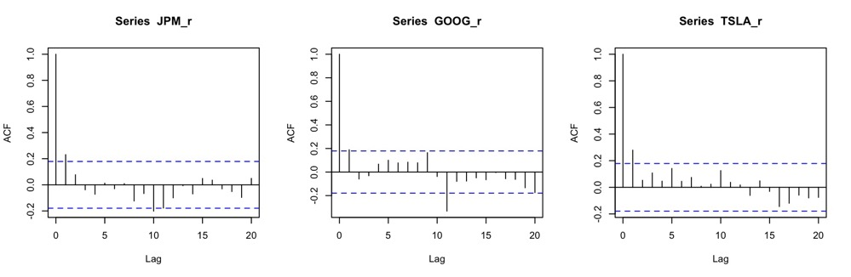
Risk Estimation – ACF of Log Return
Notes:
To determine whether it is necessary to model time dependence and volatility of log returns, we can look at the properties of the data itself. If the data exhibits strong autocorrelation, seasonality, or cyclicality, then it is likely that modeling time dependence and volatility will be important. Additionally, if the data exhibits significant changes in volatility over time, then it may be necessary to model these changes explicitly in order to capture the full range of potential outcomes.

Slide 11
Algorithms and
Implementations

Slide 12
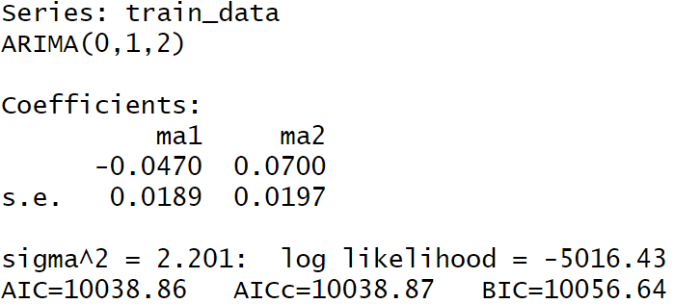
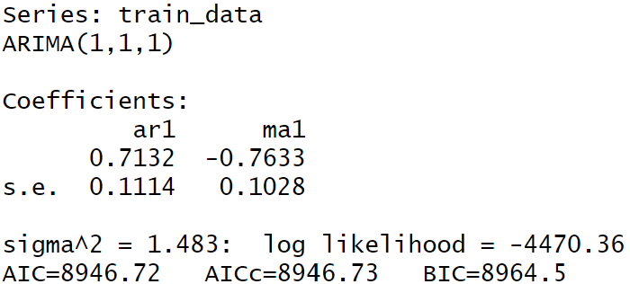
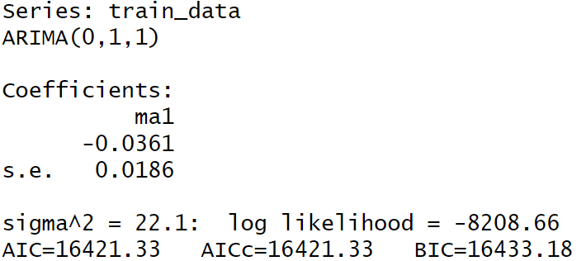
Stock Price Forecasting
1. Fit ARIMA model ​
Find the optimal parameters (p, d, q)
JPM (0, 1, 2)
Google (1, 1, 1)
Tesla (0, 1, 1)

Slide 13
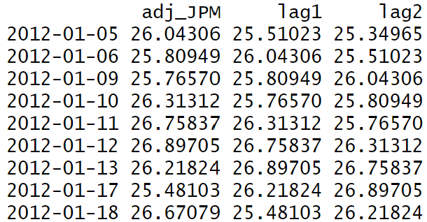
Stock Price Forecasting
2. Fit random forest ​
Create two lags
as variables
Use the variables to fit the random forest model

Slide 14
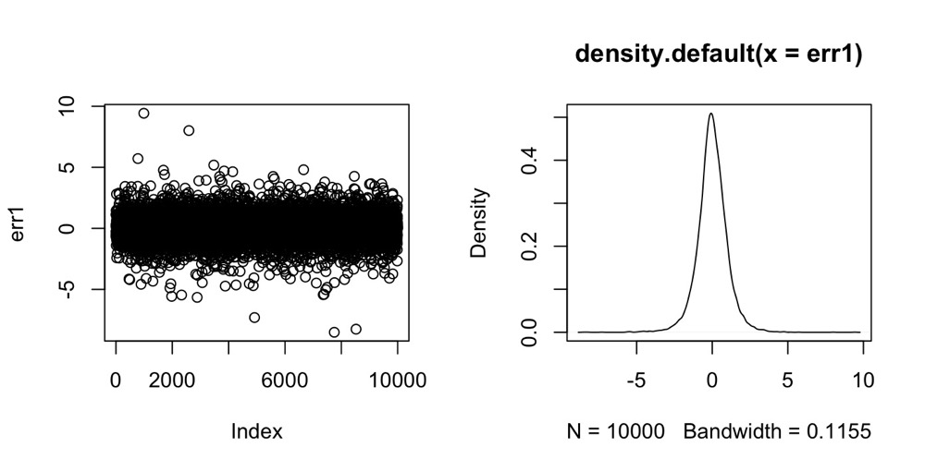



Risk Estimation
1. Fit AR(1)-GARCH(1,1) model
$X_{t+1}$ = $μ+∅X_{t}+e_{t+1}$
$$e_{t+1}=σ_{t+1}+ε_{t+1}$$
$$σ_{t+1}^{2}=ω+αe_{t}^{2}+βσ_{t}^{2}$$
$σ_{t}$: represents the time-varying uncertainty or volatility in the model's error term $e_{t}$captured by GARCH part.
εt : the standardized error term, and it can be simulated by residual models.
2. Conduct residual analysis for AR(p) part
Serial Correlation: ACF plot, Normal Q-Q plot and Box-Ljung test
Heteroscedasticity: Breusch-Pagan test
3. Simulate $ε_{t}$ from the fitted copula model

Slide 15
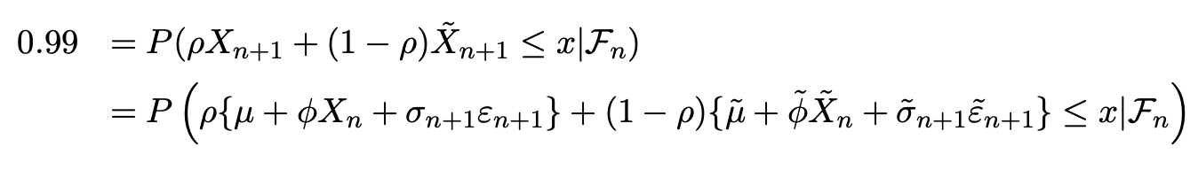


Risk Estimation
4. Predict one-step-ahead $X_{t+1}$ return distribution
Given $μ ,∅$, $σ_{t}$ from AR-GARCH model and $ε_{t}$ from simulation, we can calculate the log return ${ X}_{t}$ numerically.
$X_{t+1}$ = $μ+∅X_{t}+e_{t+1}$
$$e_{t+1}=σ_{t+1}+ε_{t+1}$$
5. Estimate the risk VaR and find the optimal portfolio (Include 2 stocks in the portfolio)
Given $X_{t+1}$ distribution, we can calculate the risk value VaR in 99% confidence level for any stocks or portfolio.
By changing the weights $ρ$, the optimal portfolio composition with least risk can be identified.

Slide 16
Results and
Evaluation

Slide 17
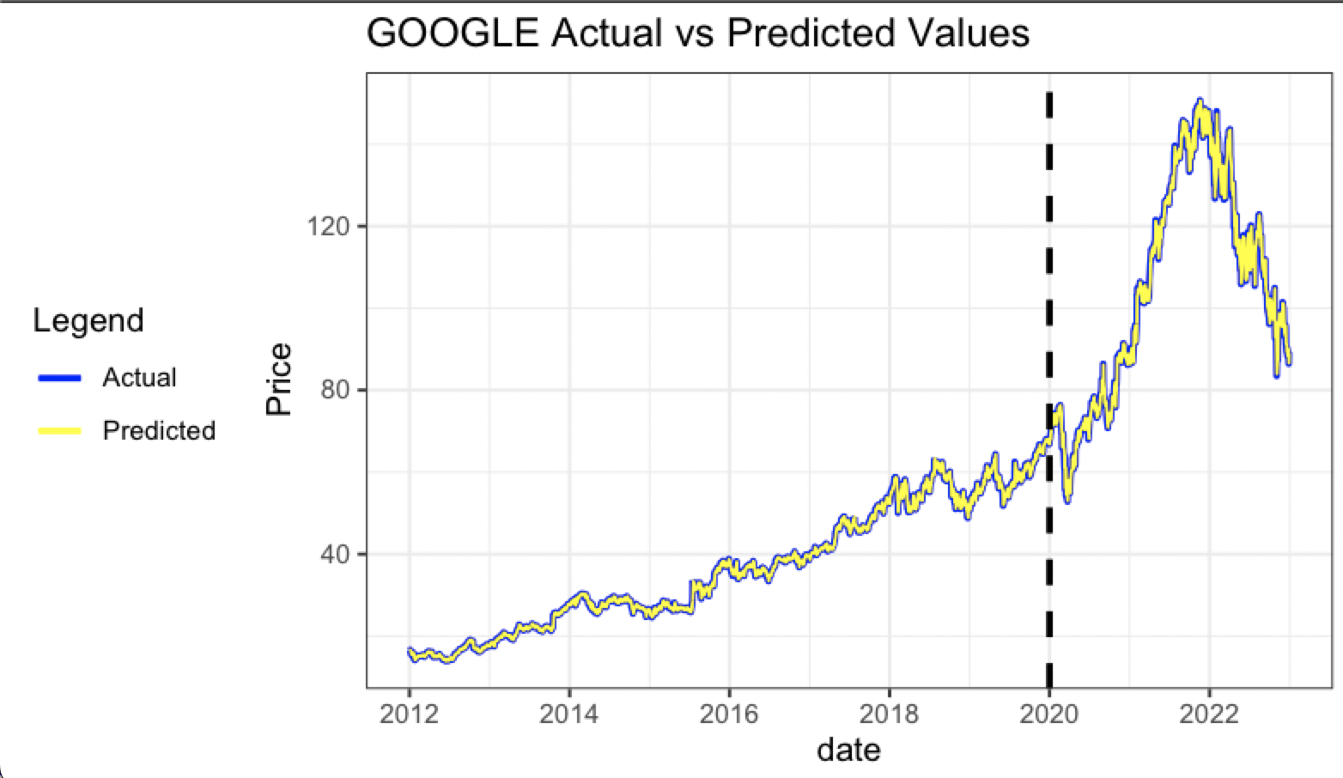
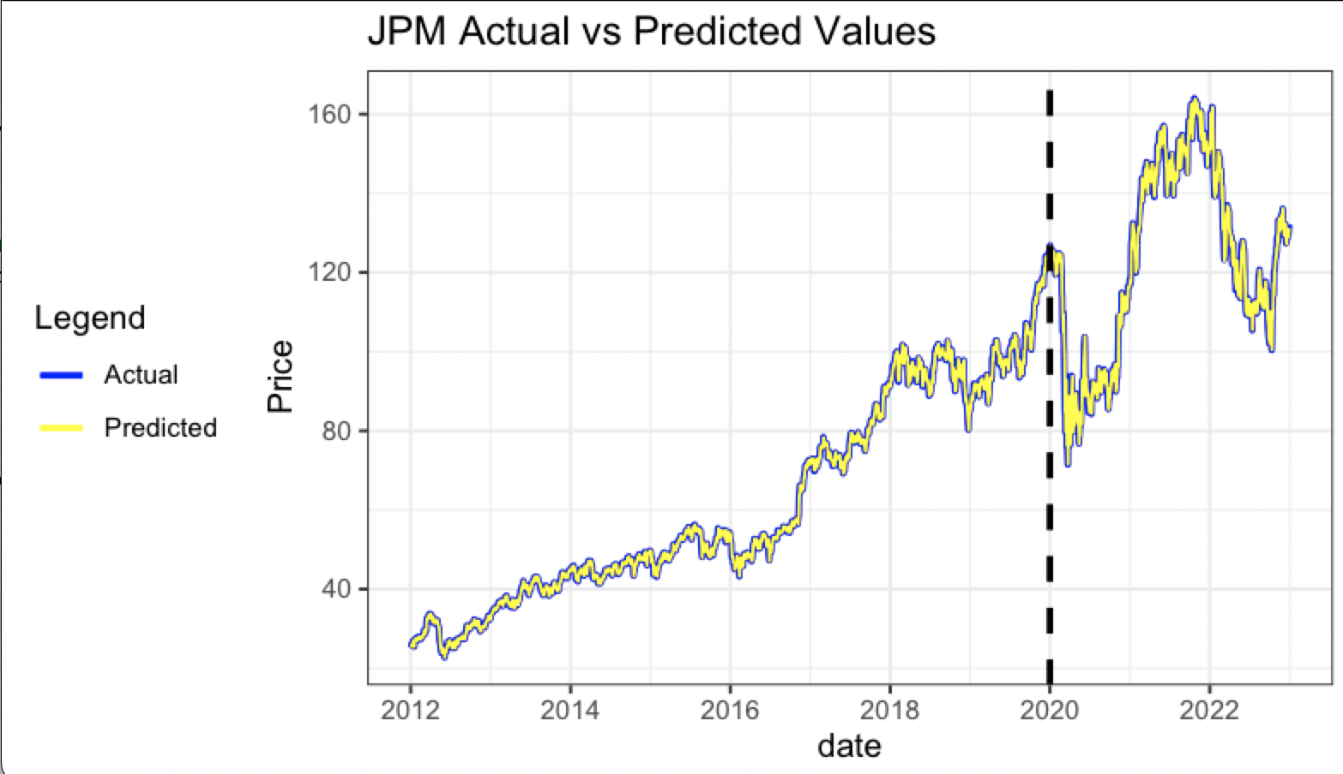
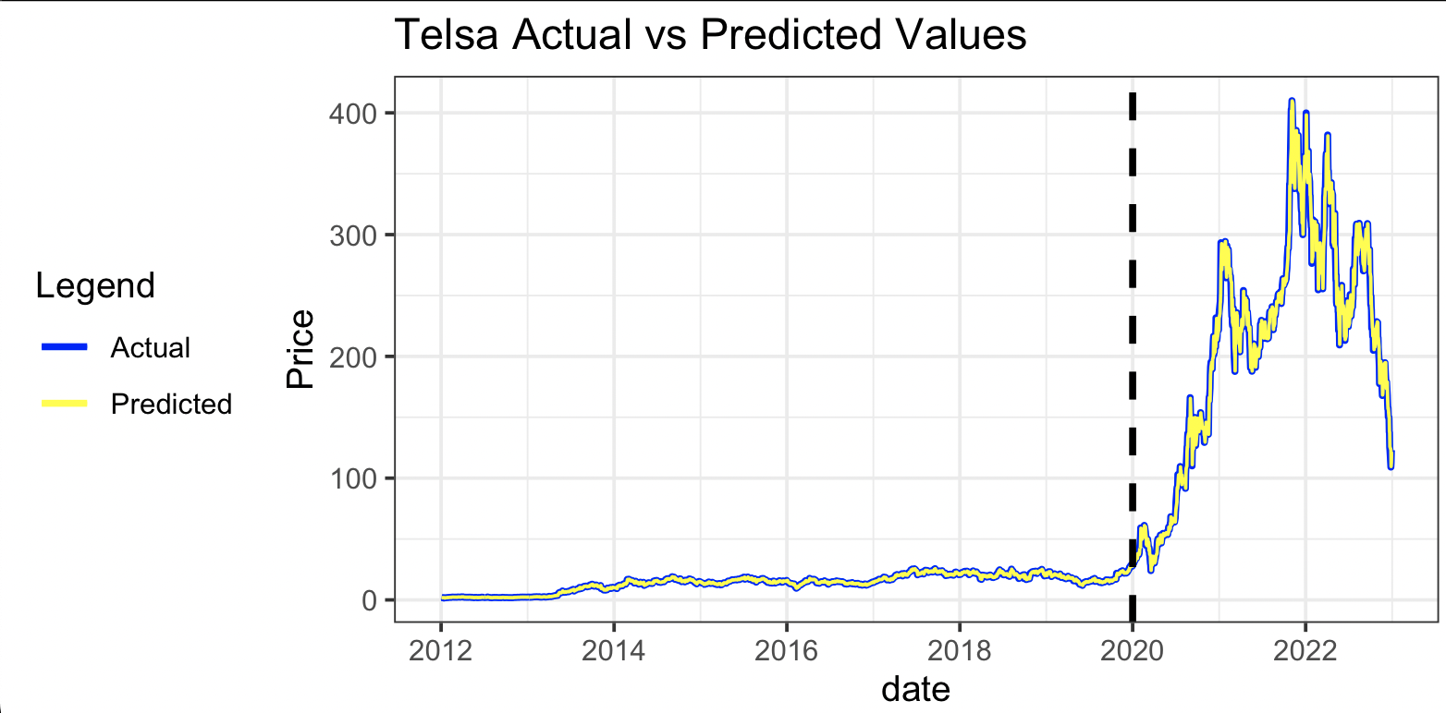
Stock Price Forecasting
ARIMA

Slide 18
Stock Price Forecasting
ARIMA
Company | Measure | Value
JPM | MAE | 0.9147
 | MSE | 2.1982
 | RMSE | 1.4826
Google | MAE | 0.6900
 | MSE | 1.4813
 | RMSE | 1.2171
Tesla | MAE | 1.8918
 | MSE | 22.0877
 | RMSE | 4.7000

Slide 19
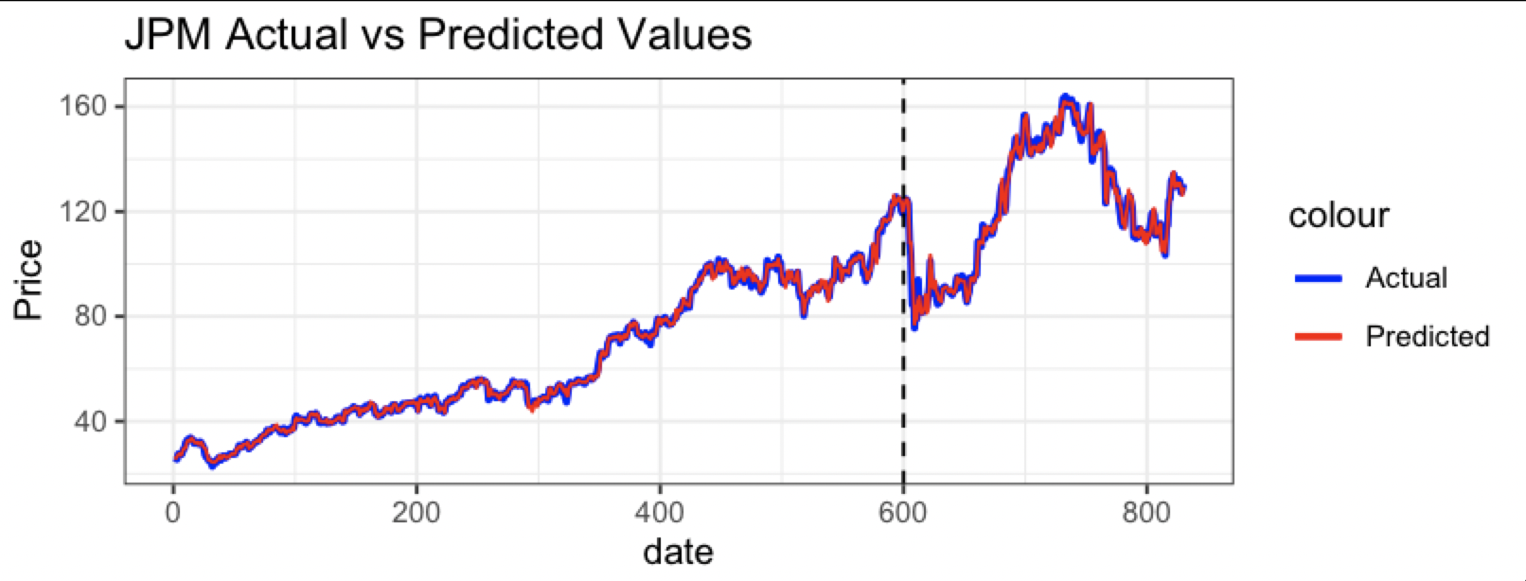
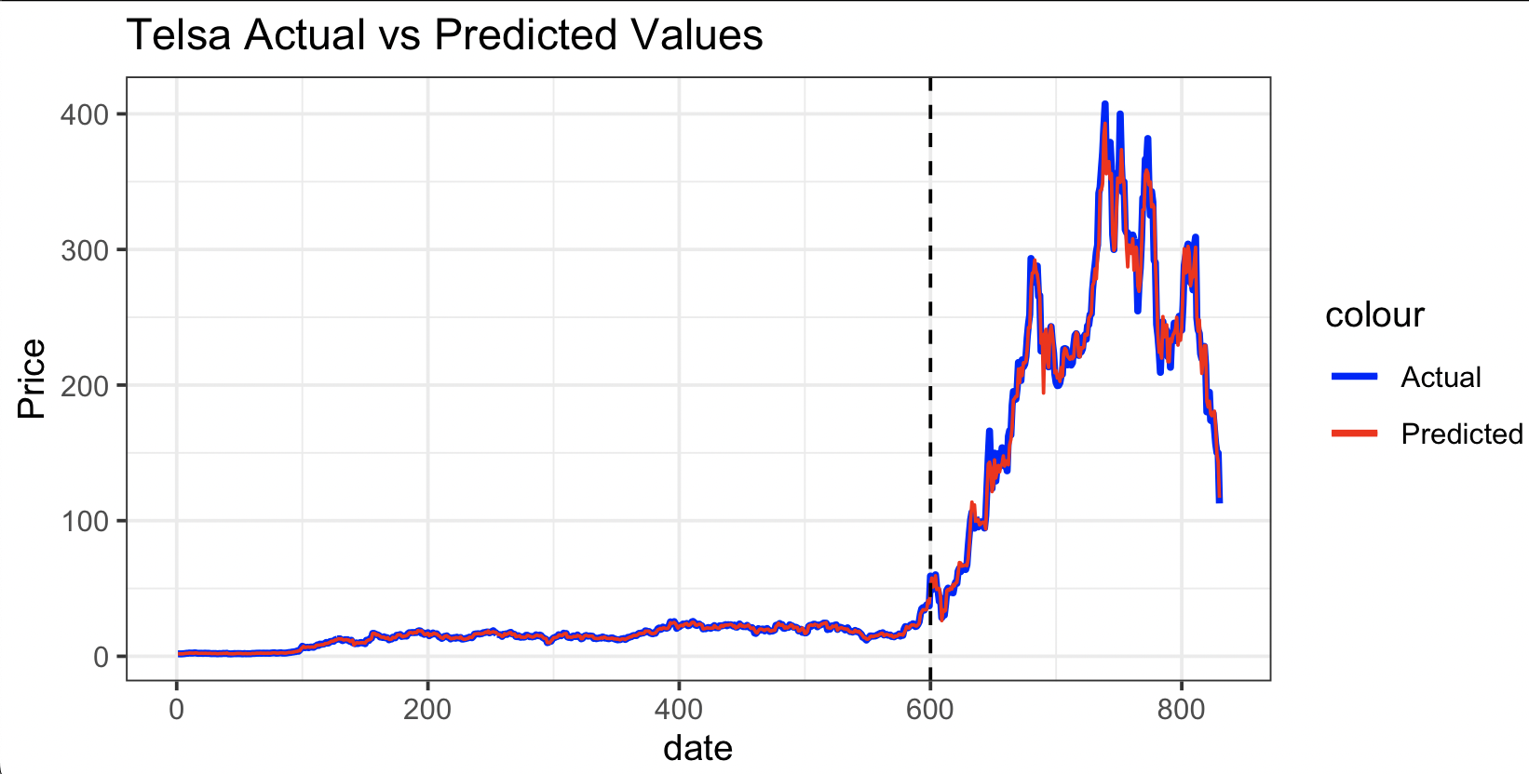
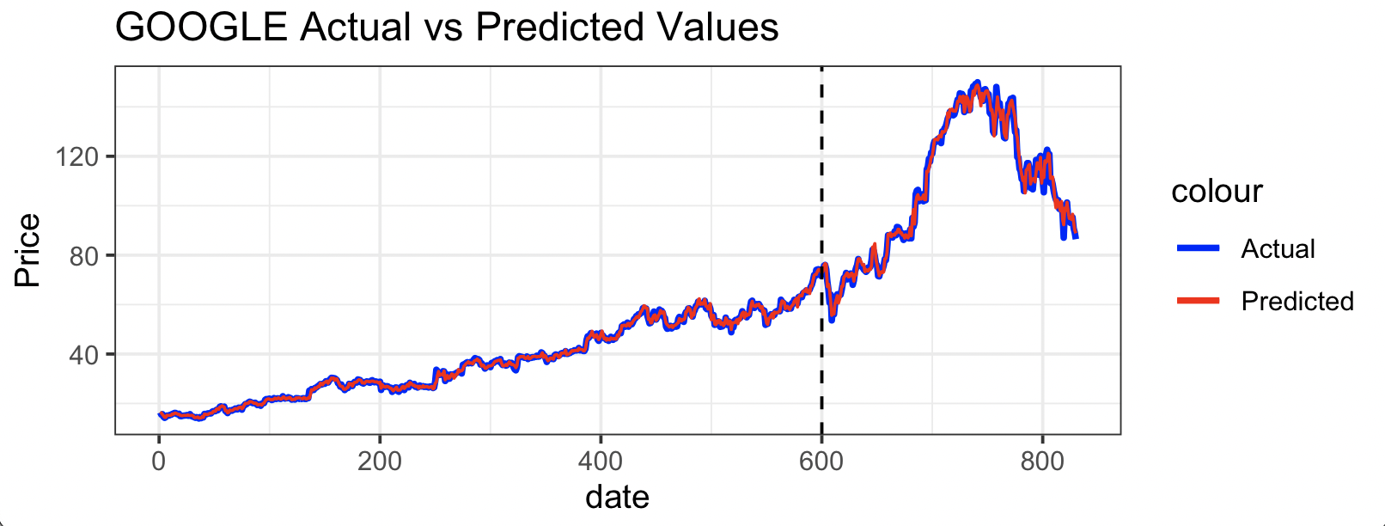
Stock Price Forecasting
Random Forest

Slide 20
Stock Price Forecasting
Random Forest
Company | Measure | Value
JPM | MAE | 1.0760
 | MSE | 2.7412
 | RMSE | 1.6557
Google | MAE | 0.8045
 | MSE | 1.8300
 | RMSE | 1.3528
Tesla | MAE | 2.2521
 | MSE | 31.3196
 | RMSE | 5.5964

Slide 21
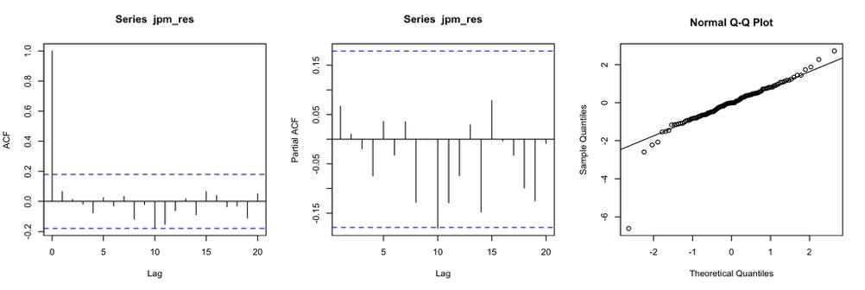
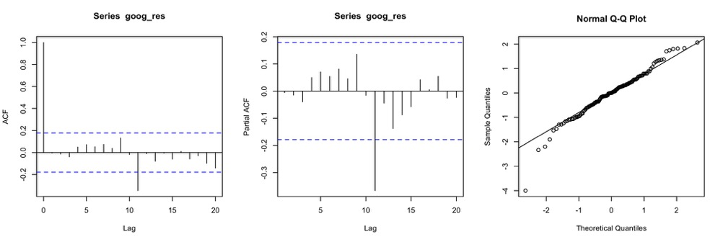
Risk Estimation – Residual Analysis
For example, we want to invest on JPM and GOOG stocks for our portfolio.
Residuals from fitted models show no autocorrelation and follows a normal distribution.
JPM (Chase)
GOOG (Google)

Slide 22
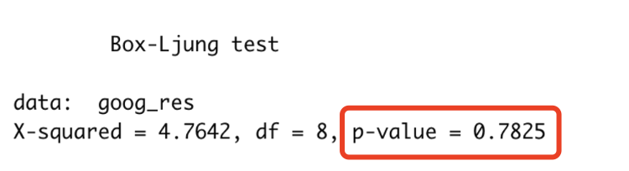
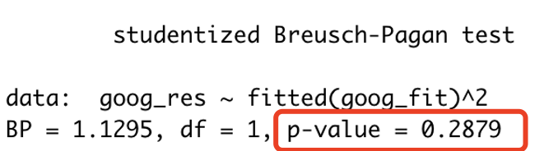
Risk Estimation – Residual Analysis
Except Q-Q plot, we implement Box-Ljung test to check normality.
Also, we want to test heteroscedasticity by Breusch-Pagan test.
Reject both null hypothesis, model good enough to catch autocorrelation and the heteroscedasticity.

Slide 23
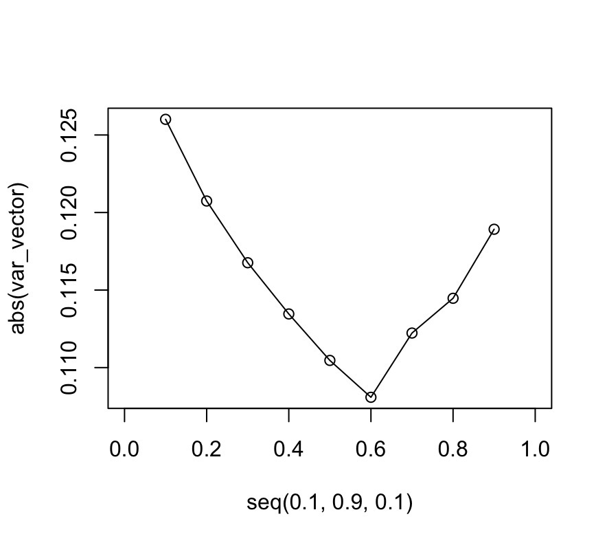
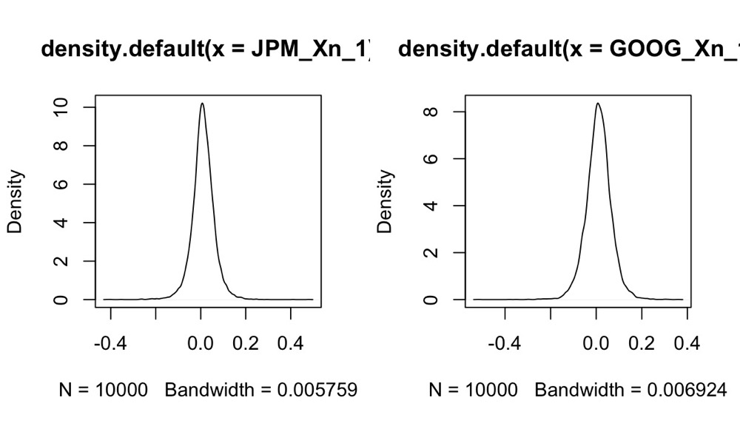
Risk Estimation – Xn+1 & Portfolio
The calculated Xn+1 distribution is like normal distribution.
The optimal portfolio with least risk includes 60% JPM stock and 40% GOOG stock.
There is 99% confidence that the portfolio will not lose more than 10.8% of the investment over next month.
Xn+1 log return
Portfolio

Slide 24
Conclusions

Slide 25
Stock Price Forecasting
Based on RMSE,
ARIMA model outperforms in terms of prediction performance
Why? ARIMA models are designed specifically for time series data, on the other hand, Random Forest models are a more general-purpose machine learning algorithm
Company | ARIMA | Random Forest
 | RMSE
JPM | 1.4826 | 1.6557
Google | 1.2171 | 1.3528
Tesla | 4.7000 | 5.5964

Slide 26
Risk Estimation
VaR can use to construct portfolios with a desired level of risk and return. Losses of 10.8% of the total investment that could be incurred on a stock investment within 99% confidence interval.
Based on the VaR, The optimal portfolio with least risk includes 60% JPM stock and 40% GOOG stock.
Cons: risk measures are only estimates and may not accurately reflect future performance. Therefore, investors should use multiple measures and conduct thorough analysis before making investment decisions.

Slide 27
Group Contributions

Slide 28
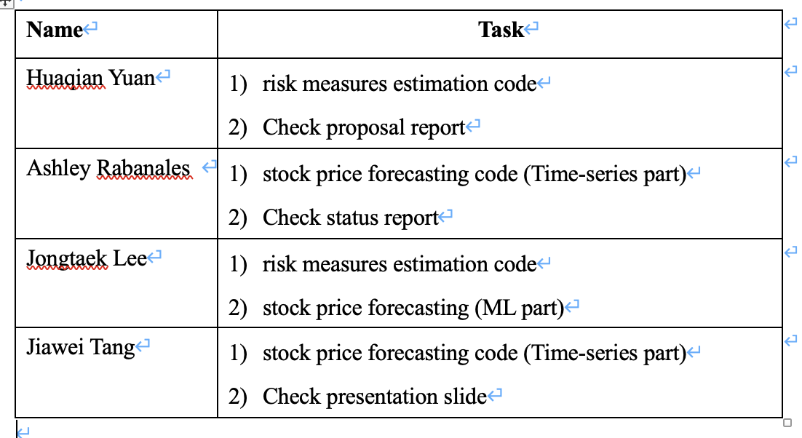

Slide 29
Thanks

