Slide 1
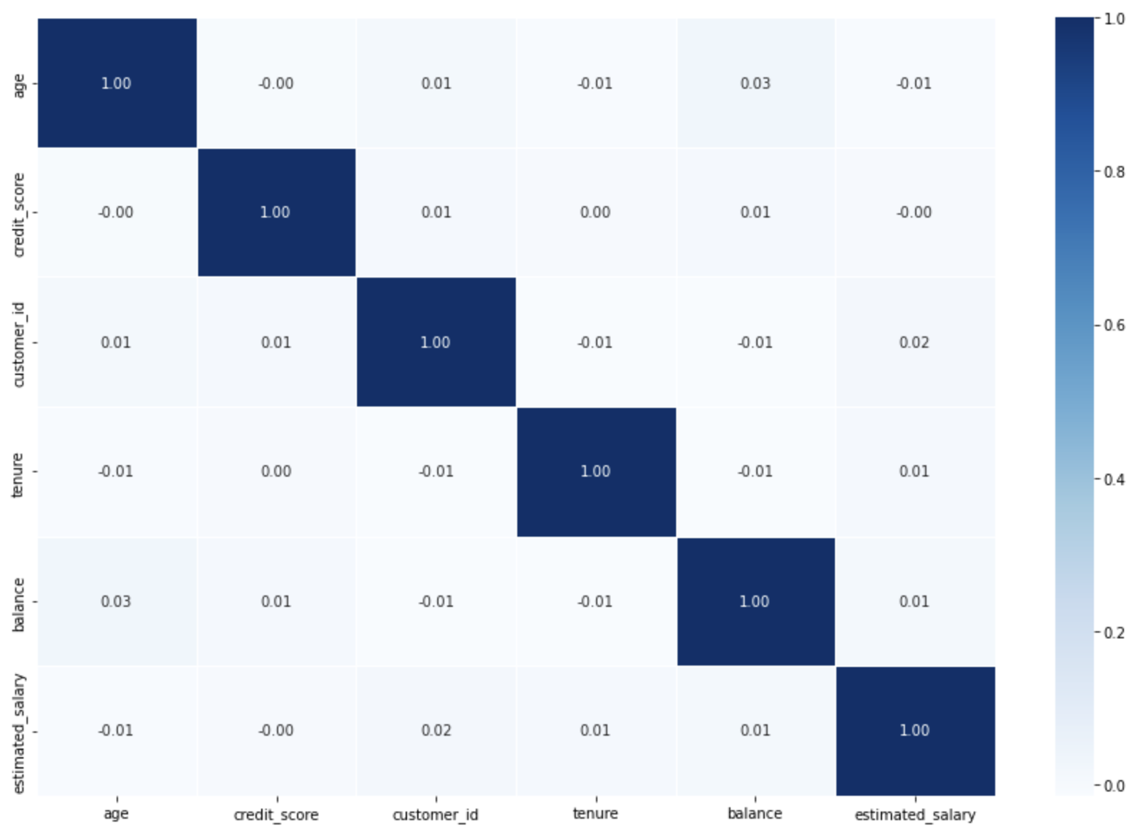
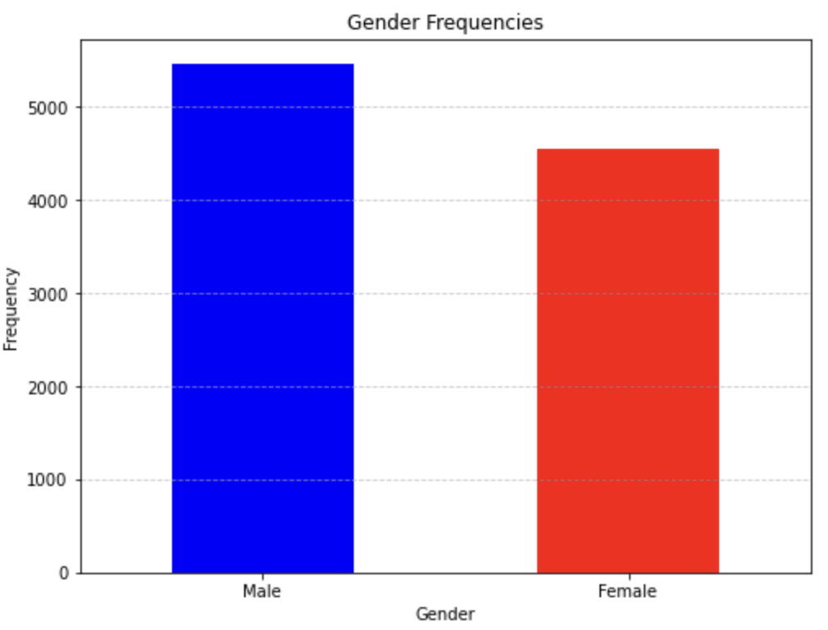
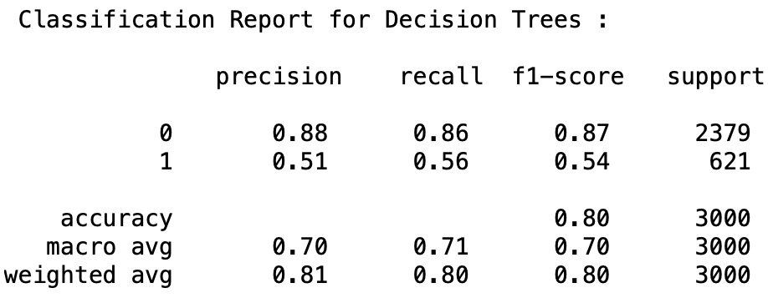
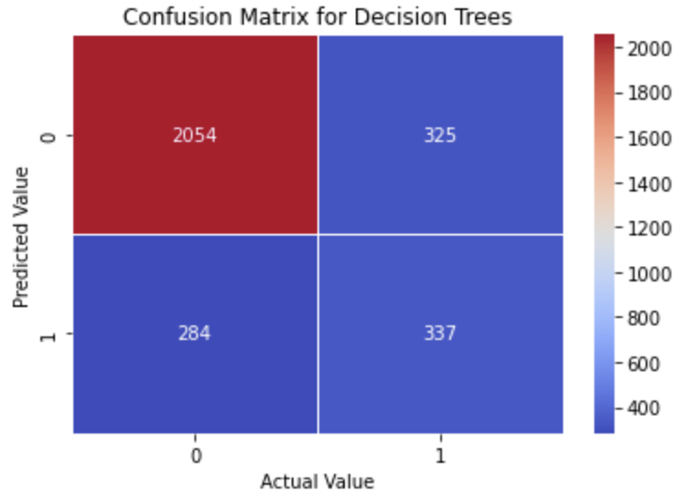
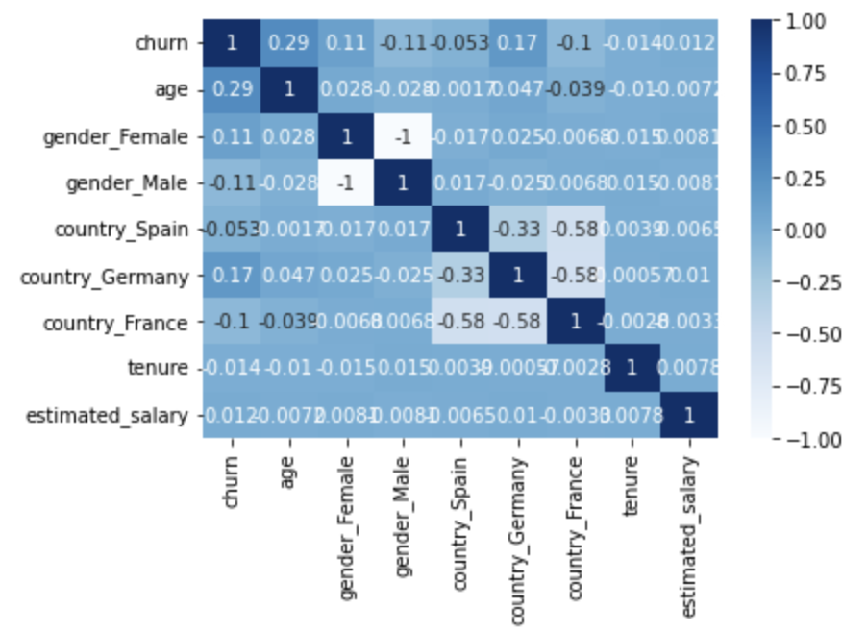
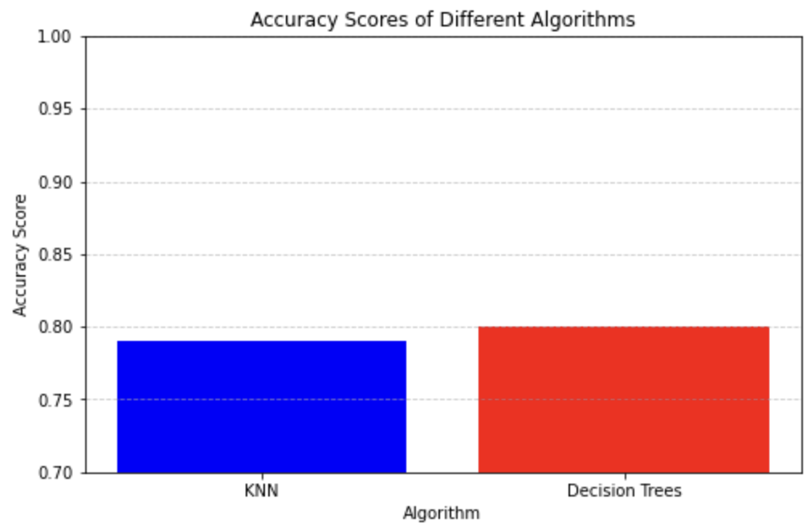
Predictive Churn Analysis
Ashley Ridley and Dr. Robert Kelley
Bellarmine University Data Science Program
In today’s high competitive banking industry, retaining customers is crucial for sustainable growth and profitability. In this project I will develop a prediction model for customer bank churn from a dataset containing customer demographic information and interaction patterns. Using the two algorithm’s, Decision Tree’s and KKN, the prediction model was proven to be successful with an accuracy score of 80 and 79%.. Unfortunately, the gender column had an imbalance of data but the model was still able to have a high prediction percentage.
Materials and Methods
Results
Conclusion
Data Preprocessing
There were no missing values
Displayed correlation matrix for categorical variables
One hot code for gender and country
Displayed frequencies and bar charts for categorical data
Model Selection
Decision Tree
KKN with GridSearchCV
Model Training
Split data into train, validation and tests sets
Dropped churn column from DataFrame
30% of the data was used for testing
70% of the data used for training
Model Evaluation
Classification report
Decision Trees 80%
KKN 79%
Heatmap for Decision Tree with 79% accuracy
Decision Tree
The Decision Tree classifier performs well in identifying instances from the male gender, with a high precision of 0.88, indicating the model is correct approximately 88% of the time. The F1-score of 0.87 is also a good indicator of a positive balance between precision and recall for the male gender. However, the performance for the females are weaker compared to the males. The precision of 51%, and recall of 54% indicate the model captures an approximation of these values. The F1-score of 53% shows a moderate balance between the precision and recall for females.
Looking at the bar chart for gender frequencies above, we can see that there is a slight imbalance of the data. This led to biased splits in the tree structure, which led to the males having a higher precision, F1 and recall score. The Decision tree classifier indicated that approximately 80% of instances are classified correctly.
KKN
Similar to the Decision Tree classifier, KKN is also affected by data imbalance. Since KKN predicts the class of a new instance based on the majority class, if the majority class dominates the neighbors, it can influence misclassifications. This algorithm stated that the best hyperparameters founds by Grid search is 18 and the corresponding bests core during cross-validation is approximately 79%. This is a reasonable average considering there is an imbalance of data from the gender column.
In conclusion, the bank churn prediction model developed in this project demonstrates high performance in identifying customers who are likely to churn. Both models performed well, considering the small imbalance of data from the gender column. The model’s ability to accurately classify customers into a churn category enables banks to proactively identify at-risk customers and implement targeted retention strategies.
For future work regarding this project, I will use another algorithm called Random Forest to see if I can receive a higher accuracy score. Unlike Decision Trees, Random Forest tends to provide high accuracy from combining the predictions of multiple decision trees, which helps overcome overfitting and improver generalization. I would also try to resample the data using SMOTE to determine how big of a difference the imbalance of data made on the accuracy scores.
Introduction
In the dynamic landscape of banking, the ability to anticipate and mitigate customer churn has become an increasing concern for financial institutions. By using historical data and analytics, banks can develop predictive models capable of identifying customers at risk of churning. A successful model can allow banks to intervene and implement strategies to retain customers, and allocate resources to maximize the effectiveness of their retention efforts
References
DS 160 notebooks
“Machine Learning - Decision Tree.” Python Machine Learning Decision Tree, www.w3schools.com/python/python_ml_decision_tree.asp. Accessed 12 Mar. 2024.
Shafi, Adam. “Random Forest Classification with Scikit-Learn.” DataCamp, 24 Feb. 2023, www.datacamp.com/tutorial/random-forests-classifier-python. Accessed 12 Mar. 2024.
RandomResearchAI. “How to Make a KNN Model in Python.” Medium, 21 July 2023, randomresearchai.medium.com/how-to-make-a-knn-model-in-python-5f7625bc1ab. Accessed 12 Mar. 2024.
objectives
The broad objective in this project is to forecast which customers are likely to churn from the banks services in the near future. The aim is to identify patterns and factors that contribute to customer churn. This project is an example that demonstrates the importance of building a prediction model for customer bank churn, which enables banks to proactively manage customer relationships, improve customer satisfaction, and ultimately drive business growth and profitability.
Contact
Email: aridley@bellarmine.edu
Email: rkelley@bellarmine.edu

