Slide 1

Predictive model for customer bank churn
Understanding and predicting customer behavior
By: Ashley Ridley

Slide 2

Project Overview
What is customer churn ? When customers terminate their relationship with a business or organization
Developed a prediction model for customer bank churn
Dataset contains customer demographic information and interaction patterns
The aim is to identify patterns that contribute to customer bank churn, allowing banks to proactively manage customer retention and ultimately drive business growth and profitability
A successful model can allow banks to intervene and implement strategies to retain customers, and allocate resources to maximize the effectiveness of their retention efforts

Slide 3
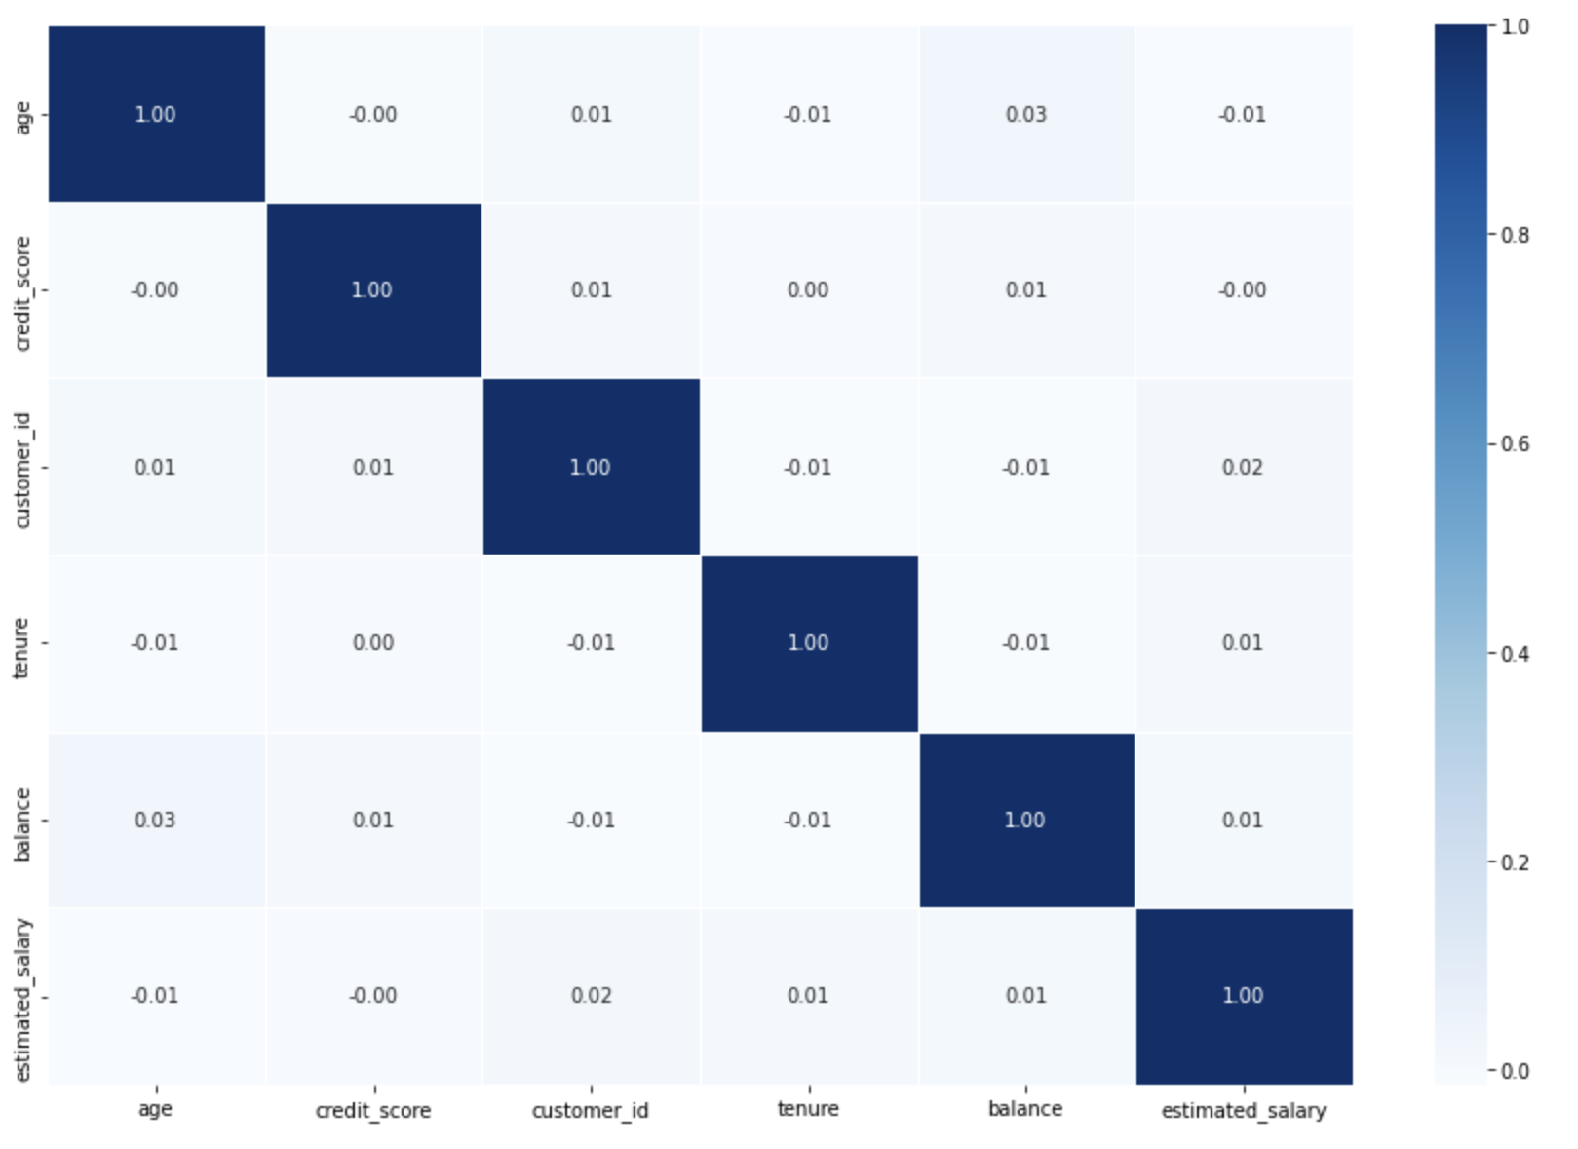
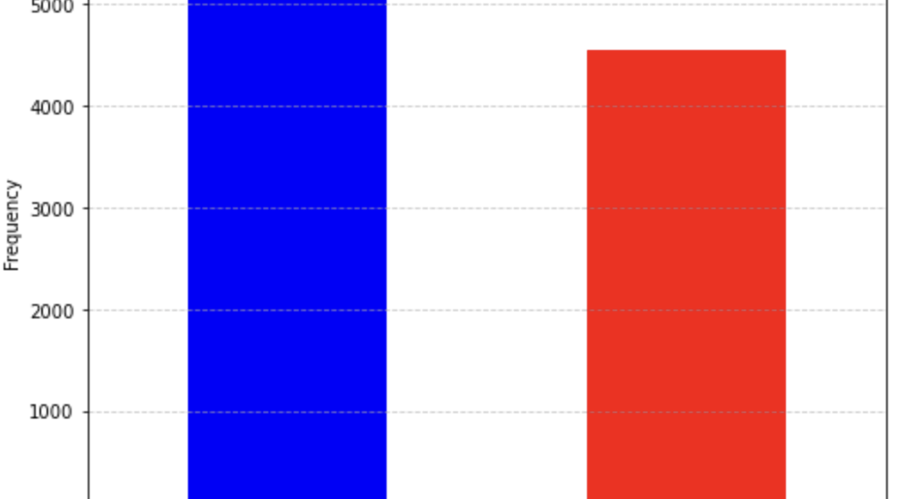
Exploratory Data Analysis
10,000 data values with 12 columns
There are no missing values
low correlation between categorical variables
Imbalance of data from the gender column
Male: 5457, females: 4543

Slide 4
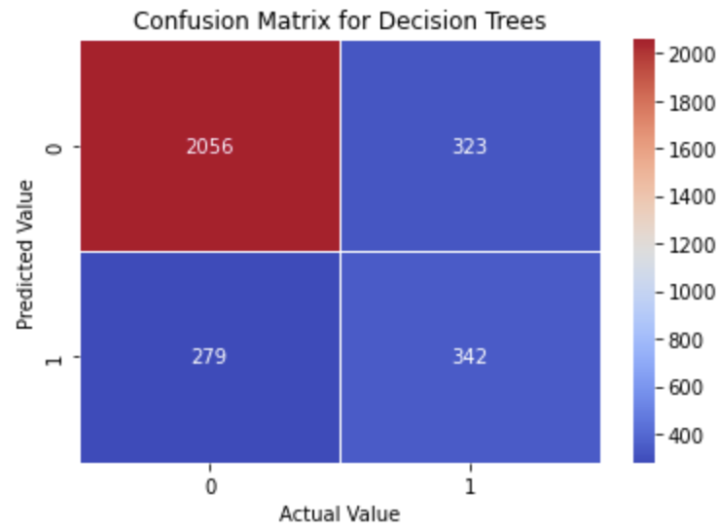
Methods/Modeling
One hot coding for gender and country columns
Displayed frequencies and their corresponding bar charts
Decision trees and K-nearest neighbor
30% used for testing and 70% used for training
Classification reports and heat maps used for model evaluation
Decision tree heat map had 79% accuracy

Slide 5
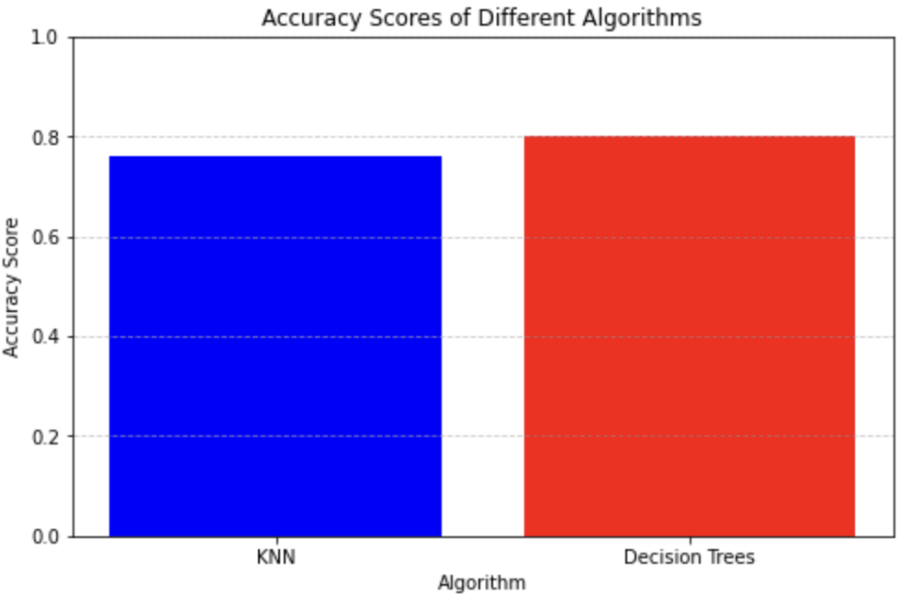
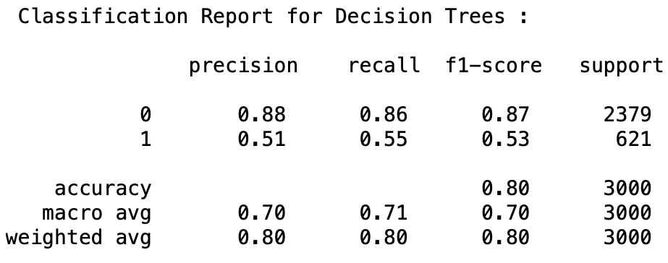
Preliminary Results
Decision Tree had 80% accuracy, KNN had 76%
Imbalance of the gender column affected both models slightly
Decision Tree had a high precision of 88% with the male column and 51% for females
Hyperparameters for KNN by Grid Search is 18

Slide 6
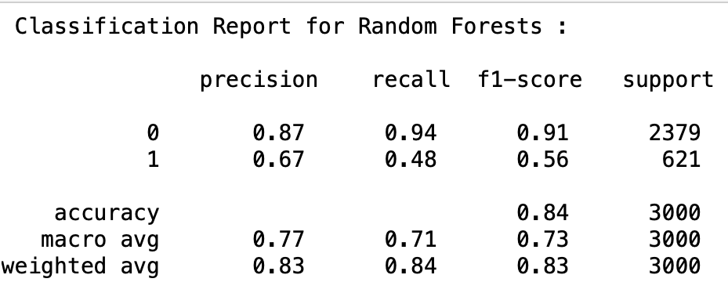
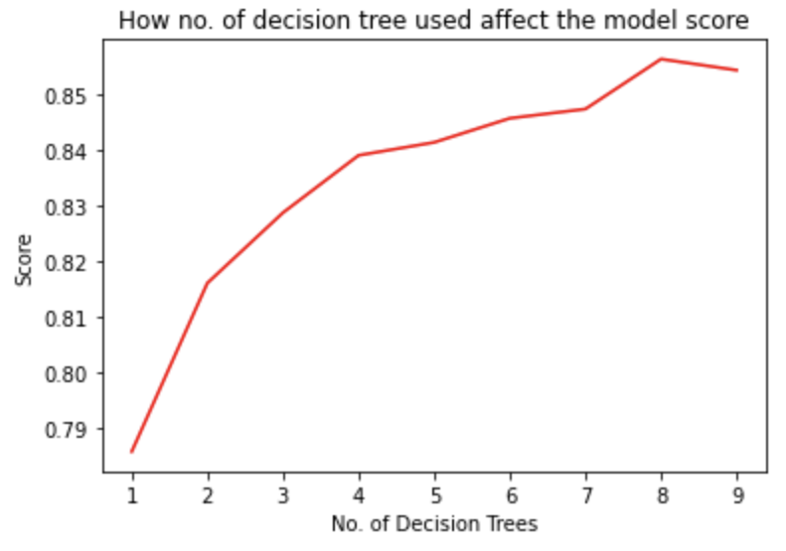
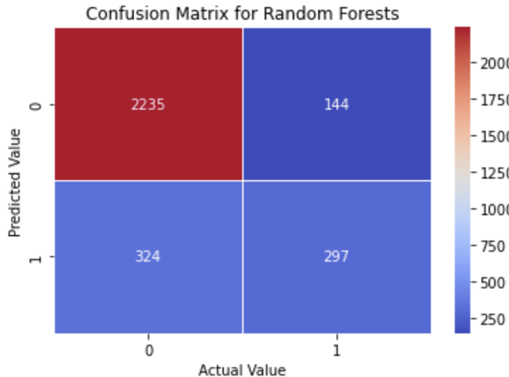
Final Results
Implemented Random Forest to help overcome overfitting and improve generalization
Random forest algorithm built upon a collection of decision trees: 84%
Precision for the female column is 16% higher, but recall is 7% less compared to the Decision Tree algorithm
Imbalance of data led to biased splits in the tree structure for the Decision Tree algorithm

Slide 7
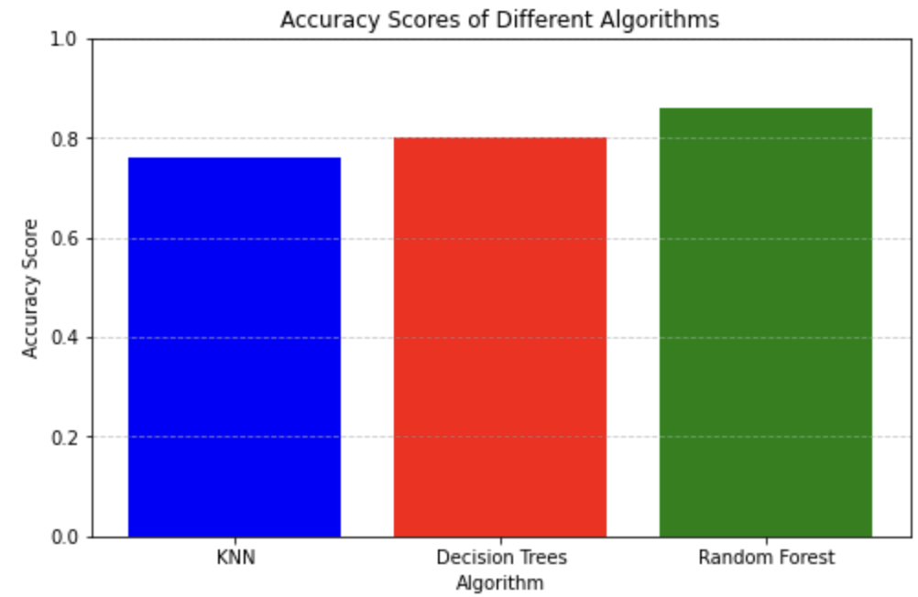
Conclusion/Future Work
The models demonstrate high performance in identifying customers who are likely to churn
All 3 models had an accuracy score above 75%
The model’s ability to accurately classify customers into a churn category enables banks to proactively identify at-risk customers and implement targeted retention strategies
Resample the data using SMOTE (synthetic minority over-sampling technique) to balance the class distribution

Slide 8
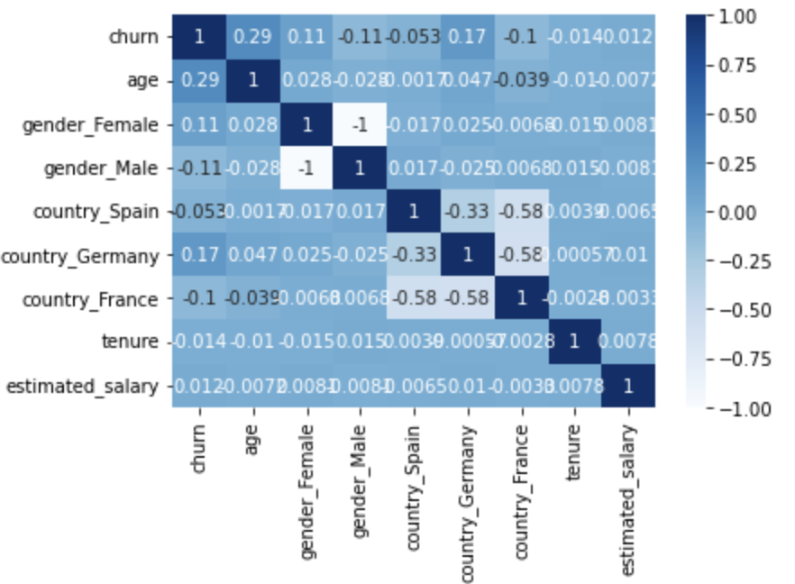
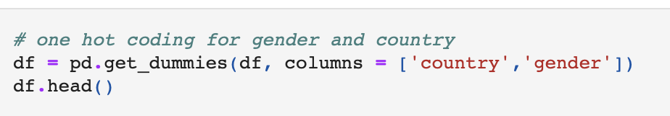
Reflection
Paying attention to the correlation matrix and their tables
Using one hot coding
Using random forest
Being more attentive to imbalances of data

Slide 9

Questions ?

