Slide 1
MLGym Onboarding Session
Welcome
Objective
  cover the basics skils need to do machine learning
  hopefully you will be able to handle the titanic dataset by end of session
This is a crash course
  I advise you to supplement the information you receive today

Slide 2
Section 1
Setup and Overview of machine learning

Slide 3
What is machine learning
Applied statical modeling
  people have many crazy ideas about what this is.
  It won't suddenly turn into a human killing robot from the future..
  this is not magic, or scifi...
It is the core set of techniques, models and algorithms that allow a computer programs to flexibly learn and adapt to a set of tasks and its changes over time

Slide 4
The basic ML process
Gather data
Analyse data
Clean data
Build model
Fit model
Deploy model

Slide 5
Installation
Please install python and pandas
Ubuntu
MacOS
  TODO no idea...
sudo apt-get install python python-dev
sudo apt-get install python-pip
sudo pip install pandas
sudo pip install jupyter

Slide 6
Section 2
Introduction to Data Anaylsis

Slide 7
Why its important
Machine learning is applied statical anaylsis,
If you dont understand the data your handling you have very little chance of succeeding in modeling it
  Note that “understand the data” is not the domain specific understanding but the “data scientist” understanding of a dataset.

Slide 8
Glossary
Feature
  Simply an input. A column of the input table, A pixel in a certain location etc
Numerical data
  Number based data
  Examples: ages, weights, etc
Class data
  A set of data that consists of labels
  Be careful some class data looks like numerical data
  Examples: a rank or title, sex, eye/hair color etc
Textual data
  A raw blog of text.
  it that may be mined for something useful
  It may be injested via a sequance based model
  Examples: peoples names, address etc

Slide 9
Techniques we will cover
Check for missing data
Computing mean, variance
Computing percentials and quartiles of data
Pivot Tables
Rendering Histograms
Plotting boxplots

Slide 10
Over to the Juypter Notebook
Please open your laptops and
work along with me

Slide 11
Section 3
Introduction to Data Cleaning

Slide 12
Data rules of thumb
The curse of dimensionality
  more features the worse fit
  Modelling confusion
The significance rule of thumb:
  30(ish) representative samples are needed for a significant statistical step/sampling
Problems in the data are often the source of model quality problems

Slide 13
Examples of significance effect
with 1 input feature and 300 samples
  your accuracy of fit is 30/300*1 = 10%
with 2 input features and 300 samples
  your accuracy of fit is 30/300*2 = 20%
with 3 input features and 3000 samples
  your accuracy of fit is 30/3000*3 = 3%
The 30 number is a wet thumb number.. it varies a lot in practice

Slide 14
Techniques we will cover
Merging data
Dropping pointless data
Converting categorical data into a usable form
Handling missing data
Segmenting data

Slide 15
Section 4
Introduction to Modelling

Slide 16
What is Modeling
Modelling is the process of taking a dataset and trying to shape a function so that it produces results that match the dataset.
By definition the model we are trying to fit on to the data is often a simplification and generalization of what we believe to be the underlying truth of the dataset.
Ideally we want the model to generalize

Slide 17
Modeling loss
E= mc^2
  right?
  so a photon - speed of light and is massless.. and by the above equation that means it has no energy..
  yea something is wrong
  E^2 = m^2c^4 + p^2c^2
What we are doing is an inductive process, the conversion from a specific set of examples to the general form.
  this means it can be incorrect (often drastically so)

Slide 18
Deep frying data
even cardboard is eatable if deep fried
any model will to some extent fit the provided data
  Newtonian physics vs relativistic physics
Try to avoid making outrageous claims because a model you think is perfect fits the data with a very high accuracy
  Ie we could have missed measuring a critical datapoint etc

Slide 19
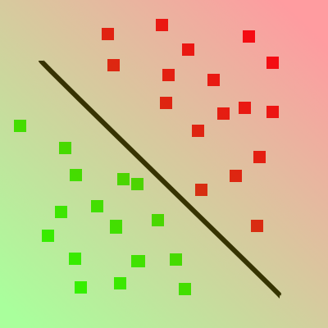
Types of models
Classification Model
  These models make a choice of class, Is the data A, B or C
Regression Model
  These models attempt to map a function y = f(x)
Both models have a fundamental interrelationship
  A classification model can be made using a regression model that outputs how “strong” a fit to class “A” the inputs are

Slide 20
Supervised vs Unsupervised learning
Supervised
  Supervised models use a known set of output labels and attempt map from inputs to outputs
  y = f(x0,x1...)
Unsupervised
  Unsupervised model use a set of data that has no clearly labeled outputs
  f(x0,x1...)
Both learning methods have a fundamental interrelationship
  y = f(x0,x1…) <=> f(y,x0,x1…)
  Hint: this idea is the key to more advanced data cleaning techniques

Slide 21
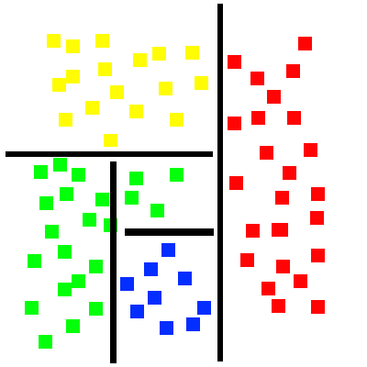
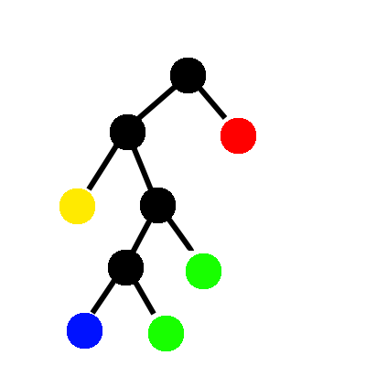
Random forest
Random forest is a rather simple “if a then x” decision tree it looks at the spread of data and makes a decision that divides the data with the largest information gain as possible

Slide 22
Over to the Juypter Notebook
Please open your laptops and
work along with me

