Slide 1
BCS499 · Brain & Cognitive Sciences · Final Project
Does music's sensitive period
leave a trace in episodic memory's white matter?
서예슬 20230340
HCP-D structural connectome · Picture Sequence Memory · n = 448 (trained-only n ≈ 183)
Date: May 28, 2026

Slide 2
01 · THE QUESTION
Did early music shape the brain — or did better brains start music early?
A long-standing debate. Children with early music training often score higher on cognitive tasks than untrained peers — but early starters also receive more total training, and may come from families with more resources, motivation, or pre-existing aptitude. Three explanations compete:
H1a
H1b
H1c
Sensitive period
Dose-response
Skeptical view
What matters is WHEN you start.
What matters is HOW MUCH you trained.
Neither matters once you control properly.
Early exposure (≲7 yr) sculpts white matter during a developmental window.
Key paper: Steele et al. 2013 (J Neurosci).
Apparent onset effects are just hours-in-disguise — early starters accumulate more practice.
Key paper: Schellenberg 2020.
Music–cognition links reduce to SES, family, and motivation.
Key paper: Sala & Gobet 2017.
2 / 12

Slide 3
02 · MOTIVATION
Why episodic memory, and why HCP-D?
Why episodic memory (PSM)?
Why this dataset?
Music learning is inherently sequential and temporal — practicing requires binding tones, fingerings, and context across time.
Picture Sequence Memory (NIH Toolbox)
probes exactly this: ordering pictured events into a remembered sequence.
Intelligence is too broad to measure in this project; PSM is concrete, well-validated in HCP-D, and theoretically linked to music.
HCP-D structural connectomes (246×246, DSI Studio QSDR) provide the white matter substrate.
NDA SAIQ
gives self-reported music history — years of training, weeks/year, days/week, minutes/session — enough to estimate both onset age and cumulative hours.
Age range 9–22 yr sits inside
Epoch 2 of the lifespan turning-points framework (Mousley et al. 2025, Nat Commun).
3 / 12

Slide 4
03 · HYPOTHESIS
Three scenarios, each pinned to a specific coefficient pattern
We split the chicken-and-egg debate using the partial regression coefficients of M3: PSM ~ β₁·onset + β₂·log(hours) + covariates
Sensitive period
|β(onset)| > |β(hours)|, both negative
onset matters even after hours is controlled
Dose-response
|β(hours)| > |β(onset)|, hours negative
hours matters; onset was just a proxy
Skeptical
both β ≈ 0, no signal
neither variable carries information
Pre-registered prediction: |β(onset)| > |β(hours)| in M3. We let the data decide which scenario wins.
4 / 12

Slide 5
04 · METHODS
Pipeline: from connectomes to scenario verdicts
STEP 1
STEP 2
STEP 3
STEP 4-5
STEP 6-7
Sample
build
Connectome
load
Graph
metrics
Confirmatory
GLMs
Brain &
mediation
HCP-D demographics × SAIQ music history × PSM behavior
→ n = 473 with PSM
QSDR 246×246 SC matrices
→ n = 448 pass QC
11 features:
global eff, mod, small-world, char path,
DMN / FPN / MTL within & between (bctpy)
Brain → PSM (Step 4)
M1–M4 Music → PSM (Step 5)
Music → Brain (Step 6)
Onset → Brain → PSM bootstrap mediation (Step 7)
Covariates throughout: age, sex, log family income, race. Primary trained-only n ≈ 183. FDR-BH multiple-comparison correction within each step.
5 / 12

Slide 6
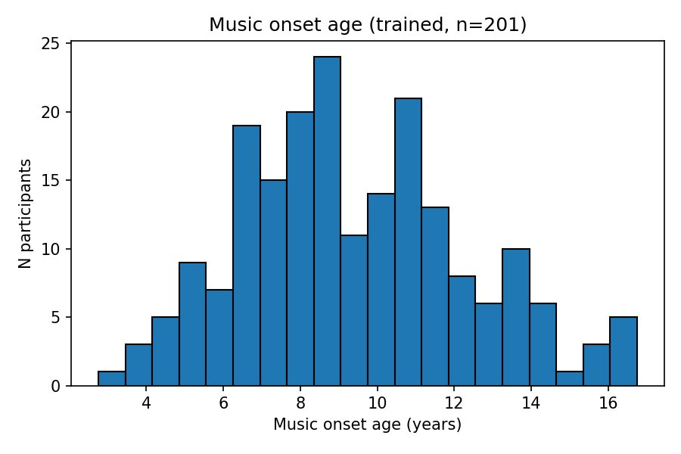
05 · SAMPLE
Who's in the data — and what we honestly can and can't test
Sample at a glance
473 with PSM
448 with usable SC (QC)
286 ever trained · 201 with complete music vars
Honest caveat
Onset concentrates at 8–11 yr. Only ~40 participants (≈20%) started before age 7.
→ We are testing 'relatively earlier vs later onset', not the classical pre-7 sensitive period. Interpret accordingly.
Fig 1. Music onset age in trained subsample (n = 201).
6 / 12

Slide 7
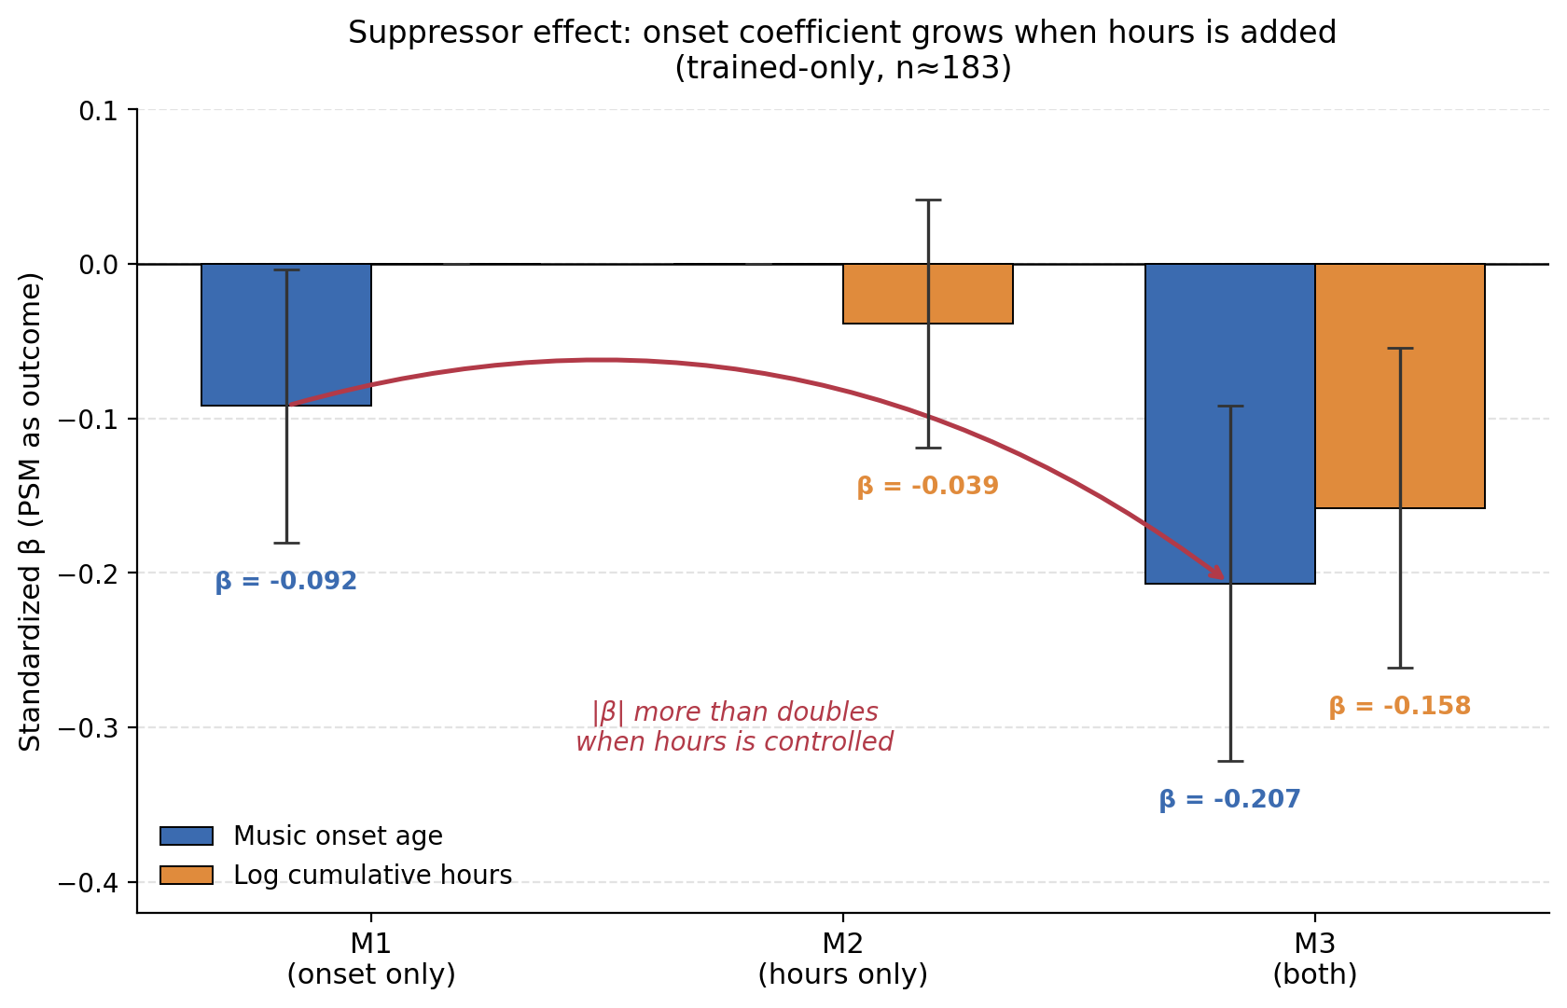
06 · RESULT A
The headline result: onset's effect grows when hours is added
What the numbers say
β(onset) in M3
−0.207
p = 0.073 (M1 alone: −0.092)
β(hours) in M3
−0.158
p = 0.129 |β| smaller than onset
β(onset × hours) = +0.030, p = 0.74 → no interaction
Fig 5. Suppressor pattern across M1, M2, M3. Error bars = ± 1 SE.
7 / 12

Slide 8
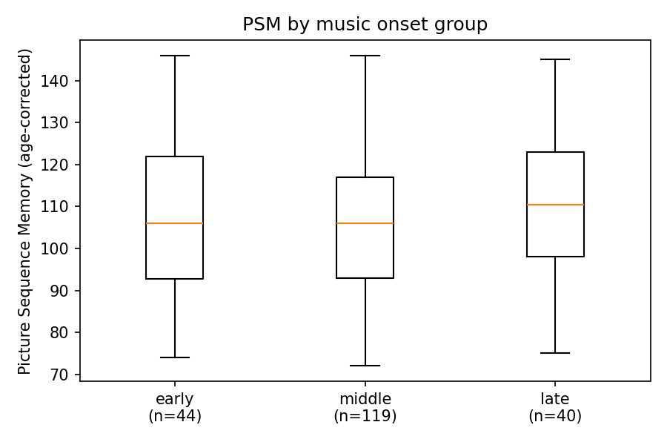
07 · INTERPRETATION
Why this pattern matters — and what it does and doesn't say
The suppressor reading
Raw box plots are misleading. Late-onset participants are also older and have completed more development — their PSM looks marginally higher in the raw plot.
Once hours is held constant in M3, onset's true partial effect emerges: |β| more than doubles (−0.09 → −0.21) and flips toward the sensitive-period direction.
This is the textbook justification for our pre-registered choice to make M3 the primary model — and our direct answer to Schellenberg (2020).
Fig 2. Raw PSM by onset group — note: 'late' is slightly higher.
8 / 12

Slide 9
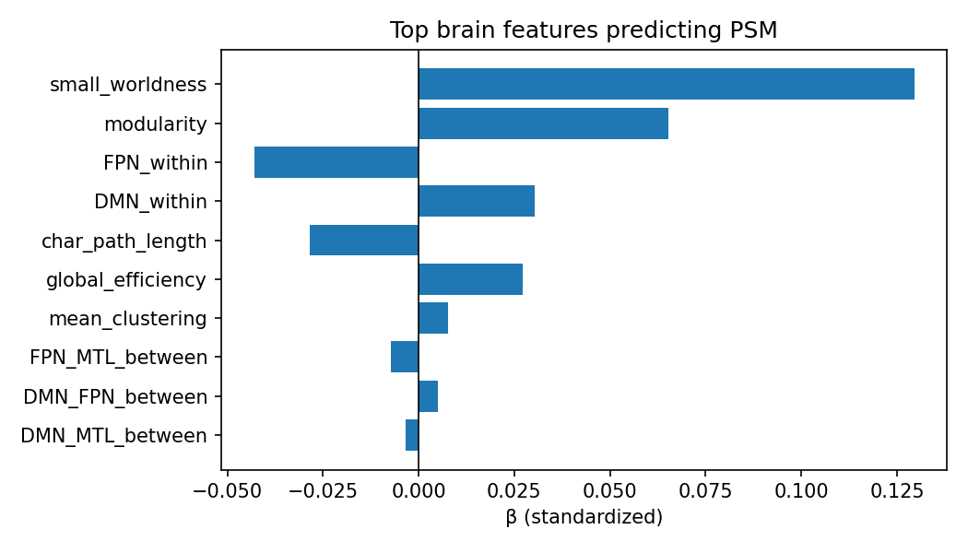
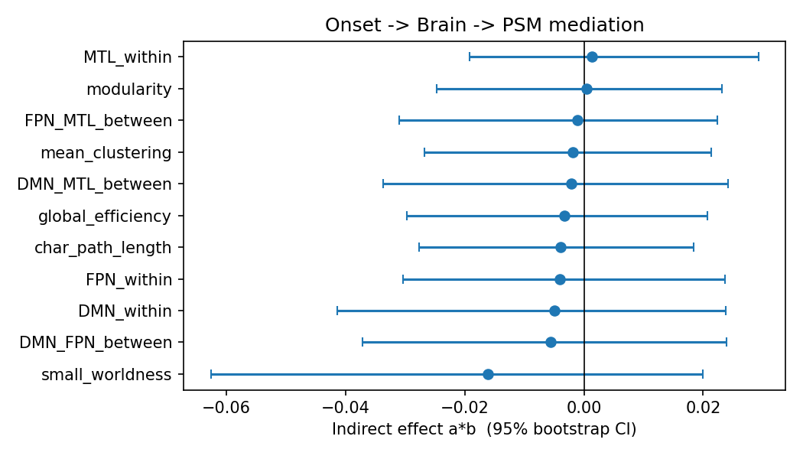
08 · RESULT B
Brain side of the question: macroscale topology is mostly silent
ALL FDR-NS
Brain → PSM
small-world β = +.13, raw p = .02; FDR n.s.
Music → Brain
22 tests, all FDR n.s.
Mediation
11 mediators, all CIs include 0
Fig 3. Brain → PSM (n = 306).
Fig 4. Onset → Brain → PSM mediation (n = 175).
Takeaway: If the onset → PSM signal (Slide 7) is real, it does NOT travel through our 11 macroscale white-matter features. small-world is the only non-zero hint, consistent with Mousley et al. Epoch 2.
9 / 12

Slide 10
09 · VERDICT
Which scenario fits best? (subject to caveats)
Sensitive period
Partially supported
Direction and relative |β| match. But p = 0.073, no mediation found — so the trace is NOT in macroscale topology.
Dose-response
Weakly disfavored
Once onset is controlled, hours has smaller |β|. No interaction (β = 0.03, p = 0.74) — sensitive period doesn't activate only with high training.
Skeptical
Cannot be fully rejected
Nothing survives FDR. n = 183 limits power. An honest report has to leave this scenario partly on the table.
The data lean toward sensitive period — but the route, if it exists, isn't through macroscale white matter.
10 / 12

Slide 11
10 · LIMITATIONS & NEXT STEPS
What we cannot say, and where we'd look next
Limitations
Where the trace might actually live
Power. Trained-only n = 183. M3 p = 0.07 lies in the gap where neither 'reject' nor 'accept' is justified.
Onset coverage. Few pre-7 starters — we cannot directly test the classical sensitive period window (Steele 2013).
Self-report. Music history is retrospective parental/self report; cumulative hours estimated from coarse units.
Cross-sectional. Causal direction (training → brain vs brain → training) cannot be separated here.
Microstructure, not topology. Tract-specific FA / RD in corpus callosum, arcuate fasciculus — where Steele (2013) found the original effect.
Gray matter & function. Hippocampal volume, MTL–PFC functional connectivity — closer to the substrate of sequence memory.
Enriched samples. Conservatory or oversampled-early-onset cohorts to populate the pre-7 region.
Same data, finer lens. Edge-level or nodal graph metrics within Yeo networks, instead of network-level averages.
11 / 12

Slide 12
TAKE-HOME
Music's onset age leaves a fingerprint in episodic memory —
but probably not in macroscale white-matter topology.
|β| ×2.2
0 / 11
scenario 1
onset's coefficient grows in M3
mediators with non-zero indirect effect
sensitive period — best fit, weakly
Thank you · questions welcome
서예슬 · 20230340 · BCS499

