Slide 1
Simulations in R
Topic 1
A minor aside

Slide 2
Contents
Overview
1
Generation schemes
2
Examples
3
What is simulation in statistics?
Design-based
Model-based
CLT

Slide 3
Simulation Study
A numerical technique for conducting experiments on a computer
Allows us to approximate the solution to any analytic problem that has a probabilistic underpinning
Probabilistic underpinning -> basically every thing in statistics

Slide 4
What is a Simulation Study?
Basic Procedure:
Generate random data under set of conditions
For example, for a given set of parameters (i.e. the truth)
Compute the estimator of interest using the data
For example, sample mean, regression coefficients, confidence intervals, test statistic, p-value, etc.
Repeat the process R times (i.e. R simulation runs)
Using the vector of computed estimates, learn about the properties of the estimator.

Slide 5
Generate Simulation Data
The generation scheme for statistical simulation studies can be divided into two categories:
Design-based sampling
Model-based sampling
A design-based generation scheme will generate the samples for each simulation replicate by repeatedly sampling from a finite population of values.
That is, using the sample() function.
A model-based generation scheme will generate the samples for each simulation replicate by randomly generating values form an assumed probabilistic model.
That is, using the suite of probability distribution functions in R.

Slide 6
Generate Simulation Data
Designed-Based Generation Scheme: Random draws from a finite population of values.
The goal is to imitate the sampling scheme that would be used in the real-life experiment.
Could sampling with or without replacement, within strata, etc.
Randomly sampling from a population of value can be achieved using the sample() function:
sample(x,size,replace=FALSE,prob=NULL)
Where x is the vector of population values, size is the number of values to be randomly selected from x, replace is a logical indicating whether or not the sample with replacement from x, and prob is a vector of probabilities that be used to weight the sampling of values from x.

Slide 7
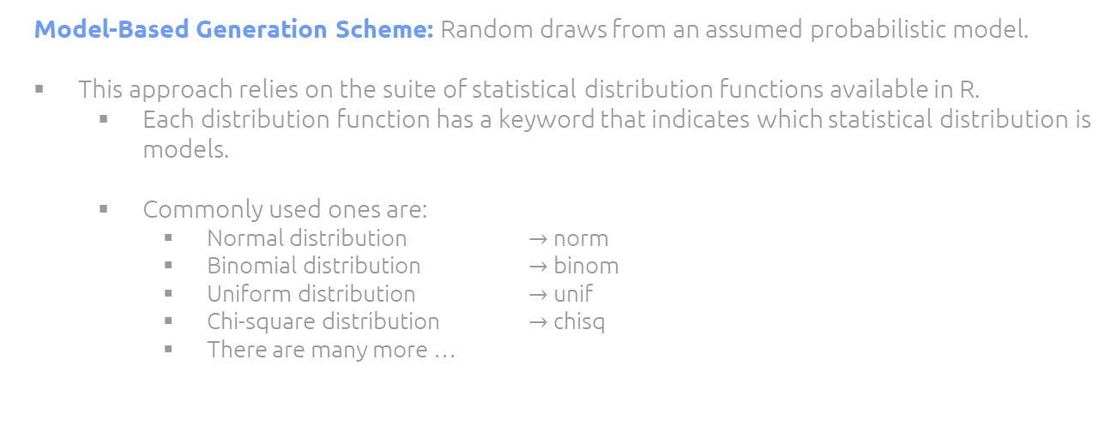
Generate Simulation Data
Model-Based Generation Scheme: Random draws from an assumed probabilistic model.
This approach relies on the suite of statistical distribution functions available in R.
Each distribution function has a keyword that indicates which statistical distribution is models.
Commonly used ones are:
Normal distribution $→$ norm
Binomial distribution $→$ binom
Uniform distribution $→$ unif
Chi-square distribution $→$ chisq
There are many more …

Slide 8
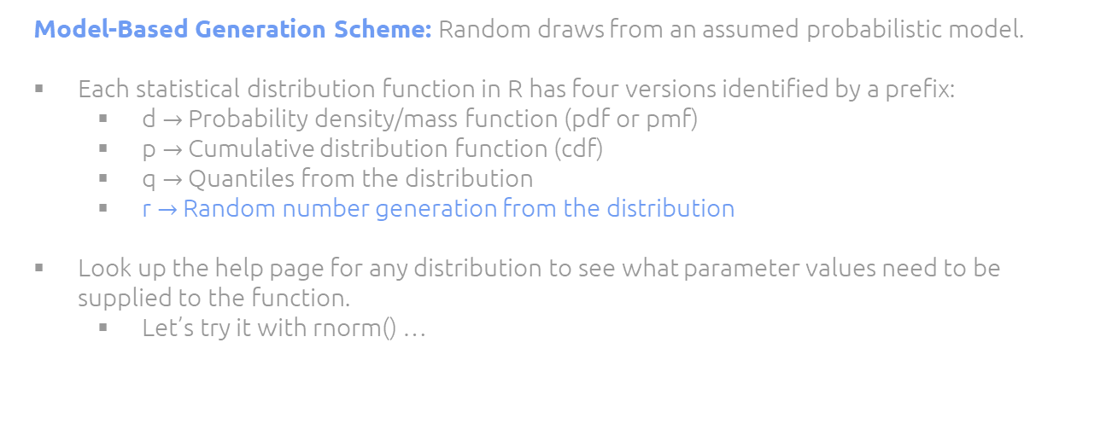
Generate Simulation Data
Model-Based Generation Scheme: Random draws from an assumed probabilistic model.
Each statistical distribution function in R has four versions identified by a prefix:
d $→$ Probability density/mass function (pdf or pmf)
p $→$ Cumulative distribution function (cdf)
q $→$ Quantiles from the distribution
r $→$ Random number generation from the distribution
Look up the help page for any distribution to see what parameter values need to be supplied to the function.
Let’s try it with rnorm() …

Slide 9
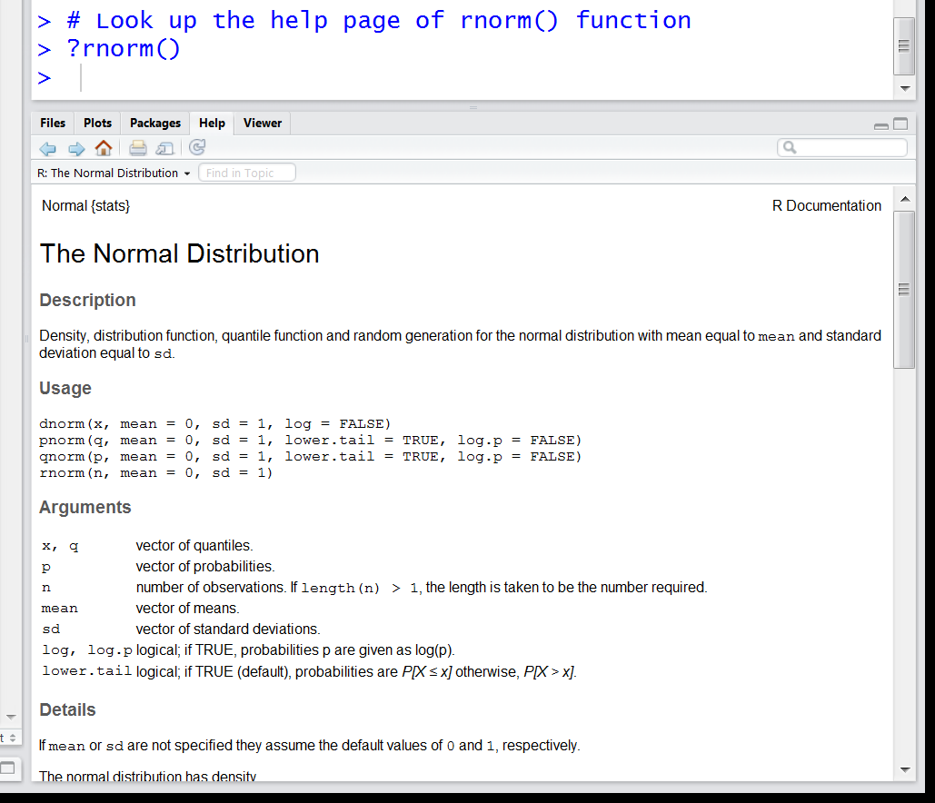
Generate Simulation Data
The normal distribution is parameterized by the mean and standard deviation.
These are inputs into all of the ‘norm’ functions.
Use the “r-version” of the norm function to randomly generate values from ANY normal distribution.
Note: The default normal distribution is the standard normal (mean = 0 and standard deviation = 1).

Slide 10
Generate Simulation Data
number of randomly generated value you want (i.e., sample size)
rnorm(10, mean=0, sd=1)
parameters of the distribution
Outputs a vector of random values

Slide 11
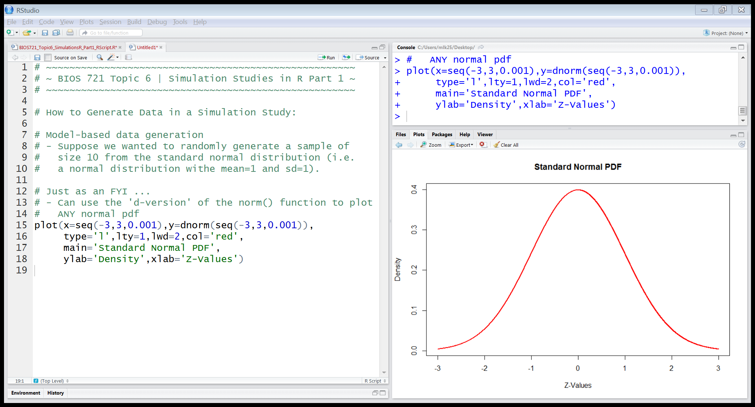
Generate Simulation Data
Can use the ‘d-version’ of the norm() function to work the pdf of the normal probability distribution.

Slide 12
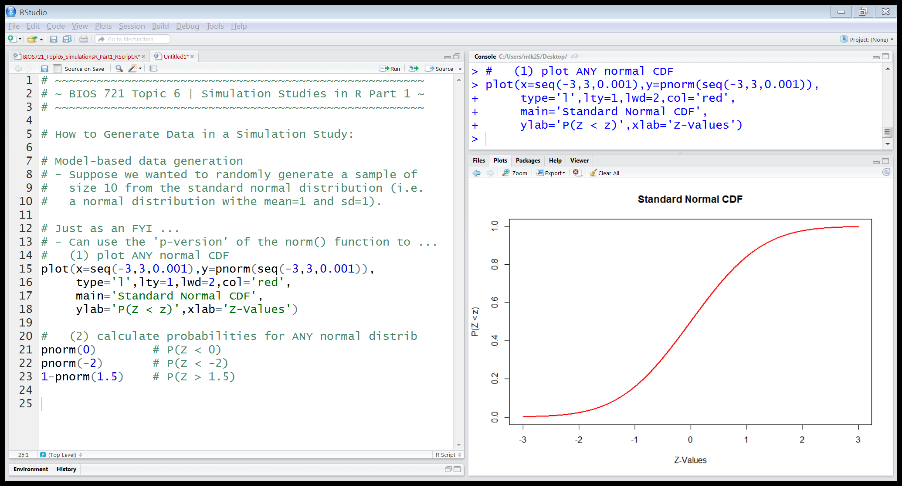
Generate Simulation Data
Can use the ‘p-version’ of the norm() function to work the cdf of the normal probability distribution.
Can also be used to calculate probabilities involving the distribution.

Slide 13
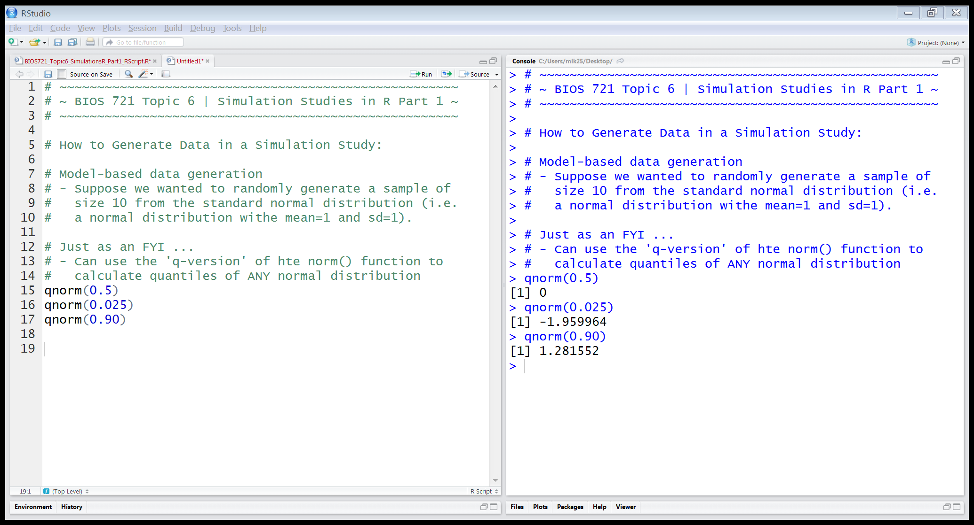
Generate Simulation Data
Can use the ‘q-version’ of the norm() function to calculate quantiles from ANY normal distribution.

Slide 14
Example: The Central Limit Theorem
In your methods course, you learned that the CLT states for a population with mean µ and standard deviation σ, the sampling distribution of the sample mean will be normally distributed with mean µ and standard deviation σ/√n, where n is the sample size, as long as the sample size is sufficiently large.
Suppose you want to determine what a “sufficiently large” sample size is assuming the population follows a Chi-square distribution with 2 degrees of freedom.

Slide 15
Example: The Central Limit Theorem
Can use a simulation study to address this question!
Procedure:
Generate n values from a Chi-square distribution and calculate the mean – this is ONE sample mean
Repeat this process R times to approximate the sampling distribution of the sample mean
Do for R = 10000 replicates
Plot the observed/empirical density and compare it to the theoretical density function given by the CLT
Repeat for small, moderate, and large values of n

Slide 16
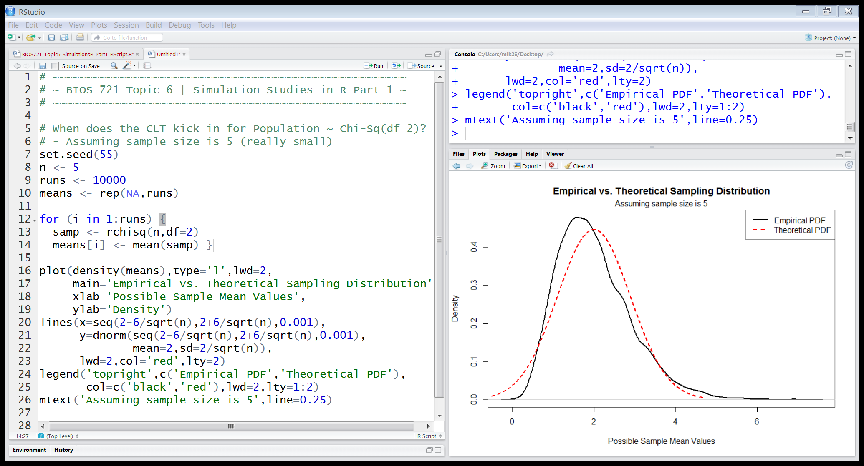
Example: The Central Limit Theorem
Set the value of the seed so that the simulation results will be reproducible.
Set the value of the sample size to be investigated.
Set the number of simulation replicates (i.e. the number of sample means that will be generated).
The more replicates, the better the approximation the simulation study can achieve.
Notes:
Set the value of the seed so that the simulation results will be reproducible.

Slide 17
Example: The Central Limit Theorem
Here ‘n’ and ‘runs’ are the simulation parameters.
You can ‘hard code’ into simulation code, but don’t recommend this approach because you can’t generalize later to other values of the parameters.

Slide 18
Example: The Central Limit Theorem
Create a storage object to collect the value of the sample mean (i.e. the estimator of interest) for each simulation replicate.

Slide 19
Example: The Central Limit Theorem
Use a FOR loop to …
Generate R replicated samples from a Chi-Sq(df=2) distribution.
Calculate the sample mean and store it.

Slide 20
Example: The Central Limit Theorem
To determine if n=5 is a large enough sample size to use the CLT, plot the empirical (i.e. observed) density and compare it to the theoretical density based on the result of the CLT.
Notes:
Can we use CLT with n=5?

Slide 21
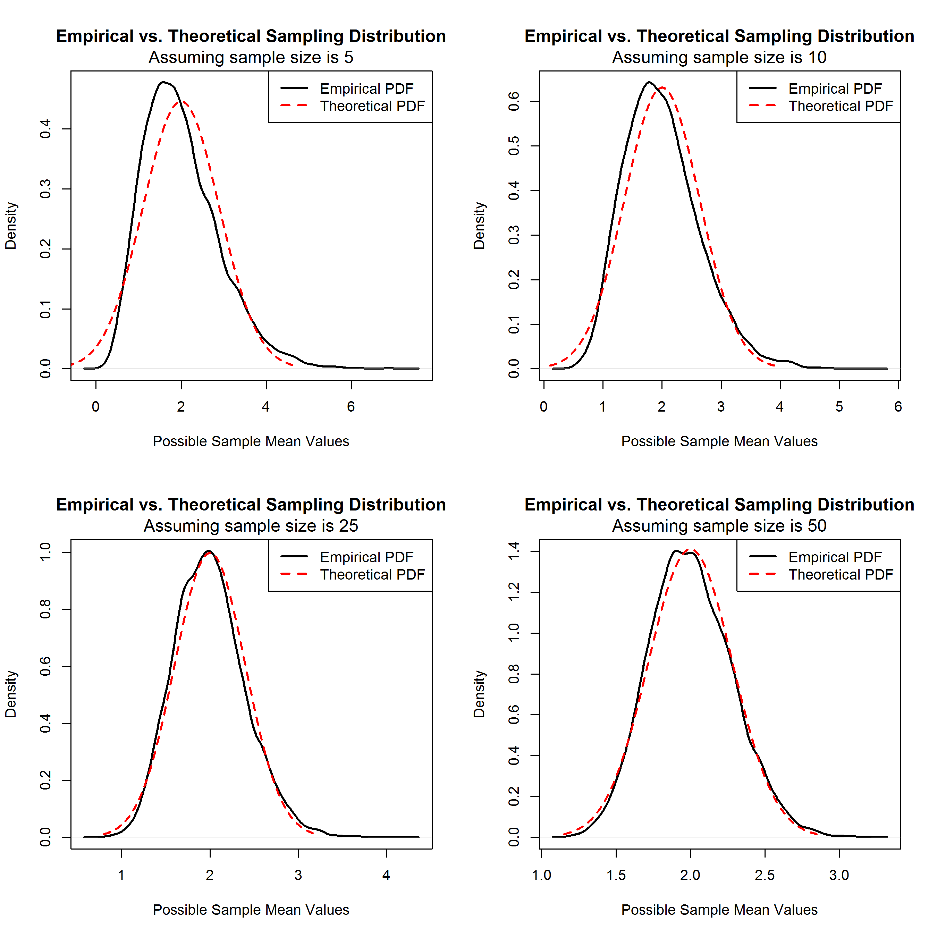
Example: The Central Limit Theorem
What is a ‘sufficiently large’ sample size for the CLT to hold when sampling from a Chi-Square (df=2) distribution?

