Slide 1
Data Management in R
Topic 2: Part 3

Slide 2
Contents
Principles of Statistical Tables
1
Table Making Packages
2
Exporting tables
3
Fundamentals
Layout and Structure
kable
gt
gtsummary
flextable
Word
PDF
Notes:
Resource: https://medium.com/design-with-figma/the-ultimate-guide-to-designing-data-tables-7db29713a85a

Slide 3
A well-designed table tells the story of your analysis clearly. Spend time on design—it is as important as the statistics themselves.

Slide 4
Table Design Fundamentals
Why?
Tables communicate your statistical findings
Poor design obscures results
Professional appearance builds your credibility
How?
Clear – should not have to search the report/manuscript to understand the table
Complete – includes all necessary information
Consistent – same formatting throughout document
You will be judged on these aesthetics both in this class and in your career

Slide 5
Layout and Structure Guidelines
Tables should be logically numbered
Keep on one page if possible
If multiple pages are needed:
Repeat column headers on each page
Include table number and title on continuation pages
Consider alignment of text, numbers, headers
Consider white space – avoid cramped appearance
Group rows/columns as needed
my pet peeve!

Slide 6
Layout and Structure Guidelines
Use bold/italics and font size to show hierarchy
Be consistent with decimal places within columns
Don’t use too many decimal places (context dependent)
Follow domain/journal standards (e.g., <0.001)
Things to consider
Units of measurement
Statistical tests used to obtain p-value
Footnotes
Explain abbreviations
Statistical methods
Adjustment variables

Slide 7
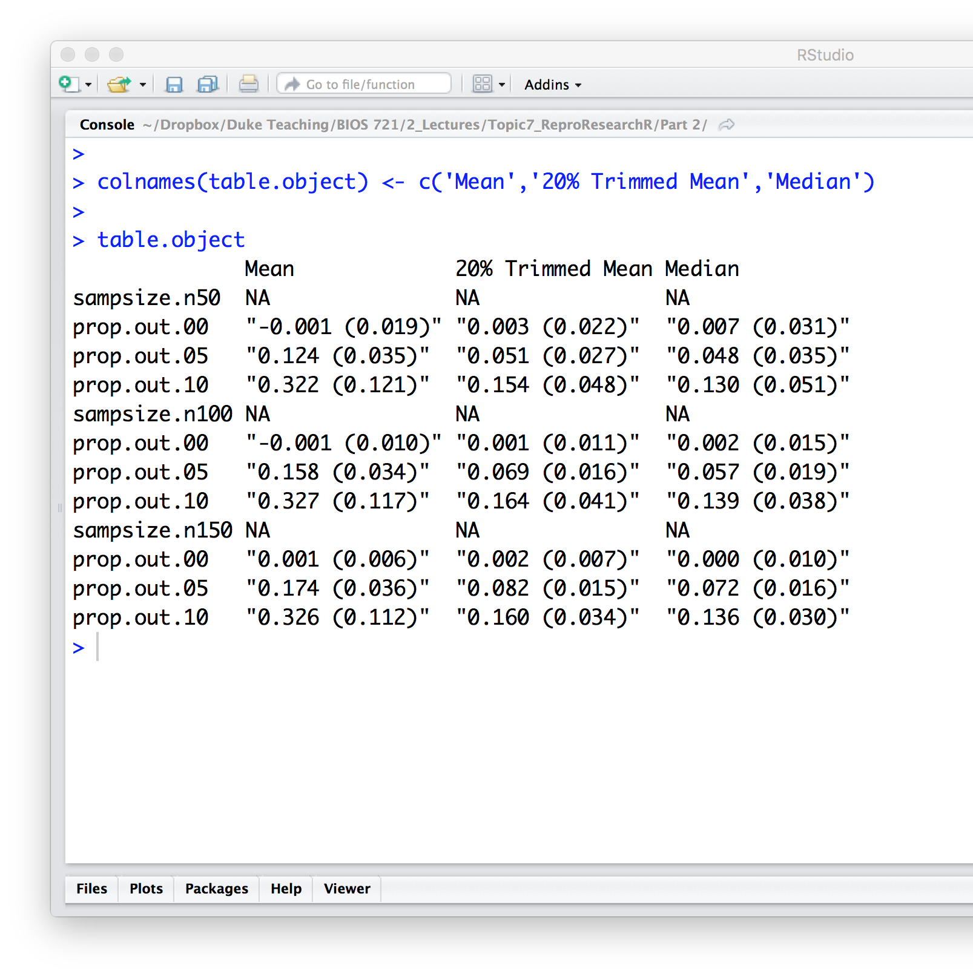
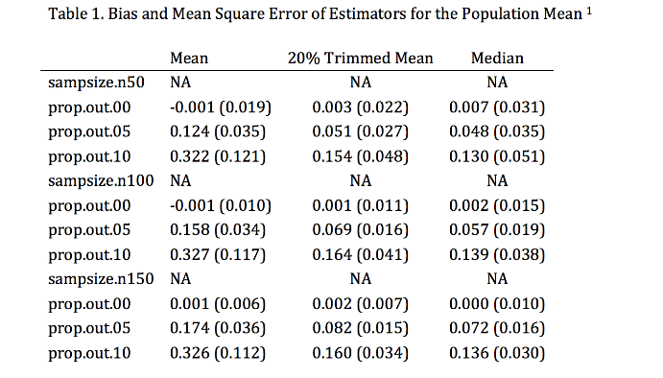
Creating a Table
Create a table object
Pass to table function

Slide 8
Example Table
What can be improved?

Slide 9



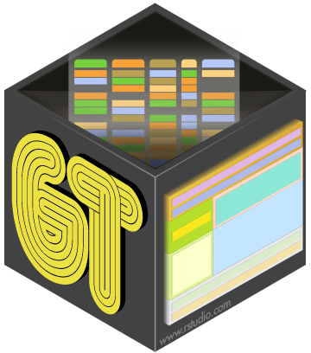
Table Packages
knitr::kable
gt
gtsummary
flextable

Slide 10
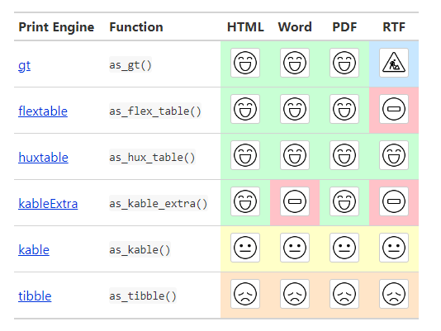
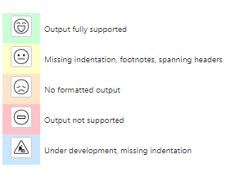
Creating a Tables in Markdown
Notes:
https://gt.rstudio.com/
https://cran.r-project.org/web/packages/gtsummary/vignettes/rmarkdown.html
https://www.danieldsjoberg.com/gtsummary/

Slide 11
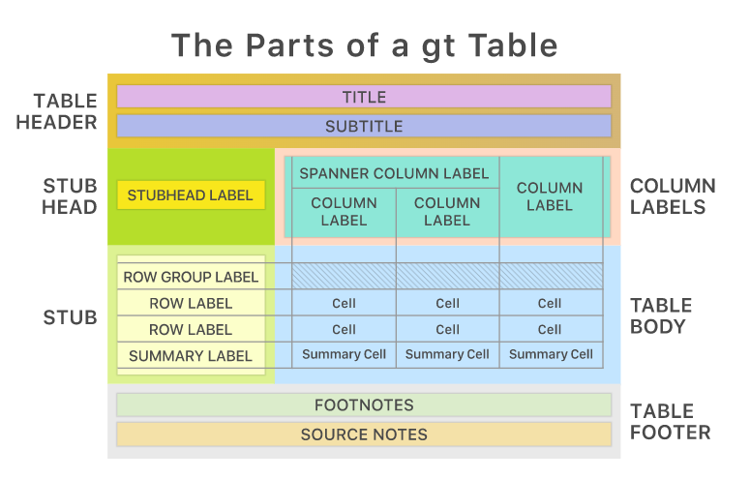
Creating a Table with gt
A table package supported by RStudio
Notes:
https://gt.rstudio.com/

Slide 12
Creating a Table with gt
Basic structure:
gt(dataframe) or dataframe |> gt()
Options structure:
dataframe |>
gt()|>
various options
Notes:
https://cloud.r-project.org/web/packages/gt/gt.pdf
https://www.pipinghotdata.com/posts/2021-07-14-polished-summary-tables-in-r-with-gtsummary/

Slide 13
Comparing gt and gtsummary R Packages
gt
gtsummary
Focuses on creating highly customizable, publication-quality tables
Offers extensive control over table appearance and layout.
Specializes in summarizing statistical models and data frames
Automates some summary statistics, p-values, and model results

