Slide 1
Object Oriented & Functional Programming
TOPIC 1

Slide 2
Outline
Object-oriented programming
1
Functional programming
2
Compare
3
What is it?
How does it relate to R?
What is it?
How is it used in R?
R vs. SAS

Slide 3
What is object-oriented programming (OOP)?
Organizes software design around data, or objects, rather than functions or logic
Focused on objects to manipulate rather than logic used to manipulate them

Slide 4
Object:
A data field with unique attributes and behaviors
Notes:
Objects are the most fundamental thing to understand in R

Slide 5
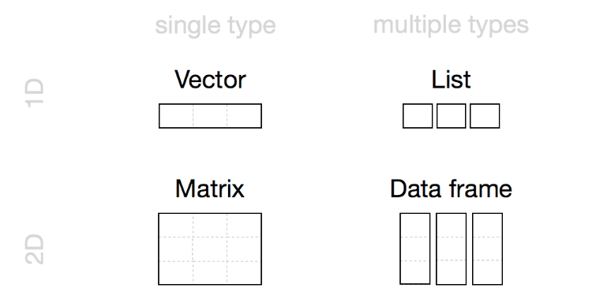
Common Objects in R
Vectors
Matrices
Lists
Data Frames
Tibbles
Factors
Character strings
Numeric objects
Logical objects (TRUE/FALSE)
NULL
Functions
Each object has attributes that impact how it is used
Source: https://rstudio-education.github.io/hopr/r-objects.html
(this is a great place to learn more!)
Notes:
Important to understand how they relate to each other

Slide 6
Thought Experiment
Consider a simple class called “Person”
What attributes could this class have?
How could you interact with this object?
Now consider another class called “School”
What attributes could this class have?
How would this class relate to the Person object?

Slide 7
Functional Programming
Another approach to software
Treats computation as the evaluation of mathematical functions
Avoids changing data (instead, creates new data through transformations)
Functions can be assigned to variables, passed to other functions, & returned from other functions

Slide 8
Object-oriented vs. Functional Programming
What does this have to do with R?
R is not purely object-oriented (Python is), but uses the OOP framework to organize objects
R is mainly a functional programming language, but not purely functional either
Understanding how objects and functions relate in R will make you a better programmer!

Slide 9
R vs. SAS
Functional based
Object-oriented features used for structuring code and creating reusable components
Objects are the fundamental unit
Functions are applied to objects
Procedural based
Not object based
Procedures are the fundamental unit
Datasets are passed to PROCs
PROCs can create new datasets

