Slide 1
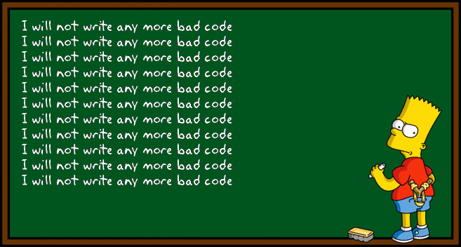
Good Programming Practice
Topic 1

Slide 2
Good Programming Practice
A set of informal “best practices” to improved the function, readability, and reproducibility of your code.
Generalizable beyond just R!

Slide 3
Good Programming Practice
First things first
Reproducibility
Topline comments:
Name
Date
What the code does
Libraries go at the top
Hard coded variables go below libraries
Use relative paths
here()
use working directory
Avoid hard coding paths where possible
Note R & package versions used in comments

Slide 4
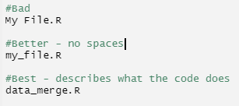
Good Programming Practice: Naming
Do not use spaces in file names
Use filenames that are relevant to what the code is doing
Use consistent convention for objects and functions
Snake_case = “The one with an underscore”
CamelCase = “The one with each word capitalized”
Short but descriptive names

Slide 5
Good Programming Practice: Readability
Readable line length (<80 characters)
Hello, this example sentence shows about how long eighty characters looks like.
Spacing
Space after commas
function(data, var1, var2)
Space between assignment operators and anything else
object = code
object <- code
No spaces by ( ), { }, [ ]

Slide 6
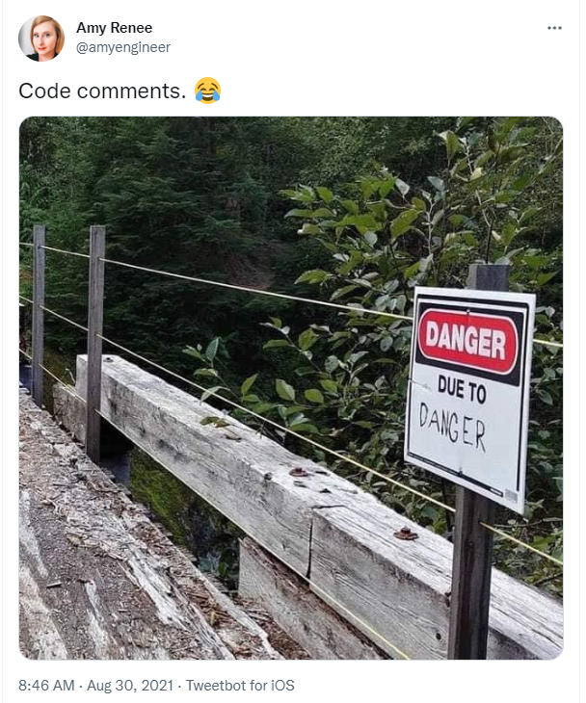
Good Programming Practice: Readability
Code sections
Ctrl + Shift + R to create a section
# Section One -------------------------------------------------------------
Shift + Alt + J to jump to a section
Foldable
Comment incessantly
“Your worst collaborator is you from 6 months ago”
Notes:
https://support.rstudio.com/hc/en-us/articles/200484568-Code-Folding-and-Sections

Slide 7
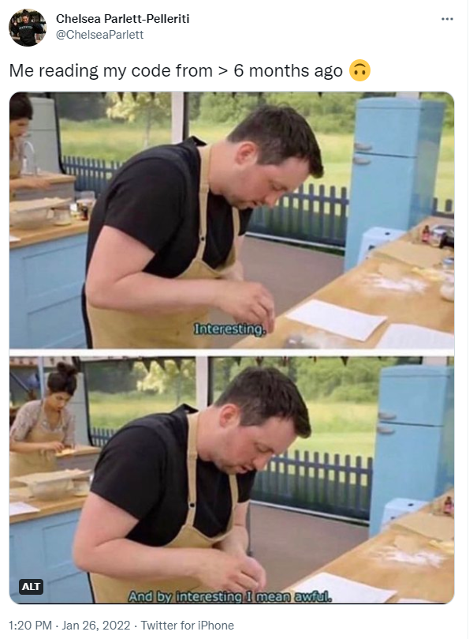
Good Programming Practice: Commenting
“Code tells you how, comments tell you why”
Comments should not duplicate the code.
Good comments do not excuse unclear code.
Comments should dispel confusion, not cause it.
Provide links to the original source of copied code.
Include links to external references when helpful.
Add comments when fixing bugs.
Use comments to mark incomplete implementations.
Notes:
https://stackoverflow.blog/2021/12/23/best-practices-for-writing-code-comments/
https://blog.codinghorror.com/code-tells-you-how-comments-tell-you-why/

Slide 8
Good Programming Practice: Style
Somewhat objective
Of course Hadley has an opinion…
A few I think will make your life better:
Use double quotes “ “
End loops on own line { r code
}
Avoid assignment in function calls
Use TRUE/FALSE instead of T/F
Use indentation
Notes:
https://style.tidyverse.org/

Slide 9
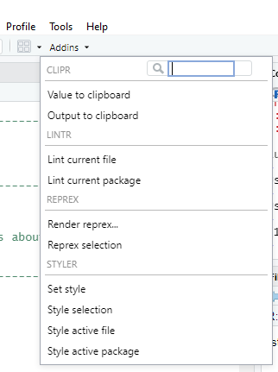
Code Analysis Tools
Addins:
Lintr
Styler

