Slide 1
Data Management in R
Topic 2: Part 1

Slide 2
Contents
Data Workflows
1
Tidy Data
2
Data in R
3
What?
Why?
How?
Tidyverse
Principles of tidy data
Formatting tips
Common errors

Slide 3
Data Analysis Pipeline
The process of moving from raw data to some disseminated product (e.g., presentation, article in a scientific journal).

Slide 4
Data Analysis Pipeline: What?
Measured/Raw Data
Analytic Data
Computational Results
Tables
Processing code
Figures
Analytic code
Dissemination
Numerical Summaries
Data storage
Text
Presentation code
Inspired by Roger D Peng
Notes:
Raw → Clean → Explore → Model → Report

Slide 5
Data Analysis Pipeline: Why?
Efficiency
Error Prevention
Reproducibility
Manage change and variation
More on this next week

Slide 6
Data Analysis Pipeline: How?
Structured systems and processes to organize:
Code
Outputs
Data
Example Tools:
Markdown
Git

Slide 7

Processing Code
Sketch your workflow before you get into coding
Save time
Reduce mistakes
Improve reproducibility
How?
Flowchart/diagram
Checklist
Pseudocode
Notes:
Checklist example:
□ Import patient_data.csv and verify 450 rows, 12 columns
□ Check for missing patient IDs (should be zero)
□ Validate age range (18-85 years)
□ Recode treatment variable (1=Control, 2=Treatment)
□ Handle missing BMI values (document pattern)
□ Create baseline characteristics table
□ Export cleaned data with date stamp

Slide 8

R: A Brief History Lesson

Slide 9
A Brief History of R
1995
2008
2022
R first released
RStudio founded
RStudio changes name its to Posit
2000
2013
2000: Stable beta R released
Rstudio hires Hadley as Chief Scientist
Notes:
R is based on the programming language S
S created in 1976 at Bell Labs
Philosophy of S: Wanted to build language that would be suitable for interactive data analysis (more command-line based) as well as for writing longer programs (more traditional programming language-like).
Both S and R were explicitly created as data analysis languages

Slide 10
The tidyverse: Your new BFF
The tidyverse is a collection of packages based on 4 principles for handling data:
1. Reuse existing data structures
2. Compose simple functions with the pipe
3. Embrace functional programming
4. Designed for humans

Slide 11
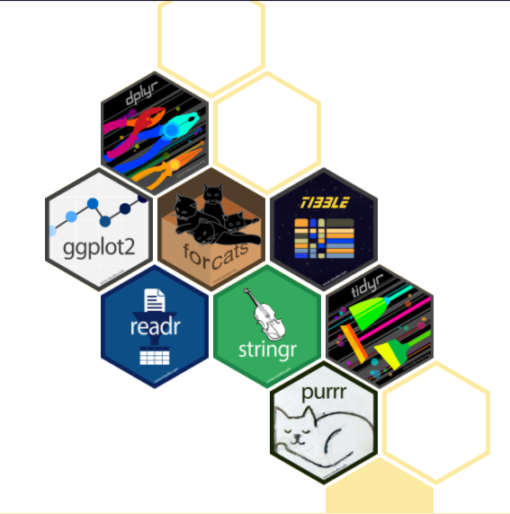
tidyverse
“The tidyverse is an opinionated collection of R packages designed for data science. All packages share an underlying design philosophy, grammar, and data structures.”
- https://www.tidyverse.org/
Install the complete tidyverse with:
install.packages("tidyverse")
Notes:
All tidyverse packages are support by Posit

Slide 12
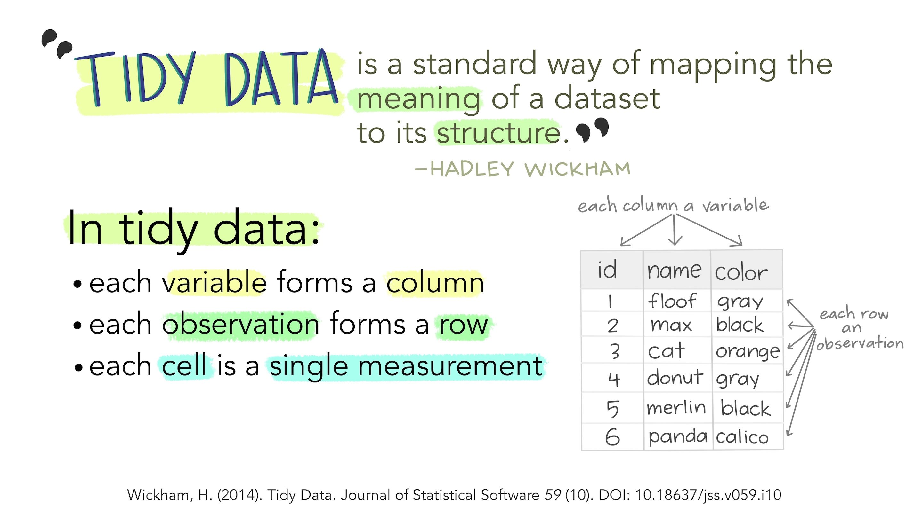
Tidy Data
In statistics, it is very important to have one observation (e.g., person, study visit, measurement) per row as that is what all our models expect!
Notes:
https://www.jstatsoft.org/article/view/v059i10
Illustrations from the Openscapes blog Tidy Data for reproducibility, efficiency, and collaboration by Julia Lowndes and Allison Horst

Slide 13
Tidy Data
Processing code
The process of making tidy data
Measured/Raw Data
Analytic Data
Rarely tidy
Tidy because you make it tidy

Slide 14
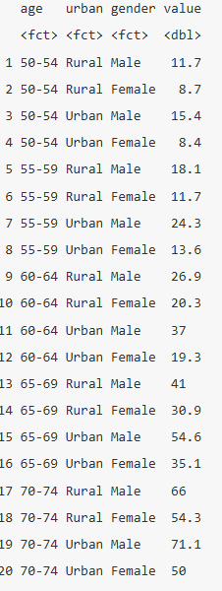
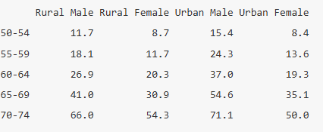
Example
Death rates in 1940 Virginia
Untidy data
Tidy data
Example from Roger Peng

Slide 15
Metadata
The information surrounding the data values
How and why was the data collected
What variables are available in the data set
What do the data values actually mean
Notes:
(i.e. what study did it come from)?
(i.e. what information is stored in the variable name dz_status)?
(e.g. for the gender variable, does 1 = Male or does 1 = Female?)

Slide 16
Before importing data into R, you should open the external file and inspect its contents (if possible).

Slide 17
Data Validation and Quality Control
How many observations are there?
How many variables?
What do the data types look like?
Are they numeric? Character?
Is there any special formatting (e.g. dollar signs or values that contain multiple words)?
Range checks
Are there any missing values?
What is the missing value indicator?
Are variable names included?
Is a row identifier included?
Is meta-information included in the file?
Track all decisions and transformations

