Slide 1
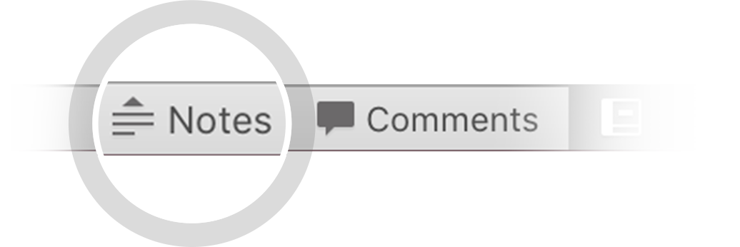
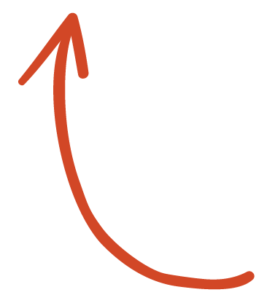
Here's your outline to get started
Key facts about your topic
A self-report study is a type of survey, questionnaire, or poll in which respondents read the question and select a response by themselves without interference. A self-report is any method which involves asking a participant about their feelings, attitudes, beliefs and so on. Examples of self-reports are questionnaires and interviews; self-reports are often used as a way of gaining participants' responses in observational studies and experiments.
See more: Open the Notes below for more information.
Notes:
QuickStarter has created an outline to help you get started on your presentation. Some slides include information here in the notes to provide additional topics for you to research.

Slide 2
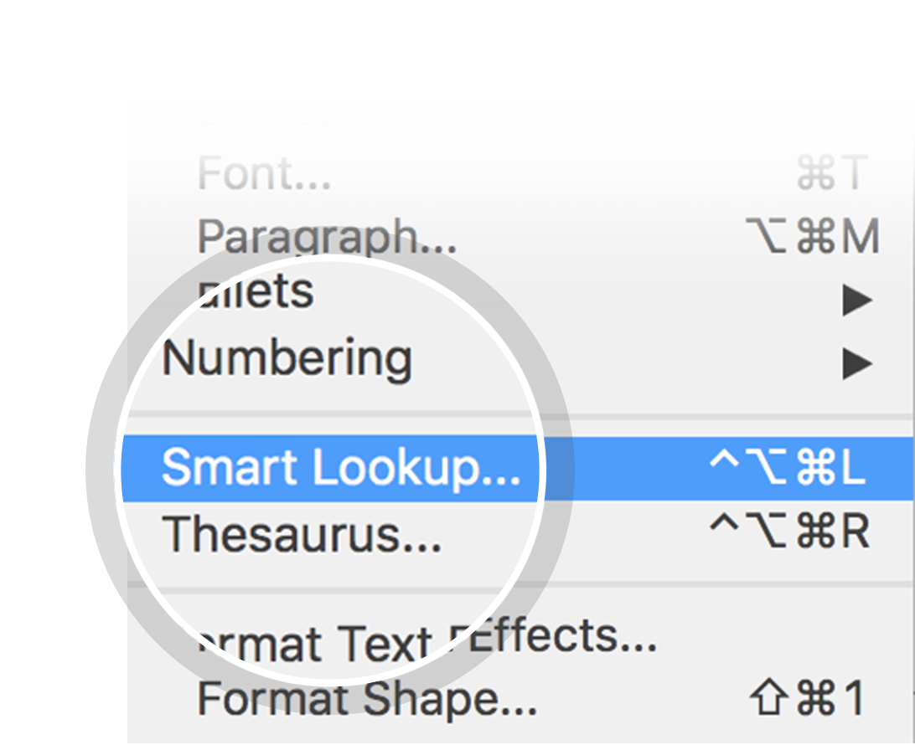
Related topics to research
Social Desirability Bias
Response Bias
Use Smart Lookup to learn more
1
Highlight one of the related topics
Right-click on the topic
Choose "Smart Lookup"
2
3

Slide 3
Cs5100 Final project: Identifying Personal Attacks in Wikipedia Comments
Yuanzhi Xu

Slide 4
Contents
Join the table
Data Visualization
Clean the data
Sample Classifier
Over-sampling: Smote
Feature Union
ML Modeling Methods
Choose the best model + cross validation
Hyperparameters Tuning
Takeaways

Slide 5
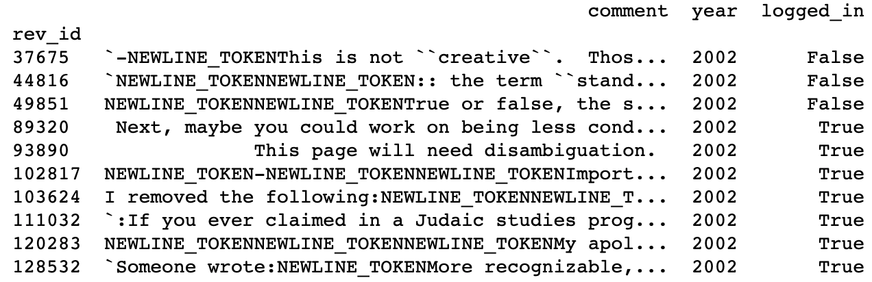
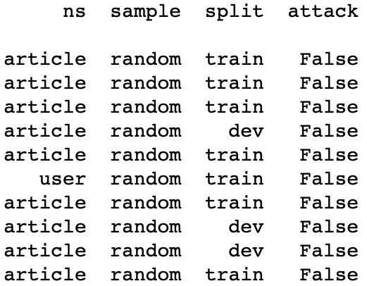
Join the tables

Slide 6
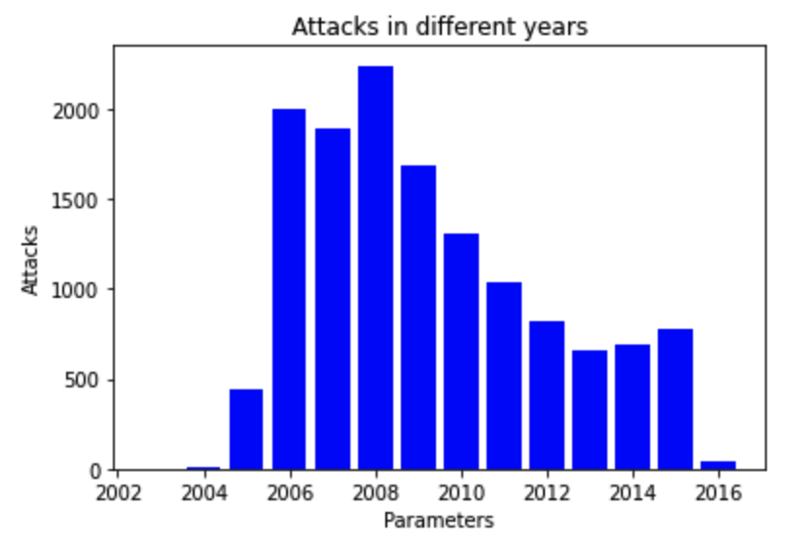
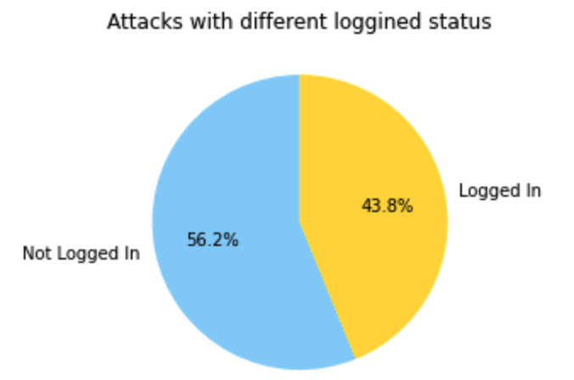
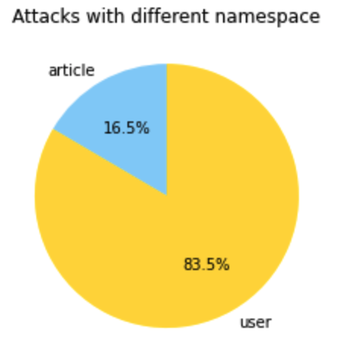
dATA visualization

Slide 7
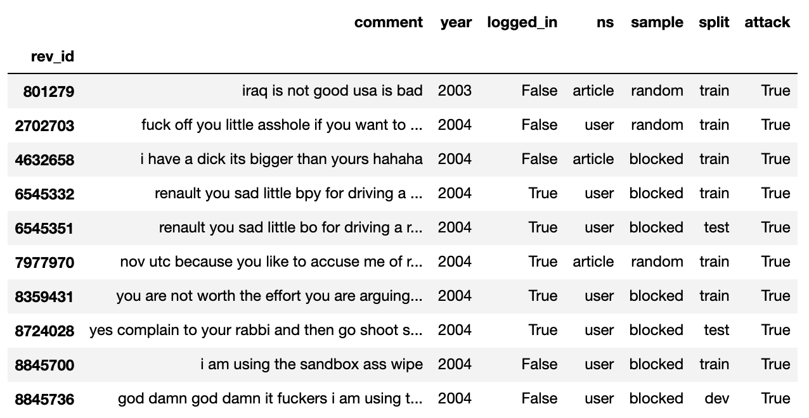
Clean the data
remove newline and tab tokens
lower and remove non unicode characters
remove non-alphabetical characters

Slide 8
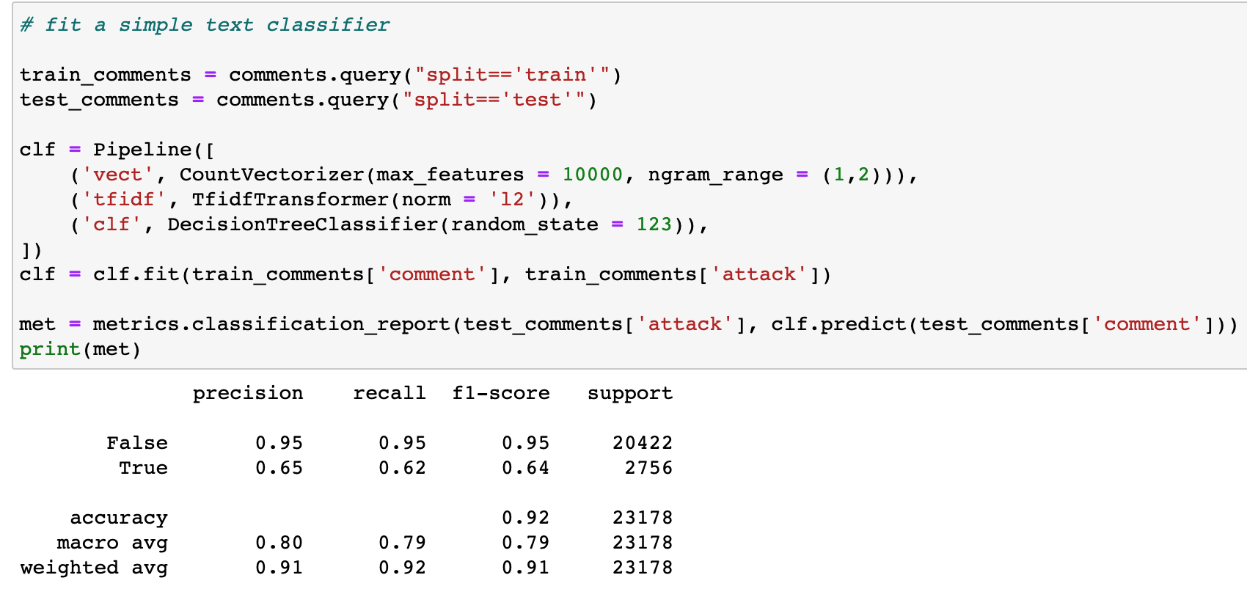
SAMPLE DECISIONTREE CLASSIFIER

Slide 9
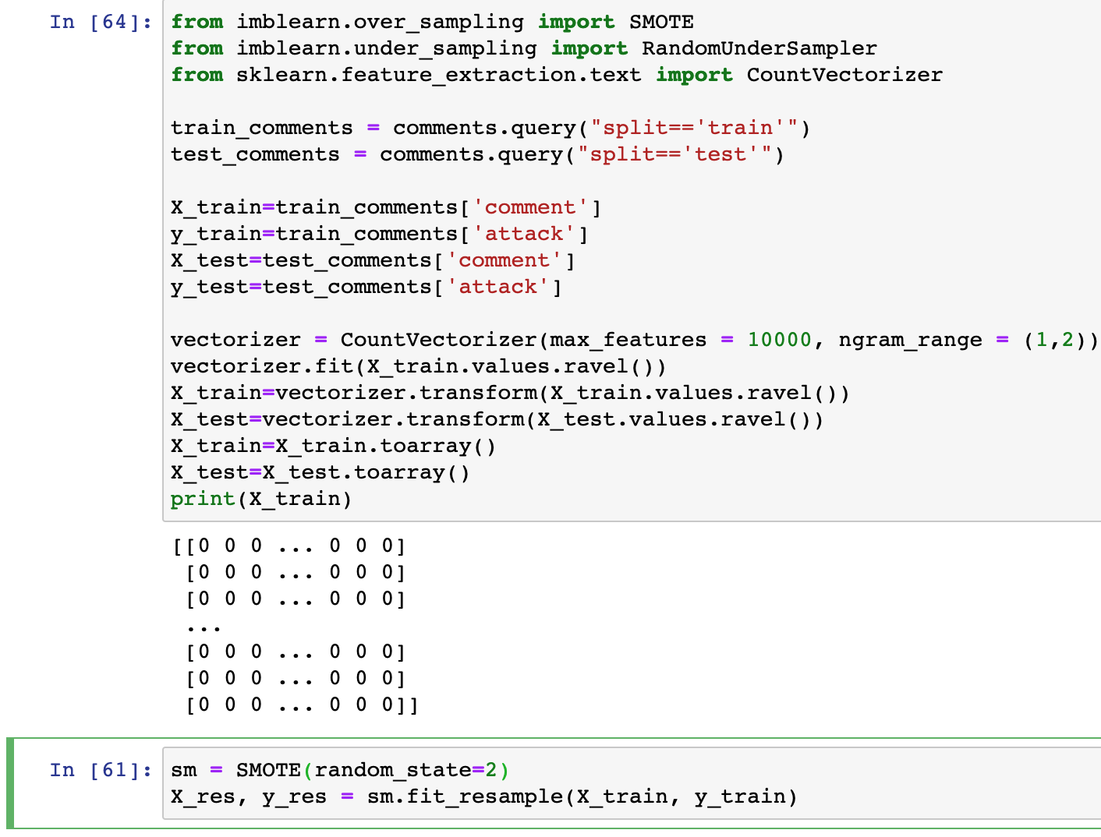
Over-Sampling: smote
Imbalanced classification problems
SMOTE:
Using the under-sample and over-sample approach, the aim is to randomly under-sample the majority class to reduce the number of values

Slide 10
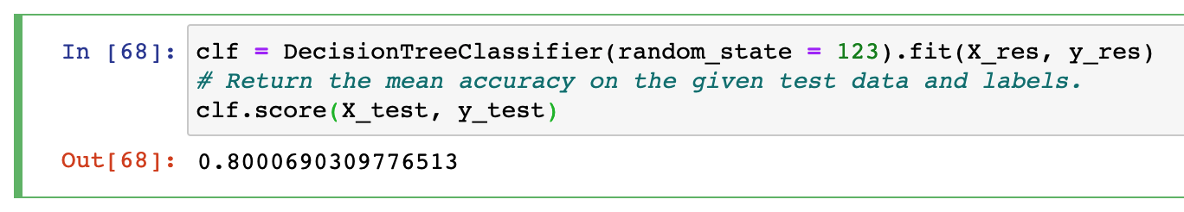
Result after resampling
It will not add very much to the performance of the model

Slide 11
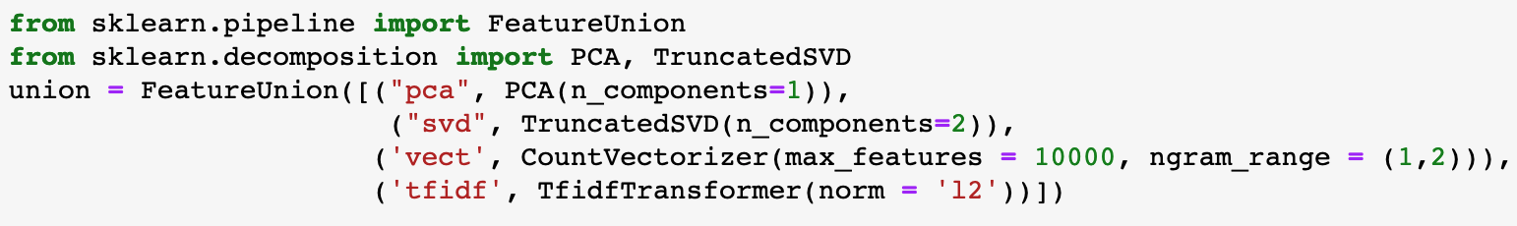
Feature union
apply different kind of transformation to the features
Takes a list of transformer objects

Slide 12
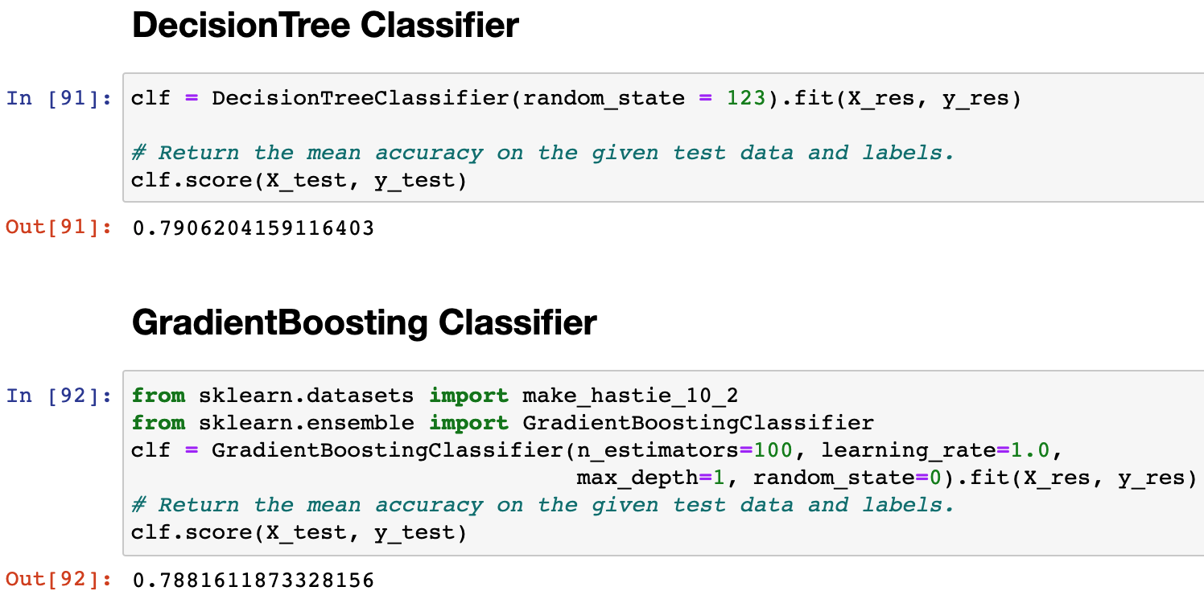
ML Modeling Methods

Slide 13
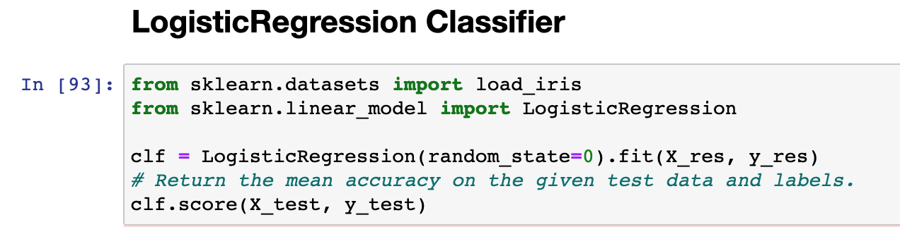
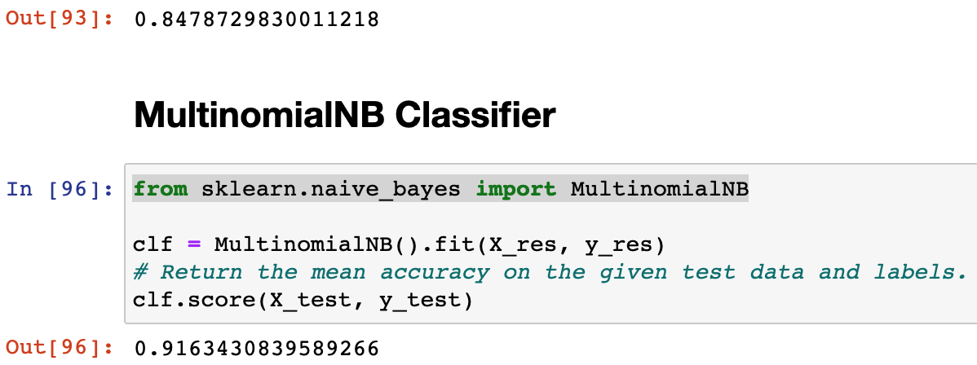
ML Modeling Methods – 4 ML mODels

Slide 14
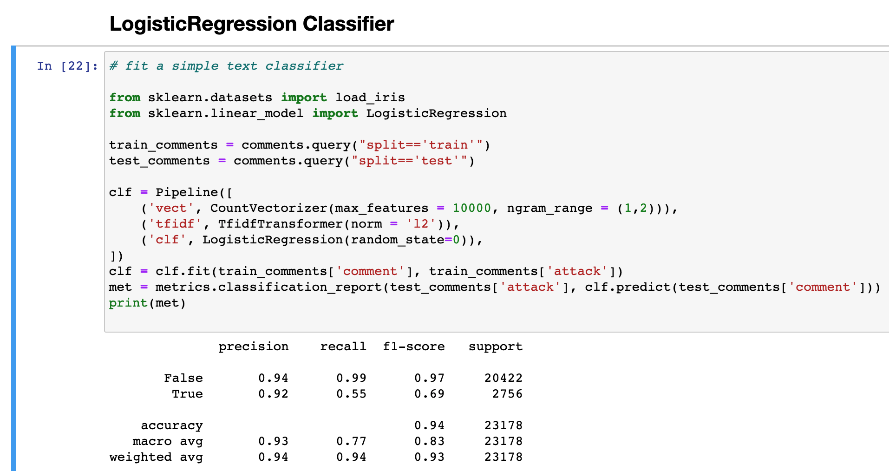
Compare confusion table

Slide 15
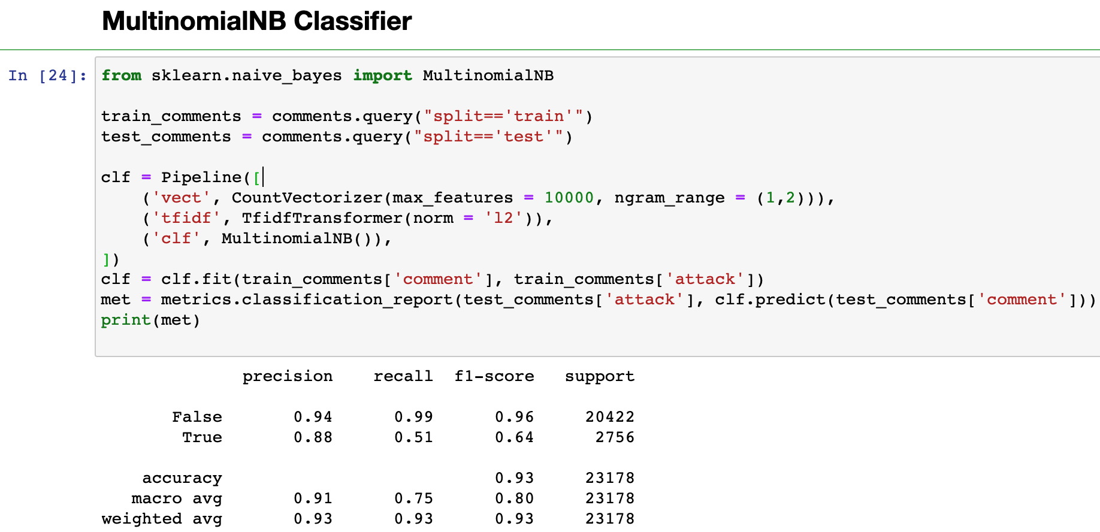
Compare confusion table

Slide 16
Hyperparameters Tuning + cross-validation
Choose Classifier: LogisticRegression Classifier
Use k-fold cross-validation, cv=2 -> in GridSearchCV
Use GridSearchCV

Slide 17
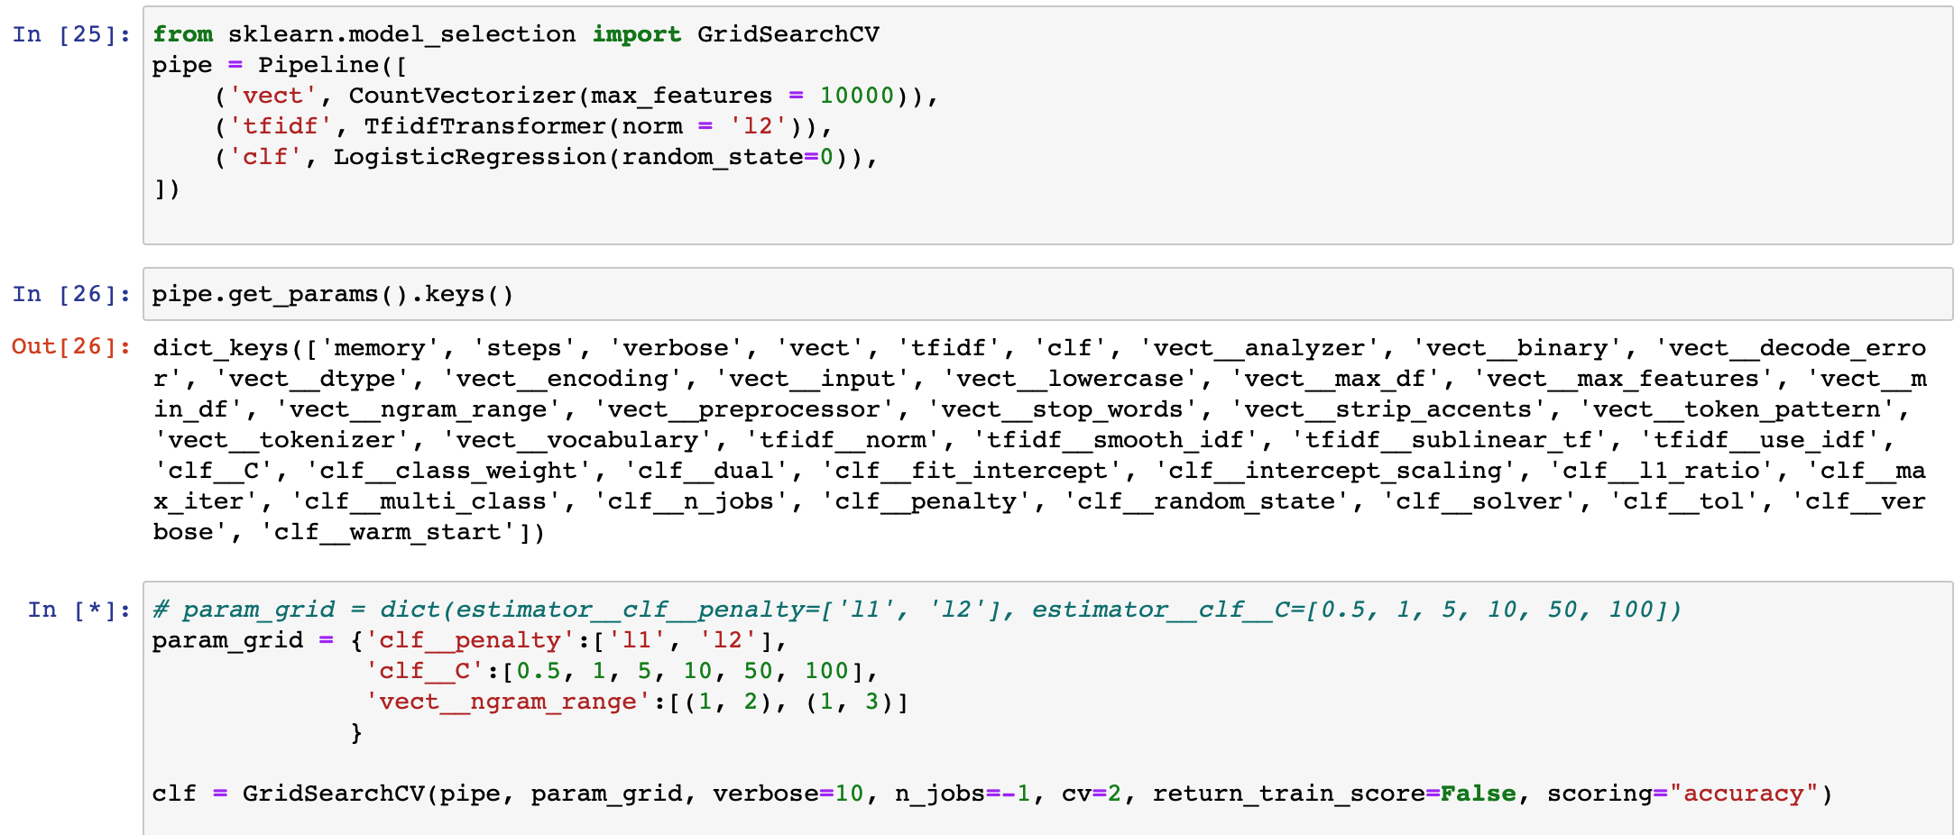
Parameter grids

Slide 18
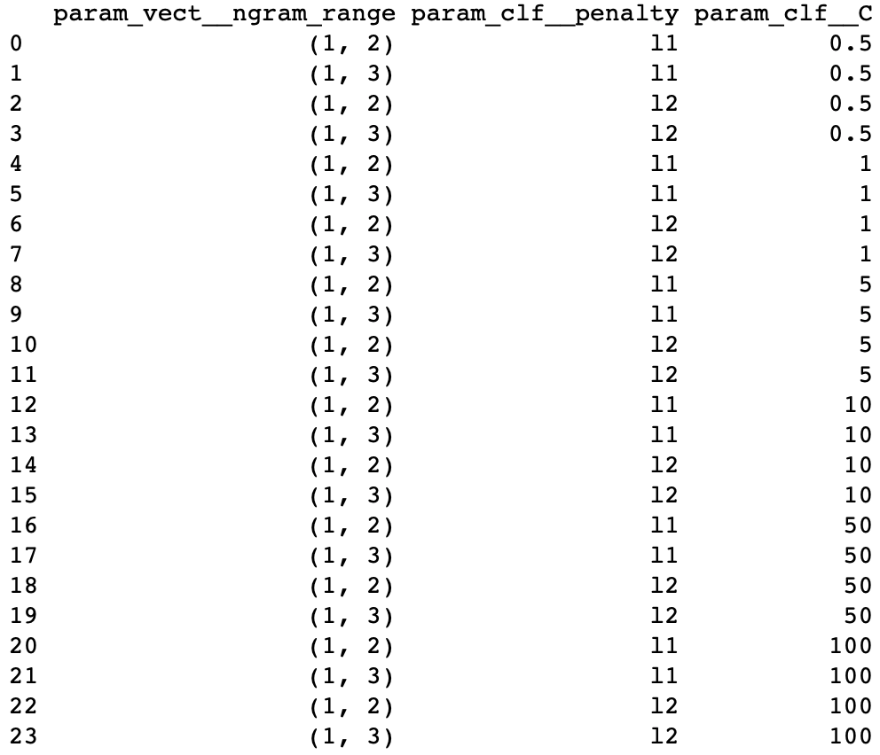
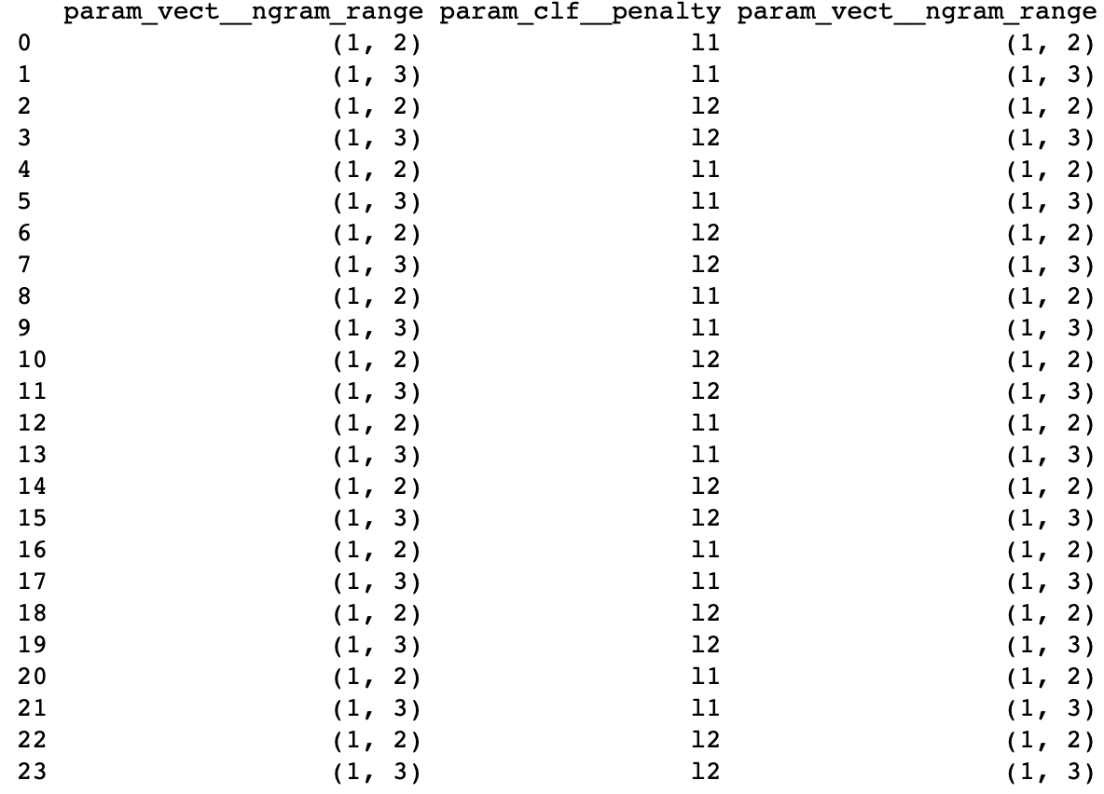
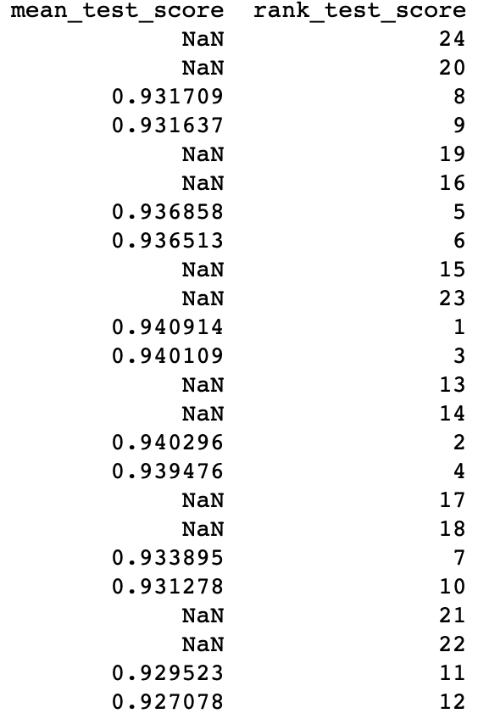
result

Slide 19
Result after hyperparameter tuning
The accuracy improves from 0.91 to 0.93 after the hypermeter tuning
I use LogisticRegression Model, and the n_gram is (1,2), clf_penalty is l2, clf_c is 5, vect_n_gram_range is (1,2)

Slide 20
takeaway
Clean the data is the foundation of the accuracy
Oversampling will not necessarily improve the performance of the model
Try to fit as many as ML models as possible, and run the confusion table
Consider about the imbalanced data and also cross-validation to improve the accuracy

Slide 21

Any questions?

