Slide 1
The Anatomy of Two Multiverse Epidemics
Ernie Chang, MD PhD
Victoria, BC
October 21, 2020

Slide 2
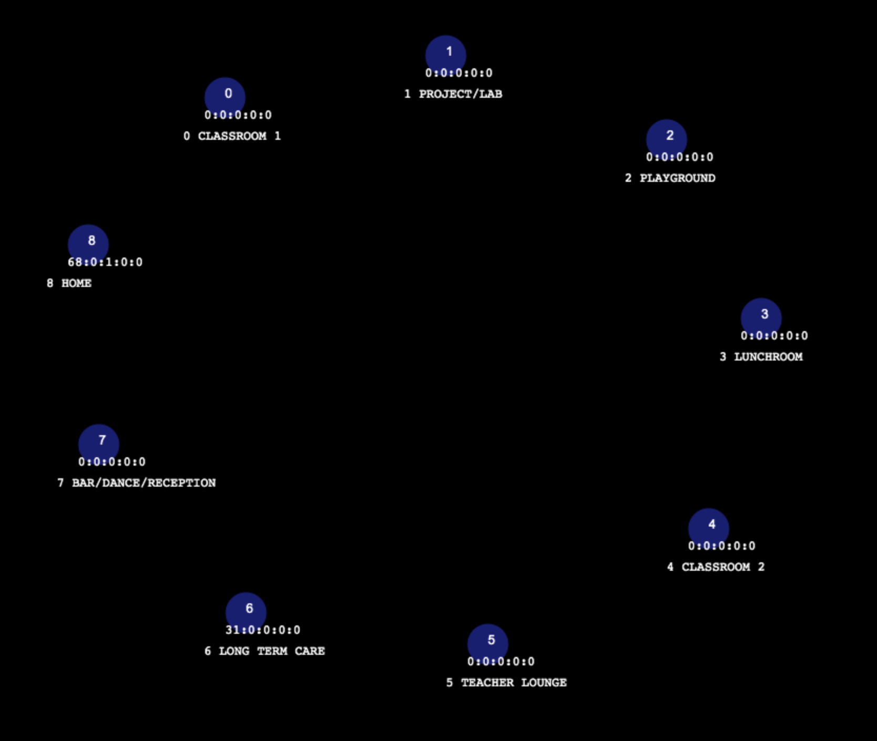
Multiverse Structure

Slide 3
Population Structure
Students 3 x 10 in groups A, B, C
Teachers 6
Grandparents 7
LTC residents 28 of which 10 are associated with families
LTC staff 14
High-mingle site (Bar) staff 10
Spouse community work 5

Slide 4
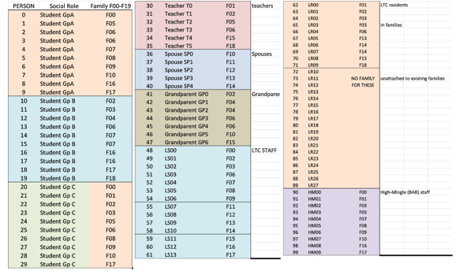
Population Structure

Slide 5
Family Structure

Slide 6
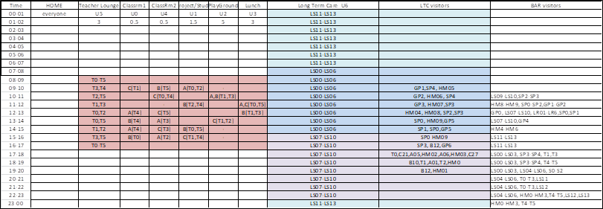
Schedule

Slide 7
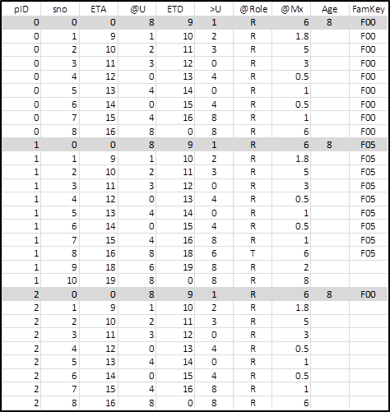
Population.csv Definitions

Slide 8
Two Trials - Parameters
Out-of-B0x
HOME Weighted
Hazard Ratio 5
Agent mF common .csv
Universe mFs all 10
Hazard Ratio 5
Agent mF common .csv
Universe mF
U6 (LTC) 0.1
U7 (bar) 80
U8 (HOME) 80
INITIAL CONDITIONS

Slide 9
Two Trials
Out-of-Box
9 survivors
self-extinguish
last transmission gen 683
HOME Weighted
1 survivor
self-extinguish
last transmission gen 486

Slide 10
SHOW MULTIVERSE AT THIS POINT

Slide 11
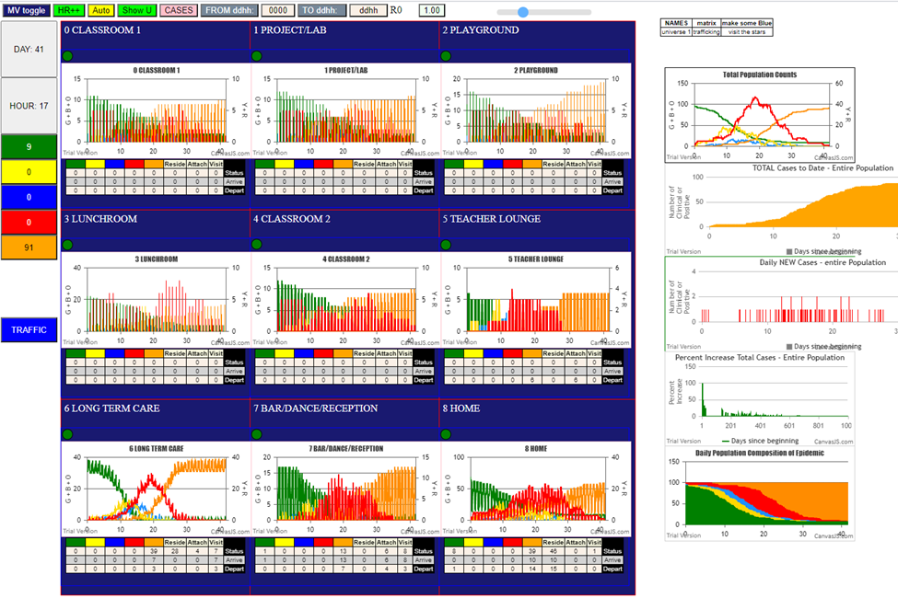
Tools – graphical interface

Slide 12
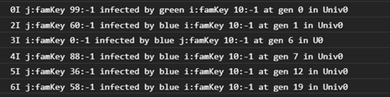
Tools – console log

Slide 13
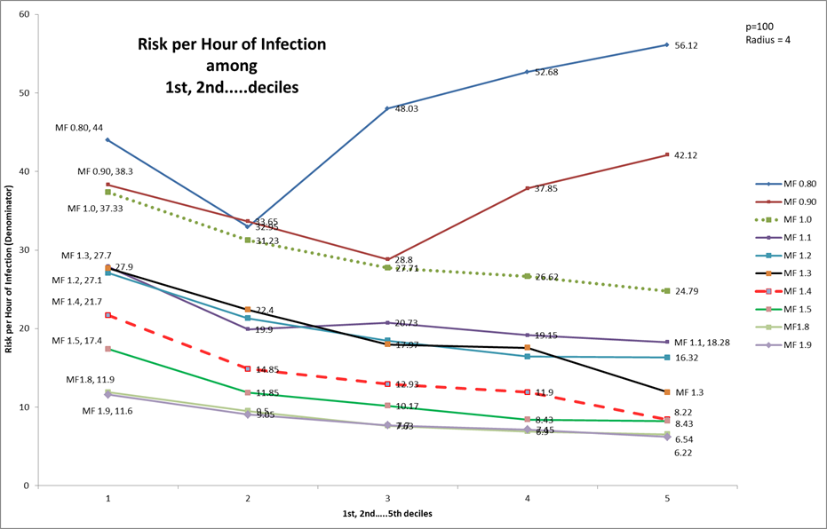
Tools – theta
theta is the average number of generations to next transmission in time span
theta-k when transmissions are 10 or less, use generations to 1st, 2nd etc
Theta-% when transmissions are large, use generations to 10%, 20% etc

Slide 14
Tools – Transmission Trees
These are built from the console.log for each trial – this is for Out-of-Box

Slide 15
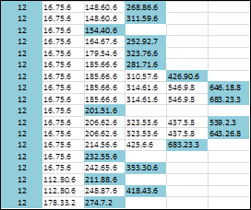
Tools – Q metric
1 3 13 11 4 4
Average Depth
A rapid epidemic has many simultaneous transmitters, hence tree is broad
- more leafs, and shallow average depth [Leafs/AvD ++]
It is rapid, so fewer generations [Gens a denom]
It is pervasive, so more distinct transmitters in entire tree [NewInf++]

Slide 16
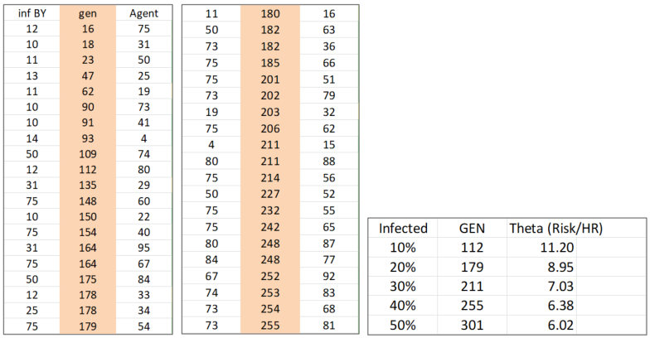
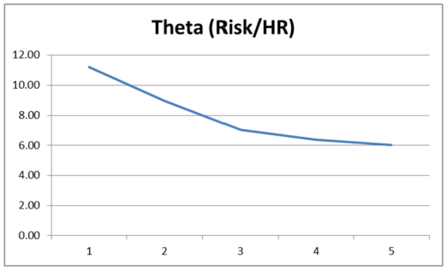
Out-Of-Box Results
Theta-% values are low in the sense that the average generations between
infections ranges from 11 in the 10% span to 6 generations in 50% span
(in the time to get to 10% infections, every 11 gens will see a new one)
Declining values indicate increasing rate
Decreasing slope leads to hope of extinction

Slide 17
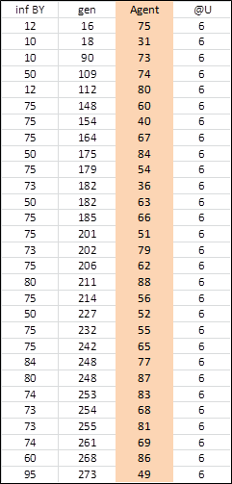
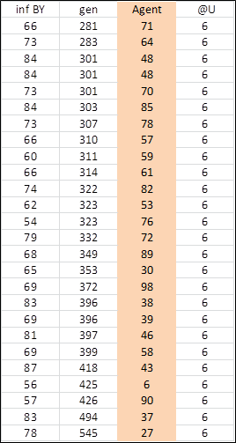
Out-of-Box LTC theta
These values are better than theta for
entire Multiverse because other
transmissions are going on at same time
With console.log, we can quantify the
relative risks in each space based on
simulations
CAVEAT: these are stochastic simulations, so the law of large numbers would
rule that many runs need to be taken to get the “real” values

Slide 18
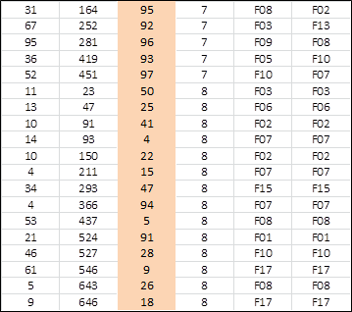
Out-of-Box HOME theta
There are 14 U8 (HOME) transmissions
theta-1 = 23
theta-2 = 23.5
theta-3 = 30.3
theta-5 = 30
theta-9 = 58
For Bar (U7) they are
theta-1 = 164
theta-2 = 126
theta-3 = 94
We see that theta appears to be a good estimator of
the intensity and risk of transmissions within component spaces

Slide 19
Out-of-Box Q values
These are the calculated Q-values for these trees.
If we consider them as first descendants of a single TREE,
its Q-value is 159.64, over total of 683 generations

Slide 20
Out-of-Box Precedences
These are velocities and counts of agents in their viral states in successive generations as
agents come and go
In the left-most charts, U7 clearly lags LTC and HOME
In the right SEIR charts, U8 HOME stays at constant peak as a prolonged plateau, while
LTC follows a classical peak at day 20

Slide 21
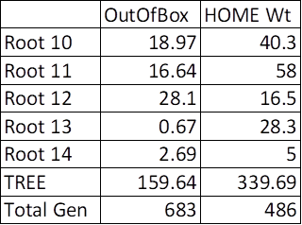
Two Trials
Out-of-Box
9 survivors
self-extinguish
last transmission gen 683
Theta overall
Theta-10% 11.20
Theta-30% 7.03
Theta-50% 6.02
Component theta’s next slide
HOME Weighted
1 survivor
self-extinguish
last transmission gen 486
Theta Overall
Theta-10% 10.6
Theta-30% 7.5
Theta-50% 6.90
Component theta’s next slide
Q values
The HOME-weighted component trees are more aggressive
in Roots 10, 11 and 13 while OutOfBox’s Root 12 is more
Recall there are stochastic influences at play
The overall TREEs are dramatically different, though with HOME Wt
being more aggressive at 339 compared to 159
This is reflective of the differences in generations, 486 to 683

Slide 22
Two Trials – theta values
OutOfBox Trial
HOMEWeighted
The U6 and U8 thetas in OutOfBox are roughly equivalent
The school Universes are hardly engaged in these trials
The U6 and U8 thetas in HOMEWeighted are dramatically different with U8 (HOME) being much
riskier (lower gens between)
The U6 values are relatively conserved in both trials, despite the effortto reduce mF. This tells us
that population density is primary.

Slide 23
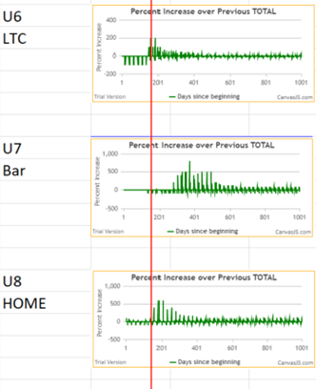
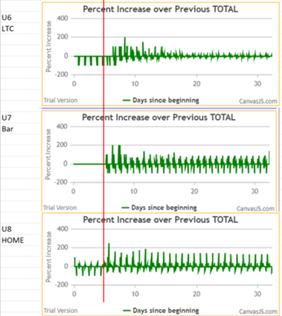
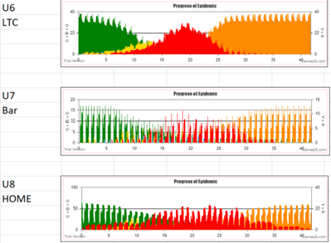
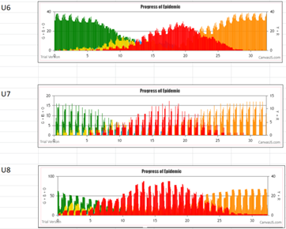
Two Trials – Precedence
U7 in OutOfBox lags,
U8 in HOMEWeighted leads
OutOfBox HOMEWeighted
The LTC in HOMEWeighted
lags behind U8 (HOME)

Slide 24
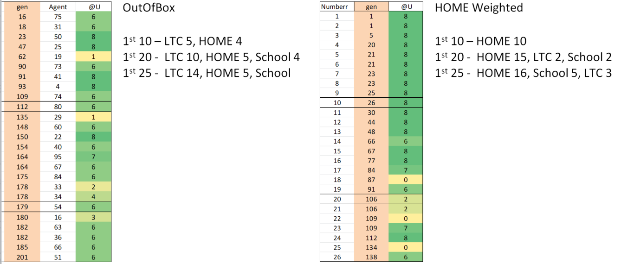
Two Trials - Incidences
As expected, in OutOfBox, the LTC leads HOME increasingly
As expected by biasing the parameters,
HOME dominates the incidence of
transmissions

Slide 25
SUMMARY
Simulation of interacting populations and spaces gave metrics of:
INTENSITY and PROGRESSION of two systems
Component contributions to the overall pandemics in:
Theta average times between transmissions
Q efficiency of Transmission Trees
Precedence and incidence measures of activity

Slide 26
CONCLUSION
The reason to simulate is first to understand
the dynamics of a complex system
the interactions and relative functions of components
the progression as influenced by various parts
From this, it may be possible to make predictions
In Covid epidemics, we only partial glimpses of the internal dynamics of the present real
In simulations, we see the details of many possible epidemic configurations
To counter the contagion, we must first truly understand it

