Slide 1
Honours Update
July 13
Ashlynn Steeves

Slide 2
Question
Does local air quality have an impact on a populations susceptibility to COVID-19?

Slide 3
Datasets
COVID-19 Data Repository, CSSE, John Hopkins University
United States Environmental Protection Agency, County Level Yearly AQI Datasets (2014-2019)

Slide 4
Air Quality Index
Good | Moderate | Unhealthy for sensitive groups | Unhealthy | Very Unhealthy | Hazardous
0-50 | 51-100 | 101-150 | 151-200 | 201-300 | 301+

Slide 5
AQI Data Pre-processing
For each year of data only the counties that had at least 180 days of air quality measurements reported were retained
AQI data was normalized by the number of days for which measurements were available
Data across all years were averaged at a county level

Slide 6
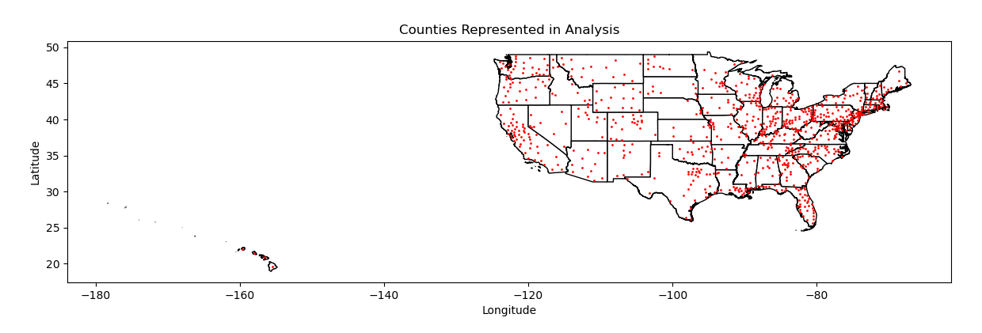
Counties included in Analysis

Slide 7
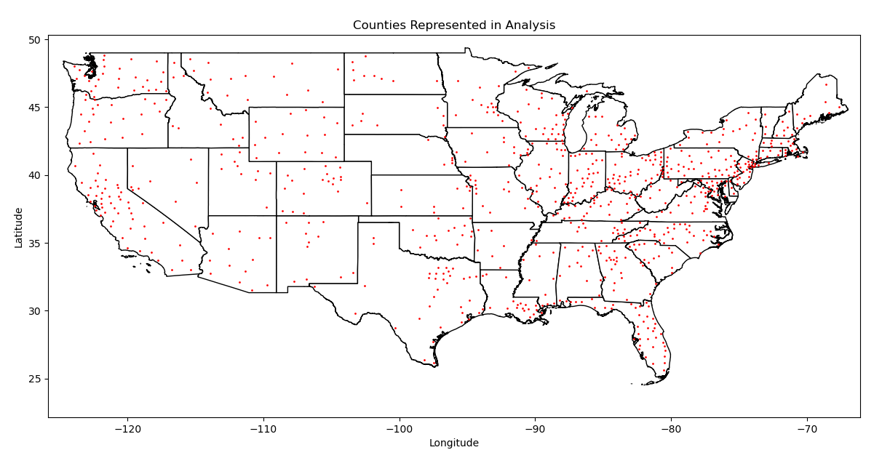
Counties included in Analysis

Slide 8
Feature Space
Current county level features include:
Frequency of Good AQI
Frequency of Moderate AQI
Frequency of Unhealthy for Sensitive Groups AQI
Frequency of Unhealthy AQI
Frequency of Very Unhealthy AQI
Frequency of Hazardous AQI
Number of confirmed COVID cases (normalized by population)
Number of confirmed COVID deaths (normalized by population)

Slide 9
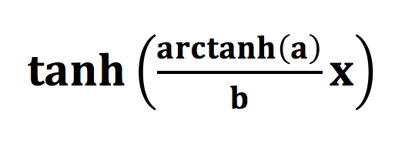
Normalization
Data was normalized on a feature level using:
Where:
a = tolerance
b = maximum value of the feature
x = data

Slide 10
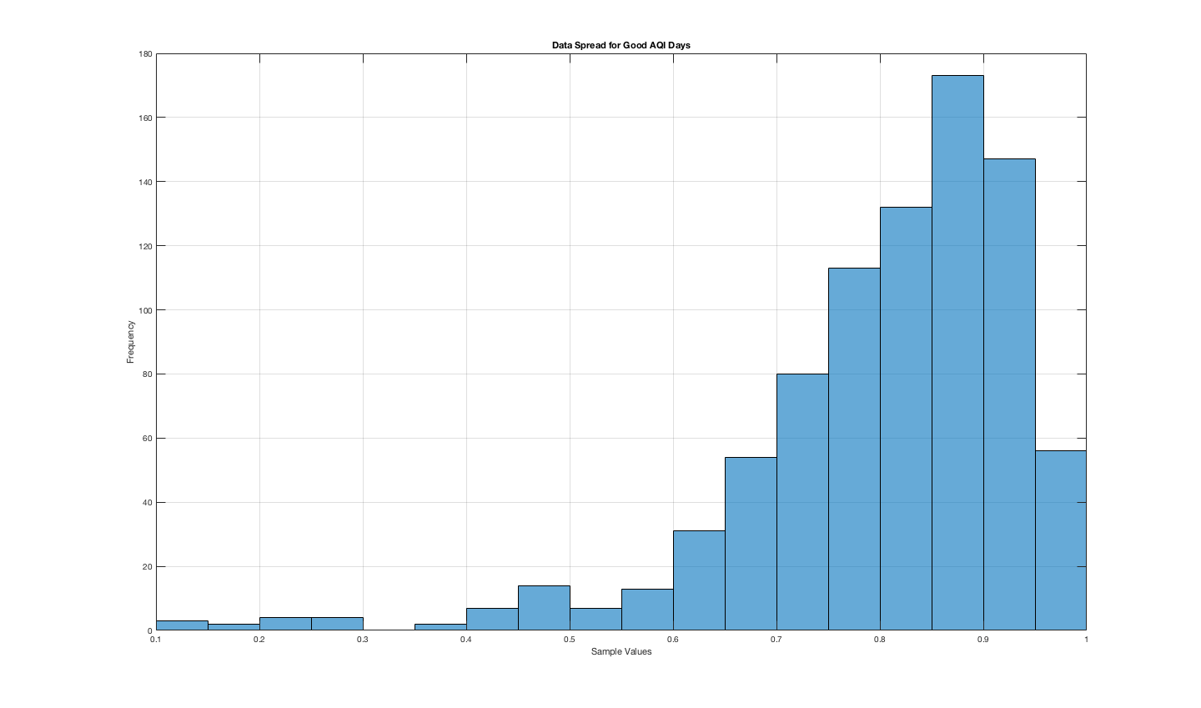
Good AQI

Slide 11
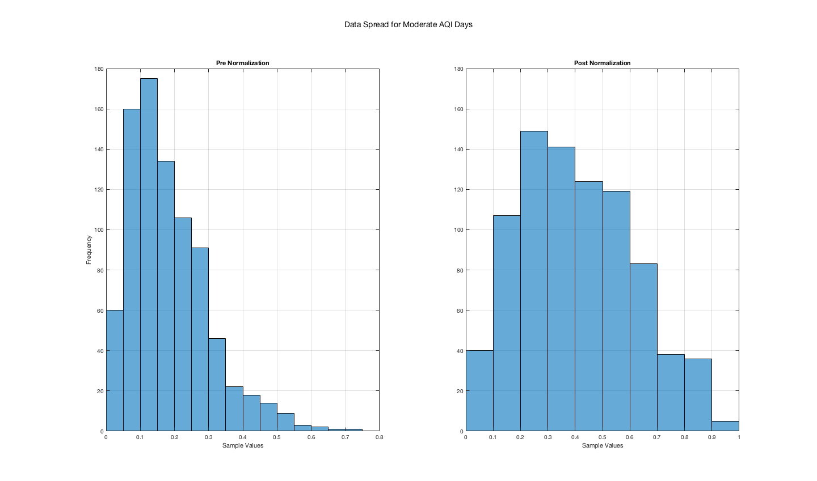
Moderate AQI
a = 0.95, b =0.7120

Slide 12
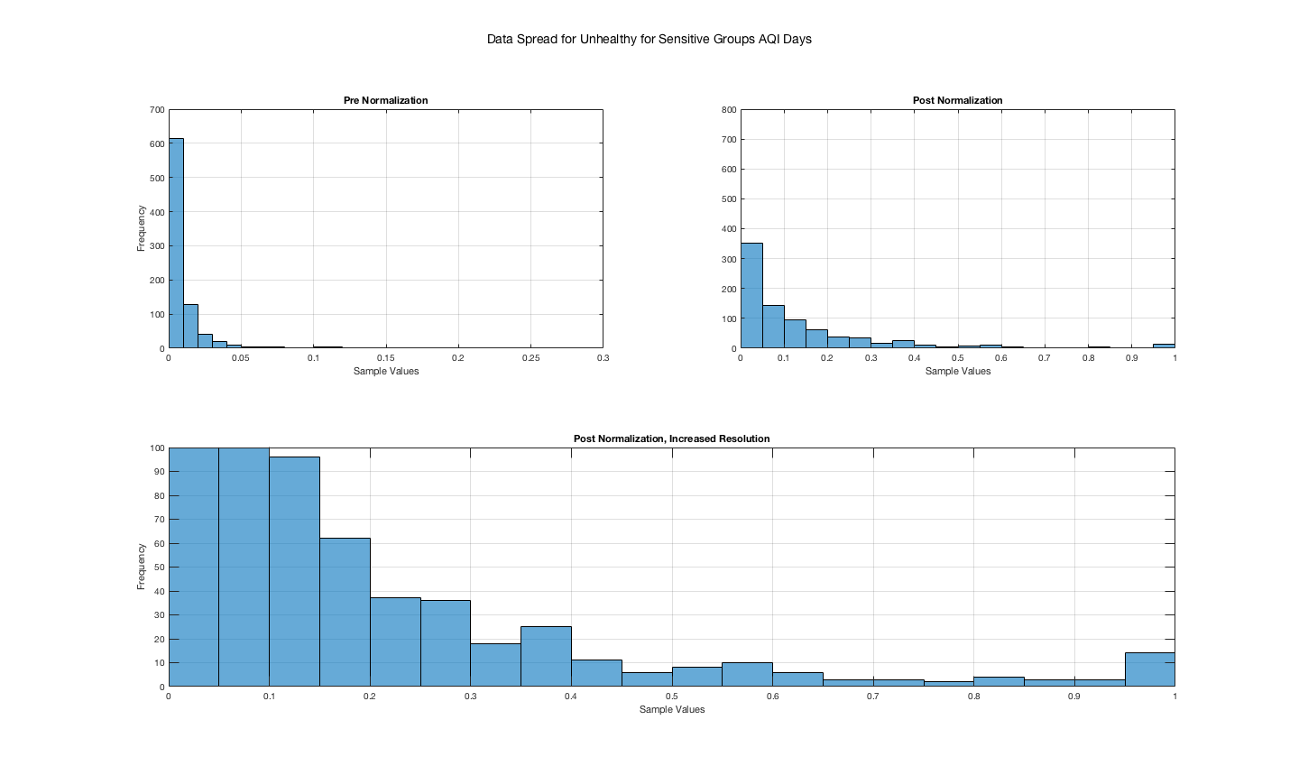
Unhealthy for sensitive groups AQI
a = 0.9999, b =0.2822

Slide 13
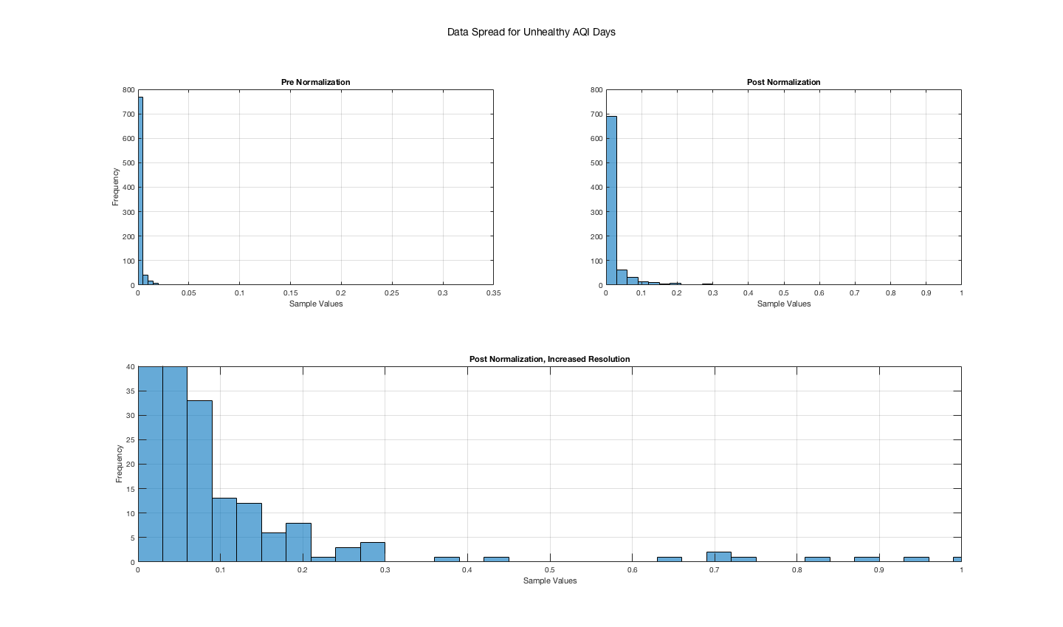
Unhealthy AQI
a = 0.9999, b =0.3305
57.3% of samples in this feature are zero

Slide 14
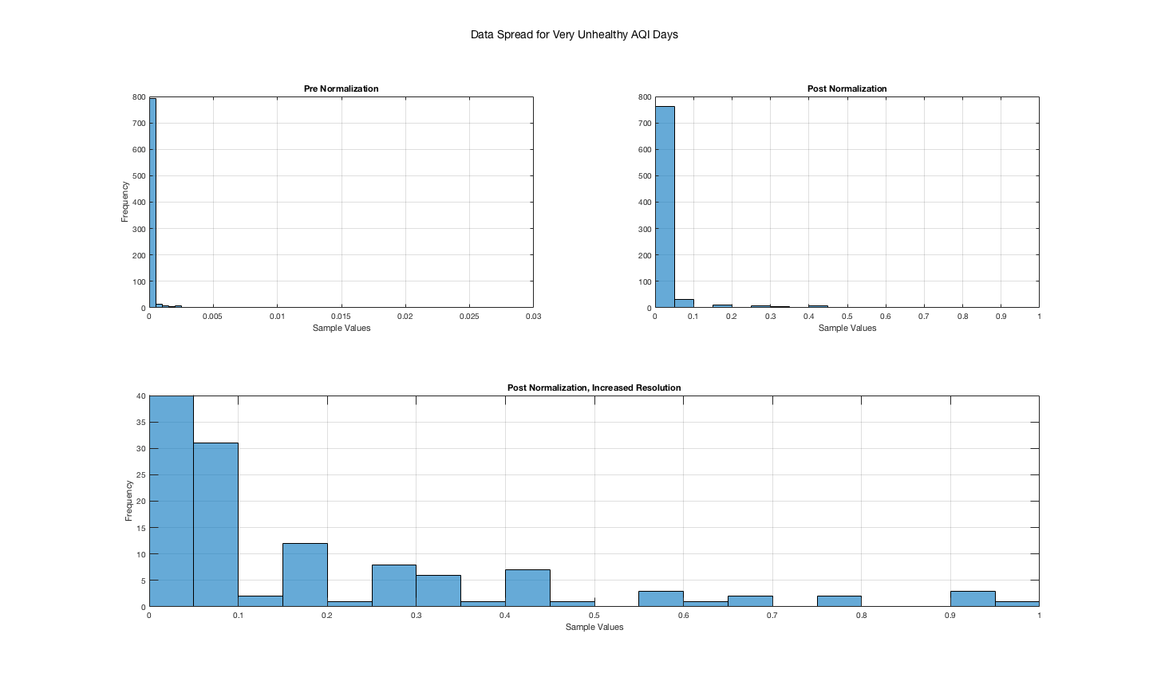
Very Unhealthy AQI
a = 0.9999, b = 0.0256
90.3% of samples in this feature are zero

Slide 15
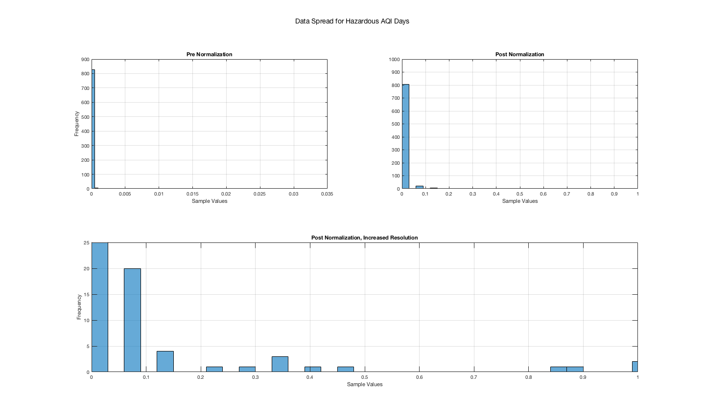
Hazardous AQI
a = 0.9999, b =0.0310
95.8% of samples in this feature are zero

Slide 16
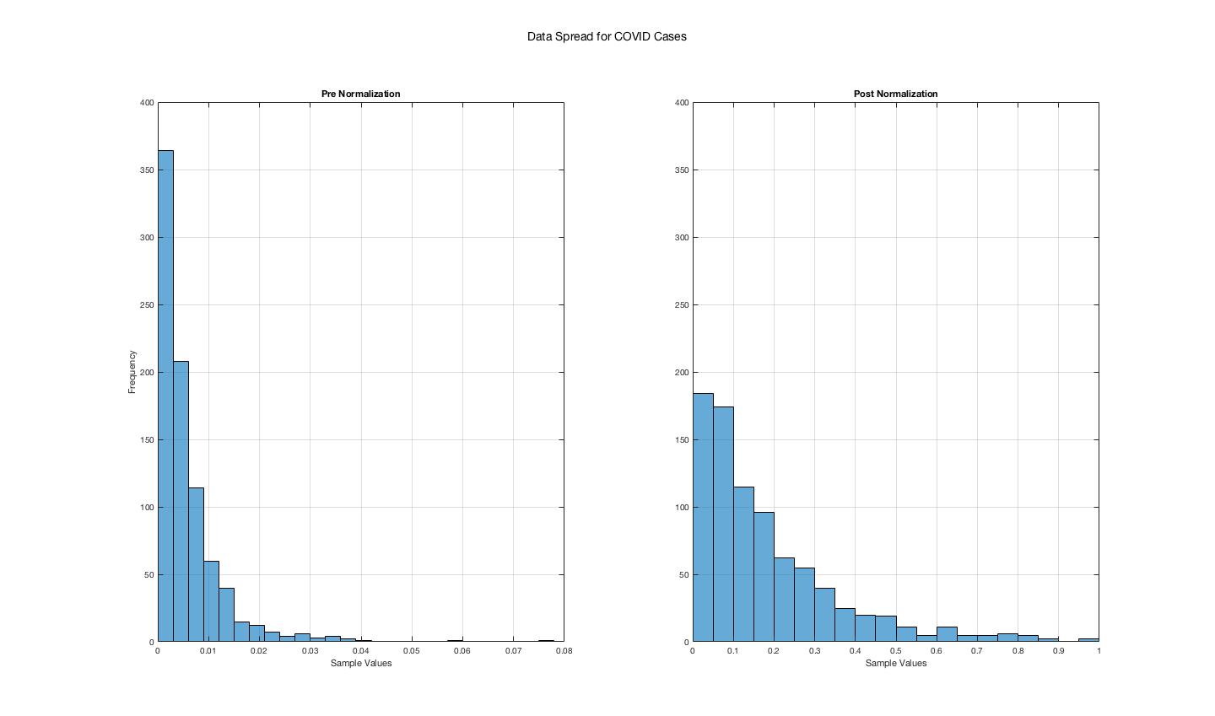
Covid Cases
a = 0.99, b =0.0772

Slide 17
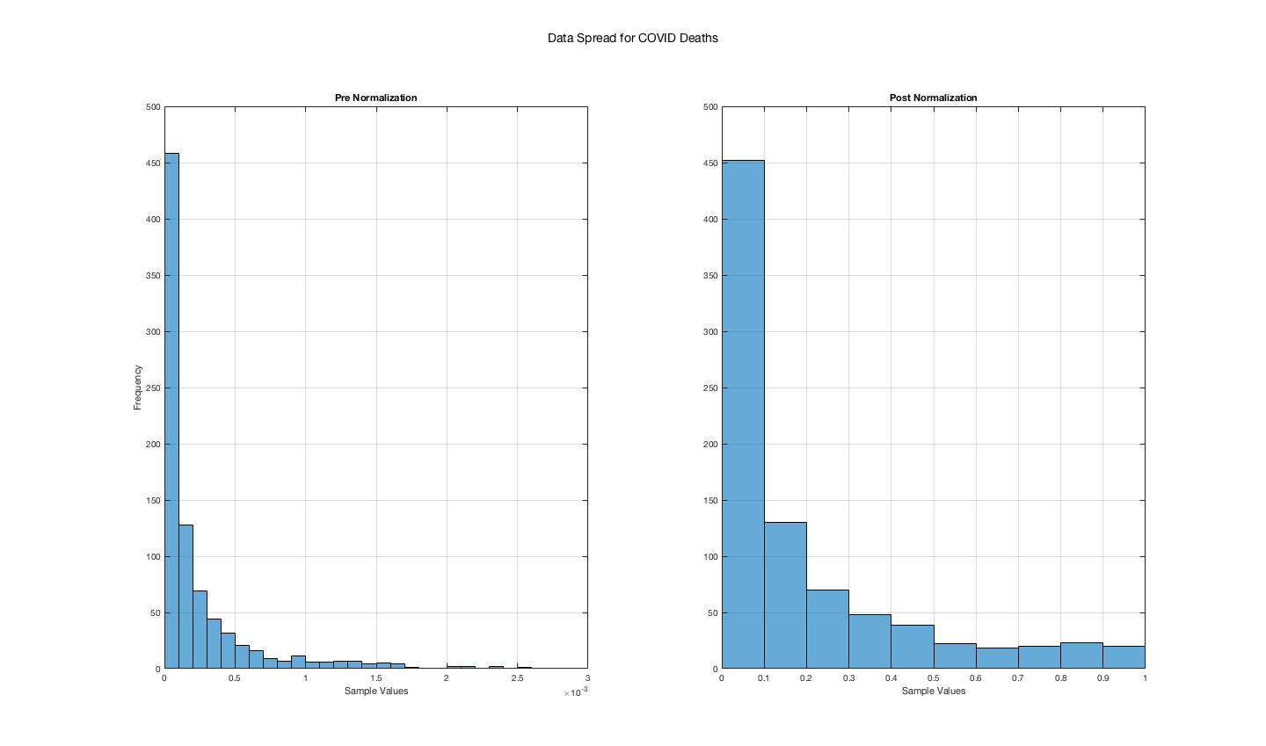
COVID DEATHS
a = 0.99, b =0.0025

Slide 18
Principal Component Analysis (PCA)
PCA was applied to the feature space as a mean to reduce dimensionality in anticipation for clustering

Slide 19
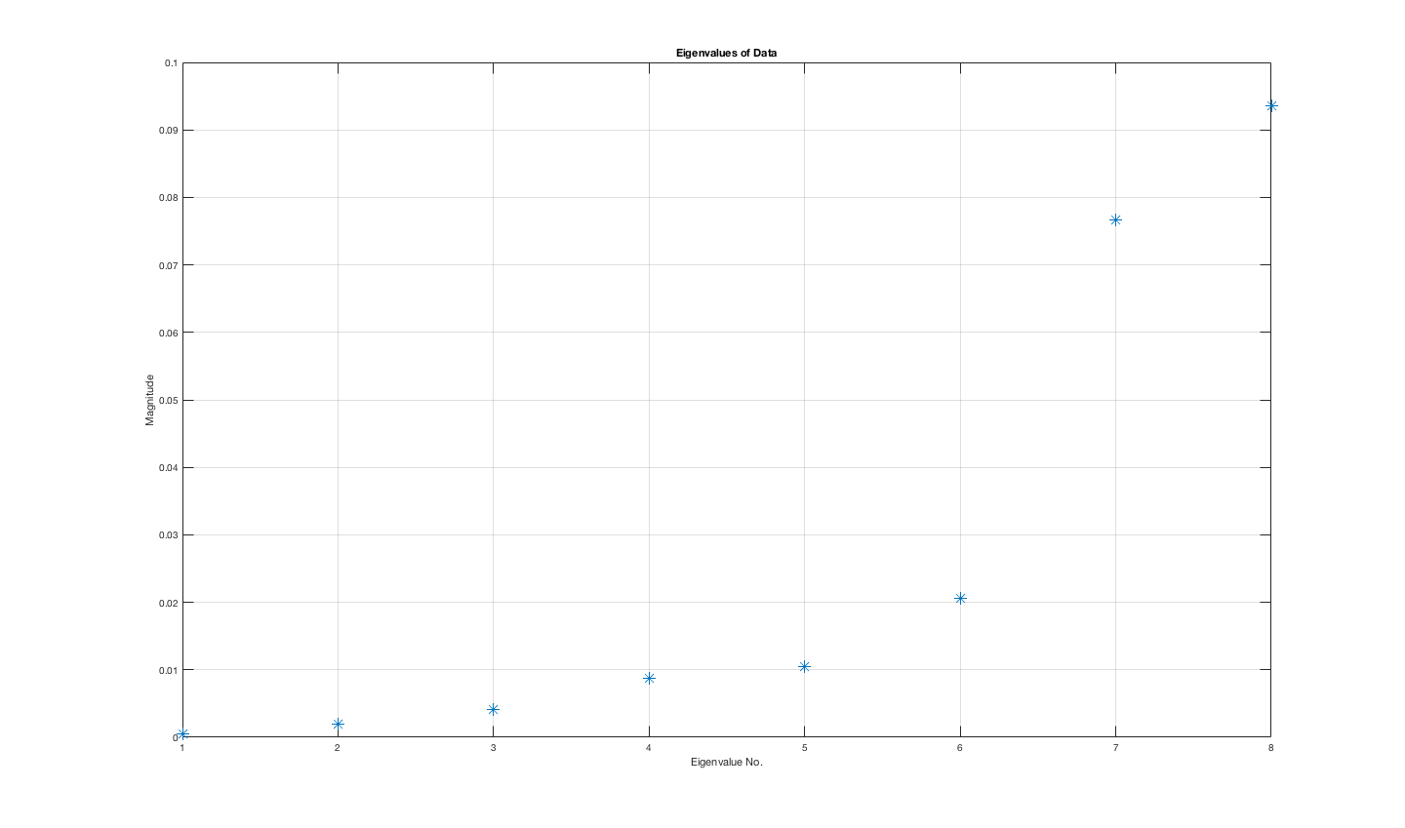
Eigenvalue spread

Slide 20
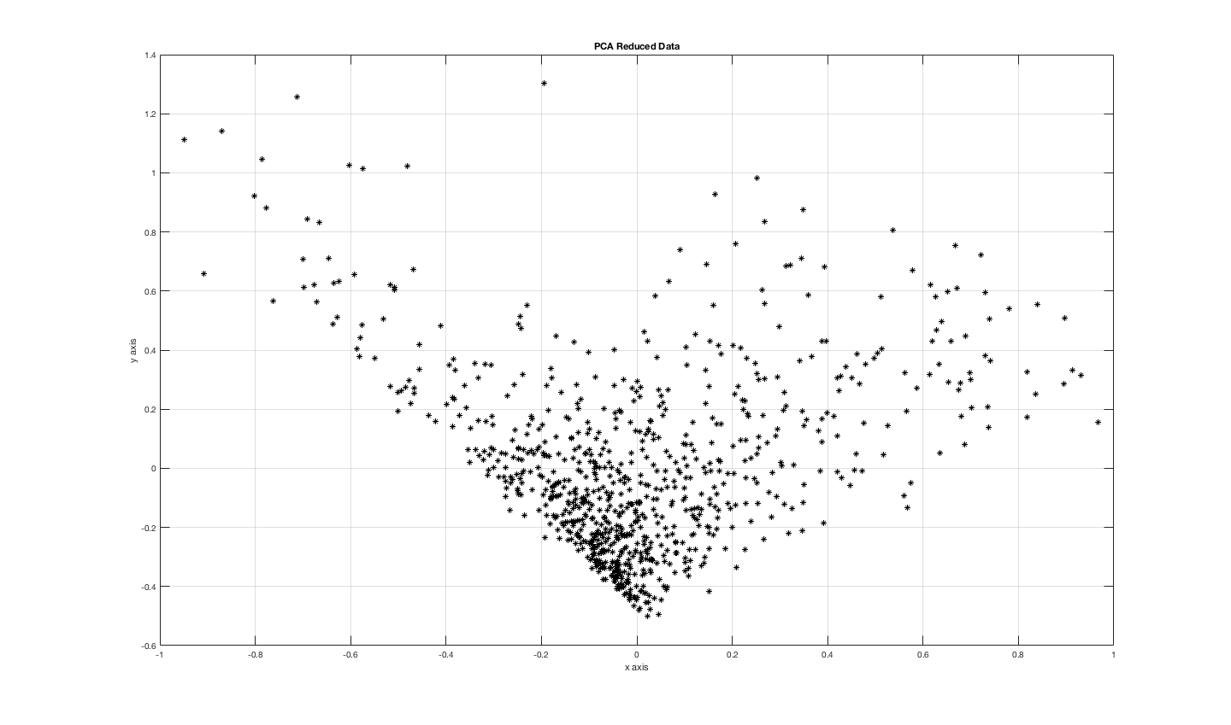
PCA Reduced Data

Slide 21
Future Work
Include specific pollutant data in the analysis
Account for county level variables such as:
Population density
Average temperature and humidity
Age of population
Socio-Economic status
State politics and social distancing regulations

