Slide 1
ECE 579a
June 15
Ashlynn Steeves

Slide 2
Question
Does local air quality have an impact on a populations susceptibility to COVID-19?

Slide 3
Datasets
COVID-19 Data Repository, CSSE, John Hopkins University
Air Quality Historical Data Platform, World Air Quality Index Project

Slide 4
Location of analysis
I have chosen to start my analysis by looking at major Australian cities. I have chosen to do so because:
Australia was heavily impacted by wildfires in early 2020, which can drastically impact local air quality
Reduces the number of confounding variables that must be accounted for
City | State | Population
Adelaide | South Australia | 1,345,777
Brisbane | Queensland | 2,462,637
Melbourne | Victoria | 4,936,349
Perth | Western Australia | 2,059,484
Sydney | New South Wales | 5,230,330

Slide 5
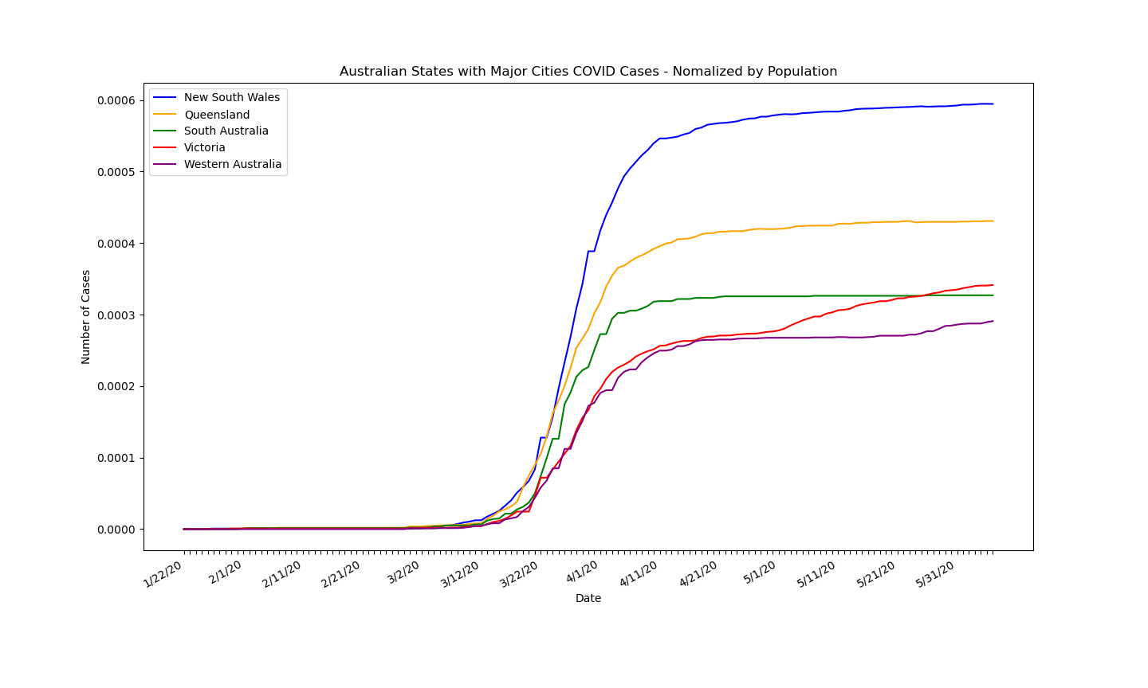
COVID CASES in Australian States with Major Cities
Normalized by the population of the major city for accurate visual representation

Slide 6
Air Quality Index
Air quality index is based on 5 major pollutants:
Ground level ozone (O3)
Particle pollution (PM)
Carbon monoxide (CO)
Sulfur dioxide (SO2)
Nitrogen dioxide (NO2)
Good | Moderate | Unhealthy for sensitive groups | Unhealthy | Very Unhealthy | Hazardous
0-50 | 51-100 | 101-150 | 151-200 | 201-300 | 301+

Slide 7
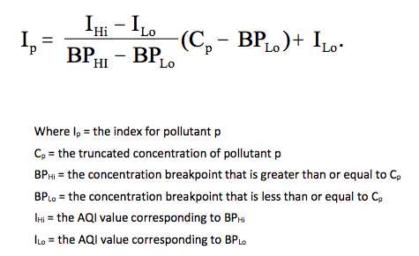
Air Quality Index
For each of the 5 pollutants, an air quality ranking is calculated using:
The highest value of air quality amongst all pollutants is reported as the air quality index

Slide 8
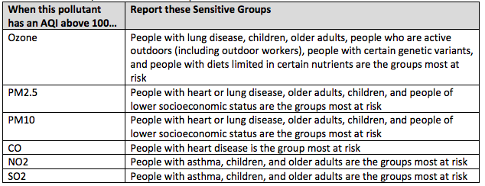
Pollutant specific Sensitive groups

Slide 9
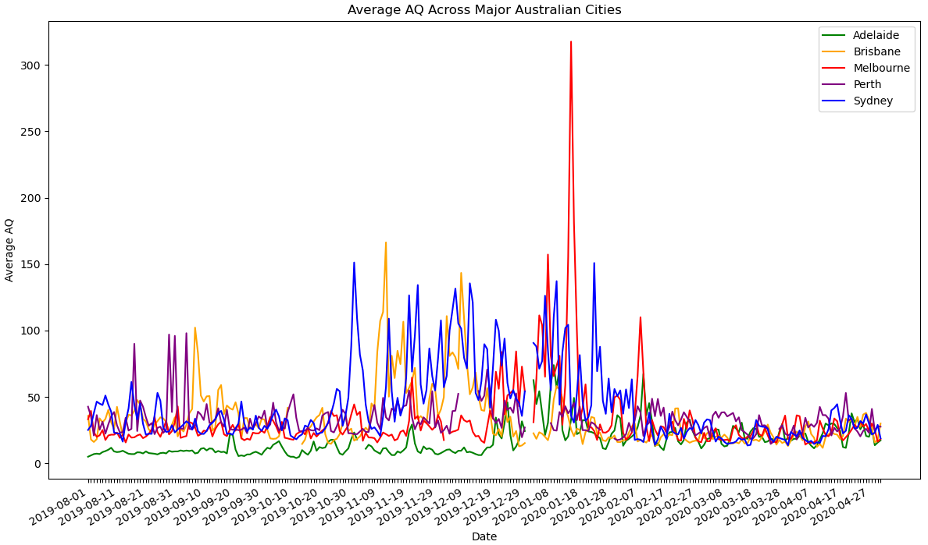
Average Air Quality

Slide 10
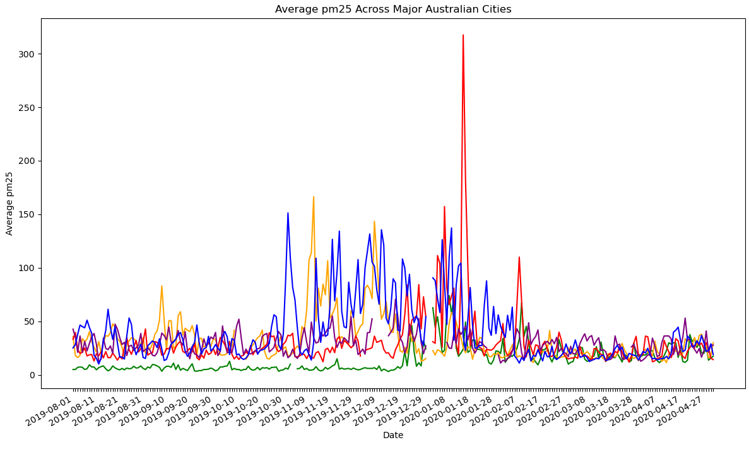
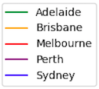
PM25
Fine particle matter, 2.5 microns or less in diameter.

Slide 11
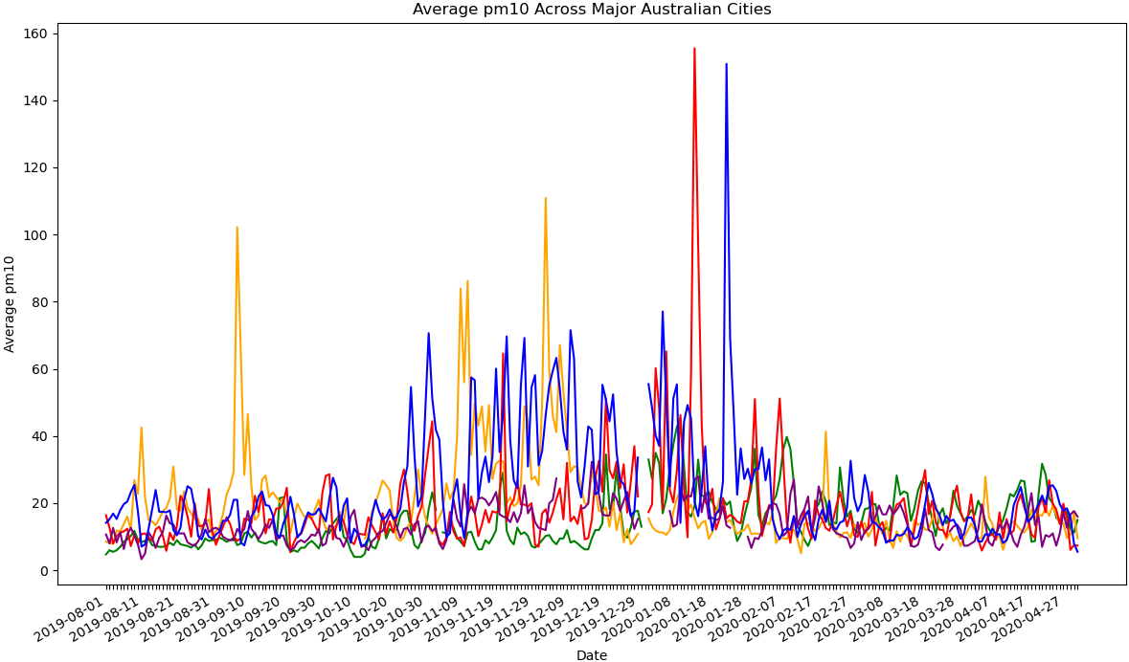
pm10
Fine particle matter, 10 microns or less in diameter

Slide 12
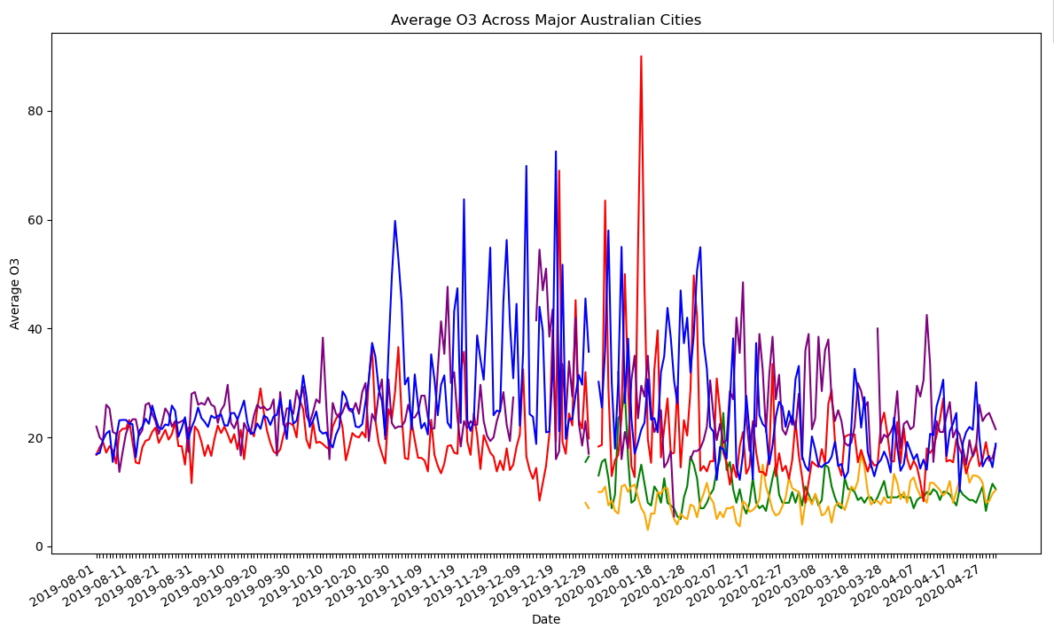
o3

Slide 13
Next Steps
Begin to investigate relationships between COVID-19 spread and Air Quality index
Begin to investigate relationship between COVID-19 spread and individual air pollutants

Slide 14
References
https://www.abs.gov.au/AUSSTATS/abs@.nsf/Lookup/3218.0Main+Features12017-18?OpenDocument
https://github.com/CSSEGISandData/COVID-19
https://aqicn.org/data-platform/register/
https://www.airnow.gov/sites/default/files/2020-05/aqi-technical-assistance-document-sept2018.pdf

