Slide 1
Endocrine therapy and reproductive-age groups in METABRIC
ER-positive breast cancer | SWE4S Assignment 7
Hypothesis: endocrine therapy receipt differs across menopause-proxy age groups, and the gap varies across cohorts even after clinical adjustment.
Cohort: n = 1,204 ER-positive patients | ≤45 likely premenopausal (n=129) | ≥55 likely postmenopausal (n=1,075)
Critical caveat: menopause was not directly measured; age is only a proxy.

Slide 2
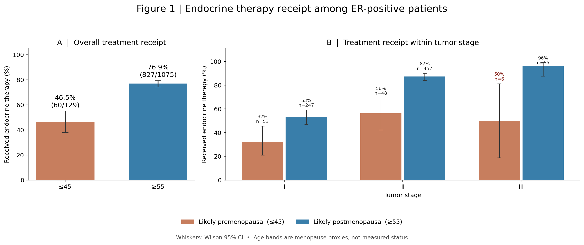
1 | Treatment receipt differs
46.5% vs 76.9% (30.4 percentage points); difference also appears within tumor stages

Slide 3
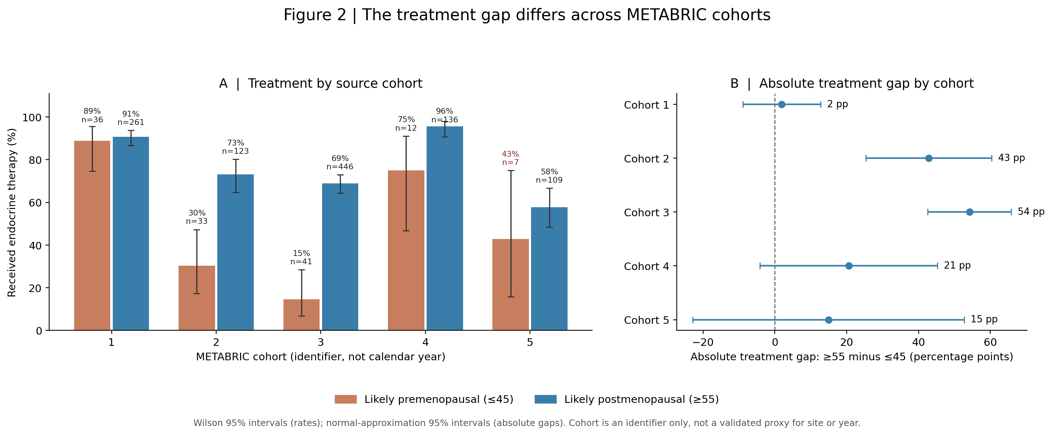
2 | Treatment gap varies by cohort
Cohort interaction likelihood-ratio p = 0.0053; cohort ID is not a diagnosis year

Slide 4
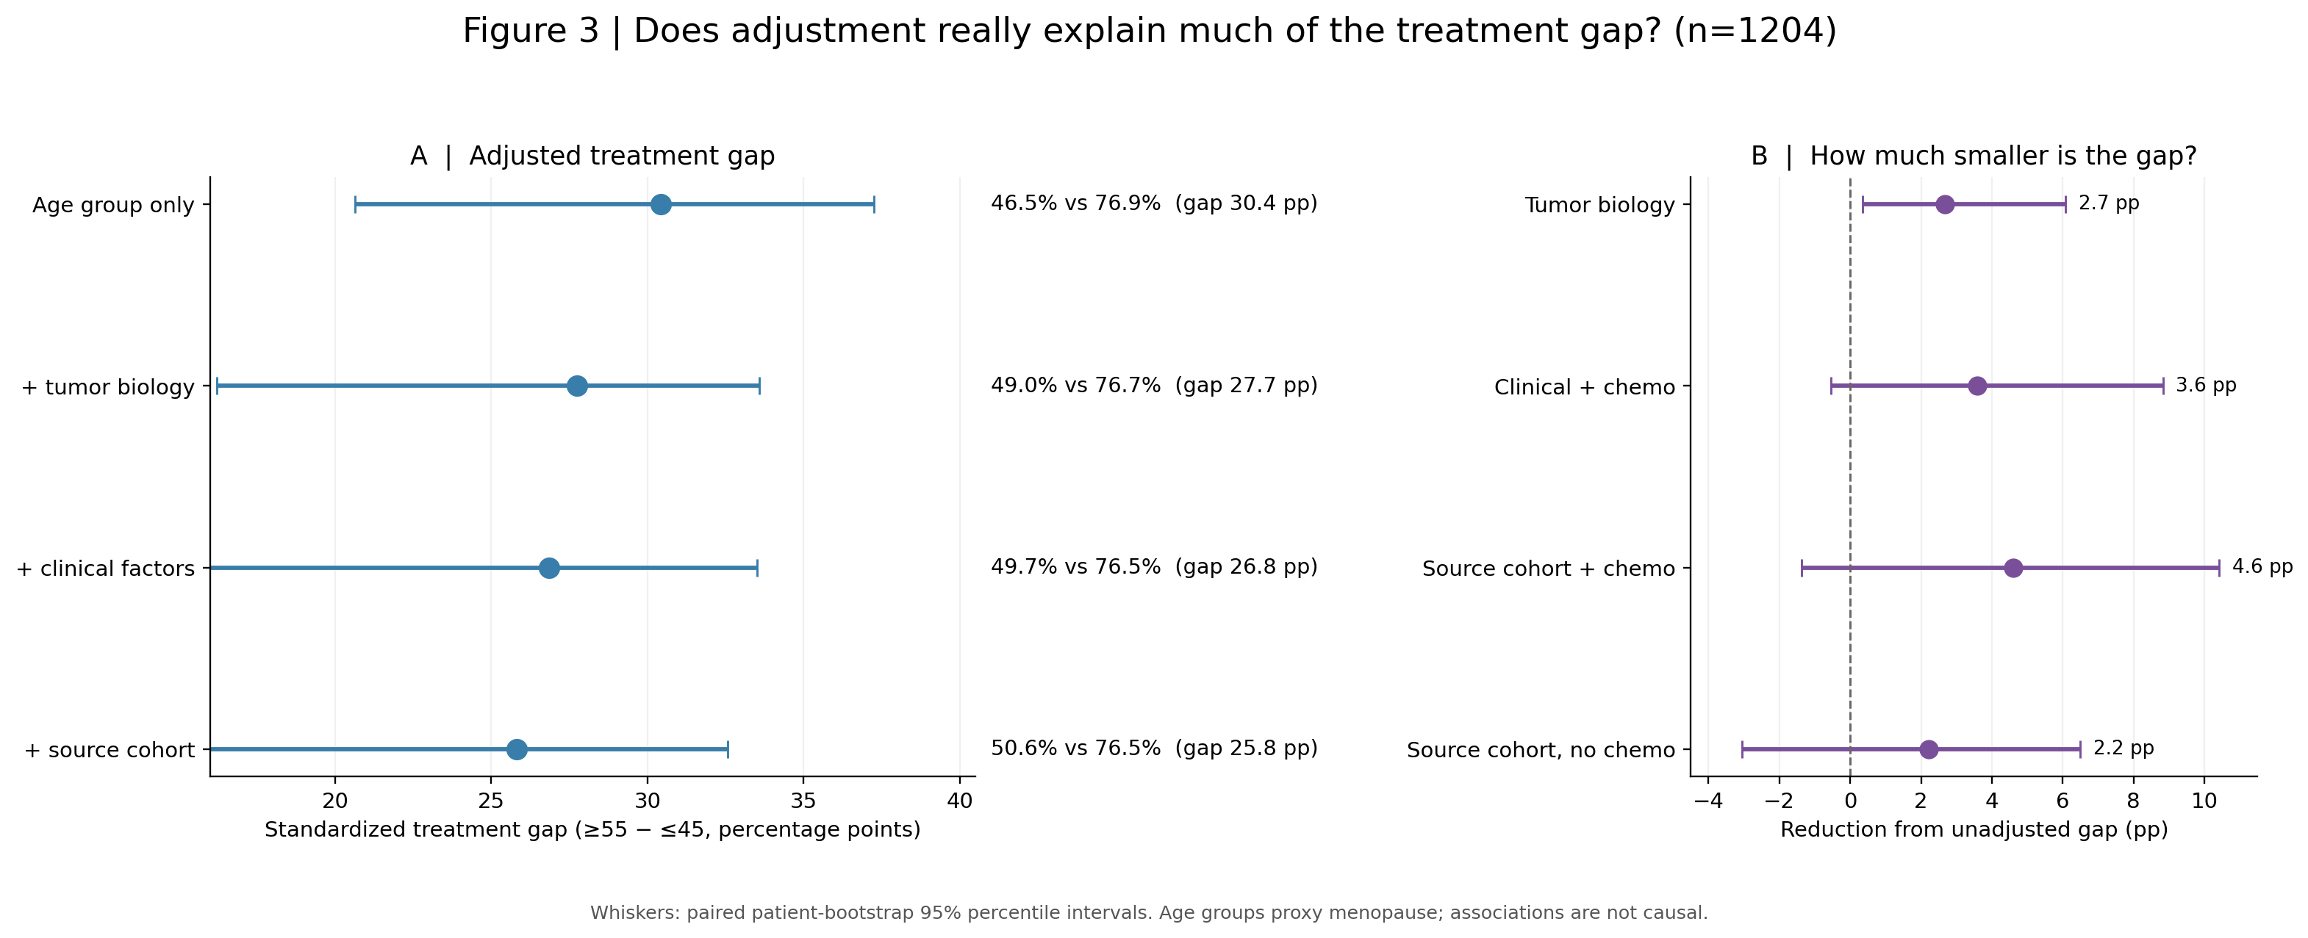
3 | Adjustment explains little of the gap
Fully adjusted: 25.8 pp; no-chemotherapy sensitivity: 28.2 pp; bootstrap CIs exploratory

Slide 5
What we would need to answer “why”
• Measured menopausal status, last menstrual period, and age at menopause
• Circulating estradiol / FSH and ovarian suppression or oophorectomy history
• Diagnosis and treatment year; endocrine drug class, initiation, persistence and adherence
• Contraindications, comorbidities, patient preference, care setting and prescribing practices
Conclusion: the recorded treatment gap persists; these data cannot isolate menopause physiology from age and clinical decision-making.

