Slide 1
Tech Boot Camp
Ashlyn Campbell

Slide 2
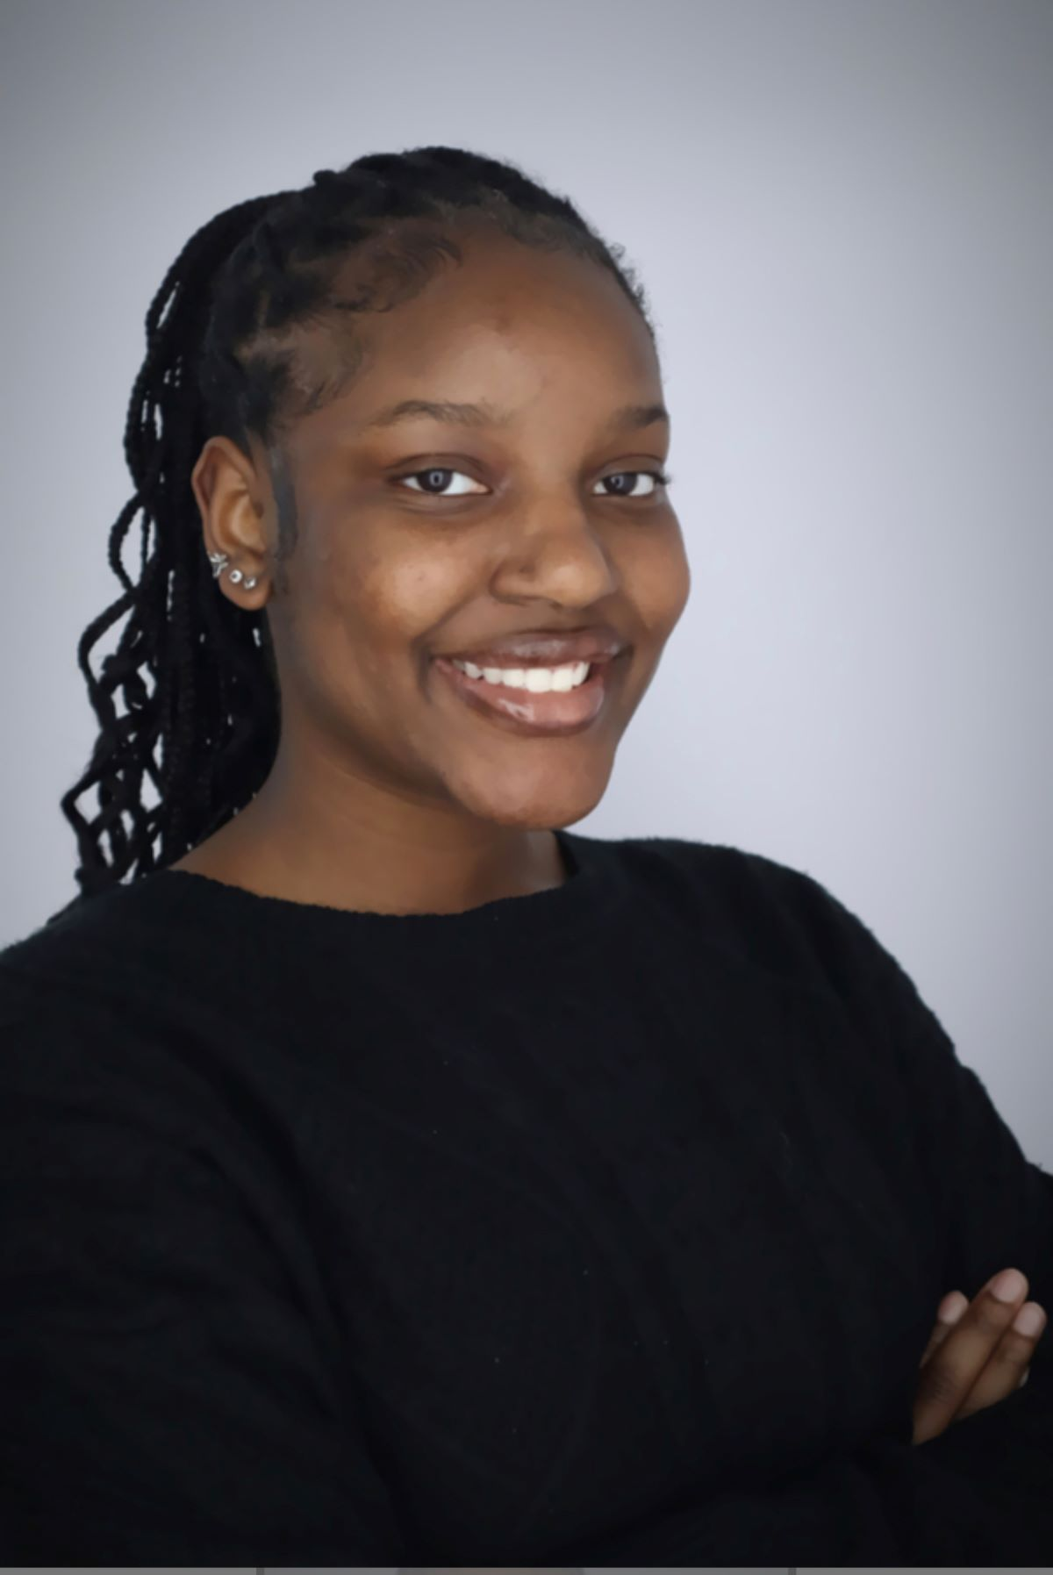
A Brief Overview About Me
My name is Ashlyn Campbell, and I am a Computer Science major at Georgia State University expecting to graduate in 2024. I have been with Georgia Community Action Association since May of this year as the Data Analytics Intern. As a Computer Science major, I study Computers all day, everyday in my discipline whether its programming, algorithms, development, or data science concepts.
A fun fact about Computers is that they are made from a Binary System. Which simply means they are made from 0’s and 1’s, Which brings me to…

Slide 3
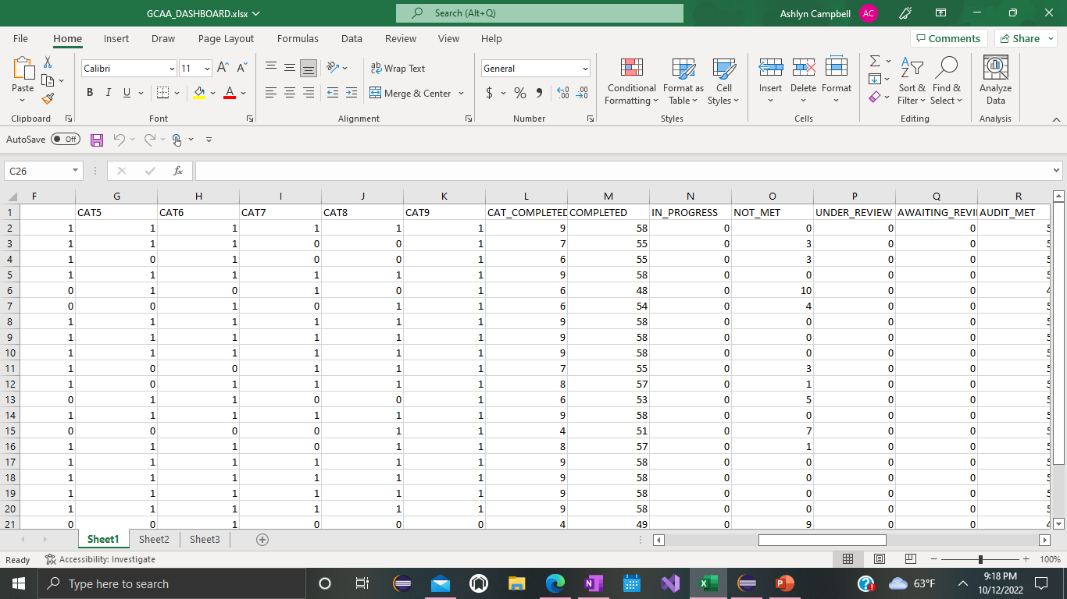

Slide 4

Agenda
Today we will evaluate the trends in unmet audits utilizing data visualization techniques with the programming language Python.

Slide 5


Community Action changes people's lives, embodies the spirit of hope, improves communities, and makes America a better place to live.
~ Combined Community Action Partnership

Slide 6
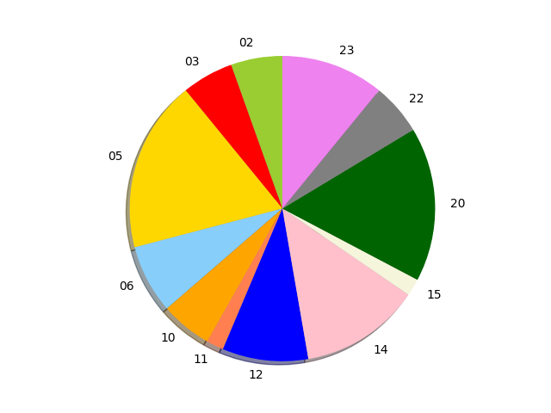
Trends in Unmet Audits
The highest number of audits not passed in this list is ten.
Twelve agencies out of 23 total have not met at least one audit.
What story do you perceive from this pie chart?
Notes:
Now let’s view the type of categories not being passed.

Slide 7
50% of Georgia Agencies did not
meet the conditions of at least one
audit.

Slide 8
What story can you tell from this bar graph?

Slide 9
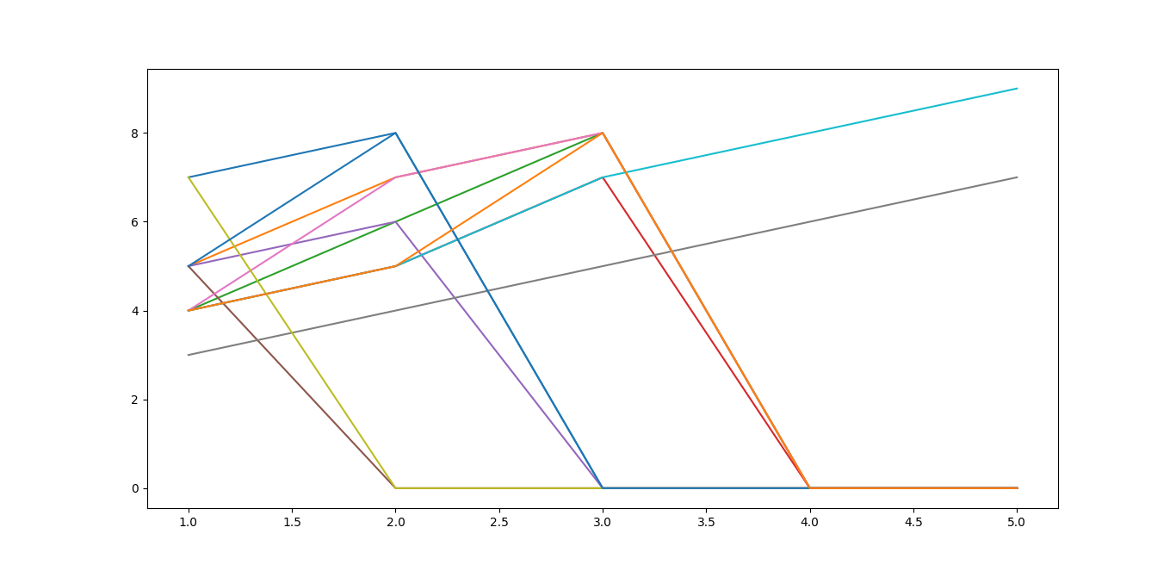
Now let’s view the intersections of missed categories.
Y- The category number
What story does this tell? What’s the story this makes you curious of?

Slide 10
Summary
Good data isn’t just about the amount that you collect or only the quality.
What your organization can learn and implement in practices, from data to continue improving and helping the community is what’s most important.

Slide 11

The way to get started is to quit talking and begin doing.
Walt Disney

Slide 12

Thank you
This Photo by Unknown Author is licensed under CC BY-NC
Ashlyn Campbell
acampbell@georgiacaa.net
https://www.linkedin.com/in/ashlyncampbell3/
DataVTechBootCamp/Audit_Data at main · ashlynthemitm/DataVTechBootCamp (github.com)

