Slide 1

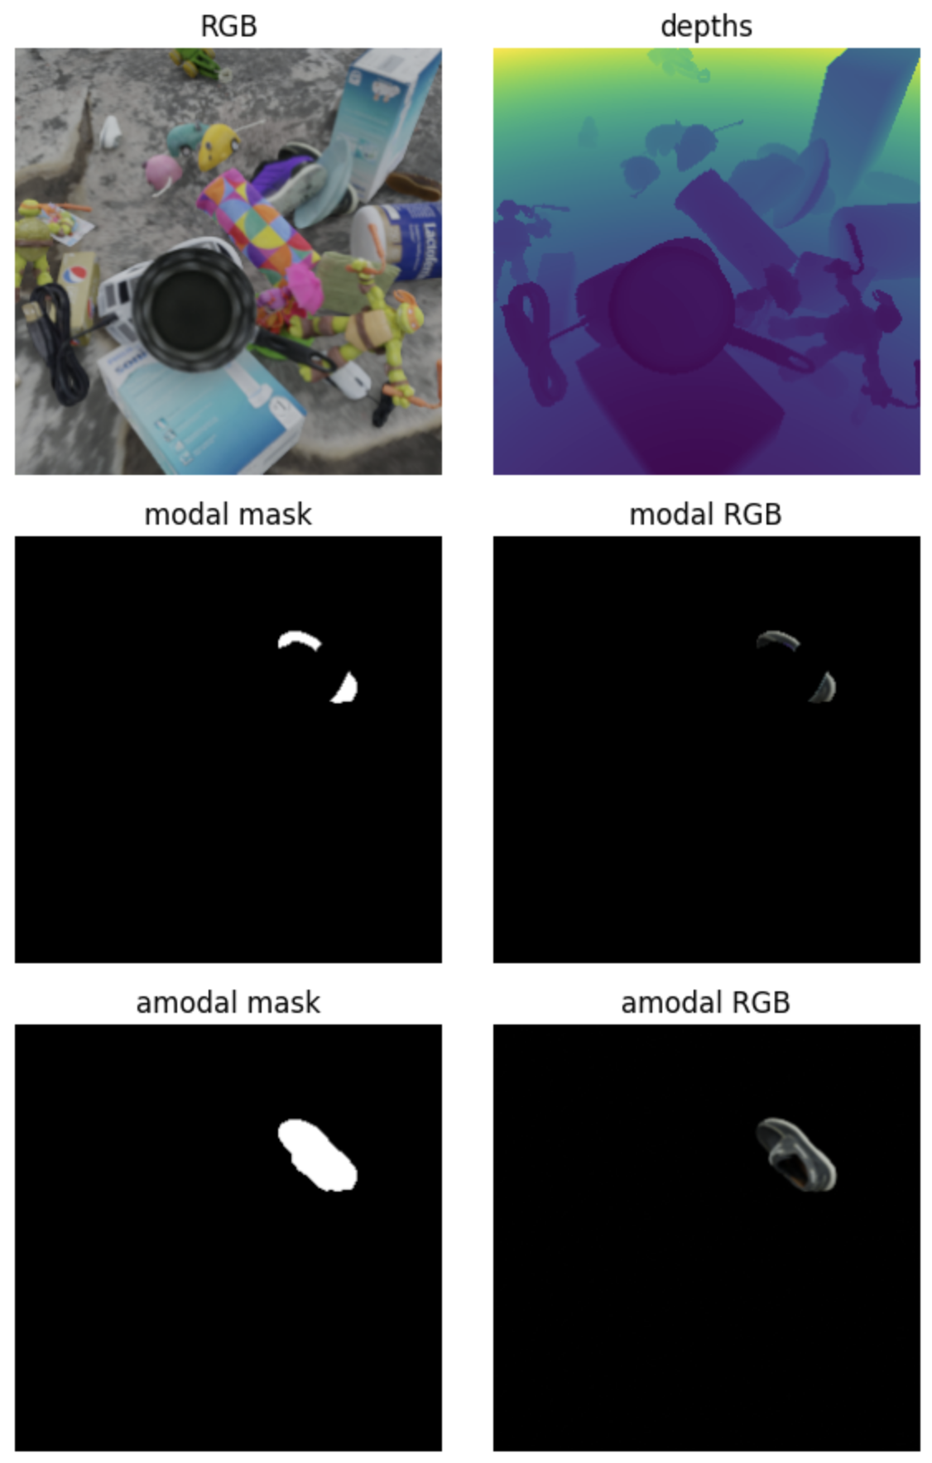
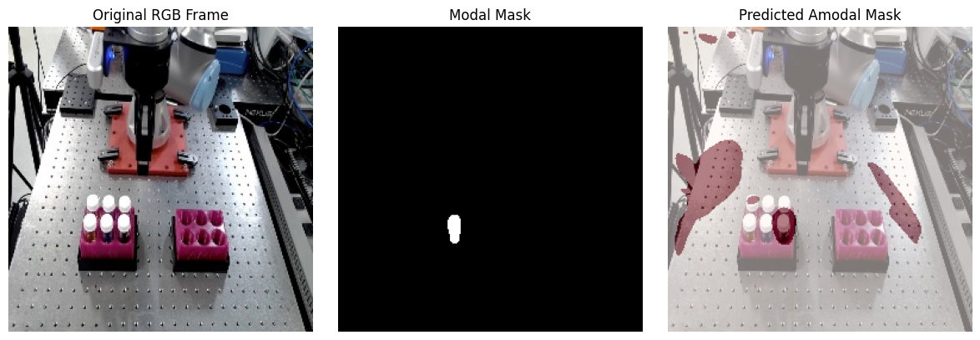
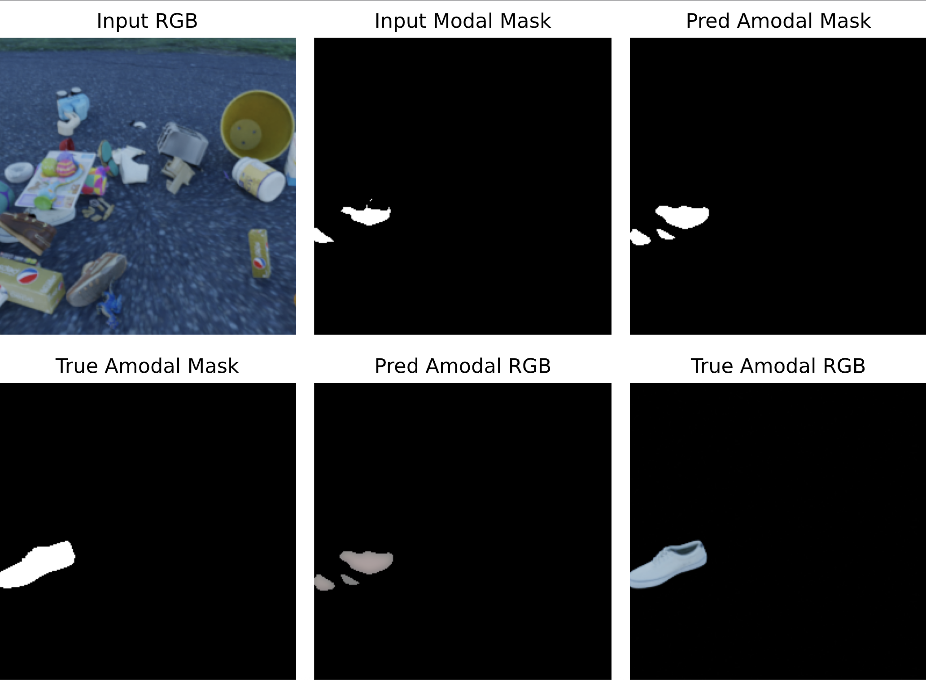
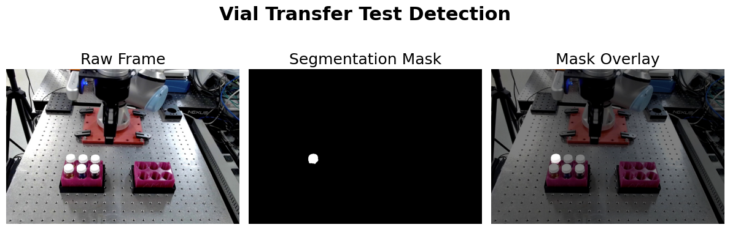

DSSI Challenge Problem: Computer Vision for Laboratory Automation
Savvas Marcou *, Ethan Pawl *, Forough Hammond *, Ashlyn Campbell *, Seoyeong Park *
* Equal Contribution
$$(c)$$
Motivation
Model Architecture
Video: 3D U-Net
Task 2: Video-Based Mask & Content
Annotated real-world data for occlusion-aware vision tasks in lab settings is infeasible (Moore et. al, 2025).
The Multiple Object Video with Multi-Cameras and Amodal Content, (MOVi-MC-AC) synthetic dataset (>200k images) can be leveraged to train computer vision models to perform lab-relevant tasks such as object reconstruction and tracking across views and time (Moore et. al, 2025).
Image: 2D U-Net
T
Single Image (features)
Single image (predictions)
H
H
W
Skip connections
W
Skip connections
U-Net encoding layers (x4)
U-Net decoding layers (x4)
U-Net encoding layers (x4)
U-Net decoding layers (x4)
3D Convolutions (H, W, Time)
Hidden features
Fig 1. A robotic arm precisely handling vials in a modern laboratory
2D Convolutions (spatial – H, W): Compress spatial dimensions, learns high-level features
Hidden features
Build target mask in spatial dimensions from latent space
Objectives
Video: 2D U-Net + ConvLSTM
Task 1: Given an image, predict an occluded object's amodal mask (1.1) and content (1.2) based on its modal RGB content and modal mask.
Task 2: Given a video, predict an occluded object's amodal mask (2.1) and content (2.2) based on its modal RGB content and modal mask.
Frame 1
Frame 2
Frame N
Frame 1
Frame 2
Frame N
Results
Fig 7. 3D U-Net Prediction of Amodal Mask and RGB
U-Net encode
U-Net encode
Model | Content | Intersection over Union (IoU) | Learned Perceptual Image Patch Similarity (LPIPS)
2D U-Net | Image | 0.43 | 0.13
3D U-Net | Video | 0.59 | 0.37
Data Preparation
Hidden 1
Hidden 2
Hidden N
Hidden 1
Hidden 2
Hidden N
Sample Filtering: We select only the best samples (only 5% of total), preferring the most relevant samples (partially occluded in-frame objects).
Stack hidden features
2-cell ConvLSTM
Learns temporal dependencies – has memory! (Shi et al., 2015)
Table 1. Model performance metrics 1) IoU, measures overlap between predicted versus actual masks 2) LPIPS, assesses perceptual similarity of RGB content
Fig 5. Model architectures used for Task 1 (top-left) and Task 2 (top-right and bottom).
Task 1: Image-Based Mask & Content
Fig 8. Unseen robotics RGB content with modal masks and predicted modal masks
Fig 3. Modal mask overlay of robotic arm vial transfer
Conclusion
Fig 2. The shoe object is partly visible trough occlusion but remains well hidden
Training the 2D U-Net with ConvLSTM was difficult, suggesting possible architectural complexity or inefficiency.
U-Net effectively reconstructs masks for visible objects.
RGB reconstruction is challenging in images but improves with video input.
Amodal mask prediction is more reliable with video, leveraging temporal information.
b)
References
Moore, A., Saini, A., Cancilla, K., Poland, D., & Carrano, C. (2025). Training for X-Ray Vision: Amodal segmentation, amodal content completion, and view-invariant object representation from multi-camera video. arXiv. https://arxiv.org/abs/2507.00339
Ronneberger, O., Fischer, P., & Brox, T. (2015, October). U-net: Convolutional networks for biomedical image segmentation. In International Conference on Medical image computing and computer-assisted intervention (pp. 234-241).
Shi, X., Chen, Z., Wang, H., Yeung, D. Y., Wong, W. K., & Woo, W. C. (2015). Convolutional LSTM network: A machine learning approach for precipitation nowcasting. Advances in neural information processing systems, 28
Fig 4. Vial transfer masks for amodal mask prediction
Fig 6. Performance of the 2D U-net model
This work performed under the auspices of the U.S. Department of Energy by Lawrence Livermore National Laboratory under Contract DE-AC52-07NA27344.
LLNL-PRES-2008913
Notes:
Acquiring large-scale annotated real-world datasets is often infeasible for traditional laboratory settings
Amodal Content (AC) (prediction of appearance of target objects through occlusions) and Multiple Camera (MC) settings (where objects can be identified and tracked between various unique camera perspectives) have not been released and are rare to include content labels making the Multiple Object Video with Multi-Cameras and Amodal Content (MOVi-MC-AC) dataset, one with ground truths for amodal content for model training on automated robotics tasks a great method to explore its generalizable skills
Training the 2D U-Net with ConvLSTM was extremely challenging. This raises questions about whether the architecture is too complex for our task or if redundant convolutions are causing inefficiency.

