Slide 1
RESTAURANT SETUP BUSINESS ANALYSIS
RESTOHUB
ASHLY SHAJAN
TCR19MCA010
MCA, Semester VI Department of Computer Application
Government Engineering College, Thrissur
Guided By, SOUMIA CHANDRAN M
RESTOHUB

Slide 2
INTRODUCTION
Restaurants have always played an essential role in the business, social, intellectual and artistic life of a thriving society.
Occupy an important place in shaping the overall economy.
With the advancement in technology, internet and social media are used as a powerful medium to run the restaurant business.
public opinion and expert reviews has taken over the internet for any business success or failure.
There are various restaurant review sites where customers can share their experiences about the food and the product quality.
These review sites have helped transform the business strategies in restaurant industry by modernizing facilities of the restaurant.
RESTOHUB

Slide 3
PROBLEM STATEMENT
When we start a new business we need to consider many parameters.
These parameters/features are important for the success of that business.
We need find features (such as location) of restaurant in which the customers are most interested in manually.
Also we need to identify strategies to increase the profit of business manually.
It is difficult to find these parameters. Also it is not easy to prioritize these features.
The problem of starting the restaurant business by strategizing the most suitable business location and providing most relevant facilities which would help to improve the customer dining experience and also increase the profit.
RESTOHUB

Slide 4
OBJECTIVES
To identify best location to setup a restaurant.
To identify the restaurant features from insights.
To view the restaurant features.
RESTOHUB

Slide 5
LITERATURE REVEIW
1 It is based on an IEEE paper “Restaurant Setup Analysis using Yelp dataset” – Sindhu Hedge,Supriya Satyappanavar, Shankar Setty- 2017 International Conference in Advances in Computing.
It describes three tasks based on dataset.
identify the features/attributes of restaurant in which customers are most interested in and provide facilities and services to increase profit.
Next identify best location that helps to make the business successful and based on nearby restaurants and their facilities.
Finally, identify most crowded days so that the best recipies and offers are made available on that days.
The performance analysis is carried out on the dataset.
This is my base paper.
RESTOHUB

Slide 6
LITERATURE REVEIW Cont.
2 Second paper is ”Predicting Restaurant Rating using Machine Learning and comparison of Regression Models” -Priya, J.-IEEE 2020 International Conference on Emerging Trends in Information Technology and Engineering.”
It describes the ML algorithms used to predict the ratings for the given review.
The review is taken from dataset.
It train the model to predict user’s ratings and can recommend the business that the user is more likely to rate higher than the others.
Based on the ratings best location, restaurant features and most crowded days are found.
RESTOHUB

Slide 7
PROPOSED SYSTEM
We propose a solution to the new entrants into the restaurant business with the help of deep analysis of data which helps in interpreting the requirements of the customers.
Helps to find best location based on dataset.
Helps to find insights like comfort zone,rating, avg. daily profit, risk, foody zone, crowded area,best dish etc... based on dataset.
RESTOHUB

Slide 8
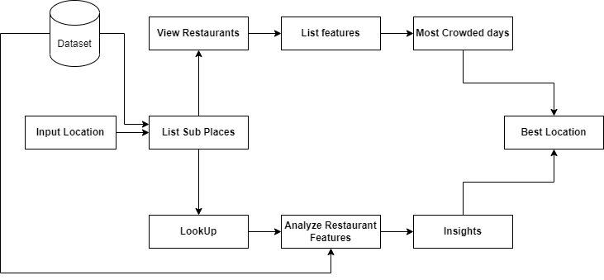
ARCHITECTURE
RESTOHUB

Slide 9
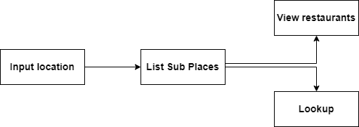
MODULES
Search
RESTOHUB

Slide 10

MODULES cont.
LookUp
RESTOHUB

Slide 11

MODULES cont.
Restaurant Features
RESTOHUB

Slide 12
REQUIREMENT ANALYSIS
Software requirements:
Operating System : Windows 7 or above
Front End : HTML,CSS, Javascript
Back End : Python
IDE : Visual Studio Code
Framework : Django
Hardware requirements:
Processor : Intel Core i3 or above
Hard Disk Space : 320 GB
Memory : 4 GB RAM or above
RESTOHUB

Slide 13
SYSTEM IMPLEMENTATION
UI begin with search bar which help user to search for location to setup restaurant based on their preference.
User can enter the sub district in the search bar and press search button.
It redirect to an html page which display sub places under searched sub district.
Sub places are rated based on the restaurants features.
User can select the location to start restaurant based on mean rating as well as the location features displayed along with the sub places.
RESTOHUB

Slide 14
SYSTEM IMPLEMENTATION
Cont.
Next user can click on two buttons ”View restaurant” and ”resto Lookup”.
View restaurant just display the restaurants and its features from the dataset based on the sub place.
Lookup displays the insights.
Insights helps the user who selected a location to identify the features of the restaurant that help to make it profitable and success.
RESTOHUB

Slide 15
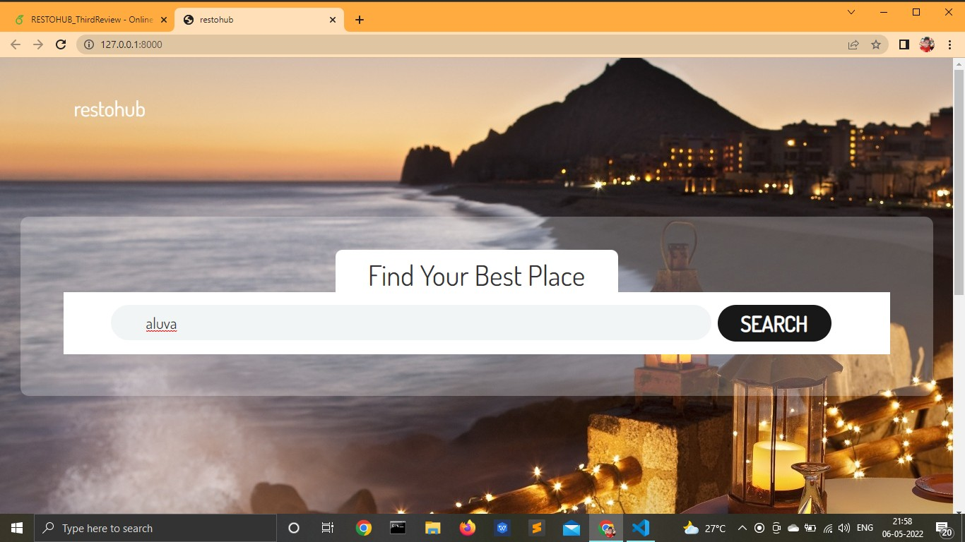
RESULT
HOME PAGE
RESTOHUB

Slide 16
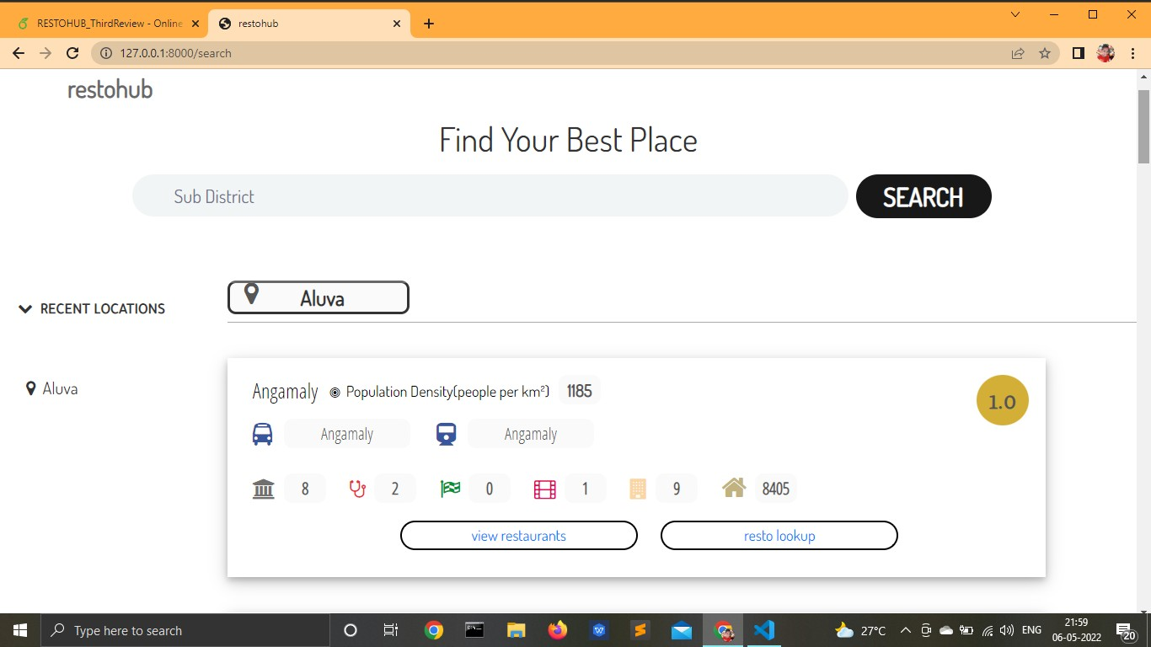
RESULT
SEARCH RESULT PAGE
RESTOHUB

Slide 17
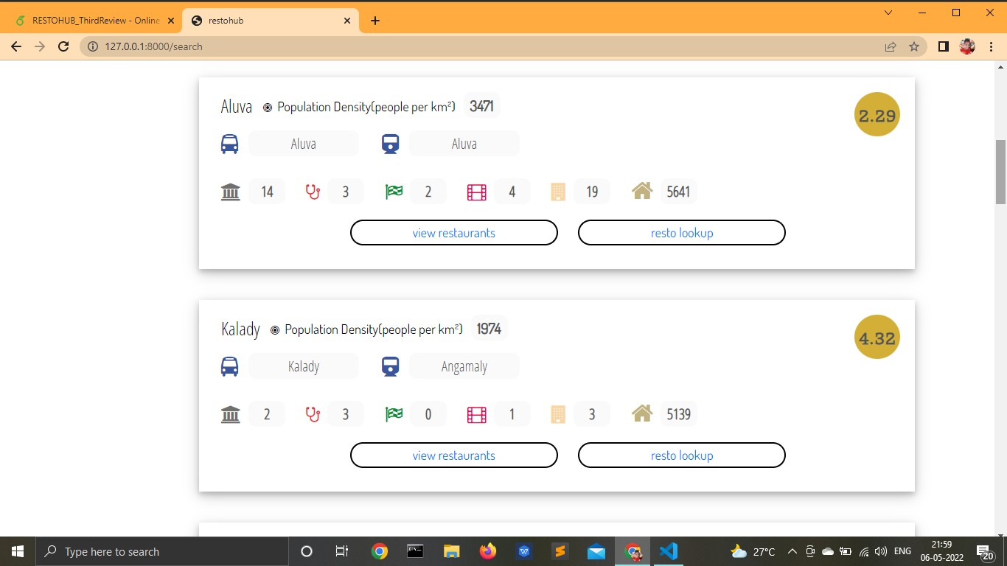
RESULT
RESTOHUB

Slide 18
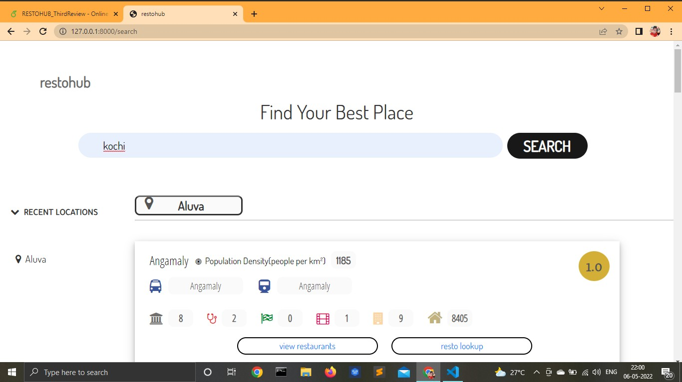
RESULT
RESTOHUB

Slide 19

RESULT
RESTOHUB

Slide 20
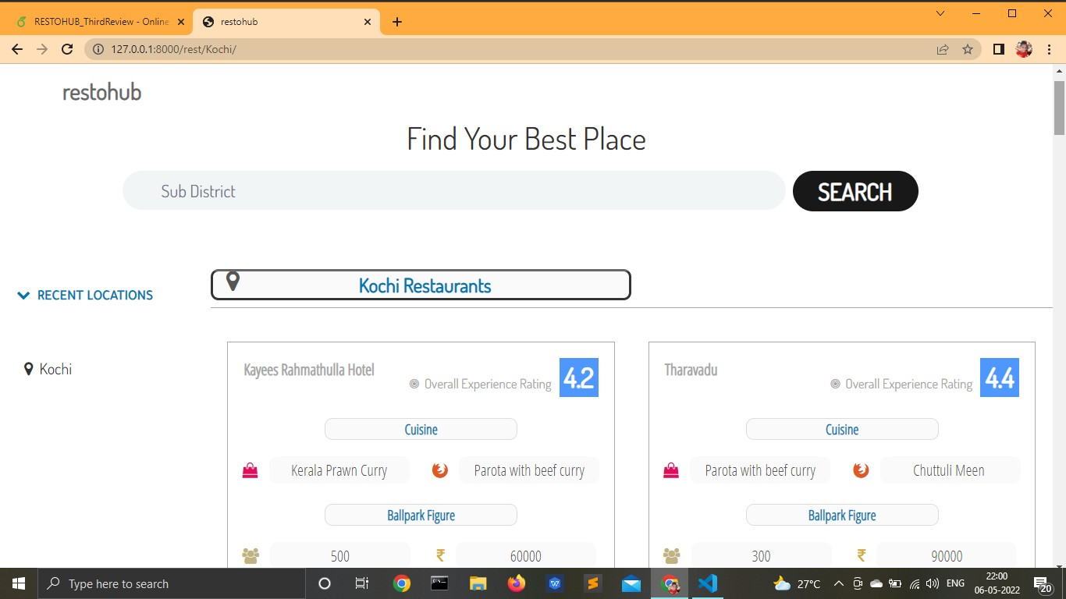
RESULT
VIEW RESTAURANTS
RESTOHUB

Slide 21
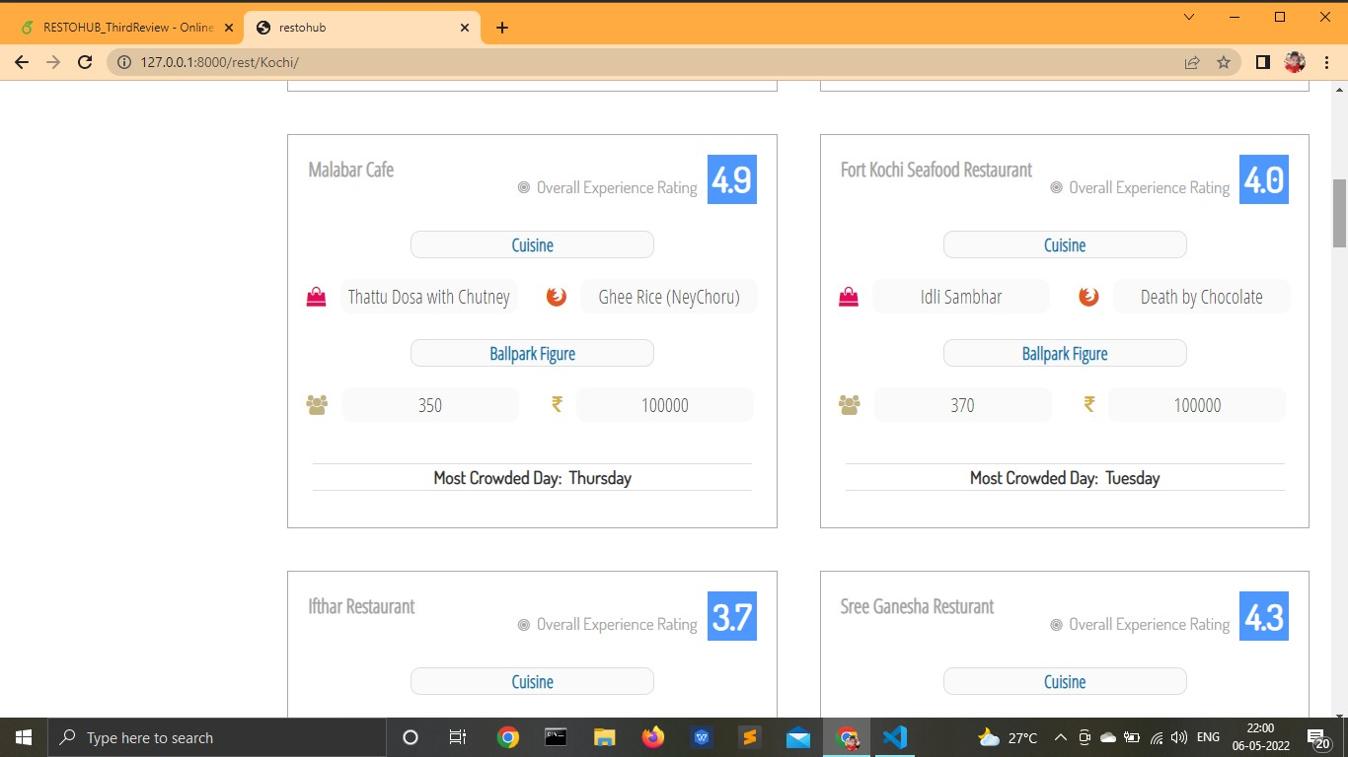
RESULT
RESTOHUB

Slide 22
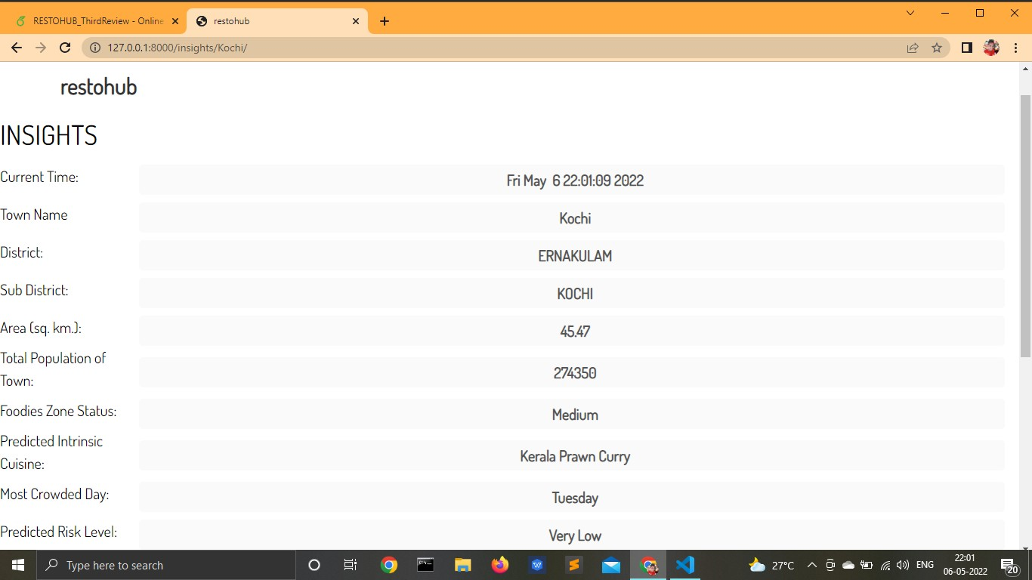
RESULT
RESTO LOOKUP
RESTOHUB

Slide 23
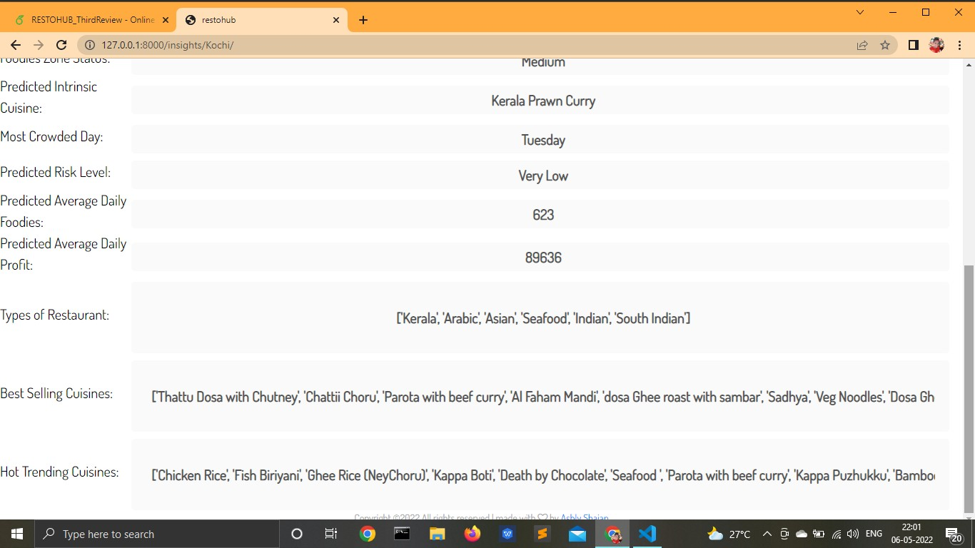
RESULT
RESTOHUB

Slide 24
FUTURE SCOPE
More analysis can be done to find best location.
More features can be used to find location and insights.
Can be implemented everywhere.
Use longitude and latitude of location to view restaurants.
RESTOHUB

Slide 25
CONCLUSION
We have addressed the problem of settingup a restaurant business by proposing a restaurant business framework.
This framework can be effectively used to boost the performance of the restaurant which leads into maximizing the profit and business.
It helps to identify the location to start business according to user,s preference.
RESTOHUB

Slide 26
REFERENCES
“Restaurant Setup Analysis using Yelp dataset” – Sindhu Hedge,Supriya Satyappanavar, Shankar Setty- 2017 International Conference in Advances in Computing.
”Predicting Restaurant Rating using Machine Learning and comparison of Regression Models” -Priya, J.-IEEE 2020 International Conference on Emerging Trends in Information Technology and Engineering.
“Restaurant Review Star Prediction for Yelp Dataset 2019”- Mengqi Yu, Meng Xue, Wenjia Ouyang.
RESTOHUB

Slide 27

RESTOHUB

