Slide 1
RESTOHUB
RESTAURANT SETUP ANALYSIS
PRESENTED BY
ASHLY SHAJAN
S6 MCA
REG. NO. TCR19MCA010
GUIDED BY
SOUMIA CHANDRAN M

Slide 2
INTRODUCTION
Restaurants have always played an essential role in the business, social, intellectual and artistic life of a thriving society.
Occupy an important place in shaping the overall economy.
With the advancement in technology, internet and social media are used as a powerful medium to run the restaurant business.
Today, public opinion and expert reviews has taken over the internet for any business success or failure.
There are various restaurant review sites where customers can share their experiences about the food and the product quality.
These review sites have helped transform the business strategies in restaurant industry by modernizing facilities like ambience, Wi-Fi, credit card, delivery and the most important, the location of the restaurant.

Slide 3
PROBLEM STATEMENT
When we start a new business we need to consider many parameters.
These parameters/features are important for the success of that business.
It is difficult to find these parameters. Also it is not easy to prioritize these features.
The problem of starting the restaurant business by strategizing the most suitable business location and providing most relevant facilities which would help to improve the customer dining experience and also increase the profit.

Slide 4
EXISTING SYSTEM
We need find features (such as location) of restaurant in which the customers are most interested in manually.
Also we need to identify strategies to increase the profit of business manually.
It is difficult to do these things manually especially to find best location.

Slide 5
PROPOSED SYSYTEM
We propose a solution to the new entrants into the restaurant business with the help of deep analysis of data which helps in interpreting the requirements of the customers.
It finds the features of restaurant.
Helps to find best location.
Display nearby restaurant in google map.
It uses dataset for taking reviews and corresponding data.

Slide 6
LITERATURE REVEIW
[1]It is based on an IEEE paper “Restaurant Setup Analysis using Yelp dataset” – Sindhu Hedge,Supriya Satyappanavar, Shankar Setty- 2017 International Conference in Advances in Computing.
It describes three tasks based on dataset.
First identify the features/attributes of restaurant in which customers are most interested in and provide facilities and services to increase profit.
Next identify best location that helps to make the business successful and based on nearby restaurants and their facilities.
Finally, identify most crowded days so that the best recipies and offers are made available on that days.
The performance analysis is carried out on the dataset.
This is my base paper.

Slide 7
LITERATURE REVIEW cont.
[2]Second paper is “Restaurant Review Star Prediction for Yelp Dataset”- Mengqi Yu, Meng Xue, Wenjia Ouyang
It describes the ML algorithms used to predict the ratings for the given review.
The review is taken from dataset.
It train the model to predict user’s ratings and can recommend the business that the user is more likely to rate higher than the others.
Based on the ratings best location, restaurant features and most crowded days are found.

Slide 8
REQUIREMENT ANALYSIS
Software requirements:
Operating System : Windows 7 or above
Front End : HTML,CSS, Javascript
Back End : Python
IDE : Visual Studio Code
Framework : Django
Hardware requirements:
Processor : Intel Core i3 or above
Hard Disk Space : 320 GB
Memory : 4 GB RAM or above

Slide 9
REQUIREMENT ANALYSIS
Functional requirements:
Search Location
View sub places
View location rankings
View Nearby restaurants
List Restaurant feature
Get most crowded days
Non functional requirements:
Proper Internet Connection
RAM less than 4 GB may cause poor performance
For running application Django need to be installed
Python should be pre installed

Slide 10
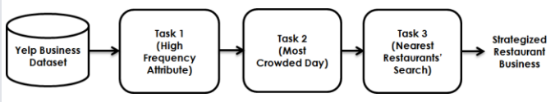
TASKS
Task 1: We identify those attributes of a restaurant in which a customer is most interested in.
Task 2: We identify the day of the week when the restaurants are heavily crowded.
Task 3: We find the nearest restaurants, for a given location (latitude, longitude).

Slide 11
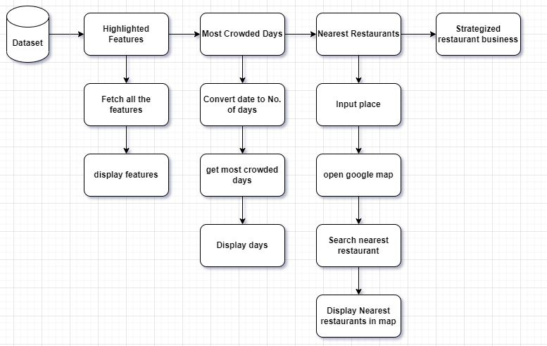
SYSTEM ARCHITECTURE

Slide 12
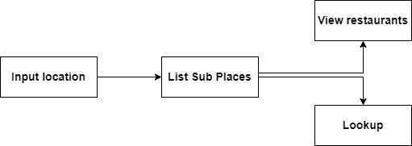
MODULES
Search:

Slide 13

MODULES cont.
View restaurants:

Slide 14

MODULES cont.
LookUp:
Insights:
Comfort zone
Risk level
Foody zone
Best dish
avg daily income
etc…
Algorithms:
Linear regression
Random forest Algorithm
Latent Factor Model
Sentiment Analysis

Slide 15
PROJECT PLAN
Project guide allocation
Feb 1
Topic Submission
Feb 14
First Review
Mar 7
(today)
Zeroth Review
Feb 17
Final Review
May 12
2022
FEBRUARY
MARCH
APRIL
MAY
2022
Topic Discussion
Feb 7 – Feb 14
Project Study
Feb 14 – Feb 20
Requirement Gathering
Feb 20 – Feb 25
Design
Feb 26 – Mar 4
Coding
Mar 5 –Apr 15
Testing
Apr 16 – Apr 24
Implementation
Apr 26 – May 3

Slide 16
EVALUATION MEASURES
Accuracy: Percentage of correct predictions for test data.
Accuracy = No. of correct predictions
Total no.of predictions
Precision: Fraction of relevant examples among all of the examples which were predicted to belong in a certain class.
Recall: Fraction of examples which were predicted to belong to a class with respect to all the examples that truly belong in the class.
Mean squared error : difference between actual and estimated values.

Slide 17
THANK YOU

