Slide 1

Film Find
Magdalena, Ayshah & Antonino

Slide 2
The Concept
Ayshah
We wanted to create an application where users could browse for a movie and find where to watch it and some information on it.
We decided to begin by searching for APIs which related to our project goal and were free to use.
The finished product consists of a search bar which the user inputs a movie title into, this then uses the OMDB API to fetch the movie from the database, if the movie isn’t found an error message is displayed to let the user know we don’t have that movie and to instead search for another. The 2nd API we used is from YouTube, this API grabs the video id of the first result of searched videos. The last API used if the getWikiArticles API, it gets the article info from Wikipedia articles and appends it to page as links for the user to explore.

Slide 3
Motivation
Magdalena
User story:
AS AN avid film watcher, I WANT to be informed on the real-world historical context of the film, SO THAT I can be aware of world events at the time the movie was made.
This can help a viewer to better understand thematic elements of a film
We pushed ourselves to try use 3 APIs so that we were able to bring together information from different websites and host it on to one

Slide 4
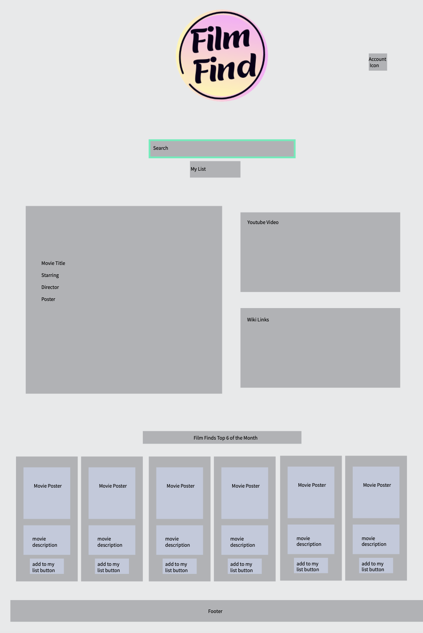
The process
Antonino
Initially, the plan was to create an application like Sky-Scanner, but it proved to be very difficult since there were no free APIs, or they required a company URL which we couldn’t provide.
As a team, we brainstormed other ideas but having learnt from our last idea, we decided to work somewhat backwards- rather than beginning with the idea, we began a search on public APIs and then thought about how we could use them.
Once we thought of our concept, we created a user story and began working on our wireframe. We used Pen Pot, (https://design.penpot.app/) to create a wireframe so that we had an idea of what our final product would look like and then got to work

Slide 5
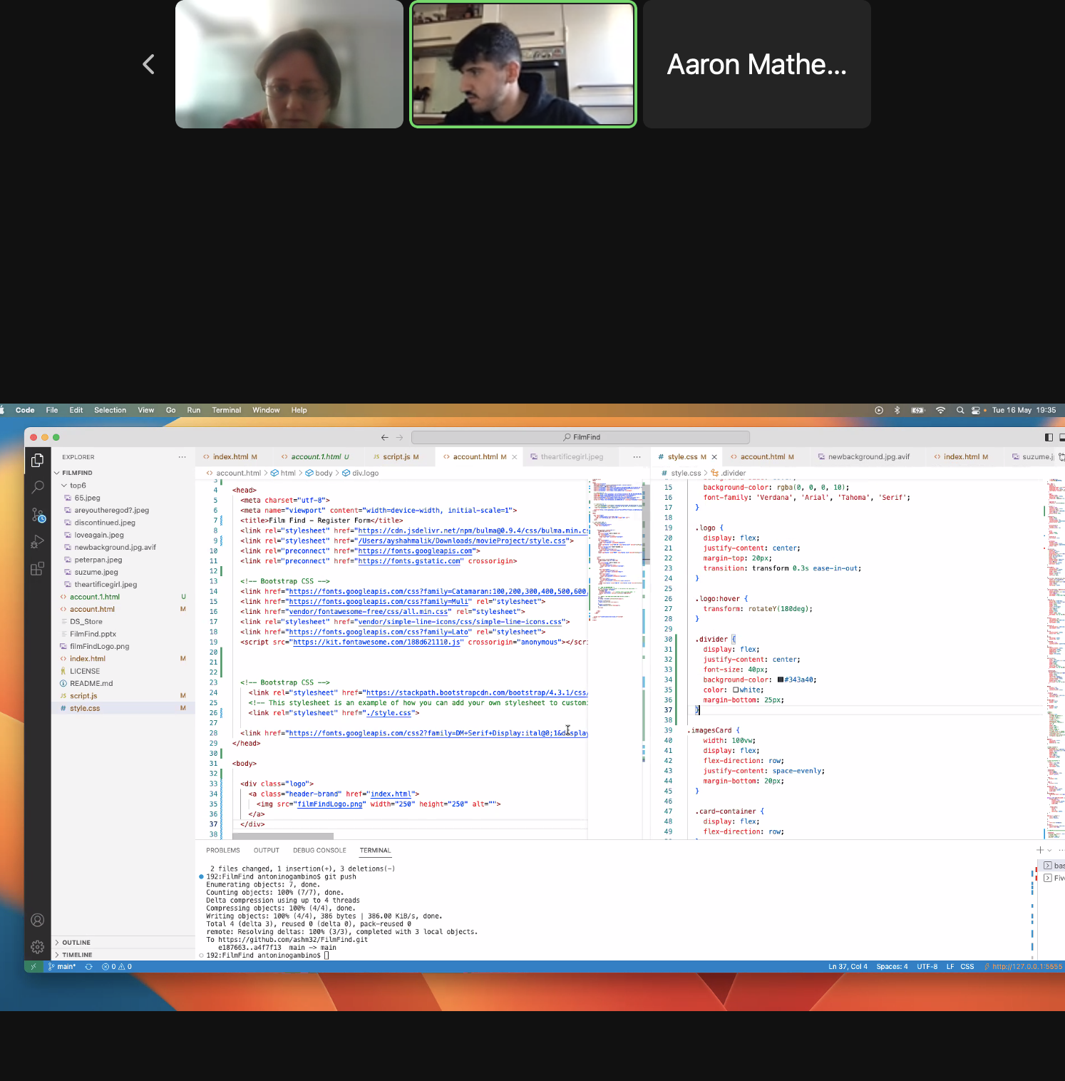
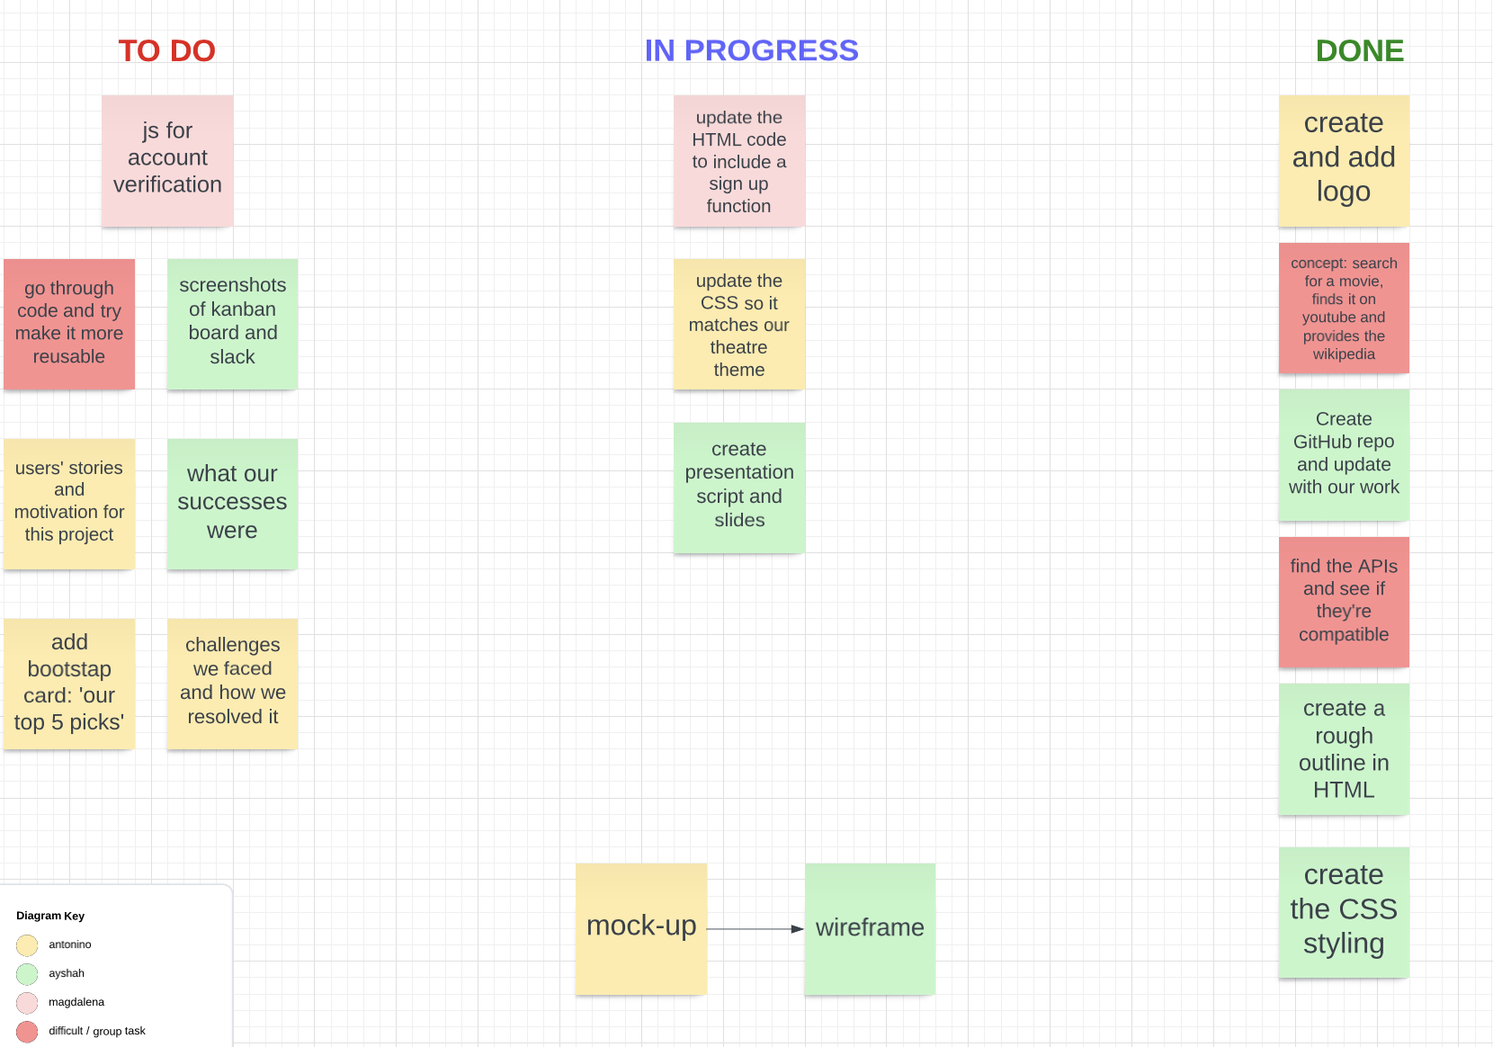
Assigning Roles & Communication
Ayshah
We began by creating a slack channel as our main means of communication. From there we agreed on times which would work best for us. We decided to use class time to work on group elements of the project and dedicate extra hours out of class/ weekends to work on our delegated roles independently.
To keep track of our progress and our tasks we created a Kanban board. Everyone was assigned a colour and all tasks to be completed were added to the ‘To do’ section.
From there we agreed on who would do what and changed the colour of the cards to reflect this. Each team member took responsibly to update the Kanban board with their progress. Each team meeting ended in a progress update of what has been done and what we will be doing in the next session.

Slide 6
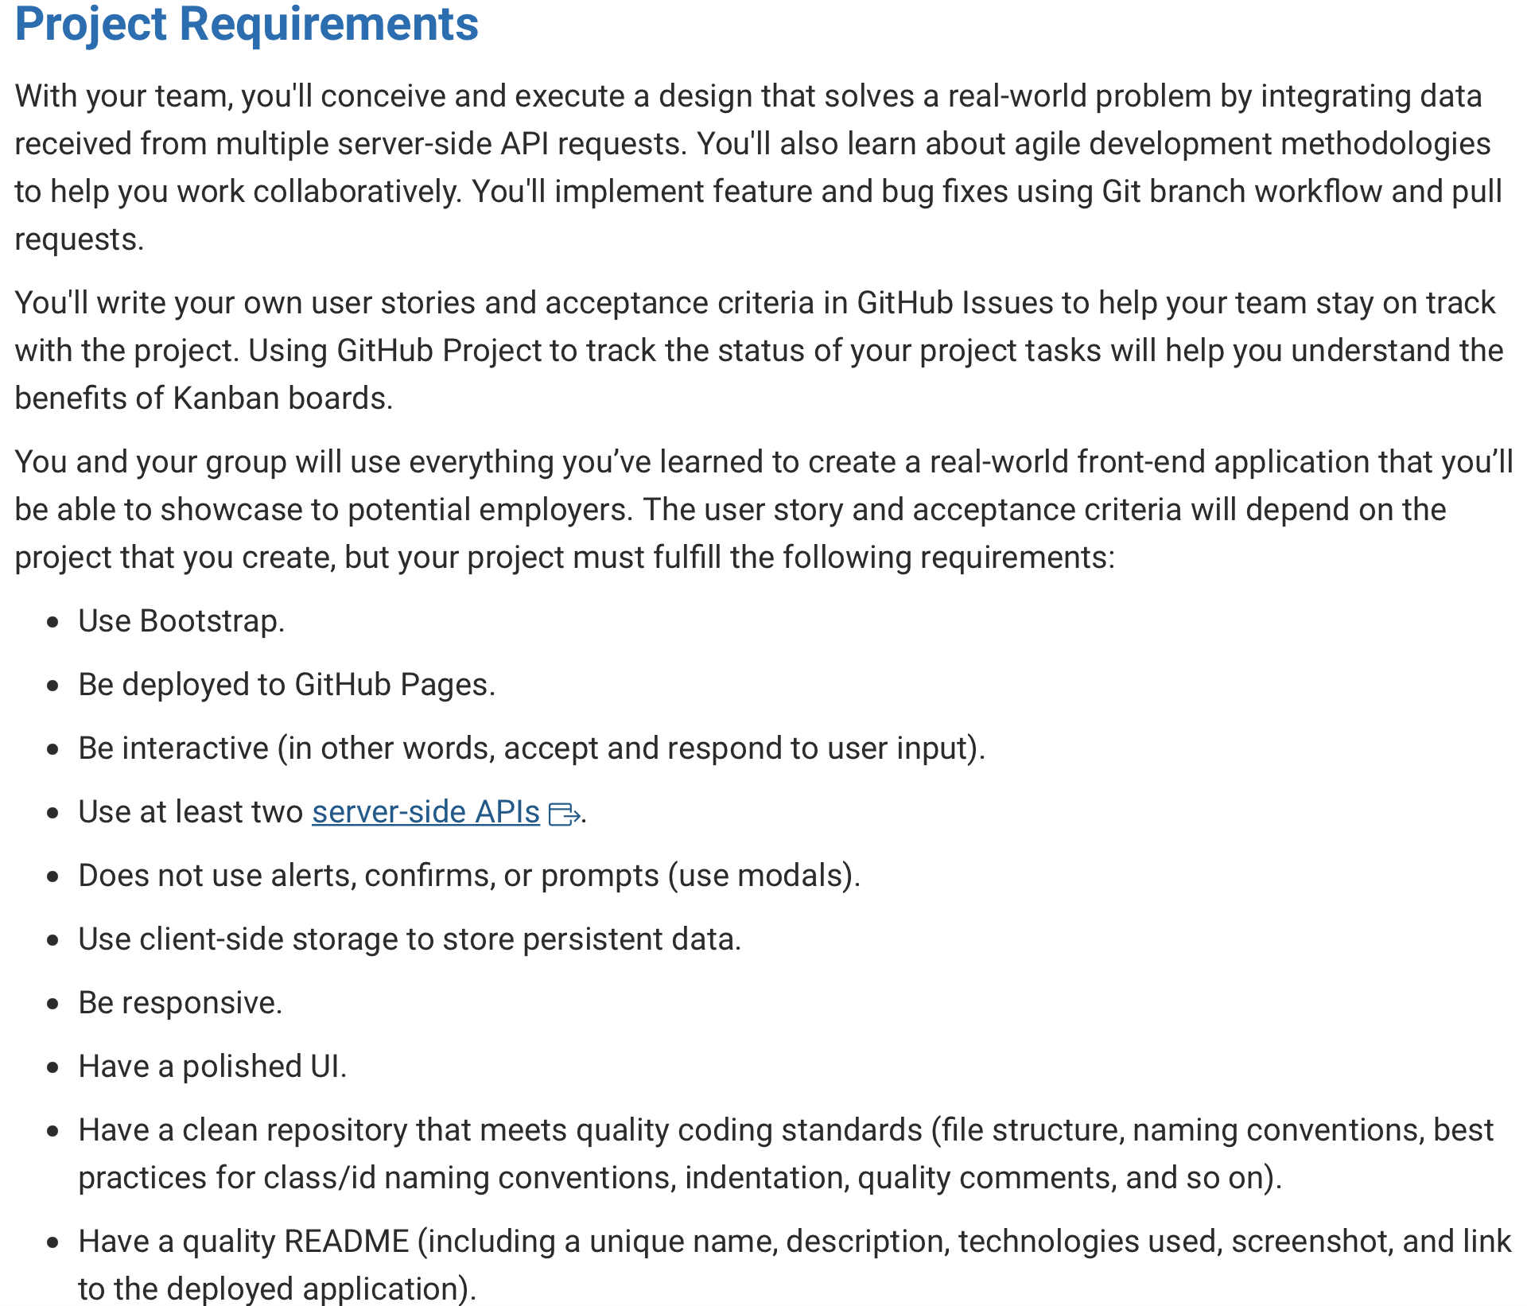
Antonino
We followed the project requirements when designing the application
The technologies we used:
HMTL
CSS
JavaScript
APIs
Modals
Client-side storage

Slide 7
Magdalena & Ayshah
What we struggled with
Finding free APIs and implementing them in our code- we had to watch a lot of YouTube videos and there was a lot of trial and error
Thinking of a way to use server-side storage but we resolved this by looking at existing apps which provide a similar service to ours (Netflix, prime)
Account validation so the user can only add a movie to their list if they’re logged in. To solve this, we looked at previous homework submissions (like the password generator) but haven’t gotten the chance to implement this
Our Successes
Used Bootstrap, HTML, CSS, APIs and JavaScript to create an interactive and responsive website which has a polished UI
Deployed our website onto GitHub into clean repository that meets quality coding standards
Worked together as a team and produced work which everyone equally contributed to
Used an agile approach by using tools like Kanban and iterations
The application works as we intended

Slide 8
Demo
Antonino
GitHub Repo
Live Deployed URL
Kanban Board

Slide 9
Future Maintenance
Ayshah
Top 6 movie recommendations:
Needs to be manually changed according to the teams' monthly recommendations
User accounts (replicas / old users):
The application currently doesn’t check what the user is inputting / if anything is being inputted at all, because of this users can add to my list without logging in
Movie doesn’t reload from ‘My List’
Once a movie has been added to My List, when a user clicks the link, it should load the movie details

