Slide 1
Ayshah Malik
CS3ECS Uploads

Slide 2
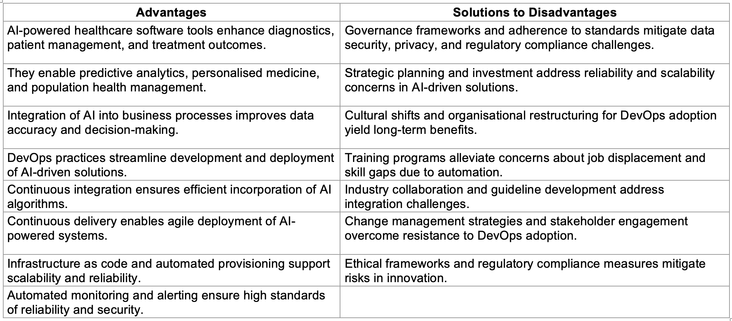
Table 2: INTEGRATION OF AI AND DEVOPS IN HEALTHCARE

Slide 3
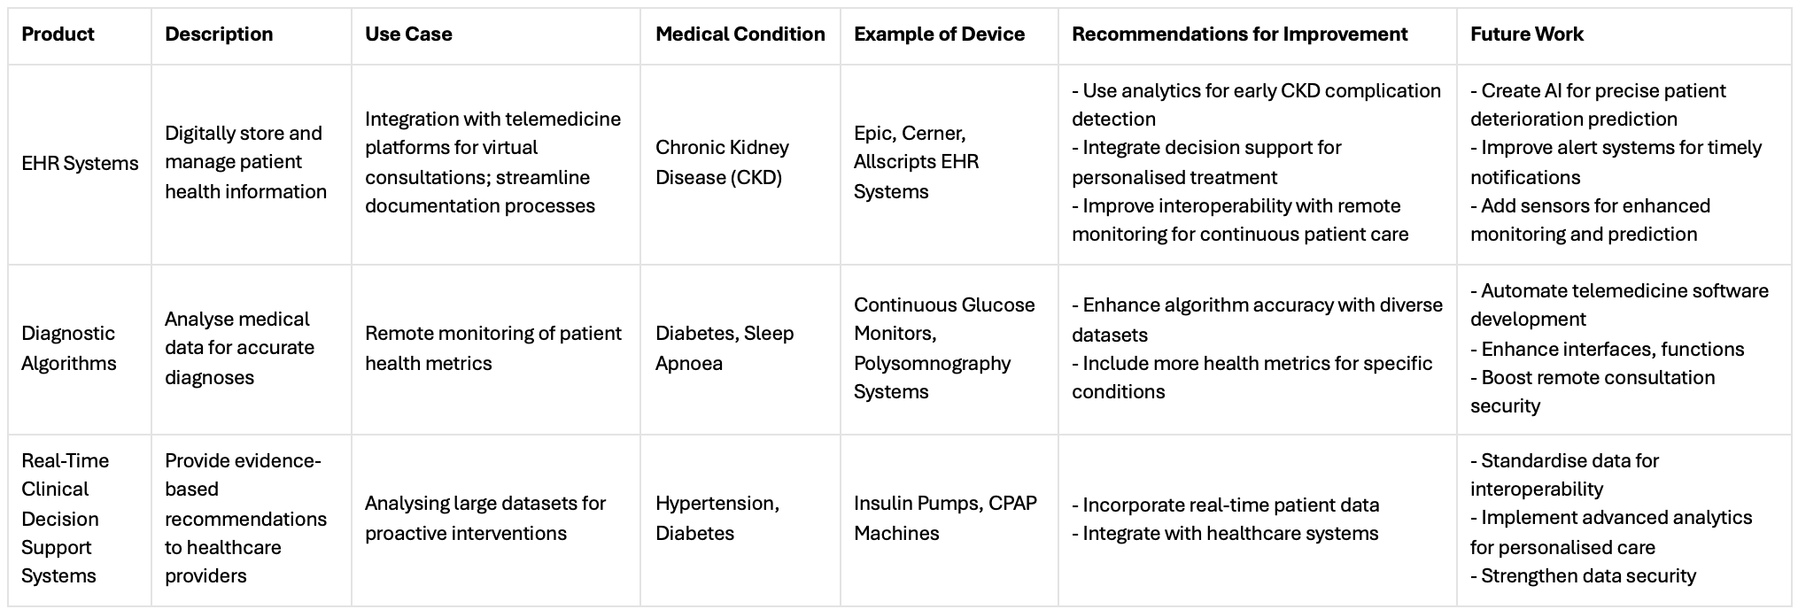
Table 4: AI POWERED HEALTHCARE RECOMMENDATIONS AND FUTURE WORK

Slide 4
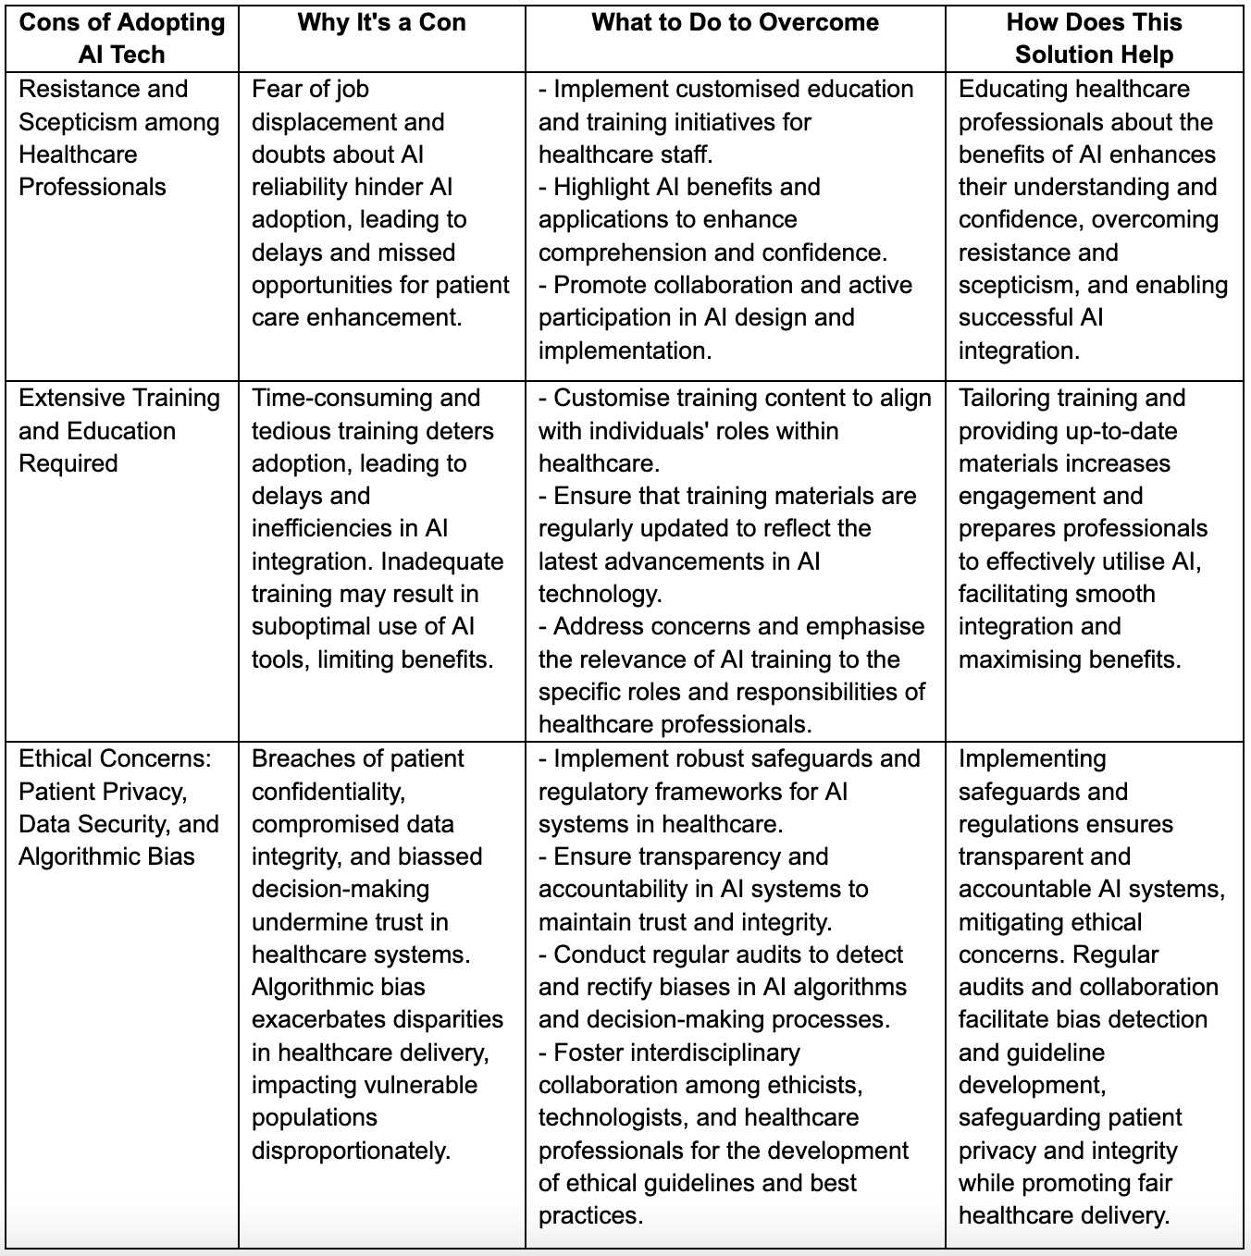
Table 5: ADDRESSING AI CONS

Slide 5
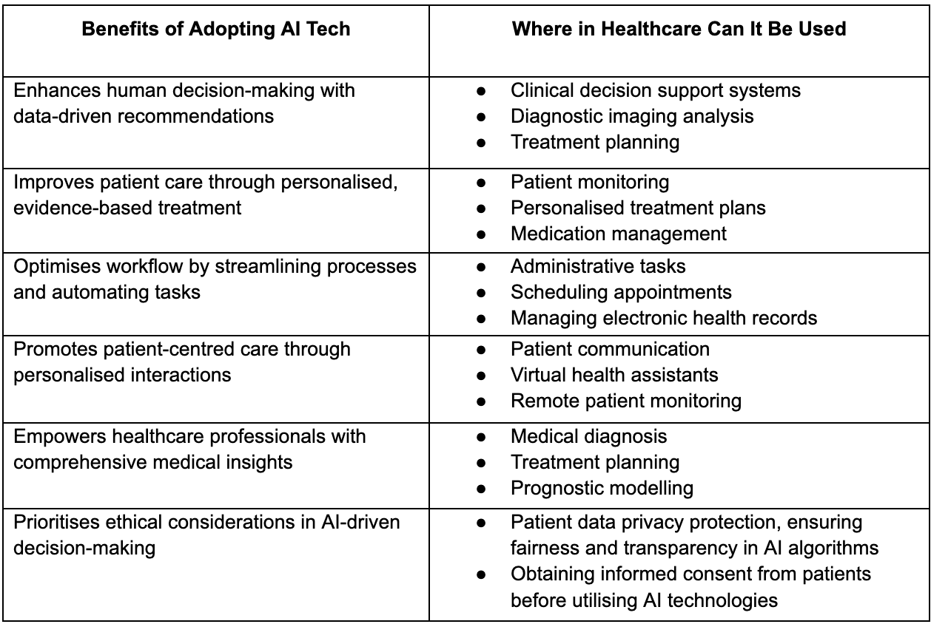
Table 6: BENEFITS OF AI

Slide 6
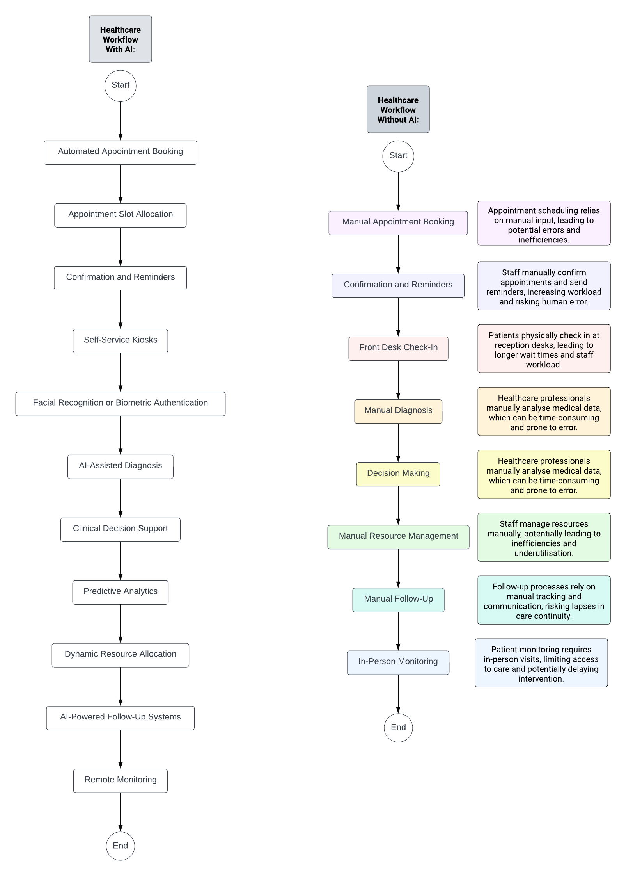
FIG1 HEALTHCARE WORKFLOW WITH(OUT) AI

Slide 7
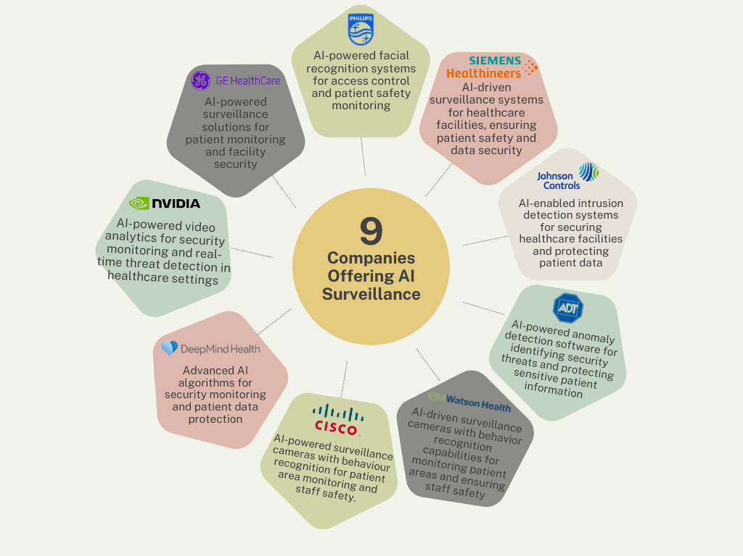
FIG5. 9 AI SURVEILLANCE COMPANIES AND THEIR BENEFITS

Slide 8
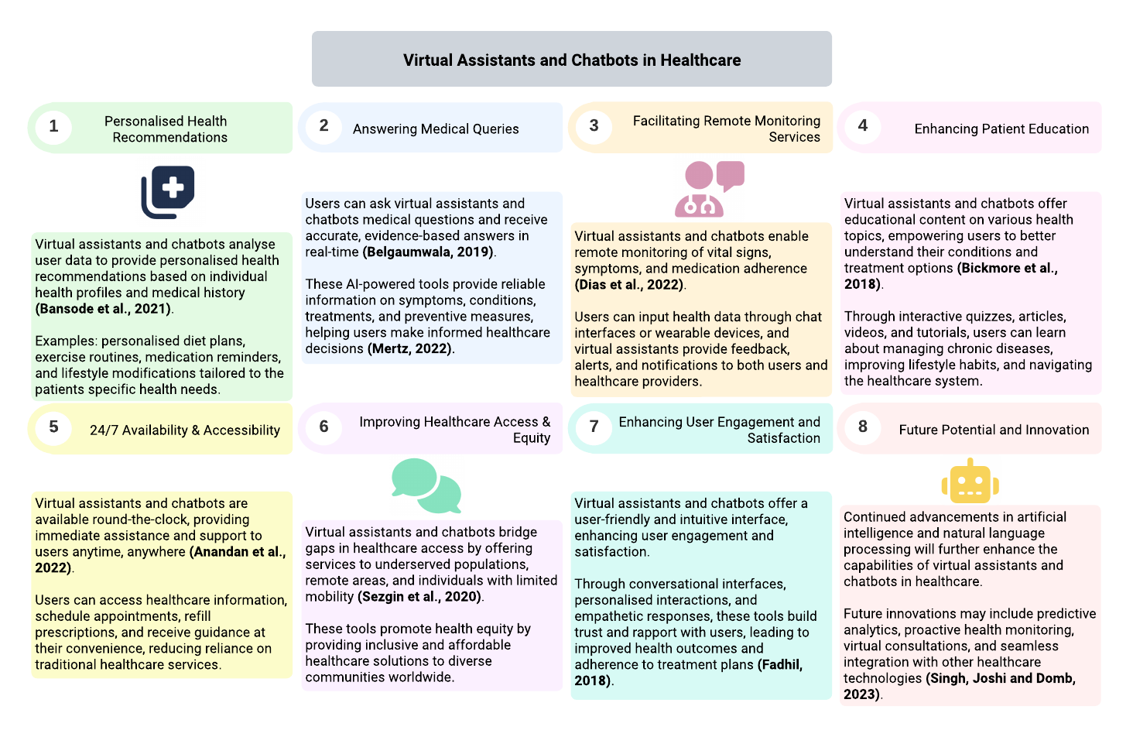
FIG7 VIRTUAL ASSISTANTS AND CHATBOTS IN HEALTHCARE

Slide 9
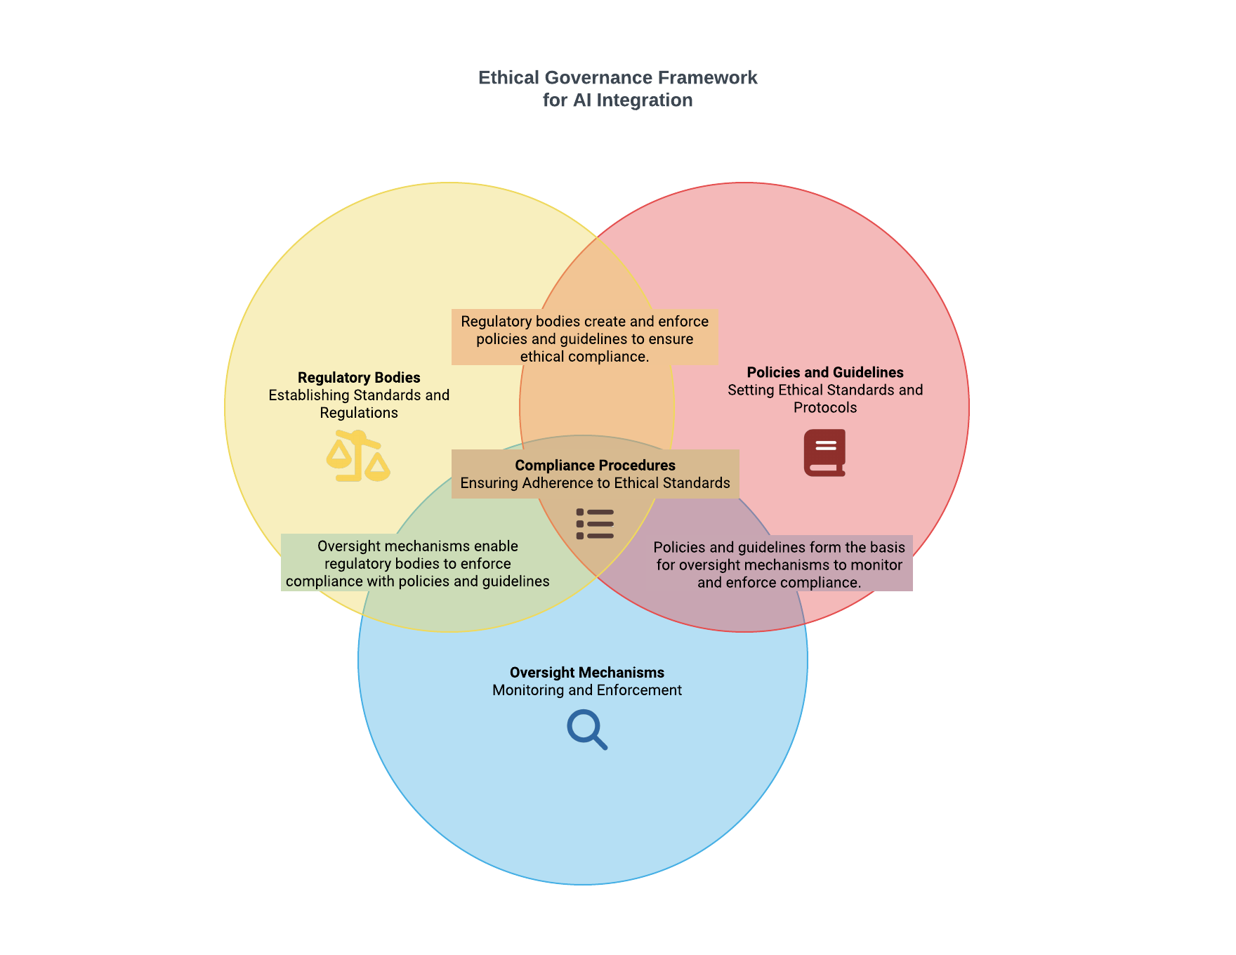
FIG9 ETHICAL GOVERNANCE FRAMEWORK FOR AI INTEGRATION

