Slide 1
MLB All-Stars: A GROUNDOUT for Game Attendance
By: Ashley Marietta
Notes:
- Good morning! My presentation looks to confront whether superstar players increase Major League Baseball game-level attendance beyond what can be explained by team performance and market size.
- As you can see from the title, I label their impact a groundout – not a strikeout and not a grand slam - given the results of the various models I ran.

Slide 2

Table of contents
Introduction
Methodology
01
02
Discussion
Conclusion
03
04
https://x.com/shoheisaveus/status/1640280171566764034
Problem motivation
Input for analysis
Overview of results
Future direction
Notes:
- In this presentation, I will explain why all-stars seem to impact the MLB more now, how I went about evaluating their influence, and end with some suggestions for teams going forward.

Slide 3
01
Introduction

Slide 4
Baseball’s Business Background
Revenue vs. Win Maximization
Uneven Revenue Distribution
All-Star Prevalence
Notes:
Professional sports teams have two goals in business: to make money and to win championships. While these two may seem to be antithetical, a recent Major League Baseball (MLB) trend of increasing top-end salaries for MLB stars may disprove the idea that revenue and win maximization are separate entities.
In baseball, fewer competitive balance checks exist than in other leagues, such as salary caps. Thus, there exists the problem of a larger disparity between small-market and large-market teams manifests itself, with clubs like the Yankees and Dodgers owning an uneven proportion of market share.
With higher payrolls, these teams can afford expensive names like Aaron Judge and Shohei Ohtani and also see higher fan turnout. Thus, I set out to find if these phenomena are correlated.

Slide 5
02
Methodology

Slide 6
Data Overview
Game Attendance
Payroll
Population
Win Percentage
Stars per Team
Dependent variable
Notes:
The variables of payroll, city population, win percentage, and stars per team were chosen for their implied impact on driving fans to the ballpark.
Here, the number of all-star players was defined as having a WAR, or Wins Above Replacement level, greater than or equal to five.
Large-market teams that can afford higher-salaried players and more marketing campaigns were predicted to have higher attendance. Additionally, teams that win more were forecasted to draw more fans to games. Cities with greater populations were generally anticipated to bring in more supporters.
Finally, the variable I cared about, when a team had more all-star players, was predicted to have a higher game-level attendance because athlete popularity, especially driven by social media advertising, could influence even non-avid baseball followers to head to the ballpark.

Slide 7
03
Discussion
Notes:
- Several models were run, including linear regression, LASSO, decision tree, hierarchical clustering, and XGBoost with SHAP values models.

Slide 8
Linear regression and lasso MODEL
Payroll
Win Percentage
Population
Stars per team
Notes:
The linear regression found that payroll and win percentage were the only statistically significant variables at the 95% confidence interval, holding other variables constant.
Once again, in the LASSO model, payroll showed the largest impact, followed by win percentage, population, and stars per team.

Slide 9
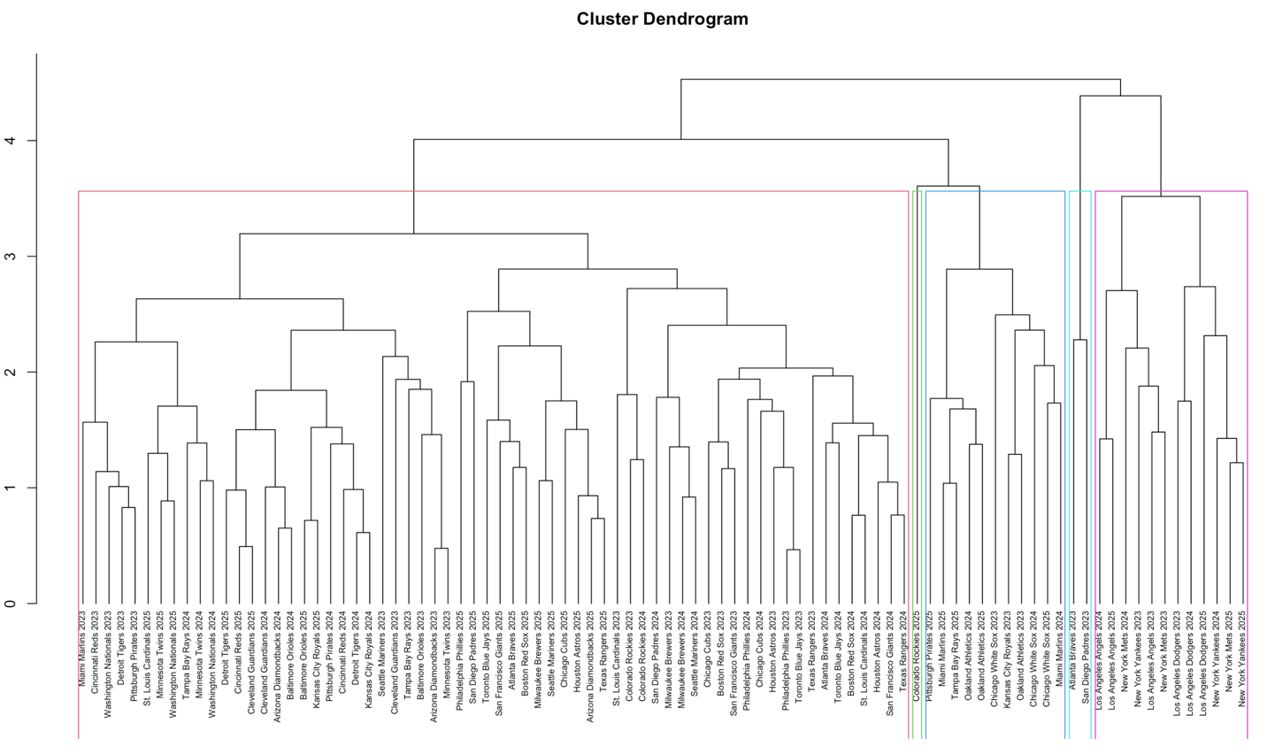
CLUSTERING
Notes:
Even in the cluster analysis, the model groups teams with similar payrolls and winning percentages, with large-market, successful teams like the New York Yankees and Los Angeles Dodgers being in the purple cluster and teams like the 2025 Colorado Rockies, who had zero all-stars and one of the worst records in baseball history, in their own separate green attendance category.
The number of all-stars did not appear to impact the clusters at all, with teams like the 2023 San Diego Padres and 2023 Atlanta Braves existing in the same light blue cluster despite having three and four all-star players, respectively.

Slide 10
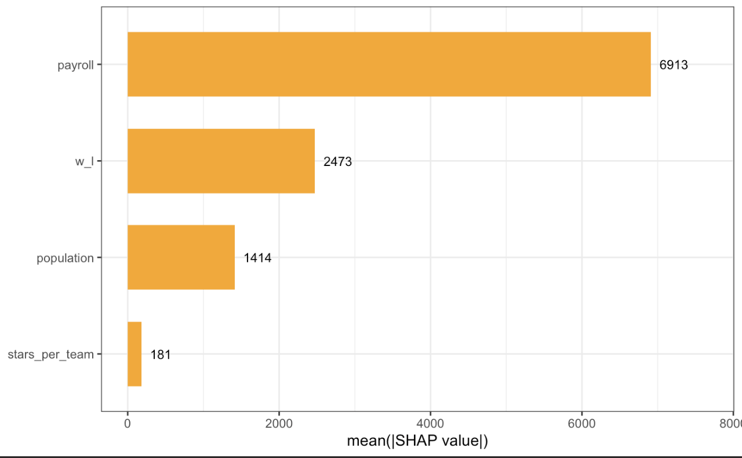
XGBOOST WITH SHAP VALUES MODEL
Notes:
- The SHAP values showed the same thing as the other models: payroll and win-loss percentages have a much greater impact than the number of stars per team in driving attendance.

Slide 11
04
Conclusion

Slide 12
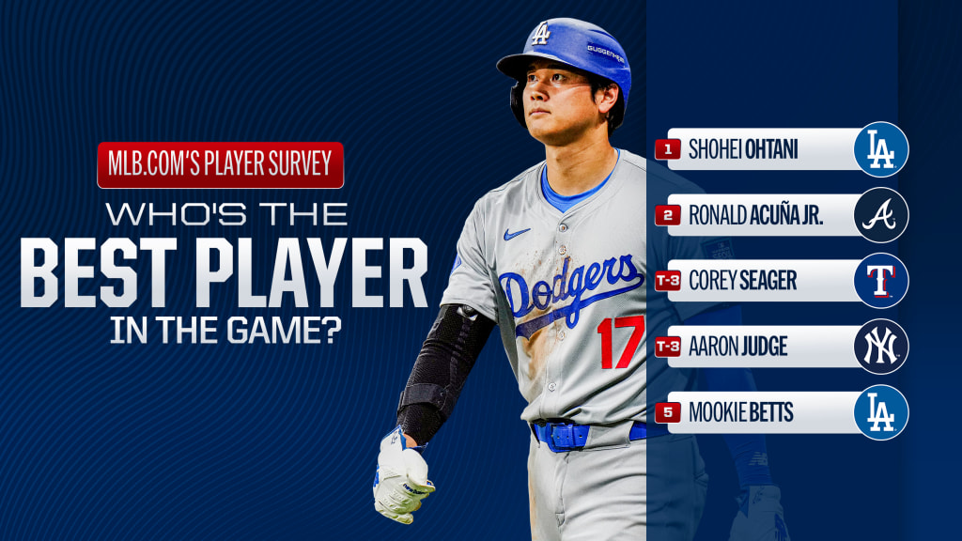
Future implication
Team recommendations
https://www.mlb.com/news/mlb-player-survey-best-player-in-baseball-2024
Notes:
Teams should use their payroll to have the best winning percentage, not one all-star, likely meaning spreading their funding for a more balanced lineup.
Small-market teams thus have two options if they aim to maximize attendance. First, they could choose to incorporate more rebuilding years where they take a hit on attendance for a few seasons to save for a year to push for the pennant, making their ticket money back in one season.
The other option is to keep their win-loss record as consistent as possible, never fully optimizing their attendance but keeping fans steadily engaged.
While large-market teams do have a payroll advantage, their disparity is not directly created by big-name players.

Slide 13
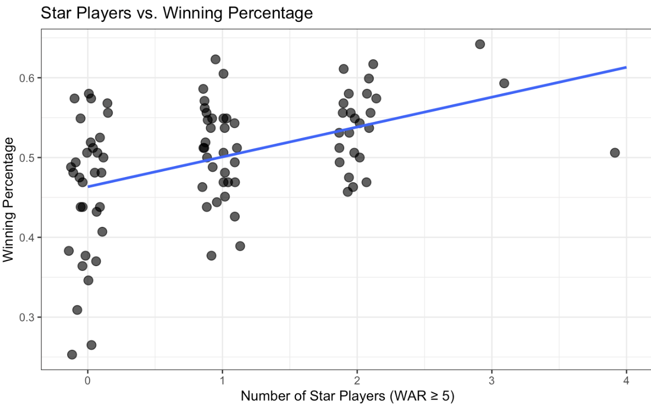
WHY NOT A STRIKEOUT?
INFLUENCE ON OTHER VARIABLES
Notes:
However, why a groundout and not a strikeout?
Star players are not completely a strikeout because they have an impact on other variables like win percentage, even if they do not directly affect game-level attendance in the way originally predicted.

Slide 14
QUESTIONS
Notes:
- Thank you for your attention. I now open myself to questions.

Slide 15
WORKS CITED
“2025 Major League Baseball Attendance & Team Age.” Baseball Reference, 2026, www.baseball-reference.com/leagues/majors/2025-misc.shtml. Accessed 31 Jan. 2026.
Clem, Andrew G. “Baseball Cities.” Clem’s Baseball Blog, www.andrewclem.com/Baseball/Baseball_cities.html. Accessed 4 Feb. 2026.
“Los Angeles Dodgers Salaries and Contracts.” Baseball Reference, 2026, www.baseball-reference.com/teams/LAD/los-angeles-dodgers-salaries-and-contracts.shtml. Accessed 9 Feb. 2026.
“MLB Wins Above Replacement.” ESPN, ESPN Internet Ventures, www.espn.com/mlb/war/leaders/_/type/seasonal/year/2025. Accessed 2 Feb. 2026.
Rivers, Dominic H., and Timothy D. DeSchriver. “Star Players, Payroll Distribution, and Major League Baseball Attendance.” Sport Marketing Quarterly, vol. 11, issue 3, 2002, pp. 164-173. https://doi.org/10.1177/106169340201100304. Accessed 9 Feb. 2026.
“War Leaderboards.” FanGraphs Baseball, www.fangraphs.com/leaders/war. Accessed 4 Feb. 2026. Accessed 3 Feb. 2026.

