Slide 1
The Impact of Travel Fatigue on College Athlete Performance
By: Ashley Marietta
Notes:
- Good morning! I am excited to present my cluster analysis for classifying Notre Dame softball student-athletes based on their resistance to travel fatigue.

Slide 2

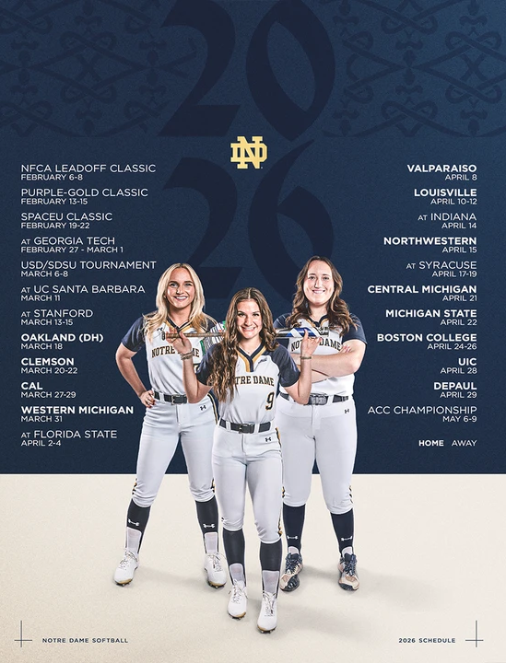
Introduction
Problem: increase in long-distance travel
Objective: cluster student-athletes based on response to travel stress
Output: XGBoost model to predict cluster assignment
Notes:
With the increase in long-distance travel due to conference realignment, student-athletes must travel frequently for competitions, heightening the risk of travel fatigue. For athletes’ health, safety, and longevity, minimizing fatigue becomes a fundamental priority.
The objective of my analysis is to cluster softball student-athletes at the University of Notre Dame based on how their force plate jump performance responds to shared team travel stress, grouping them into one of five clusters based on their individual stress response.
This analysis uses force plate data from Notre Dame Athletics, as well as the official travel itinerary from each softball trip.
The outputs include two baseline random forest models and two XGBoost models, with one of the XGBoost performing best.

Slide 3
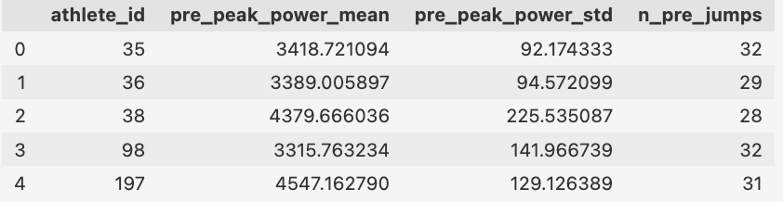
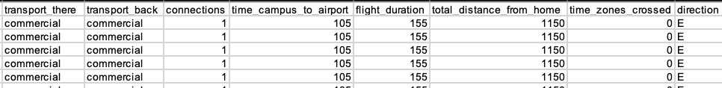
Data Input
Notes:
The main dataset contained travel metrics that were transformed into stress functions that measured everything from time zones crossed and direction to the total distance and travel time. Other factors included transit type, trip length, return time to campus, and turnaround time before the next trip.
Trip Score measured the sum of all these variables, which was then used to calculate Daily Residual Travel Load (RTL), which was the fatigue score beginning on the first day home after travel, and Seasonal Cumulative Load (CRTL), which equaled the cumulative sum of RTL across the season.
The jump performance dataset incorporated four main variables: athlete ID, z-score of peak power, peak power, and date.
Because peak power varied drastically by body weight and position, z-score of peak power provided a better baseline by capturing variation relative to each athlete’s pre-season average jump score.
There were a total of 623 pre-season jumps from August 1 until February 4, and 328 in-season jumps from February 5 until April 18.

Slide 4
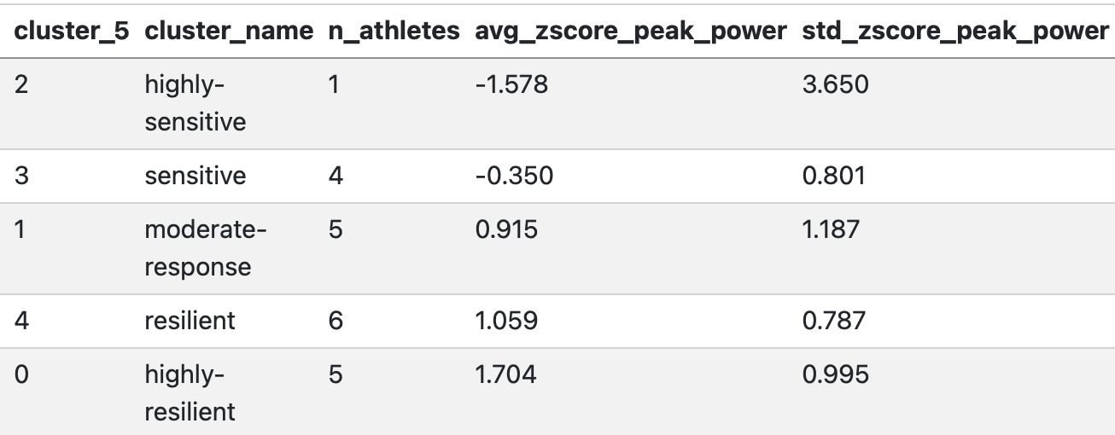
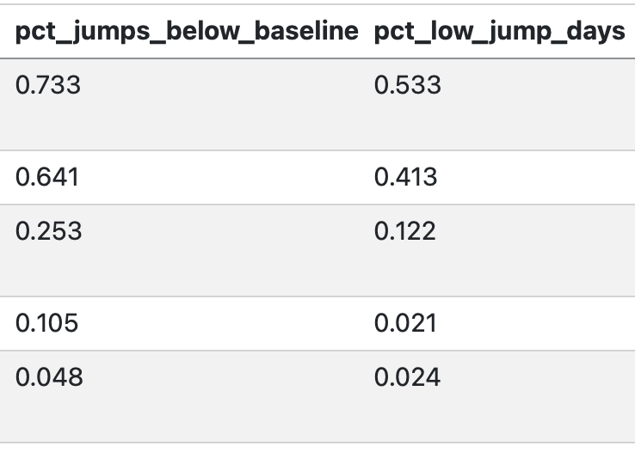
Data Setup
Data split: athlete-level data
Variable measurement: fall baseline for spring prediction
Cluster formation: highly-resilient to highly-sensitive
Notes:
The data split was made on an athlete level because the season was too short for a meaningful temporal split. Leave-one-out cross-validation was used to prevent the model from memorizing patterns specific to athletes seen during training.
Athlete instances were then created from only spring data, and players were clustered into five groups based on response variation from their fall baseline.
The resulting clusters represented varying levels of fatigue sensitivity: highly-sensitive, sensitive, moderate-response, resilient, and highly-resilient.
The highly-sensitive bucket held those who were most likely to suffer travel fatigue, and the highly-resilient group incorporated players who showed minimal fatigue as the season progressed.

Slide 5
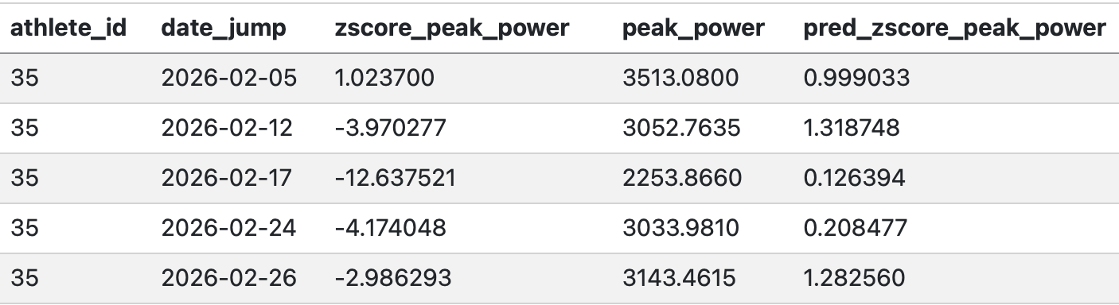
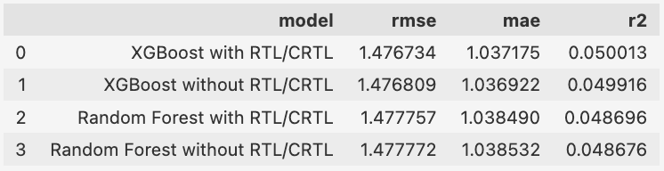
XGBoost Model
Model hyperparameters
Summary statistics
Output limitations
Notes:
After forming cluster groups, several models predicted which bucket each of the 21 athletes would be classified into.
The XGBoost Model that included RTL and CRTL had the best RMSE, so it is the model I will focus on here.
The model outputted an RMSE of 1.48, MAE of 1.04, and R-squared of 0.05.
These values all indicated weak predictive performance, which was a key issue in the analysis. However, given the small sample size at the athlete level, the model is better suited to signal coaches and administrators toward capabilities with a larger sample size.
The top chart shows a sample output from the model, predicting athlete 35’s jump metrics from the first week of the season on.

Slide 6
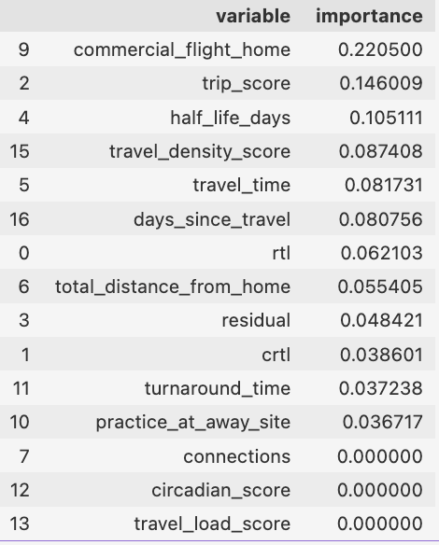
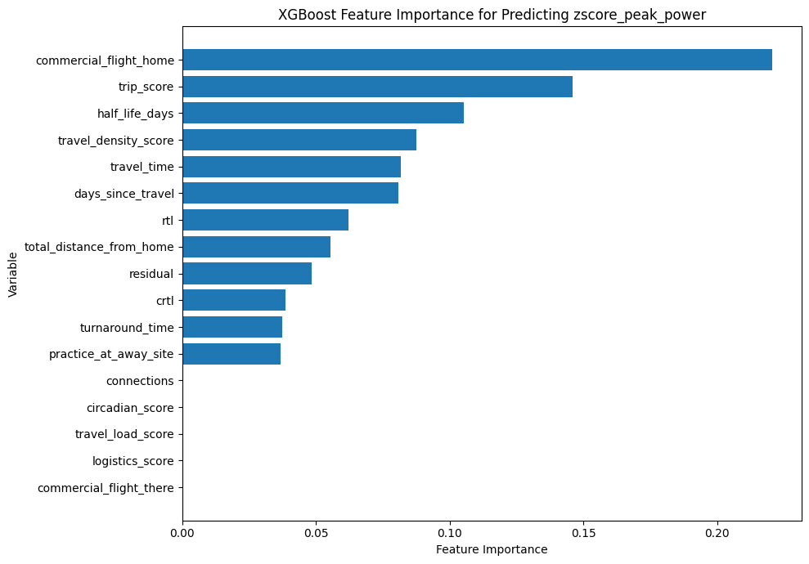
Feature Importance
Notes:
The most important predictor for the z-score of peak power with an importance of .22 was whether the team took a commercial flight home, followed by the Trip Score with an importance of .15.
The binary variable of commercial return flight had the most predictive power likely because trips with a commercial flight back also involved a bus ride from Chicago to campus, resulting in a much later return time.
By contrast, the least predictive variables were whether a commercial flight was taken to the away series and the individual travel functions, like the Logistics Score and Travel Load Score.
The low scores for these travel functions may have resulted because they were included in the overall Trip Score.

Slide 7
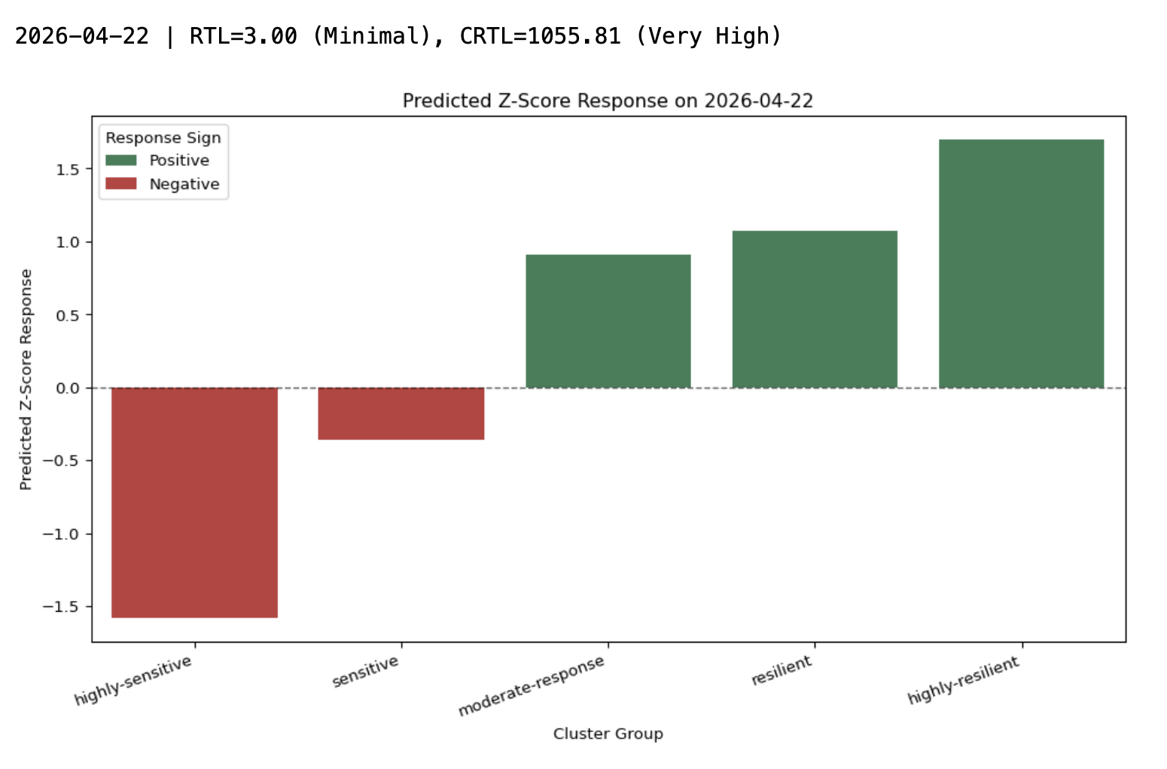
Future Prediction
Notes:
For the remaining seven games in the season as of last Tuesday, a prediction model was built to determine each individual’s expected z-score and to flag if the coaching staff should monitor an athlete more closely.
It also shows the CRTL as it accumulates through the rest of the season, providing context for the predicted jump z-scores.
Having the personal experience of living through the last week, I can say that some of my teammates were definitely feeling the accumulated stress of our previous travel trip before midweek games last week, so I would expect that their jumps from last Thursday would align with a dip in performance.

Slide 8

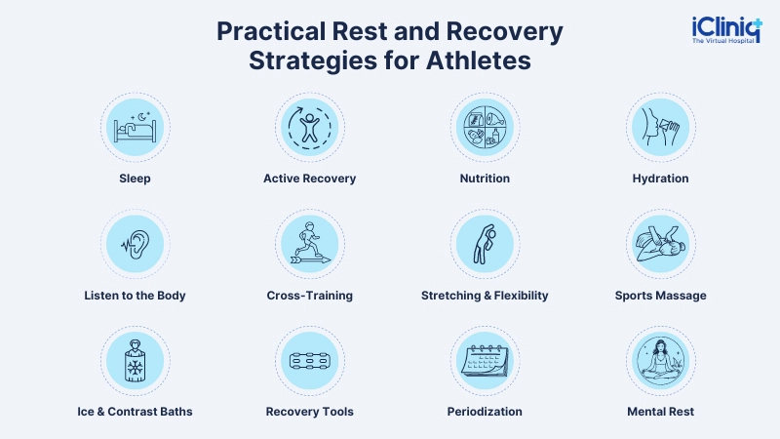

Model Recommendation
Stakeholder responsibilities
Modified training plans
Return charter flights
Notes:
Stakeholders include administrators in the Notre Dame Athletics Department and coaches.
From this information, coaches can form training plans based on the habits of highly-resilient players; for example, fatigue-resistant athletes could share their sleep or nutrition habits with teammates who are more sensitive to travel.
This analysis also suggests that administrators should adjust travel budgets to allow for charter flights home from tournaments, even if it means flying commercially to more competition sites.
Because variables like RTL and CRTL did not meaningfully improve model performance, it suggests that accumulated load may be less informative than immediate recovery conditions.

Slide 9
Future Work
Conference games
Additional variables
Travel logistics
Notes:
With more time and data, the analysis could emphasize ACC competition travel, which carries more importance than pre-season games.
Additionally, incorporating variables, such as academic workload and opponent strength, would provide a more complete picture of performance variation.
Introducing an injury flag would also help control for athletes who may be classified as fatigue-sensitive due to physical pain rather than travel effects.
Overall, while predictive performance remains limited, this study establishes a foundation for recognizing how travel logistics impact athlete performance.

Slide 10

Q&A

Slide 11
Bibliography
Heller, et al. "The Negative Effects of Travel on Student Athletes Through Sleep and Circadian Disruption." Journal of Biological Rhythms, vol. 39, iss. 1, Feb. 2024, pp. 5-19. https://journals.sagepub.com/doi/epub/10.1177/07487304231207330. Accessed 2 Apr. 2026.
Norlander, Matt. “NCAA Votes to Increase College Basketball Schedules to 32-Game Season Beginning in 2026-27.” CBS Sports, CBS Interactive Inc., 25 June 2025, www.cbssports.com/college-basketball/news/ncaa-set-to-allow-college-basketball-schedules-increase-to-32-game-season-beginning-in-2026-27/. Accessed 9 Apr. 2026.
VanZant, River Mackenzie. Effect of Travel Stress and Physiological Training Load on In-Game Performance, Recovery, and Subjective Sleep Quality in NCAA DI Women’s Basketball Athletes. 2024. University of Georgia, PhD dissertation. https://openscholar.uga.edu/record/1923/files/VanZantRiverPHD.pdf. Accessed 2 Apr. 2026.

