Slide 1
DARSHAN

Slide 2
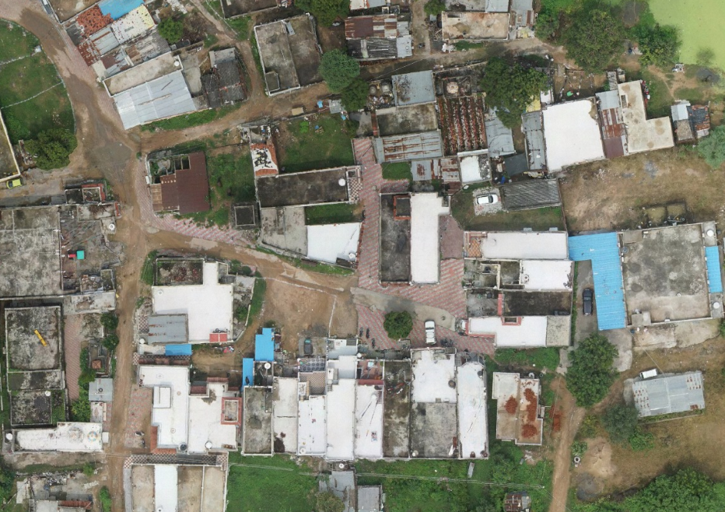
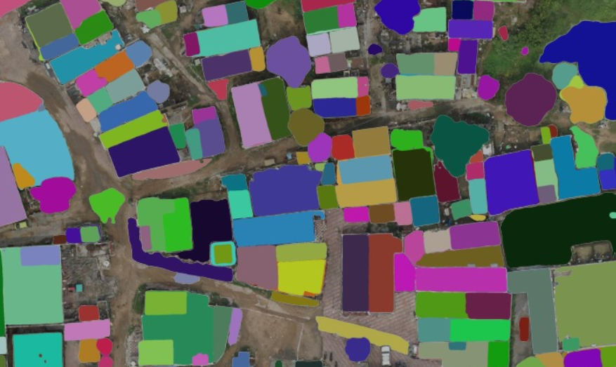
INPUT VS OUTPUT

