Slide 1
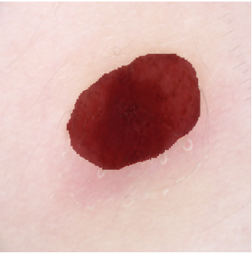
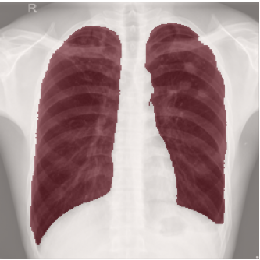
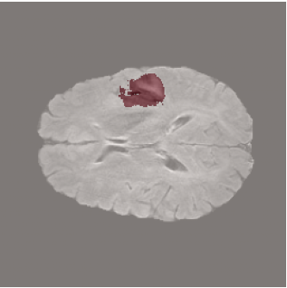
EfficientSAM for Medical Image Segmentation
Skin lesion analysis with a cross-modality generalization study
CSE411 Computer Vision Project · Team 27
Ashmi S N · Samradhi Rathore · Nimisha M Iyer · Thariq Muhammed
Notes:
Introduce the project: one lightweight SAM variant, three medical modalities. The three images on the right are real fine-tuned predictions for skin lesion, chest X-ray and brain MRI from our evaluation notebooks.

Slide 2
Why a lightweight SAM?
632M
58.5%
0
parameters in SAM's ViT-H encoder, too costly for interactive or low-resource use
mean Dice of zero-shot SAM on medical images (Ma and Wang, 2024)
surveyed studies testing one lightweight SAM across skin, X-ray and MRI
EfficientSAM-Ti: SAMI-pretrained ViT-Tiny with 10.2M parameters, never evaluated on medical images until this project.
Notes:
SAM is accurate on natural images but its ViT-H encoder has about 632M parameters, and zero-shot it only reaches about 58.5% mean Dice on medical images (Ma and Wang, 2024). EfficientSAM compresses the encoder through SAMI pretraining. The gap: nobody in our 10-paper survey tested it across skin, X-ray and MRI.

Slide 3
Literature survey: the research gap
1
2
3
Heavy backbones
Light, but narrow
Generalists, not efficient
SkinSAM, YOLOSAMIC, SAM-Adapter and the X-ray LoRA model keep full SAM and report no parameters or speed.
EfficientSAM was tested only on natural images; RepMedSAM and EMedSAM only on CT. None covers skin or X-ray.
MedSAM and Med-SA span many modalities but are heavy, and no paper compares skin, X-ray and MRI in one study.
Our gap: one lightweight SAM, three modalities, accuracy plus parameters and speed, with a working GUI.
Notes:
We surveyed ten papers. Skin and X-ray SAM methods keep the full SAM encoder and report accuracy only. Lightweight variants were only tested on natural images or CT. General medical SAMs are not efficiency-oriented and never compare skin, X-ray and MRI together.

Slide 4
Objectives and contributions
1
Part A: skin lesion
Adapt EfficientSAM-Ti to ISIC 2018 and compare zero-shot with decoder fine-tuned results.
2
Part B: generalization
Run the identical pipeline on chest X-ray and brain MRI.
3
Efficiency
Report parameter count and inference speed next to Dice and IoU.
4
Usability
Deliver a Gradio GUI for dermoscopic image upload and mask overlay.
Notes:
Four objectives: Part A skin lesion depth, Part B generalization, efficiency reporting and a usable GUI.

Slide 5
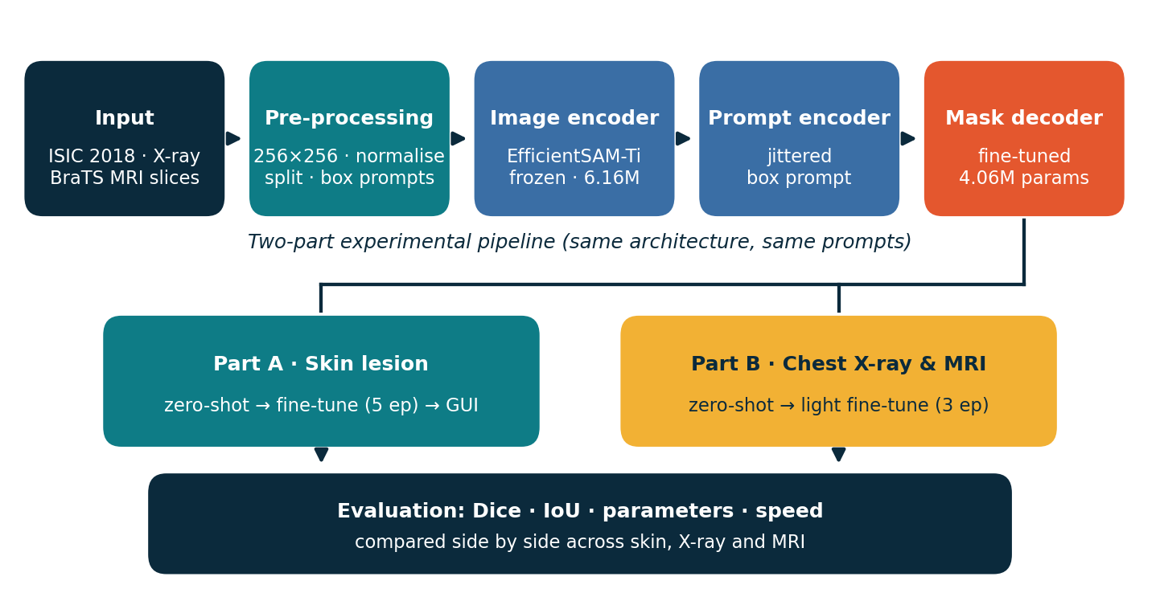
System architecture
Same encoder, prompt scheme and evaluation code for all three modalities.
Notes:
Input images are pre-processed, passed through the frozen EfficientSAM-Ti encoder, combined with a box prompt, and decoded by the lightweight mask decoder. The pipeline then splits into Part A (skin) and Part B (X-ray and MRI), both evaluated with the same metrics.

Slide 6
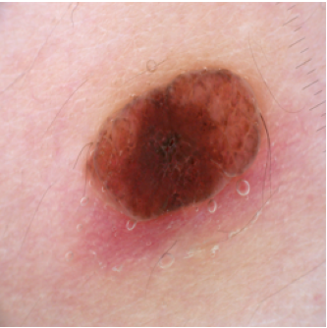
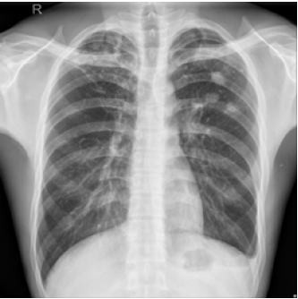
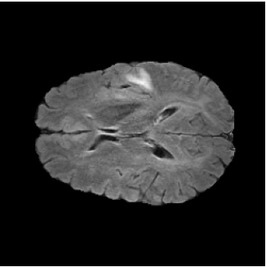
Three modalities, one pipeline
Skin lesion
Chest X-ray
Brain MRI
ISIC 2018 · 2,594 pairs
Train / val: 2,334 / 260
Target: lesion
Montgomery + Shenzhen · 704
Train / val: 598 / 106
Target: lung fields
BraTS 2020 FLAIR · 105 slices
Train / val: 89 / 16
Target: whole tumour
Notes:
Skin: ISIC 2018 Task 1, 2,594 pairs. Chest X-ray: Montgomery plus Shenzhen, 704 pairs. MRI: BraTS 2020 2D FLAIR slices, 105 tumour-positive slices, deliberately small for Colab limits.

Slide 7
Pre-processing and box prompting
1
Resize
2
Normalise
3
Split
4
Box prompt
256×256 RGB; masks nearest-neighbour, binarised
Pixel values scaled to [0, 1] tensors
Seeded shuffle: 90/10 skin, 85/15 X-ray and MRI
From the mask, up to 5 px random jitter
MRI slice extraction (BraTS 2020)
369 volumes found
→
40 patients × 3 central FLAIR slices
→
105 tumour-positive 2D slices
Notes:
All images are resized to 256 by 256 and normalised; splits use a fixed seed so zero-shot and fine-tuned runs are comparable. The box prompt is derived from the ground-truth mask with up to 5 pixels of jitter to simulate a user-drawn box. For MRI we took the first 40 of 369 BraTS patients and the three central FLAIR slices of each, keeping tumour-positive slices.

Slide 8
Decoder-only fine-tuning
10.2M
total parameters (10,223,204)
Training setup
Optimizer: AdamW, lr 1e-4
Loss: Dice loss
Batch / input: 4 / 256×256
Epochs: 5 skin · 3 X-ray · 3 MRI
Prompt: Jittered ground-truth box
Hardware: Tesla T4 (Colab)
6.16M
frozen image encoder
4.06M
trained mask decoder (39.7%)
Notes:
The encoder with about 6.16M parameters stays frozen. Only the 4,058,340-parameter mask decoder is trained, with AdamW at 1e-4 and Dice loss. The same budget is used for all three modalities and each modality starts from a fresh pretrained copy.

Slide 9
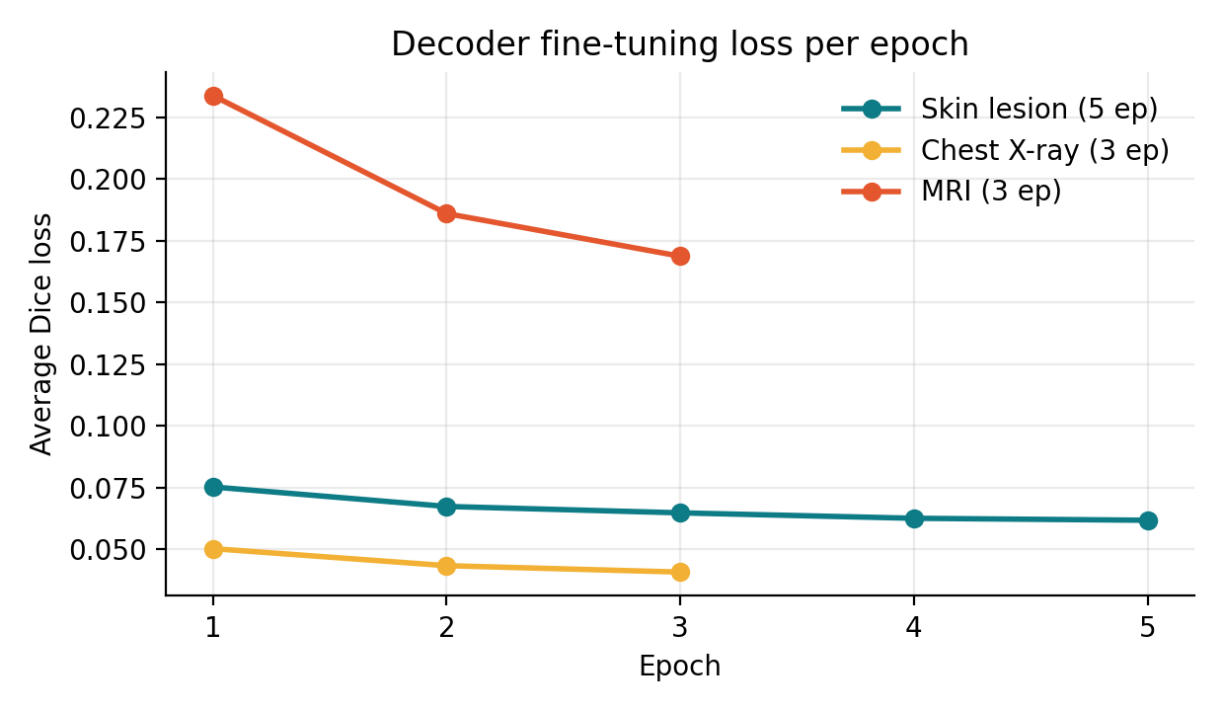
Training behaviour
What the logs show
All three runs decrease steadily.
X-ray: 0.050 → 0.041
Skin: 0.075 → 0.062
MRI: 0.234 → 0.169, still the highest loss
Average Dice loss per epoch (from the training logs).
Notes:
Loss curves from the notebook logs: skin 0.0752 to 0.0617 over five epochs, X-ray 0.0502 to 0.0407, MRI 0.2338 to 0.1687 over three. MRI loss stays highest, consistent with it being the hardest domain.

Slide 10
Implementation journey
25%
50%
75%
100%
Task 4
Task 5
Task 6
Task 7
Datasets, pre-processing, model loading, zero-shot skin baseline
Part A fine-tuning done; zero-shot X-ray and MRI
Part B fine-tuning, comparison script, GUI prototype
Final results, GUI, packaging, report
Notes:
Progress followed the Task 4 to Task 7 milestones: 25% datasets, preprocessing and zero-shot baseline; 50% Part A fine-tuning plus zero-shot Part B; 75% Part B fine-tuning, comparison and GUI prototype; 100% final results, polished GUI and packaging.

Slide 11
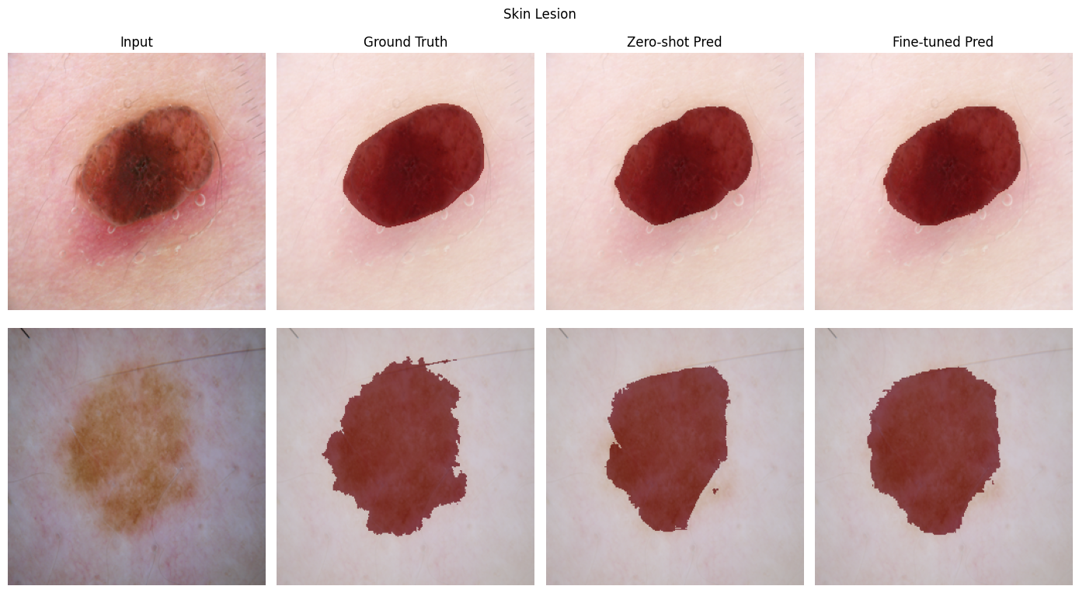
Part A: skin lesion results
Dice (zero-shot → fine-tuned)
0.8655 → 0.9344
+6.9 Dice points
IoU (zero-shot → fine-tuned)
0.7714 → 0.8794
+10.8 IoU points
Input · Ground truth · Zero-shot · Fine-tuned (two validation samples)
Fine-tuning follows irregular lesion borders more closely. 5 epochs, 260 validation images.
Notes:
Skin lesion: zero-shot Dice 0.8655 and IoU 0.7714 rise to 0.9344 and 0.8794 after five decoder-only epochs, a gain of 6.9 Dice points. The qualitative panel shows the fine-tuned boundary following irregular lesion borders more closely.

Slide 12
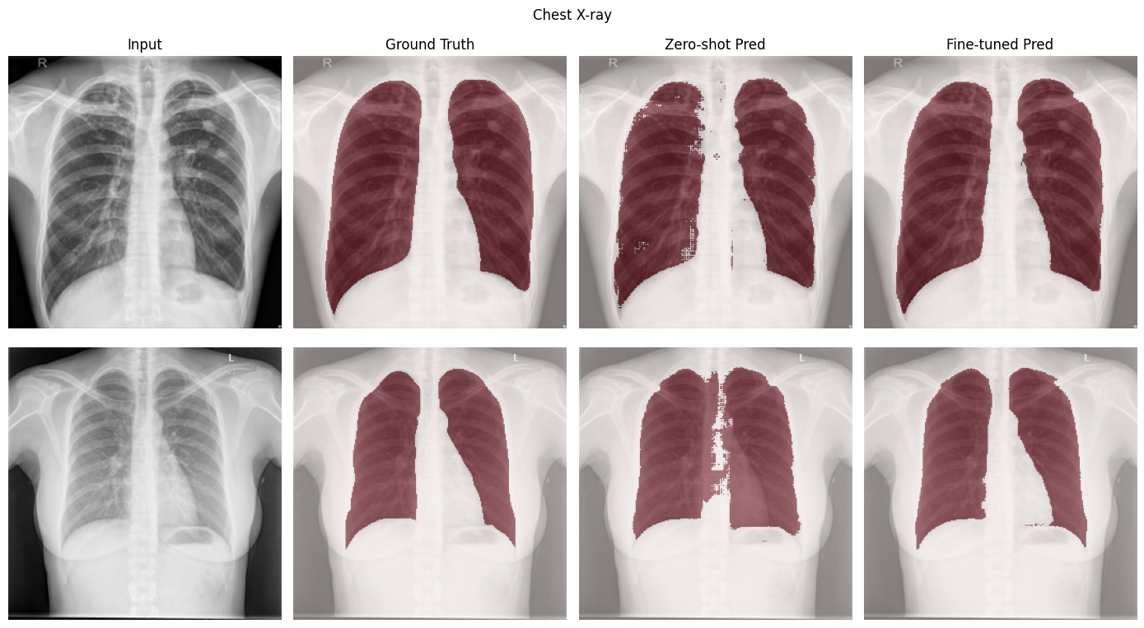
Part B: chest X-ray results
Dice (zero-shot → fine-tuned)
0.8741 → 0.9607
+8.7 Dice points
IoU (zero-shot → fine-tuned)
0.7831 → 0.9253
+14.2 IoU points
Input · Ground truth · Zero-shot · Fine-tuned (two validation samples)
Zero-shot masks have holes; fine-tuning gives clean lung fields. 3 epochs, 106 validation images.
Notes:
Chest X-ray is the strongest modality: Dice 0.8741 to 0.9607 and IoU 0.7831 to 0.9253 after three epochs. Zero-shot masks have holes and ragged edges; the fine-tuned masks are clean lung fields.

Slide 13
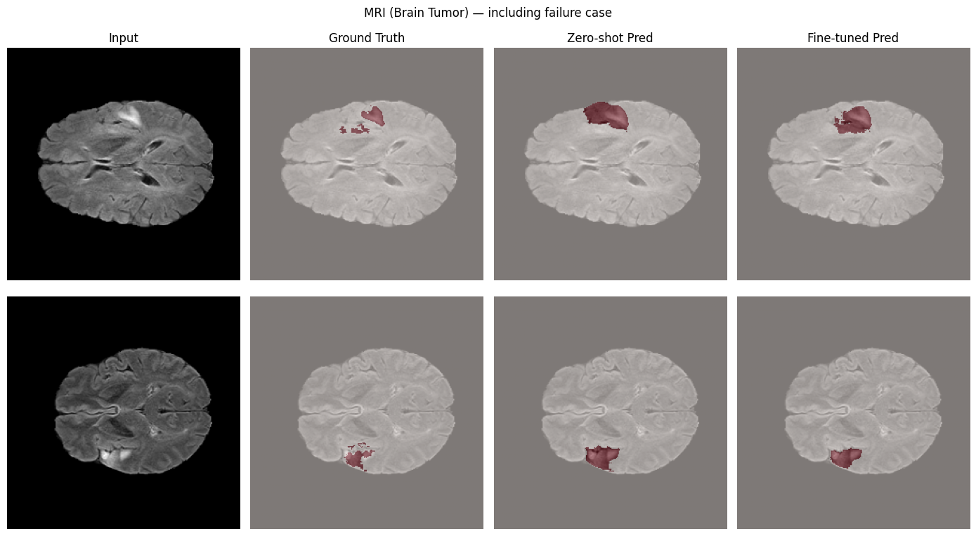
Part B: MRI results
Dice (zero-shot → fine-tuned)
0.6982 → 0.8107
+11.3 Dice points
IoU (zero-shot → fine-tuned)
0.5488 → 0.6899
+14.1 IoU points
Input · Ground truth · Zero-shot · Fine-tuned (including failure cases)
Largest gain, lowest final score; fragmented tumour regions are still missed. 16 validation slices.
Notes:
MRI is hardest: zero-shot Dice 0.6982 rises to 0.8107, IoU 0.5488 to 0.6899, the largest gain but the lowest final score. The qualitative panel includes failure cases where fragmented tumour regions are missed. Only 16 validation slices, so the estimate is noisy.

Slide 14
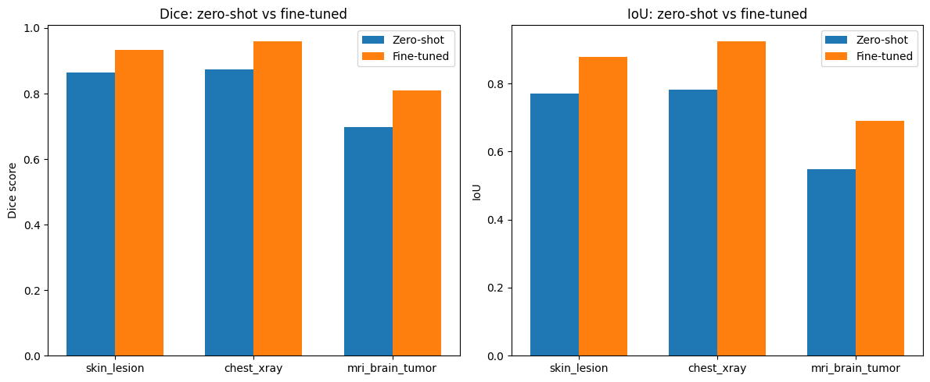
Cross-modality comparison
Modality | Dice zero-shot | Dice tuned | IoU tuned
Skin lesion | 0.8655 | 0.9344 | 0.8794
Chest X-ray | 0.8741 | 0.9607 | 0.9253
MRI slices | 0.6982 | 0.8107 | 0.6899
Output of the comparison notebook: Dice (left), IoU (right).
X-ray > skin > MRI. MRI gains the most (+11.3 Dice points) yet stays lowest: it sits furthest from natural-image pretraining.
Notes:
Fine-tuned Dice: chest X-ray 0.9607, skin 0.9344, MRI 0.8107. MRI gains the most but remains lowest, consistent with 2D cross-sectional MRI being furthest from natural-image pretraining. The chart on the left is the actual output of our comparison notebook.

Slide 15
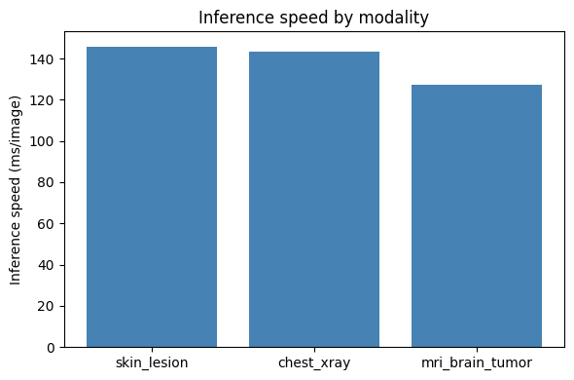
Efficiency: 62× fewer parameters
Inference speed per modality (ms/image, Tesla T4).
≈ 6.9 images/s · 145.85 ms/image (skin)
61.8× fewer parameters than SAM ViT-H · only 39.7% of them trained
Notes:
SAM ViT-H has about 632M parameters; our EfficientSAM-Ti checkpoint has 10,223,204, about 61.8 times fewer, and only 39.7% of them are trained. Speed on a Tesla T4 is about 127 to 146 ms per image, roughly 6.9 images per second for the skin model; the small spread across modalities is most likely timing variability since the architecture and input size are identical.

Slide 16
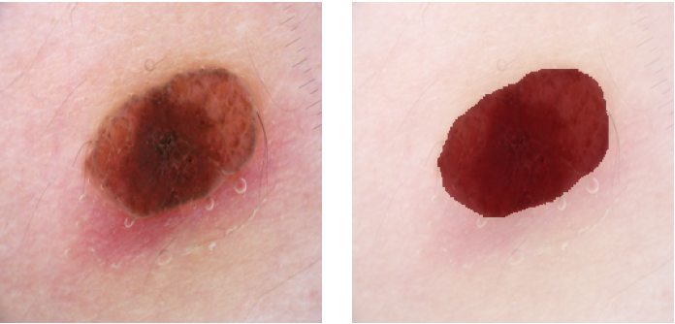
GUI: upload, segment, measure
Boundary overlay (red)
1
Cropped lesion patch
2
Background removed (clean lesion)
3
Input → red lesion overlay (rendered from the evaluation notebook).
Prompt in the GUI: a point at the image centre, since no ground truth exists at inference.
Metrics: area, perimeter, compactness, asymmetry, hue, IoU confidence
4
Notes:
The Gradio app loads the fine-tuned skin-lesion checkpoint. Because no ground-truth mask exists at inference time it prompts with a point at the image centre. It returns the red boundary overlay, a cropped lesion patch, a background-removed lesion, and quantitative lesion metrics. The picture shows an input and the fine-tuned overlay rendered from the evaluation notebook, not a screenshot of the live app.

Slide 17
What the results tell us
1
Efficiency preserved
2
Strong on X-ray and skin
Encoder never unfrozen: about 62× fewer parameters than SAM ViT-H, 4.06M trained.
Dice 0.961 and 0.934 after fine-tuning; skin exceeds SkinSAM's 0.888 (different protocol).
3
MRI is hardest
4
Decoder-only is enough
Dice 0.698 → 0.811: diffuse FLAIR tumours, 89 training images, 3 epochs.
A good box prompt localises the target; adapting the decoder closes much of the gap cheaply.
Notes:
Four takeaways: efficiency is preserved because the encoder is untouched; X-ray and skin hold up well; MRI is the hardest domain; and decoder-only adaptation is enough when the box prompt does the localisation. Skin Dice of 0.934 versus SkinSAM 0.888 is indicative only because protocols differ.

Slide 18
Limitations and future work
Limitations
Future work
256×256 input; decoder-only; Dice loss
Boxes come from ground truth (GUI uses a centre point)
MRI: 16 val slices, slice-level split
Single run, no separate test set
Literature comparison not like-for-like
1024×1024, test set, patient-level splits, seeds
Adapters / LoRA, partial encoder unfreezing
Automatic box detector
Full BraTS, multi-sequence, sub-regions
Edge deployment: ONNX, quantisation
Notes:
Be upfront: 256 by 256 inputs, decoder-only tuning, Dice-only loss, box prompts from ground truth, a 16-image MRI validation set split at slice level, a single run, and an indicative rather than like-for-like literature comparison. Future work addresses each of these.

Slide 19
Conclusion
+6.9
+8.7
+11.3
Skin lesion
Dice 0.9344
Chest X-ray
Dice 0.9607
MRI
Dice 0.8107
Dice points gained from decoder-only fine-tuning with a 10.2M-parameter SAM, about 62× smaller than SAM ViT-H.
Delivered: 3 fine-tuned checkpoints · results JSON and CSV · comparison plots · Gradio GUI · final report
Notes:
Decoder-only fine-tuning of a 10.2M-parameter SAM improved Dice by 6.9, 8.7 and 11.3 points on skin, X-ray and MRI. Deliverables: three fine-tuned checkpoints, results JSON and CSV, comparison plots, Gradio GUI and this report.

