Slide 1
Project Title : Maze Game
Name and Roll No: Ashmit Singh
2210990189

Slide 2
Index
Objective
Introduction
Methodology, Approach & Techniques
Algorithm
Result
Source Code (screenshots)
Conclusion
Reference

Slide 3
Objective
Reach the Exit: The primary objective is for the player to reach the exit or end point of the maze. This may involve finding the shortest or optimal path through the maze while avoiding dead ends, traps, or enemies..
Solve Puzzles: Maze games may incorporate puzzle elements where players need to solve challenges or riddles to progress through the maze. These puzzles could involve logic, spatial reasoning, or pattern recognition

Slide 4
Introduction
It It is a Maze Game project using Python programming language.
In this thrilling maze game, you'll embark on an exciting journey through a maze filled with twists, turns, and challenges.
Use W/A/S/D key to move your character through the maze. Your goal is to reach the exit marked by the letter "E" before time runs out

Slide 5
Methodology, Approach & Techniques
Agile Development: This approach allows for flexibility and responsiveness to changes in requirements throughout the development process.
Modular Development: Break down the development process into smaller, manageable modules or components, such as player movement, maze generation, collision detection, and game logic. This facilitates easier debugging, testing, and maintenance of the game code.
Collision Detection: Use collision detection techniques to detect and handle collisions between the player character and walls or obstacles within the maze. This ensures that the player's movement is restricted by the maze's layout.

Slide 6
Algorithm
Define the maze layout as a grid of characters, where '#' represents walls, 'S' represents the starting position, and 'E' represents the exit.
Define functions to print the maze, check if the player has won, and validate player moves.
Define the main function (main()) to run the game loop.
Set the player's initial position to the starting point (S) of the maze.
Enter a while loop to continuously prompt the player for moves and update the game state until the game ends.
Iterate Through Words
Join Corrected Text
Output

Slide 7
Result
The code successfully enables maze navigation from start to exit, with feedback on invalid moves.Upon reaching the exit, a congratulatory message is displayed, indicating successful completion.Users interact with the game via keyboard inputs (W/A/S/D) for navigation.Future improvements may include graphical enhancements and additional gameplay features.Overall, the project enhances understanding of Python programming and algorithmic logic.

Slide 8
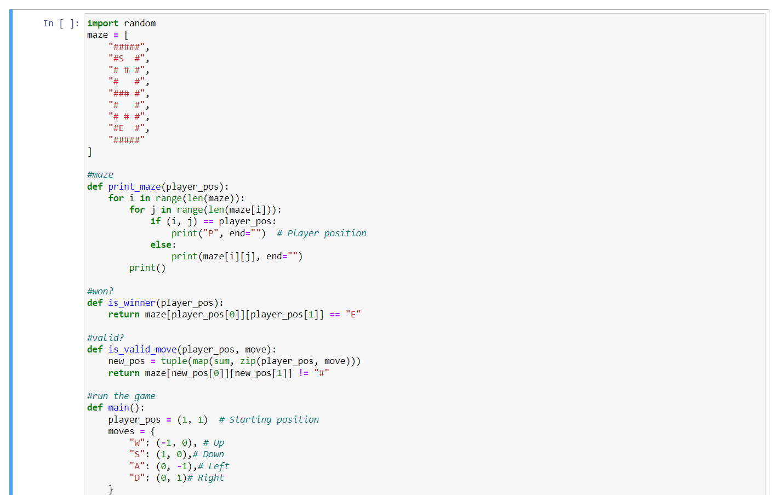
Source Code (screenshots)

Slide 9
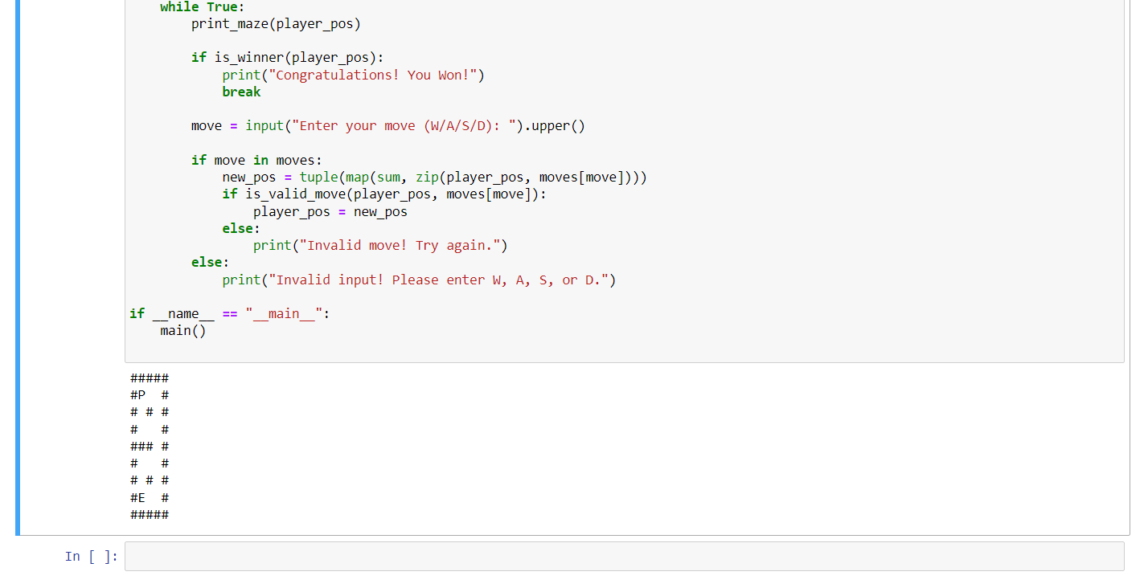

Slide 10
Conclusion
The maze game project successfully demonstrated the implementation of maze navigation and player interaction using Python programming.
Through coding and running the project, valuable insights were gained into algorithmic logic, Python syntax, and problem-solving strategies.
While the current implementation offers a basic maze game experience, there is ample opportunity for future expansion and enhancement.
The maze game project showcases the potential of Python programming for creating interactive and engaging experiences. It encourages ongoing learning and inspires further exploration in the realm of game development and algorithmic design.

Slide 11
Reference
GeeksForGeeks
Javapoint

Slide 12
The End

