Slide 1
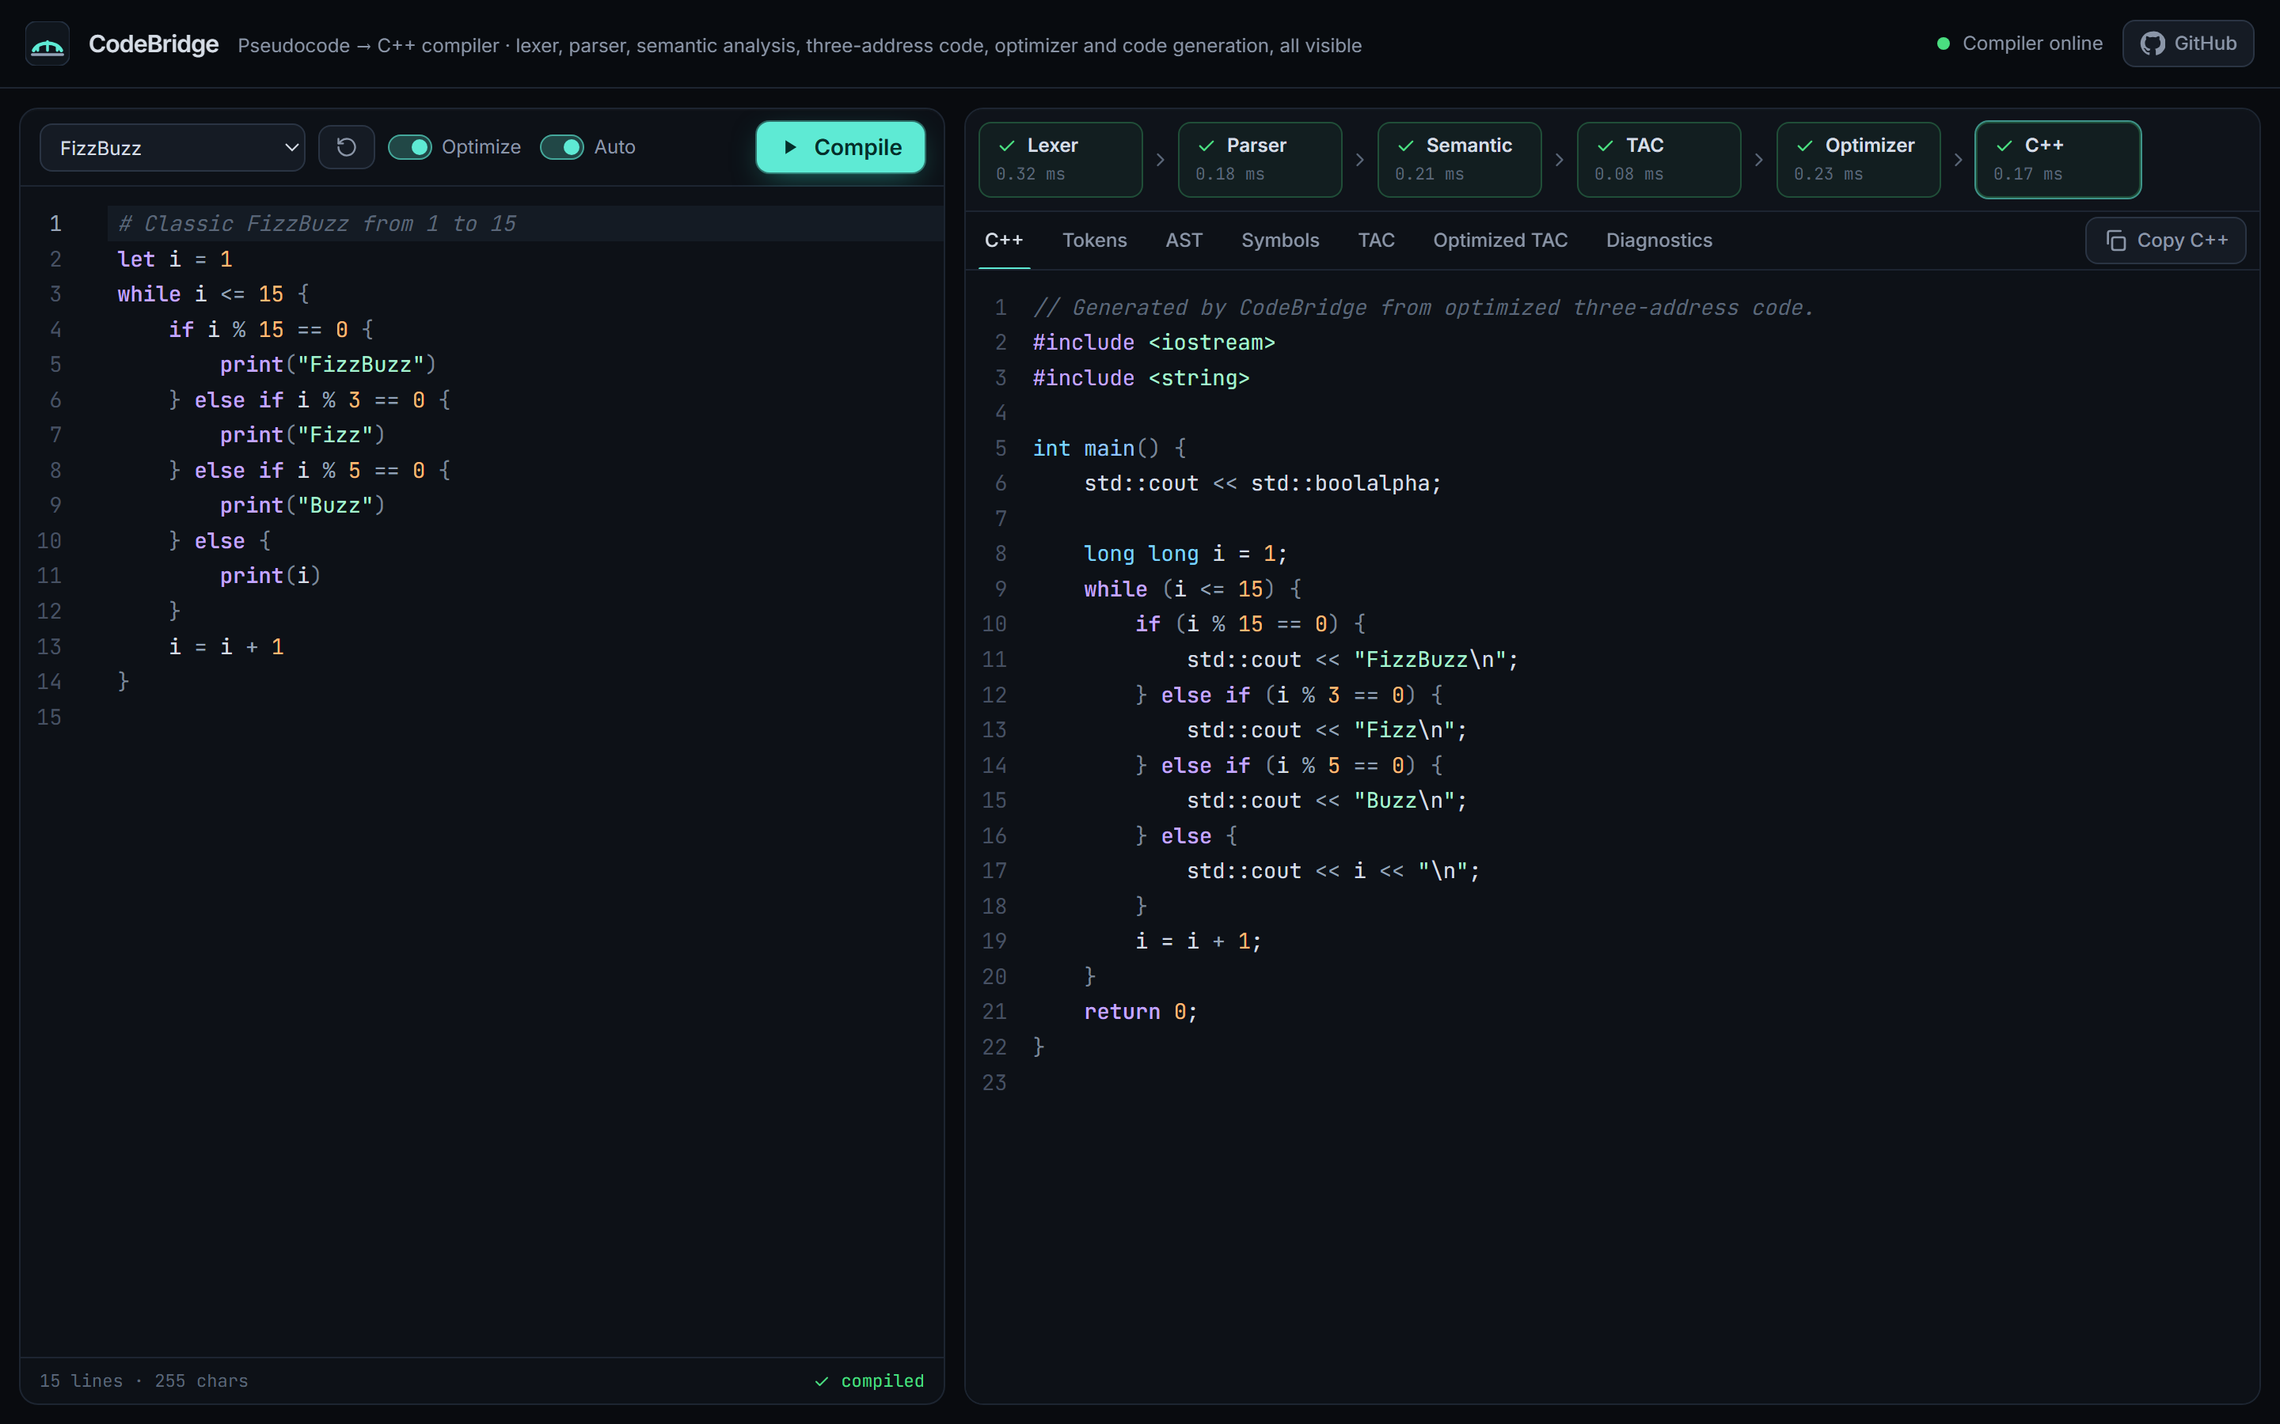
COMPILER DESIGN MINI-PROJECT
CodeBridge
Pseudocode-to-C++ Compiler
A hand-written six-phase compiler with a live web workbench that shows every phase.
Presented by [Student Name] · [Roll Number]
Guide [Guide Name]
Department [Department], [Institution] · [Academic Year]
Live deployment: FizzBuzz compiled to C++
Live codebridge-swart.vercel.app
Code github.com/ashmita-dev/CodeBridge
Notes:
Introduce CodeBridge: a compiler written from scratch in Python that translates a small pseudocode language into C++17. The screenshot is the live deployment compiling FizzBuzz. Fill in name, roll number, guide and institution before presenting.

Slide 2
INTRODUCTION
Introduction and project overview
▸ CodeBridge translates a small, statically typed pseudocode language into C++17 source code.
▸ Every phase is hand-written in Python: lexer, recursive-descent parser, semantic analysis, TAC, optimizer and C++ generator. No parser generators.
▸ A web workbench shows tokens, AST, symbol table, original and optimized TAC, C++ and diagnostics for the code being edited.
▸ Deployed: React frontend on Vercel, FastAPI backend on Render.
6
233
compiler phases
automated tests
(213 backend + 20 frontend)
12
300
bundled example
programs
random programs in the
optimizer differential test
Output is real C++.
Generated programs are built with g++ in the test suite and must print exactly what the source program means.
CodeBridge · Pseudocode-to-C++ Compiler
2 / 15
Notes:
Give the one-sentence summary, then the numbers: six phases, 233 automated tests, twelve examples and a 300-program differential test. Stress that correctness of the generated C++ is checked by compiling it.

Slide 3
WHY THIS PROJECT
Problem statement
Phases learned in isolation
Optimizers are invisible
Translation must be correct
Lexing, parsing, semantic analysis, IR and optimization are usually taught separately and on paper.
Students rarely see how an optimizer rewrites intermediate code, or why a transformation is safe.
A translator that emits plausible but wrong C++ is worse than none. Output must preserve meaning.
PROBLEM STATEMENT
Build a compiler that accepts a simple pseudocode language, reports lexical, syntax and semantic errors precisely, generates and optimizes intermediate code, and emits equivalent C++, with every phase visible through a web interface.
CodeBridge · Pseudocode-to-C++ Compiler
3 / 15
Notes:
Three gaps motivate the project: phases are taught separately, optimizers are a black box, and a translator is only useful if its output is correct. The problem statement on the slide is the project's formal goal.

Slide 4
SOLUTION
Proposed solution and objectives
1
Design a small, complete language: int, float, string, bool, arithmetic, logic, print, if/else, while
The solution
▸ A complete source-to-source compiler from pseudocode to C++17.
▸ Exposed as a JSON API: POST /compile returns every artifact.
▸ A browser workbench that renders each phase for the current program.
▸ Testing against reference interpreters and real g++ binaries.
2
Implement every phase by hand, each testable without the web framework
3
Report structured errors: stage, code, message, line and column
4
Generate TAC, optimize it safely, and emit behaviour-preserving C++
5
Present all phases in a responsive web app and deploy it publicly
CodeBridge · Pseudocode-to-C++ Compiler
4 / 15
Notes:
The solution has three parts: the compiler, the API and the workbench, tied together by testing. Read the five objectives; each is revisited later with evidence.

Slide 5
LANGUAGE
Features and supported language constructs
examples/fizzbuzz.cb
Construct | Syntax
Declaration | let x = 5 let f: float = 2
Assignment | x = x + 1
Output | print(a, b) or print a, b
Selection | if … else if … else { }
Iteration | while cond { }
Operators | + - * / % == != < <= > >= and or not
Types → C++ | int→long long, float→double, string, bool
# Classic FizzBuzz from 1 to 15
let i = 1
while i <= 15 {
if i % 15 == 0 {
print("FizzBuzz")
} else if i % 3 == 0 {
print("Fizz")
} else if i % 5 == 0 {
print("Buzz")
} else {
print(i)
}
i = i + 1
}
▸ C++ semantics: / truncates, % follows the dividend, and/or short-circuit.
▸ Only int → float converts implicitly; conditions must be bool.
CodeBridge · Pseudocode-to-C++ Compiler
5 / 15
Notes:
Walk through FizzBuzz: let, while, an else-if chain, print. The table lists everything the language supports; functions, arrays, for loops and input are intentionally out of scope.

Slide 6
TOOLS
Technology stack
Compiler + API
Frontend
Testing
Deployment
• Python 3.13.15
• FastAPI 0.143
• Pydantic 2.14
• Uvicorn 0.54
• React 19.3
• TypeScript 7.0
• Vite 8.3
• Tailwind CSS 4.3
• CodeMirror 6
• pytest 9.1 + httpx2
• Vitest 5.0
• g++ 16.1 (C++17)
• GitHub Actions CI
• Render (API)
• render.yaml
• Vercel (frontend)
• vercel.json
hand-written compiler package and JSON API
workbench UI, editor and artifact views
unit, API, end-to-end and g++ build-and-run
both redeploy on every push to main
No parser generators or transpilers: the lexer, parser, type checker, IR, optimizer and code generator are all original Python code.
CodeBridge · Pseudocode-to-C++ Compiler
6 / 15
Notes:
Versions are the ones pinned in requirements.txt and package.json. The compiler uses only the Python standard library; FastAPI and Pydantic are only in the web layer.

Slide 7
ARCHITECTURE
System architecture
React frontend · Vercel
FastAPI backend · Render
lib/api.ts · useCompiler
POST /compile · GET /health
650 ms auto-compile debounce
JSON request
app/main.py
GET /health · POST /compile
CORS · 413 · JSON 500
config · schemas
CORS_ORIGINS
MAX_SOURCE_CHARS · Pydantic
JSON response
CodeMirror 6 editor
highlighting · error underlines
pipeline.compile_source()
runs phases in order, times each, stops at first failure
Pipeline strip + 7 tabs
C++ · Tokens · AST · Symbols
TAC · Optimized TAC · Diagnostics
lexer
parser
semantic
tacgen
optimizer
codegen
app/compiler: no web dependencies, each module unit-tested
CodeBridge · Pseudocode-to-C++ Compiler
7 / 15
Notes:
Two tiers. The browser sends the editor contents as JSON to POST /compile. main.py validates the request, applies the size limit and CORS, and calls compile_source, which runs the six compiler modules. The compiler package has no FastAPI imports, so every phase is unit-tested on its own. VITE_API_URL is baked into the frontend at build time; CORS on Render allows only the Vercel origin.

Slide 8
PIPELINE
Compiler pipeline: six phases
source text ▸
Lexer
lexer.py
Parser
parser.py
Semantic
semantic.py
TAC
tacgen.py
Optimizer
optimizer.py
C++ gen
codegen_cpp.py
tokens
AST
typed AST
+ symbols
three-address
code
optimized
TAC
C++17
source
L001–L005
P001–P002
S001–S006
Structured diagnostics: stage · code · message · line:column · hints
A failing phase stops the pipeline: later phases are reported as skipped and no TAC or C++ is returned.
Artifact in the API response | tokens | ast | symbols | tac | optimized_tac | cpp
Workbench tab | Tokens | AST | Symbols | TAC | Optimized TAC | C++
CodeBridge · Pseudocode-to-C++ Compiler
8 / 15
Notes:
The six phases, the module that implements each and what it produces. Only the first three phases can report user errors: lexical L001 to L005, syntax P001 and P002, semantic S001 to S006. When a phase fails the pipeline stops, so the UI never shows TAC or C++ for an invalid program. Each artifact maps to one tab.

Slide 9
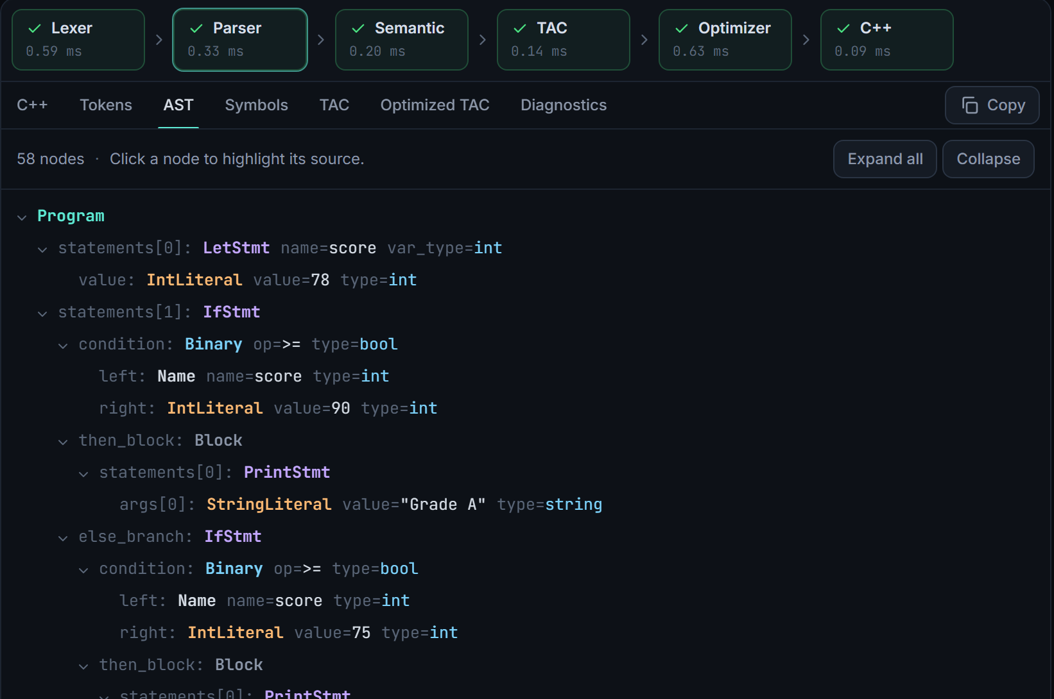
FRONT END OF THE COMPILER
Lexer, parser and abstract syntax tree
Lexical analysis (lexer.py)
▸ Hand-written scanner; longest-match operators (<= before <).
▸ 1-based line:column span on every token; newlines ignored inside ( ).
▸ Reports all lexical errors in one pass, with hints (! → use not).
Syntax analysis (parser.py)
▸ Recursive descent: one method per grammar rule.
▸ Precedence from the call chain: or < and < not < equality < comparison < + - < * / % < unary.
▸ Typed AST dataclasses with spans, serialized to JSON for the AST tab.
▸ Stops at the first syntax error; nesting ≤ 50, expression height ≤ 150.
Live AST tab: typed nodes for an else-if chain (cropped screenshot)
CodeBridge · Pseudocode-to-C++ Compiler
9 / 15
Notes:
The lexer collects every lexical error so the user sees them all at once. The parser is predictive recursive descent; precedence is encoded by which method calls which, and left associativity by loops. Depth limits stop malicious input from overflowing Python's call stack. The screenshot is the live AST tab.

Slide 10
MIDDLE END
Semantic analysis, intermediate code and optimization
Semantic analysis
Original TAC
Optimizer: 11 passes
▸ Symbol table = stack of scopes, one per block.
▸ S001 undefined · S002 redeclared · S003 bad assignment · S004 operand types · S005 non-bool condition · S006 division by literal 0.
▸ Shadowed names renamed (x → x_2).
▸ All errors collected, no cascades; S100 unused warning.
t1 = 2 * 3
t2 = t1 + 4
x = t2
i = 0
L1:
t3 = i < x
ifFalse t3 goto L2
repeated until nothing changes
✓ Constant folding
✓ Constant propagation
✓ Copy propagation
✓ Algebraic simplification
✓ Self-assignment removal
✓ Branch folding
✓ Temporary coalescing
✓ Dead temporary elimination
✓ Unreachable code removal
✓ Redundant jump removal
✓ Unused label removal
Optimized TAC
x = 10
i = 0
L1:
t3 = i < x
ifFalse t3 goto L2
Safe by design: local to basic blocks, no overflow or ÷0 folding, exact float identities only.
CodeBridge · Pseudocode-to-C++ Compiler
10 / 15
Notes:
Semantic analysis assigns a type to every expression and reports the six semantic error codes. TAC is the intermediate representation: one operator per instruction, labels and conditional jumps. The code panels show exact compiler output for let x = 2 * 3 + 4 before a loop: folding and propagation reduce three instructions to x = 10. Propagation is reset at labels, so it never crosses into a loop body.

Slide 11
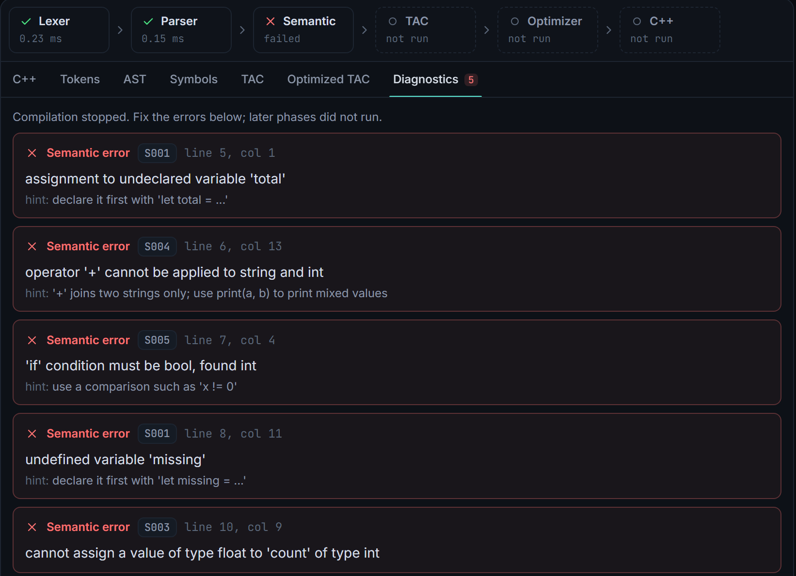
BACK END
C++ code generation, error handling and output
CodeBridge source
Generated C++ (body of main)
let n = 1
let total = 0
while n <= 5 {
if n % 2 == 0 {
total = total + n * n
} else {
print n, "is odd"
}
n = n + 1
}
print("sum of even squares:", total)
long long n = 1;
long long total = 0;
while (n <= 5) {
if (n % 2 == 0) {
total = total + n * n;
} else {
std::cout << n << " is odd\n";
}
n = n + 1;
}
std::cout << "sum of even squares: "
<< total << "\n";
Live Diagnostics tab (cropped): code, line:col, message, hint
▸ Errors underlined in the editor
▸ 413 if too large, 422 if malformed
▸ JSON 500, never a crash
▸ No C++ after a failure
▸ Built from optimized TAC: single-use temporaries inlined, jump patterns rebuilt as while / if / else if, goto fallback.
▸ g++ output: 1 is odd, 3 is odd, 5 is odd, sum of even squares: 20: identical to the reference interpreter.
CodeBridge · Pseudocode-to-C++ Compiler
11 / 15
Notes:
This pair is unedited compiler output; the last C++ statement is wrapped here only to fit the slide. The generator never sees the AST, only optimized TAC, and reconstructs structured control flow from jump patterns. On the right is the error handling: structured diagnostics, HTTP limits, and the rule that no C++ is produced for a failing program.

Slide 12
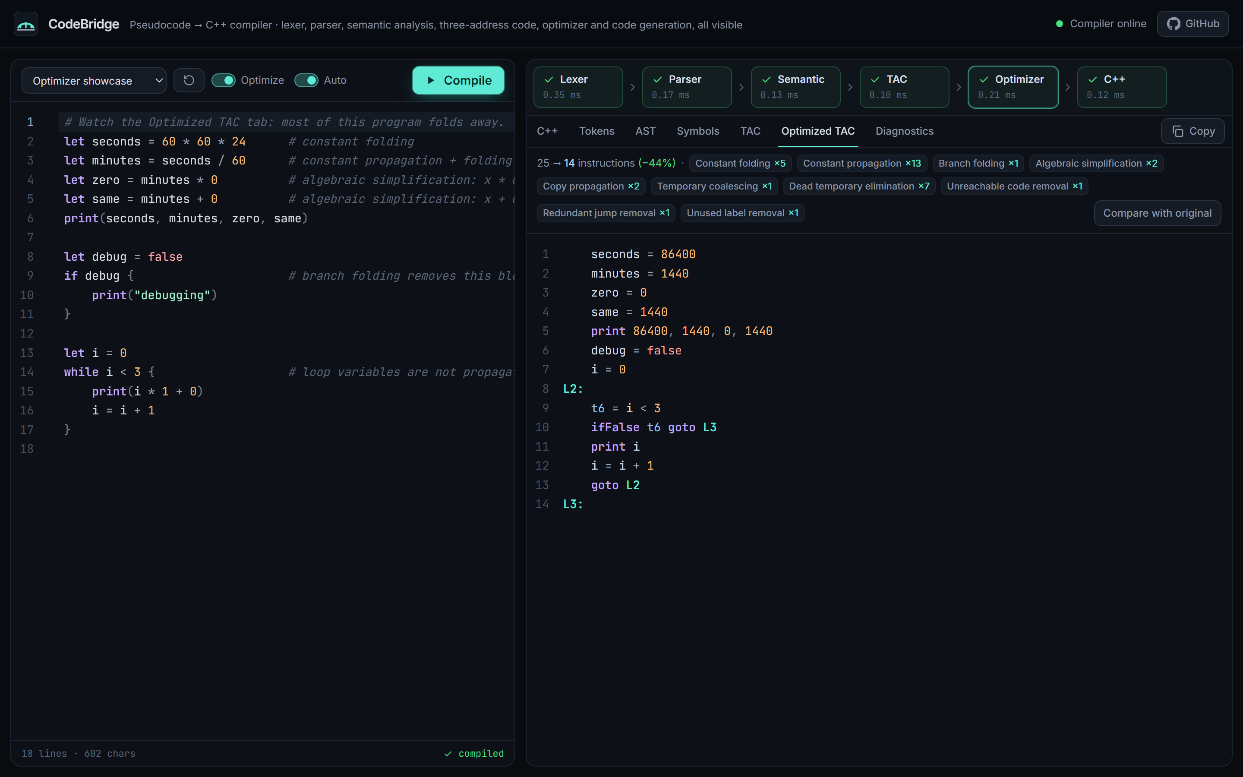
DEMO
Live application and user workflow
1
Open
codebridge-swart.vercel.app; first request may wake the free-tier server
2
Write or pick
type a program or choose one of 12 examples
3
Compile
auto-compiles 650 ms after typing, or press Compile (Ctrl+Enter)
4
Inspect
switch tabs: Tokens, AST, Symbols, TAC, Optimized TAC
5
Use the C++
copy the generated C++ and build it with any C++17 compiler
codebridge-swart.vercel.app: Optimizer showcase, 25 → 14 TAC instructions (−44%)
CodeBridge · Pseudocode-to-C++ Compiler
12 / 15
Notes:
This is a screenshot of the deployed site, not a mock-up. If the network allows, switch to the live site and follow the five steps: load the Optimizer showcase, show Optimized TAC, introduce a typo to show an inline error, then open the C++ tab.

Slide 13
VERIFICATION
Testing strategy and verified results
Automated suite | Tests | Highlights
Lexer | 12 | every lexical error code
Parser + AST | 48 | precedence, 21 syntax errors
Semantic | 31 | S001–S006, scopes
TAC | 18 | TAC vs. AST interpreter
Optimizer | 28 | 300 random programs
C++ generation | 36 | g++ build and run
API + health | 34 | 413/422/500, CORS
End-to-end | 6 | server → HTTP → g++
Frontend (Vitest) | 20 | API client, views
213
20
backend tests
passed
frontend tests
passed
Manual checks (not automated)
▸ /health → HTTP 200
▸ CORS: Vercel origin allowed, others rejected
▸ Headless Edge: app online, all phases green
▸ Live C++ for 3 examples built with g++ = expected output
▸ Warm compile round trip 0.55–1.45 s
▸ Audit: 192 random programs matched g++
Oracle: each example must print the same output in the AST interpreter, original TAC, optimized TAC and a g++-built binary.
CodeBridge · Pseudocode-to-C++ Compiler
13 / 15
Notes:
Distinguish the two kinds of evidence. The table is the automated suite, run locally and in GitHub Actions: 213 backend and 20 frontend tests, all passing. The box on the right lists checks done by hand or with one-off scripts against the deployed site on 13 October 2026; they are not part of the automated suite.

Slide 14
NEXT STEPS
Limitations and future enhancements
Current limitations
Future enhancements
▸ No functions, arrays, for loops or input
▸ Only the first syntax error is reported
▸ Optimization is local to basic blocks; no loop-invariant code motion
▸ Run-time ÷0 or overflow is undefined, as in C++
▸ Free hosting sleeps when idle: cold start up to ~1 minute
▸ Functions with a call stack in TAC
▸ Panic-mode error recovery for multiple syntax errors
▸ Global data-flow analysis and SSA form
▸ Run generated C++ in the browser via WebAssembly
CodeBridge · Pseudocode-to-C++ Compiler
14 / 15
Notes:
Be candid: the language is intentionally small and the optimizer is intentionally conservative. The future work list follows from the limitations; WebAssembly would show program output without executing code on the server.

Slide 15
CONCLUSION
What CodeBridge delivers
Thank you
▸ A complete, hand-written six-phase compiler from pseudocode to C++17.
▸ Every phase visible in a deployed, responsive web workbench.
▸ Safe, measurable optimization (e.g. 25 → 14 TAC instructions).
▸ Correctness backed by 233 automated tests, reference interpreters and real g++ builds.
Questions?
Live app
codebridge-swart.vercel.app
Source code
github.com/ashmita-dev/CodeBridge
[Student Name] · [Roll Number] · Guide: [Guide Name] · [Institution]
Notes:
Summarize the four outcomes, then invite questions. Likely questions: why recursive descent (simple, precise errors, no generator), why optimize TAC rather than the AST (classical, easier to reason about), how correctness is checked (reference interpreters and g++), and why code is not executed on the server (security).

