Slide 1
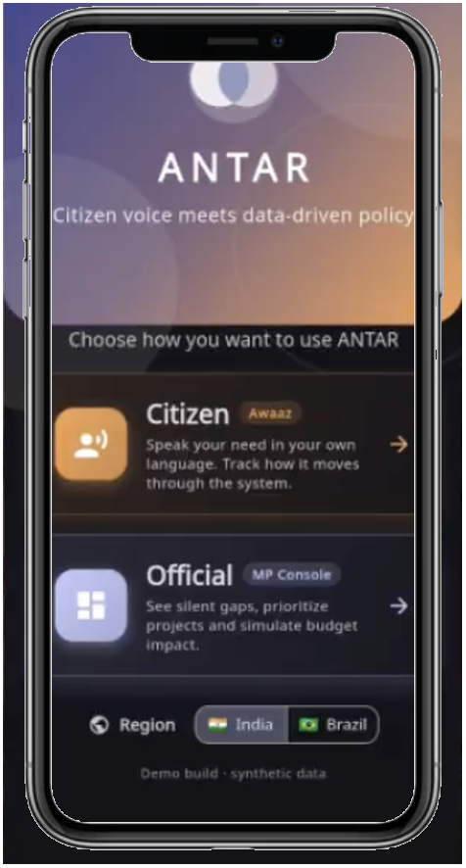
ANTAR
AI FOR DIGITAL PUBLIC
INFRASTRUCTURE & GOVERNANCE
Citizen voice meets data-driven policy.
A Digital Public Good powered by Google Gemini.
Build with AI: Code for Communities
TEAM ALGOCODERS

Slide 2
THE PROBLEM
543
INDIA'S GOVERNANCE FEEDBACK
LOOP IS BROKEN
CONSTITUENCIES
Fragmented feedback systems
with no unified data layer
Citizen feedback lives in fragmented,
disconnected systems across 543 constituencies.
22+
Development requests never reach
the right policymaker at the right time.
LANGUAGES
No inclusive voice channel
for non-English speakers
No data-driven way to prioritize
where public money should go.
22+ languages create barriers
to inclusive civic participation.
₹0
DATA-DRIVEN SPEND
The feedback is digital, but the people waiting for change are real.
Public spending decisions
made without demand data

Slide 3
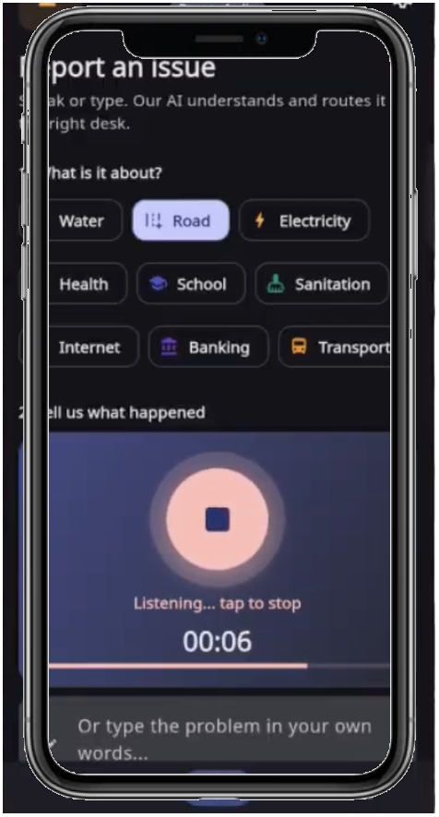
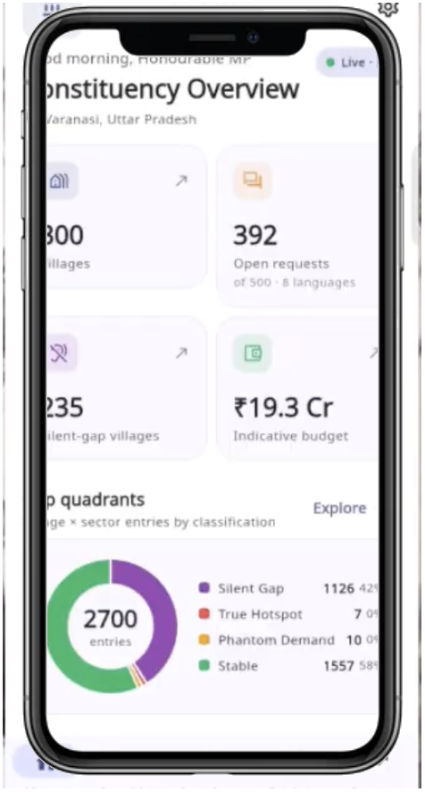
WHAT IF EVERY CITIZEN'S
VOICE SHAPED POLICY?
Introducing ANTAR — two interfaces connected by one AI engine.
CITIZEN AWAAZ
MP CONSOLE
Citizens report infrastructure
issues via voice or text in their
native language.
Every report is tagged with
location and tracked to resolution.
Policymakers see constituency
analytics — gap maps, scatter
plots, budget simulations,
and AI recommendations.
Auto-generated PDF briefs
for ministry meetings.
AI

Slide 4
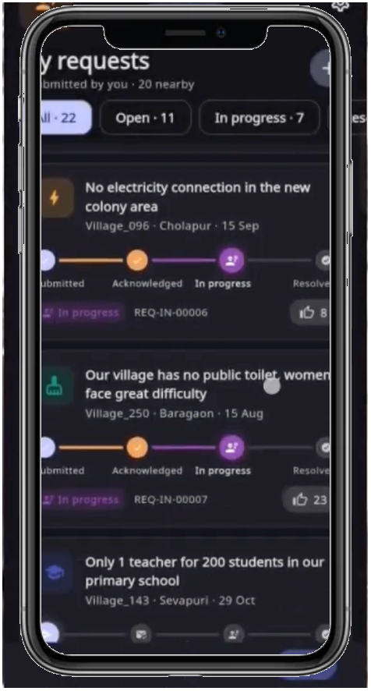
CITIZEN AWAAZ
REPORT. TRACK. BE HEARD.
Voice & Text Reporting
Citizens describe issues in their native language
via voice recording or text — no English required.
Smart Categorization
Issues auto-classified into Roads, Water, Sanitation,
Electricity, Health, School, and more using Gemini AI.
Google Maps Tagging
Every report is pinned to an exact location on Google
Maps — enabling geographic analysis at scale.
Real-Time Tracking
Citizens track their issue from submission through
resolution — closing the accountability loop.
5 Languages: English Hindi Bengali Tamil Portuguese

Slide 5
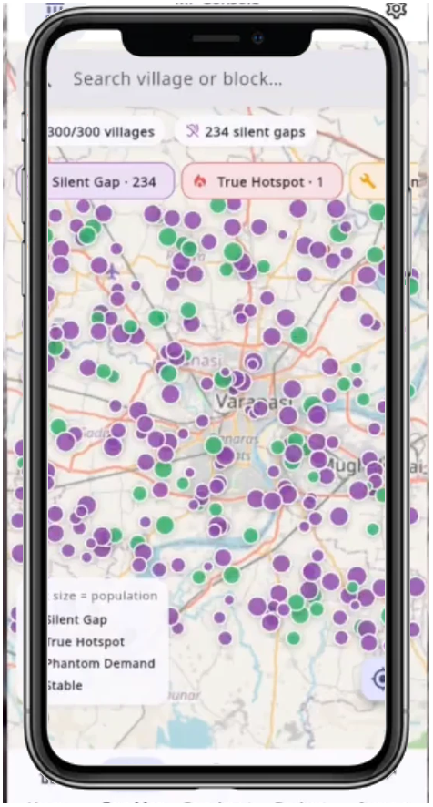
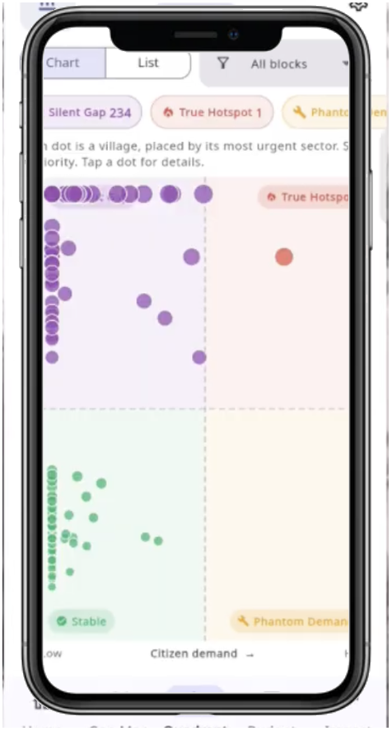
MP CONSOLE
DATA-DRIVEN GOVERNANCE AT YOUR FINGERTIPS
GAP MAP
Geographic heatmap overlaying citizen demand
hotspots with existing infrastructure coverage.
Identifies underserved villages where investment
is most needed — powered by Google Maps.
QUADRANT ANALYSIS
Scatter-plot analytics plotting infrastructure gap
vs. citizen demand across every village. Helps MPs
prioritize: high-gap + high-demand issues
demand immediate action.

Slide 6
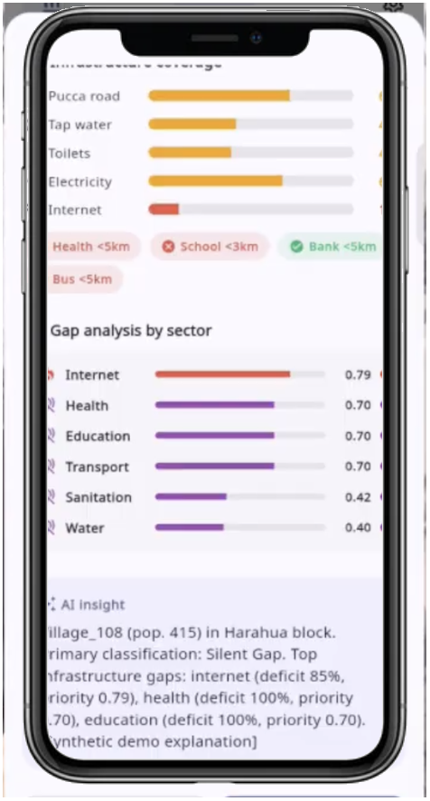
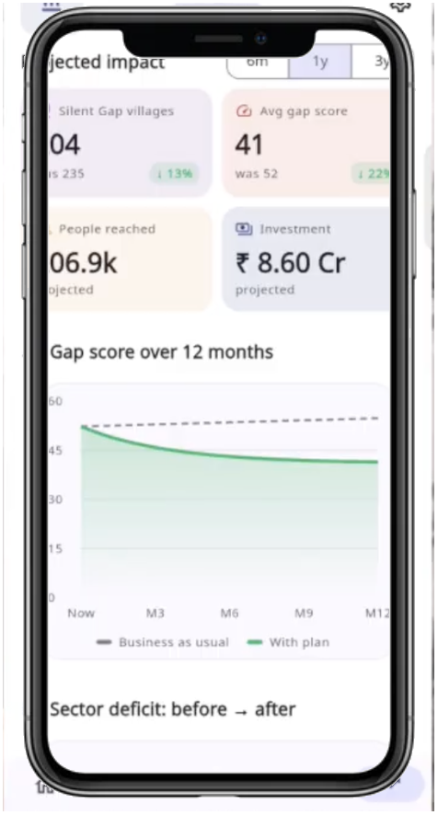
SIMULATE. RECOMMEND. ACT.
VILLAGE DEEP-DIVE
Tap any village on the map to see infrastructure
coverage (roads, water, toilets, electricity, internet),
gap analysis by sector, and AI-generated insights.
AI RECOMMENDATIONS
Gemini analyzes aggregated citizen requests
against demographic and infrastructure data to
generate prioritized project suggestions matched
to government schemes (PMGSY, Jal Jeevan, KUSUM).
PROJECTED IMPACT
Track gap score reduction over time, people reached,
and investment needed — with before/after projections.

Slide 7
POWERED BY GOOGLE AI
Mandatory Google AI integration across the entire platform.
GEMINI API
CLOUD SPEECH-TO-TEXT
Core AI engine. Analyzes aggregated citizen
grievances against national demographic and
infrastructure data. Generates prioritized
policy recommendations and project rankings.
Enables voice-based issue reporting in
multiple Indian languages. Citizens speak
naturally — AI transcribes, classifies, and
routes their feedback automatically.
GOOGLE MAPS PLATFORM
TRANSLATION API
Location tagging for every citizen report.
Powers the Gap Map visualization — geographic
heatmaps revealing infrastructure coverage
gaps across constituencies.
Real-time multilingual support across India's
linguistic regions. Hindi, Bengali, Tamil,
English, Portuguese — with architecture
ready for all 22 scheduled languages.

Slide 8
BUILT FOR INDIA,
AT SCALE
Designed as a Digital Public Good — open, scalable, deployable.
543
28+
5
1.4B
Lok Sabha
Constituencies
States &
UT Coverage
Languages
Supported
Citizens
at Scale
Works offline in demo mode — Firebase-ready for production
One ward to national deployment — same architecture
Expandable to all 22 scheduled Indian languages
Open-source, auditable, government-ready

Slide 9
TECHNOLOGY
End-to-end stack built for performance, scale, and accessibility.
FRAMEWORK
AI / GenAI
MAPS
BACKEND
Flutter (Dart)
Google Gemini API
Google Maps Platform
Firebase
Cross-platform mobile app
with single codebase
Policy recommendation
engine & text analysis
Location tagging &
gap-map visualization
Auth, Firestore, Storage
Real-time sync
VOICE
CHARTS
STATE
ROUTING
Speech-to-Text + TTS
FL Chart
Riverpod
GoRouter
Multilingual voice input
and audio feedback
Interactive scatter plots
and budget visualizations
Reactive state management
with code generation
Declarative navigation
with deep linking

Slide 10
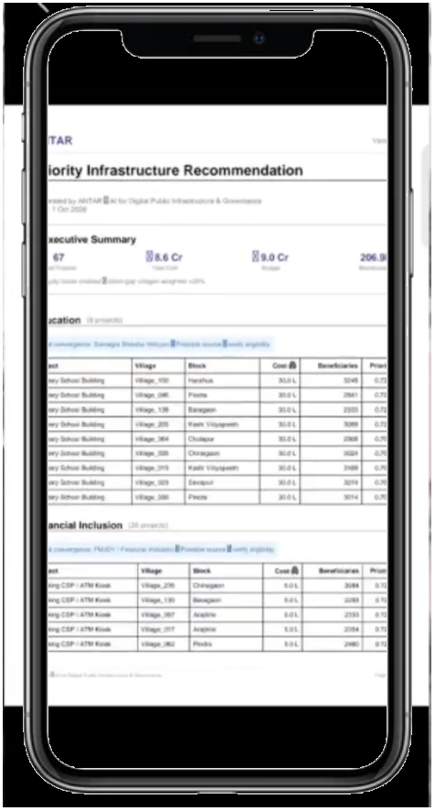
SEE IT
IN ACTION
DEMO VIDEO
3-5 minute end-to-end walkthrough
https://drive.google.com/file/d/1fA5JOmdmvQpxJPvYE9XSki9bhGm58L5e
SOURCE CODE
Open-source GitHub repository
https://github.com/ashmita-web/antar
TEAM ALGOCODERS
Build with AI: Code for Communities
Second Edition

