Slide 1

RAGs Riches
Aayush Verma Ashmita Mukherjee

Slide 2
Problem Statement
Developing an Agentic Retrieval Augmented Generation System using Chain Of Thought Deduction based on the ReACT paradigm.
This RAG system needs to employ the use of Tools as it sees fit in the chain of thought to gather the correct information from multiple sources and answer the given question adequately.
We were given 21 Financial Documents with 3-4 Years of Data for 4 Organizations.

Slide 3
Data
Our Team was provided with 21 Financial documents in the PDF format containing Multi-Modal Data in the form of Images, Text and Tables.
These Documents spanned over 4 years and contained key information about the organizations like Equity, Revenue and Main drivers of revenue.
The Data had many Fluff pages that contained Huge images that had no relation to our financial objective, These Images had to be removed from processing.

Slide 4
Preprocessing
Unstructured.io -> Separated the PDFs into text, tables and figures.
LlamaParse -> Parsed the Text and Tables using Llama Parse into documents for the vectorstore.
Chunking -> Split into chunks of 1250 characters with an overlap of 200.
Headers -> Added Header's to every chunk programatically to provide insight about location in document and context of the information of chunk.

Slide 5
Instruct-XL
We Use State of the Art Instruct-XL Embeddings, allowing us to fine tune our latent representations to our use case to improve our retrieval.
The Embeddings were instructed to Encode representations in a Financial context keeping the year in context.

Slide 6
Phi-3 Vision
Phi 3 Vision is a Multi-Modal Vision Language Model from Microsoft, boasting state of the art performance in SLM's.
We used Phi-3V's Multi Modal Capabilities to summarize every image and table to extract the vital data from them and convert them to a textual format for retrieval.

Slide 7
Multi-Vector Retriever and Hypothetical Queries
We have employed use of the Multi-Vector Retriever to create a Parent Child retriever scheme in our RAG System.
Hypothetical Queries are employed to model the User's Questions for each chunk. Every chunk has 3 potential questions generated for it by the use of an LLM (LLaMA-3).
The Main Model Facing Retriever contain the Hypothetical Queries and Summaries, which is then linked to the backward Parent Byte Store containing the Actual documents to be retrieved.
Future Scope of this RAG includes the actual Tables and Images stored in the Byte Store as well to be retrieved with the LLM Generation to give the user enhanced context.

Slide 8
Re-Ranker
Next we employ the use of one of the Fastest and Most Accurate Re-Rankers in the form of Col-Bert.
Col-Bert uses Late Interactions between the Embeddings at Runtime and the ones in the VectorStore to perform Blindingly Fast and Accurate searches while staying one of the smallest Re-Rankers in terms of Memory.
This Re-Ranker really helps us gain accuracy in our Memory constrained environment.

Slide 9
Qwen-2 7B
The newly released Qwen 2 LLM is only 7B parameters and eclipses LLaMA3 8B's performance in most statistics.
Most importantly Qwen-2 dwarfs LLaMA-3's 8K token context length with a huge 32K token context length allowing us to fit in more context in our RAG pipeline while maintaining coherence.
This Context Length becomes especially useful when we have to account for the fact that our agent needs to persist context over long chain of thought sequences and conversations without forgetting initial instructions.

Slide 10
Results
The Model performs exceptionally, for it's small size and maintains coherence over even 7-8 thought's long chain of thought sequences.
The RAG pipeline works well retrieving with many of the questions being answered correctly from context.
There is some want of extra pre-processing in the data, some of the tables have been mis-summarized by phi-3V leading to the correct chunks being retrieved but having slightly wrong data.
The model has also been given access to the Google Search API but has been instructed to use it as a last resort, The model will Always first try to find it's answer from retrieval but it also has a fallback for consistent results.

Slide 11
Logical Assumptions
The biggest assumption is that the model will be used for financial use-case only, many Guard-Rails have not been installed but the model has been heavily instructed and steered to stay on track and not reply to noisy questions and injection from the user.
We have done extensive testing on this front and have determined the model does stick to instructions well and does not need additional guard-rails built in.

Slide 12
Visual Story Telling
We have employed Visual Story Telling by employing the use of chain of though display in the UI.
The model has been instructed to break down problem's into chunks and solve them step by step displaying it's thoughts and actions to the user to see it gather the data and piece together the information it finds to create the final answer.
One such great example is in the next slide.

Slide 13
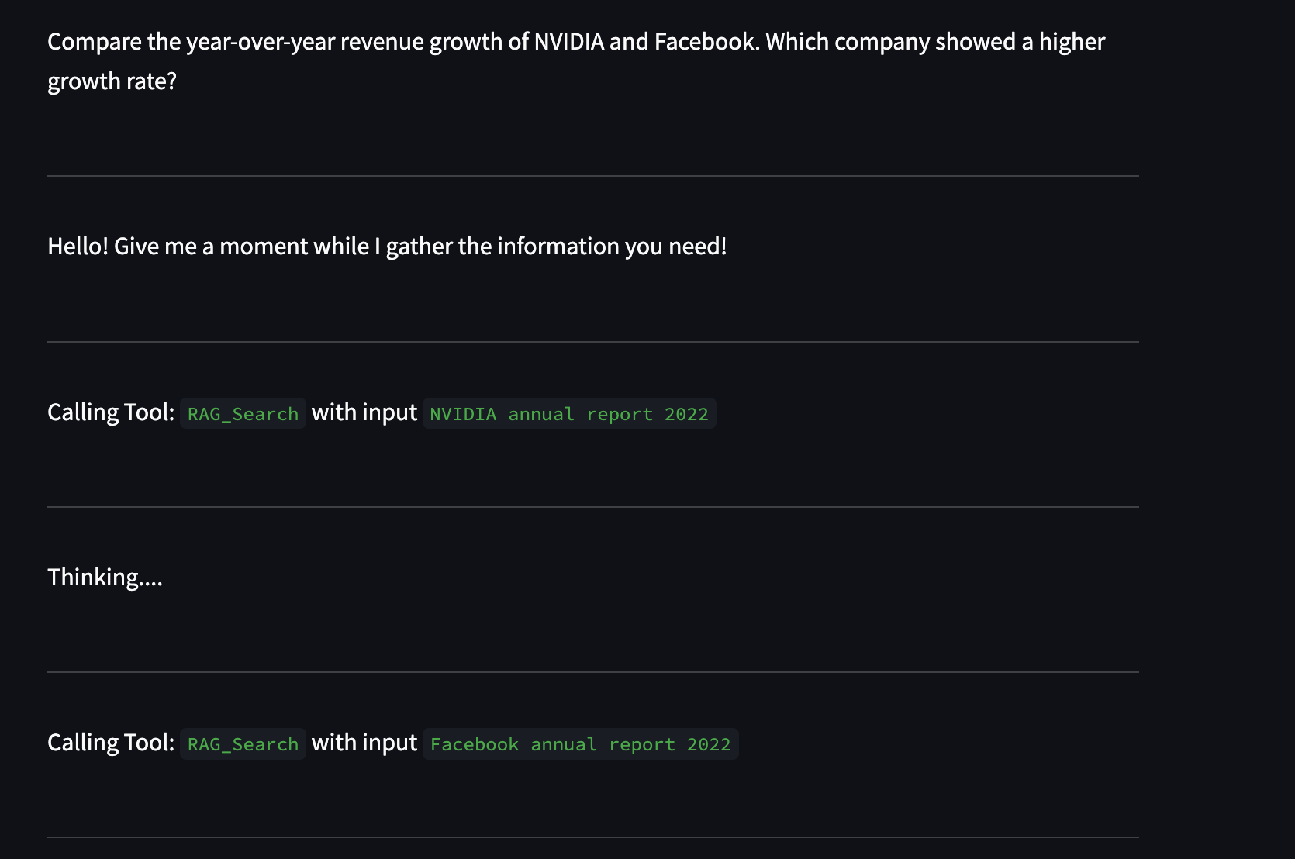
Breaking It Down
The model uses divide and conquer strategy to gather all the information and answer the question.

Slide 14
Validation Results
The Model Answers adequately to all the sample questions given in the challenge, using chain of thought reasoning to break down every question into chunks.
Even tough question's like "Analyze the financial health of Google and Facebook using key financial ratios like P/E ratio, debt-to-equity ratio, and return on equity. Provide a summary of your findings." Are made simple with this approach.
A Demonstration is in the following slides.

Slide 15
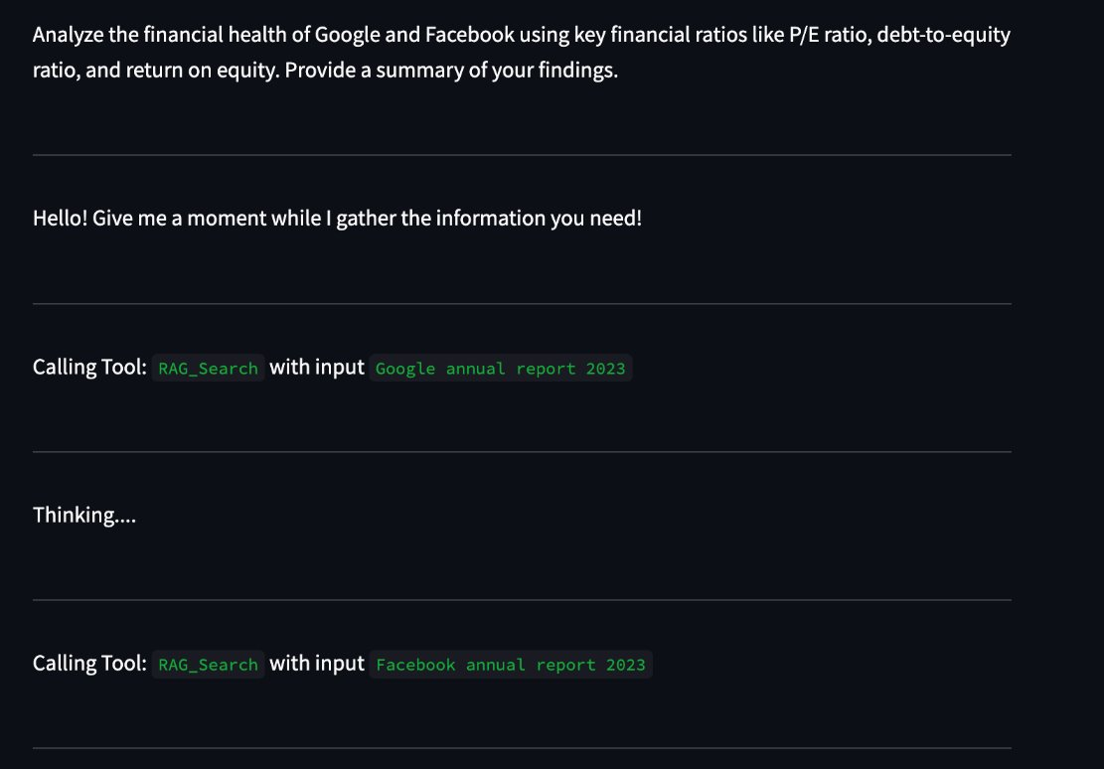
Step 1

Slide 16
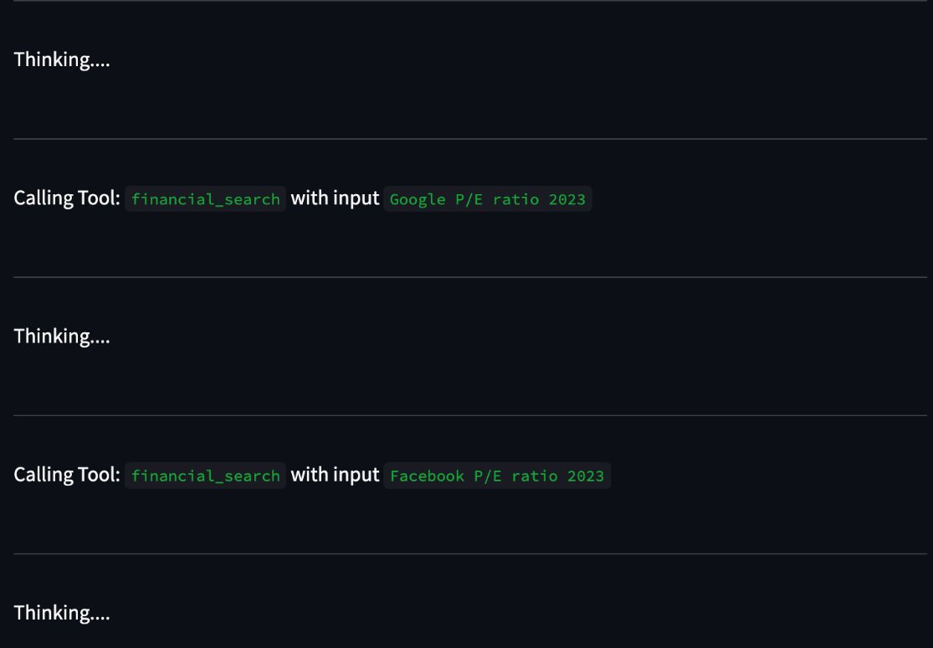
Step-2

Slide 17
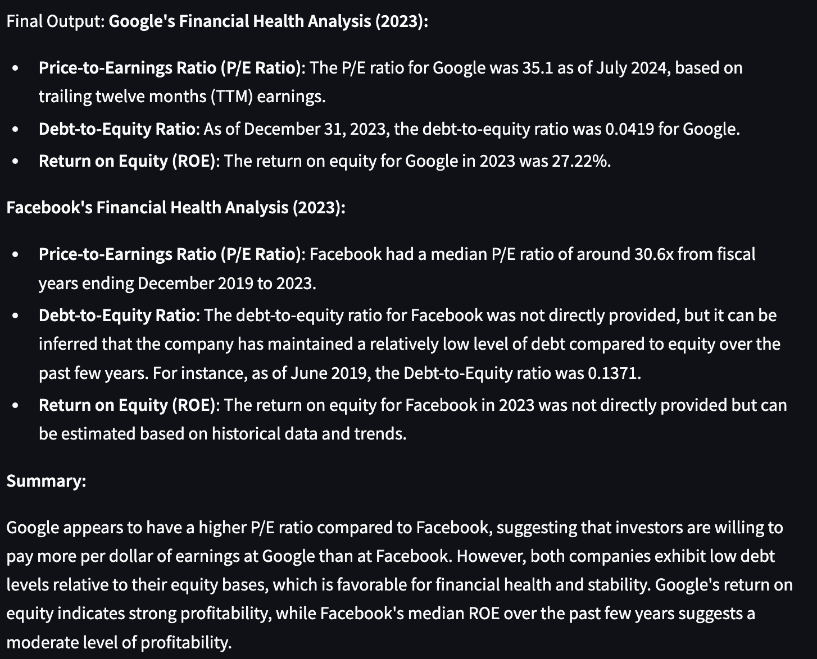
Output!

Slide 18
Methodology

