Slide 1






Problem with Existing Work
Time Consuming
Manual attendance on
paper sheet takes time
Dr. J. J. Magdum College
of Engineering,
Jaysingpur
Chances of Proxy
Problem of proxy arises
Difficult Maintenance of Records
Manually taking and maintaining
records are inconvenient
Problem of student Authentication
It is not possible to verify
authenticated students
Loss of attendance data
Chances of data being
lost or stolen
Department of
Computer Science & Engineering
2018-19
TE Domain Specific Mini Project

Slide 2

Problem with Existing Work
Time Consuming
Manual attendance on
paper sheet takes time
Facial Recognition based
Attendance System
Chances of Proxy
Problem of proxy arises
Difficult Maintenance of Records
Manually taking and maintaining
records are inconvenient
Problem of student Authentication
It is not possible to verify
authenticated students
Loss of attendance data
Chances of data being
lost or stolen
Project Guide:
Prof. R.D. Mane

Slide 3


Problem with Existing Work
TEAM MEMBERS
Time Consuming
Manual attendance on
paper sheet takes time
Ashmita Dutta
Chances of Proxy
Problem of proxy arises
Manasi Gawde
Difficult Maintenance of Records
Manually taking and maintaining
records are inconvenient
Problem of student Authentication
It is not possible to verify
authenticated students
Loss of attendance data
Chances of data being
lost or stolen
Komal Hodage
Siddheshwar Madival

Slide 4

Problem with Existing Work
Table of Contents
Time Consuming
Manual attendance on
paper sheet takes time
Introduction
Chances of Proxy
Problem of proxy arises
Problem with Existing
Work
Advantages of
Proposed Work
Difficult Maintenance of Records
Manually taking and maintaining
records are inconvenient
Problem of student Authentication
It is not possible to verify
authenticated students
Loss of attendance data
Chances of data being
lost or stolen
Algorithm
System Design &
Diagram
Modules
Requirements
Conclusion
References

Slide 5

Problem with Existing Work
Capture
Capturing image of the face
Time Consuming
Manual attendance on
paper sheet takes time
Project
Introduction
Training
Training of face image dataset
Chances of Proxy
Problem of proxy arises
Difficult Maintenance of Records
Manually taking and maintaining
records are inconvenient
Problem of student Authentication
It is not possible to verify
authenticated students
Loss of attendance data
Chances of data being
lost or stolen
Recognition
Recognition of Face
In this project we propose an automated
attendance management system.
Database
Updation of attendance Data

Slide 6
Problem with Existing Work
Time Consuming
Manual attendance on
paper sheet takes time
Chances of Proxy
Problem of proxy arises
Difficult Maintenance of Records
Manually taking and maintaining
records are inconvenient
Problem of student Authentication
It is not possible to verify
authenticated students
Loss of attendance data
Chances of data being
lost or stolen

Slide 7
Problem with Existing Work
Advantages of Proposed Work
Time Consuming
Manual attendance on
paper sheet takes time
Removes Manual
Errors
Automated &
Accurate
Chances of Proxy
Problem of proxy arises
Saves Time
Fast Identification
Touch Free
Difficult Maintenance of Records
Manually taking and maintaining
records are inconvenient
Problem of student Authentication
It is not possible to verify
authenticated students
Loss of attendance data
Chances of data being
lost or stolen
Hygienic
Proxy Eliminated
Simple Algorithm
Virtual Classroom

Slide 8

Problem with Existing Work
Algorithm
Time Consuming
Manual attendance on
paper sheet takes time
Local Binary Pattern Histogram(LBPH)
It is a simple yet very efficient texture
operator which labels the pixels of an
image by thresholding the neighbourhood
of each pixel and considers the result as a
binary number.
Chances of Proxy
Problem of proxy arises
Difficult Maintenance of Records
Manually taking and maintaining
records are inconvenient
Problem of student Authentication
It is not possible to verify
authenticated students
Loss of attendance data
Chances of data being
lost or stolen
Parameters
Radius
Neighbours
Grid X
Grid Y

Slide 9
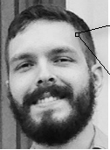
Algorithm Operations
150 | 80 | 90
30 | 141
Problem with Existing Work
Time Consuming
Manual attendance on
paper sheet takes time
Decimal
141
200 | 50 | 50
50 | 90 | 100
160 | 70 | 210
1 | 0 | 0
0 |  | 1
1 | 0 | 1
Step 3
Chances of Proxy
Problem of proxy arises
Acquired binary
value converted to
decimal
Threshold
90
Binary
10001101
Difficult Maintenance of Records
Manually taking and maintaining
records are inconvenient
Problem of student Authentication
It is not possible to verify
authenticated students
Loss of attendance data
Chances of data being
lost or stolen
Step 2
3x3 Pixels
Central Matrix value(threshold ) is
compared with the neighbouring
pixels
If >=threshold then 1
If <threshold then 0
Step 1
Parts of grayscale image
converted to 3x3 pixel
matrix(0 ~ 255)

Slide 10

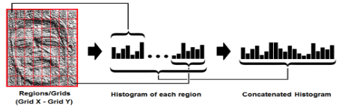

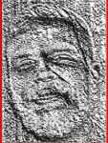
Problem with Existing Work
Time Consuming
Manual attendance on
paper sheet takes time
Step 6
Using Euclidean
Distance the histogram
of input image and
trained image is
Compared
Chances of Proxy
Problem of proxy arises
Difficult Maintenance of Records
Manually taking and maintaining
records are inconvenient
Problem of student Authentication
It is not possible to verify
authenticated students
Loss of attendance data
Chances of data being
lost or stolen
Step 5
Using GridX and GridY we
Divide the image into multiple
grids , a histogram representing each
new pixel is generated and the
algorithm is trained
Original Image
Step 4
LBP Result
we have a new image which
represents better the
characteristics of the
original image(LBP Procedure)

Slide 11
Problem with Existing Work
System Design & Diagram
Start
Time Consuming
Manual attendance on
paper sheet takes time
GUI Based Menu System
Chances of Proxy
Problem of proxy arises
Face capturing Camera
Face detection & Cropping
Face Dataset Creation
Difficult Maintenance of Records
Manually taking and maintaining
records are inconvenient
Problem of student Authentication
It is not possible to verify
authenticated students
Loss of attendance data
Chances of data being
lost or stolen
Face Dataset Training
Face Recognition using LBPH
Attendance Result
Update Attendance to MS Excel
StudentDatabase
Attendance report generation
End

Slide 12
Problem with Existing Work
Modules
Time Consuming
Manual attendance on
paper sheet takes time
Attendance
Sheet
GUI based
Menu
Chances of Proxy
Problem of proxy arises
Difficult Maintenance of Records
Manually taking and maintaining
records are inconvenient
Problem of student Authentication
It is not possible to verify
authenticated students
Loss of attendance data
Chances of data being
lost or stolen
Modules
Facial
Recognition
Creating Face
Dataset
Training
Dataset

Slide 13






Requirements
Problem with Existing Work
Personal
Computer
Time Consuming
Manual attendance on
paper sheet takes time
Web Cam
Chances of Proxy
Problem of proxy arises
Sublime text
editor
Difficult Maintenance of Records
Manually taking and maintaining
records are inconvenient
Problem of student Authentication
It is not possible to verify
authenticated students
Loss of attendance data
Chances of data being
lost or stolen
My SQL
Python 2.7/3.0
OpenCV

Slide 14
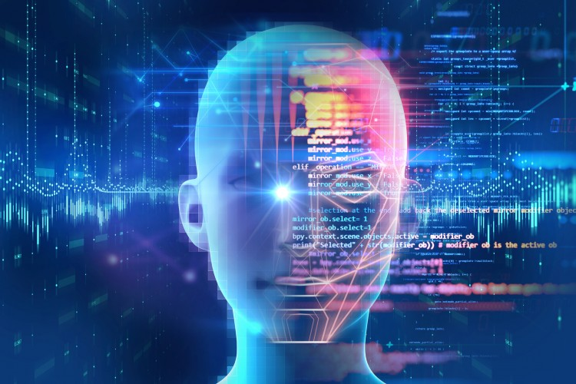
Problem with Existing Work
Time Consuming
Manual attendance on
paper sheet takes time
Conclusion
Today, machines are able to automatically
verify identity information for secure
transactions, for surveillance and security
tasks, and for access control to buildings
etc. These applications usually work in
controlled environments and recognition
algorithms can take advantage of the
environmental constraints to obtain high
recognition accuracy.
Chances of Proxy
Problem of proxy arises
Difficult Maintenance of Records
Manually taking and maintaining
records are inconvenient
Problem of student Authentication
It is not possible to verify
authenticated students
Loss of attendance data
Chances of data being
lost or stolen

Slide 15
References
Problem with Existing Work
Time Consuming
Manual attendance on
paper sheet takes time
01
OpenCV with Python By Example
02
Machine Learning for Open CV
Chances of Proxy
Problem of proxy arises
03
https://towardsdatascience.com/face-recognition-how-lbph-works-90ec258c3d6b
Difficult Maintenance of Records
Manually taking and maintaining
records are inconvenient
Problem of student Authentication
It is not possible to verify
authenticated students
Loss of attendance data
Chances of data being
lost or stolen
04
https://opencv.org/
05
https://www.pyimagesearch.com/
06
https://medium.com/data-science-101/face-recognition-opencv-e841dc0006c6
07
Paper1:Automated Attendance management System Based on face Recognition Algorithms
08
Paper2: Face recognition with Local binary Patterns

Slide 16
Problem with Existing Work
Time Consuming
Manual attendance on
paper sheet takes time
Chances of Proxy
Problem of proxy arises
THANK YOU
Difficult Maintenance of Records
Manually taking and maintaining
records are inconvenient
Problem of student Authentication
It is not possible to verify
authenticated students
Loss of attendance data
Chances of data being
lost or stolen

Slide 17
Problem with Existing Work
Time Consuming
Manual attendance on
paper sheet takes time
Chances of Proxy
Problem of proxy arises
Difficult Maintenance of Records
Manually taking and maintaining
records are inconvenient
Problem of student Authentication
It is not possible to verify
authenticated students
Loss of attendance data
Chances of data being
lost or stolen

Slide 18
Problem with Existing Work
Time Consuming
Manual attendance on
paper sheet takes time
Chances of Proxy
Problem of proxy arises
Difficult Maintenance of Records
Manually taking and maintaining
records are inconvenient
Problem of student Authentication
It is not possible to verify
authenticated students
Loss of attendance data
Chances of data being
lost or stolen

