Slide 1
Data Structures and Algorithms -3 (25CS2103E)
Resume Search and Candidate Screening System
LINGALA ASHMITHA REDDY 2520030061
ARIKATLA NAGAJYOTHI 2520030208
KONDAMUDI HARIKA 2520030397
Under the Esteemed Guidance of
Dr. V.Sireesha

Slide 2
Contents
Abstract
Introduction
Literature survey
Problem Statement and Objectives
Hardware and Software requirements
Results
Conclusion
Future Scope

Slide 3
Abstract
The Resume Search and Candidate Screening System is designed to simplify and improve the process of identifying suitable candidates from a collection of resumes. In traditional recruitment, recruiters often need to manually screen a large number of resumes, which can be time-consuming and inefficient. Our system searches and analyzes resumes based on the skills and requirements provided for a particular job role. Pattern matching is used to identify exact required skills and keywords present in resumes, while fuzzy search helps detect approximate matches and spelling variations. A similarity algorithm is then used to measure the relevance between the job requirements and the resume content. Based on the obtained scores, candidates can be ranked according to their relevance, helping recruiters identify suitable candidates more efficiently.

Slide 4
Introduction
The recruitment process often involves reviewing a large number of resumes to identify candidates who best match a particular job role. Manual resume screening can be time-consuming and may lead to inconsistent results, especially when recruiters need to compare candidates based on multiple skills and requirements.
The Resume Search and Candidate Screening System aims to provide an efficient approach for searching and analyzing resumes based on specified job requirements. The system examines resume content to identify relevant skills and keywords using pattern matching. It also uses fuzzy search to handle spelling mistakes and approximate matches that may not be detected through exact keyword searching.
Furthermore, a similarity algorithm is used to determine how closely a candidate's resume matches the given job requirements. The resulting scores can be used to rank candidates according to their relevance, making the screening process faster and more systematic.

Slide 5
Literature Survey
Existing Approach | Description | Limitation
Manual Resume Screening | Recruiters manually read and compare resumes with job requirements. | Time-consuming and difficult when the number of resumes is large.
Keyword-Based Search | Searches resumes for specific skills and keywords. | May miss relevant candidates when different terms or spelling variations are used.
Pattern Matching | Identifies exact skills or keywords in resume text. | Exact matching may not handle spelling mistakes or similar terms.
Fuzzy Search | Finds approximate matches even when the search term and resume text are slightly different. | May require a similarity threshold to avoid irrelevant matches.
Similarity-Based Screening | Measures how closely a resume matches the given job requirements. | Accuracy depends on the similarity technique and text representation used.

Slide 6
Problem Statement and Objectives
Problem Statement
Recruiters often spend significant time manually screening large numbers of resumes. Traditional keyword-based searching may miss relevant candidates due to spelling variations or differences in how skills are written. Therefore, an efficient system is needed to search resumes and identify candidates based on their relevance to specific job requirements.
Objectives
Search resumes based on job requirements and skills.
Implement pattern matching to identify required skills and keywords.
Implement fuzzy search to handle spelling variations and approximate matches.
Calculate similarity between job requirements and resume content.
Rank candidates based on their relevance scores.

Slide 7
Flow Chart
START
↓
Enter Job Requirements
↓
Read Resume Files
↓
Extract Resume Text
↓
┌─────────────────┐
│ Pattern Matching│
└─────────────────┘
↓
Fuzzy Search
↓
Similarity Calculation
↓
Calculate Scores
↓
Rank Candidates
↓
Display Results
↓
END

Slide 8
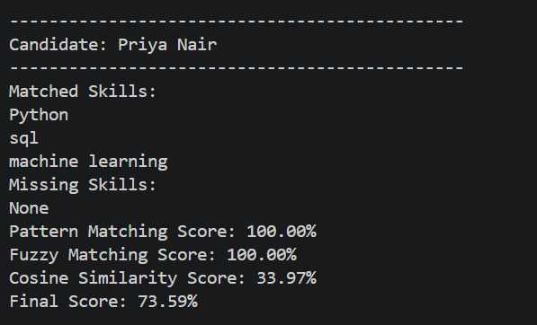
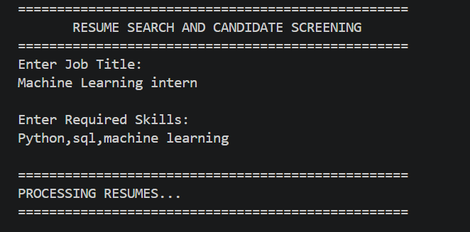
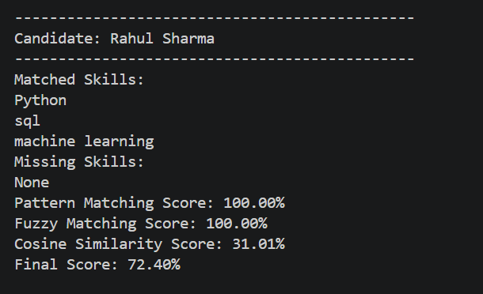
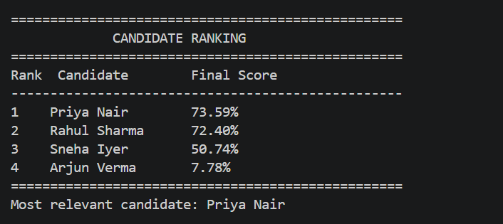
Results

Slide 9
Hardware and Software requirements
Hardware Requirements
Laptop / Desktop Computer
Minimum 4 GB RAM
Minimum 1 GB free storage
Keyboard and Mouse
Software Requirements
Operating System: Windows / Linux / macOS
Programming Language: Java
JDK: JDK 17 or above
IDE: Visual Studio Code
Version Control: Git & GitHub
Libraries/Concepts: Java Collections, Regular Expressions, File Handling

Slide 10
Conclusion
The Resume Search and Candidate Screening System provides an efficient approach to identifying relevant candidates from resumes. The Review-2 implementation focuses on pattern matching, fuzzy search, and similarity algorithms to compare candidate resumes with job requirements. Pattern matching identifies required skills, fuzzy search handles approximate matches, and similarity calculation measures the relevance of resumes. These results can be used to score and rank candidates, making the resume screening process more systematic and efficient.

Slide 11
Future Scope
Add PDF and Word resume upload.
Create a mobile or web app for recruiters.
Store resumes and candidate details in a database.
Improve the system to understand skills and experience.
Provide better candidate ranking and filtering.
Add a recruiter dashboard to manage shortlisted candidates.

Slide 12
Thank you

