Slide 1
Load-Aware Adaptive H-Bridge Motor Driver for Robotic Actuators
SENSE
Shunt current to voltage
ADAPT
Final Project Review | 23 October 2026
Duty follows load current
Ashmit Singh
B.Tech Electronics Engineering (VLSI Design & Technology), VIT Vellore
Faculty: Anil Kumar Rajput
DRIVE
H-bridge with dead-time
Notes:
Introduce the project: an adaptive H-bridge motor driver whose PWM duty responds to sensed load current. Reviews 1 and 2 cover: literature review, limitations and how we resolve them, the proposed design and schematics, simulation results, and comparison with previous work.

Slide 2
Why robotic actuators need an adaptive driver
0.6-1.7 A
1.8 V
85→35 %
8
motor current range in the adaptive run
gpdk090 simulation supply
PWM duty as load rises (read from plot)
instances under the top-level cell
The problem
Our idea
Robot joints see variable, unpredictable loads
Fixed-duty PWM ignores the load current
Current limits are fixed or used only for protection
Adaptive ideas (e.g. dead-time) are studied separately from load-aware control
Sense motor current with a shunt and amplifier
Lower the duty as load current rises, before the hard overcurrent trip
Keep dead-time and UVLO / OCP protection in one hierarchy
Notes:
Targets (1-5 A, 6-24 V) come from the review slides and are design targets, not measured results. The idea is to close the loop from sensed current to PWM duty inside the driver.

Slide 3
How motor-driver architectures evolved
1
Discrete H-bridge
2
Integrated IC
3
Current-regulated
4
Smart / adaptive
Conventional
Monolithic
Closed loop
Proposed
Strength
Strength
Strength
Strength
Flexible, high-current, easy to prototype
Compact, protection built in
Limits current, better torque control
Adaptive PWM from load current; integrated sensing and protection
Limit
Limit
Limit
Limit
Many external parts; no adaptive features
Fixed behavior; basic or no current sensing
Fixed current limit; slow to adapt
More complex design and verification
Typical use
Typical use
Typical use
Typical use
Prototyping, high power
Consumer, general purpose
Precision torque, stepper, BLDC
Robotics, variable-load actuators
Notes:
From the review slides. Our proposed architecture is the fourth column: it keeps the integrated protection of column 2 and the current feedback of column 3, and adds load-aware PWM.

Slide 4
Five papers reviewed
# | Paper | Technology | Supply | Current | Main contribution
1 | Zhang et al., 2010 Fully integrated H-bridge DC motor driver | 0.5 um HV CMOS | 2.5-5.5 V | 1 A | Bridge, control and UVLO / OCP / OTP on one chip
2 | Xu et al., 2012 Monolithic BLDC vibration-motor driver with Hall sensor | 0.18 um CMOS | 2-4 V | 300 mA | Sensor, control and driver on one chip
3 | Krenzke et al., 2003 36 V H-bridge driver interface | 0.35 um CMOS | up to 36 V | external FETs | Charge-pump high-side drive, dead-time, short-circuit detection
4 | Dong et al., 2025 Stepper driver with integrated current sensing | 0.18 um BCD | 8-40 V | 2 A (1.6 A cont.) | Cascode-mirror sensing for PWM current chopping
5 | He et al., 2026 Adaptive dead-time high-side gate driver | 0.18 um BCD | 24 V input | gate driver | Adaptive dead-time; 7.4 % lower power than fixed dead-time
Specifications as summarized from the papers in the review slides.
Notes:
One line per paper. Papers 1-2 show integration, paper 3 high-side drive and dead-time, paper 4 on-chip current sensing, paper 5 adaptive dead-time. Check each specification against the original paper before presenting.

Slide 5
Papers 1-3: integration, sensing and high-side drive
Paper 1 | Zhang, 2010
Paper 2 | Xu, 2012
Paper 3 | Krenzke, 2003
Fully integrated H-bridge
Monolithic BLDC driver with Hall sensor
36 V H-bridge driver interface
2.5-5.5 V, 1 A, PWM and analog speed control
2-4 V, 300 mA, 7-stage inverter gate drive
up to 36 V, 50 kHz PWM, on-chip charge pump
What we take
What we take
What we take
Integrating power stage, control and UVLO / OCP / OTP in one IC is practical; gives baseline metrics.
On-chip sensing can sit beside the driver; strong multi-stage gate drive.
Charge pump, dead-time and cross-conduction protection inform our GATE_DRIVER.
Gap
Gap
Gap
Conventional control; basic current sensing; no adaptation.
300 mA only; BLDC-specific; no load-dependent drive.
Gate driver only; external FETs; sensing only for protection.
Notes:
For each paper: what it shows and the gap relative to our goal. Common gap: none of them adapt the drive to load current.

Slide 6
Papers 4-5: current sensing and adaptive dead-time
Paper 4 | Dong, 2025
8-40 V | 2 A
Paper 5 | He, 2026
-7.4 % power
Integrated current sensing in a stepper driver
Adaptive dead-time high-side gate driver
Technique
Technique
Cascode current mirrors sample the bridge current for PWM current chopping, without an external sense resistor.
Adaptive dead-time with cross-interlocked drive; verified by tape-out and hardware test (0.18 um BCD, 24 V).
What we take
What we take
Supports our CURRENT_SENSE block; shows on-chip sensing enables closed-loop control.
Techniques reusable in our gate driver; shows adaptation pays off.
Gap
Gap
Stepper-specific; regulation is not load-adaptive.
No load-current-based duty control.
Notes:
Paper 5 DOI: 10.1016/j.mejo.2025.106937 (Microelectronics Journal, vol. 167, 2026). The 7.4 % figure is from that paper (power vs fixed dead-time). Our extension is current-sensed load-aware PWM.

Slide 7
Base paper: Dong et al., IEICE Electronics Express, 2025
What the base paper gives
What was missing for us
What we built on top
Two-phase stepper driver in 0.18 um BCD
8-40 V supply; 2 A maximum, 1.6 A continuous
Integrated H-bridge, driver circuits and protection
Cascode current mirrors sample the bridge current
Stepper only: no brushed-DC actuator case
Regulation is reference-based current chopping, not load-aware PWM
No explicit gate-driver and dead-time hierarchy
Sensing serves chopping; duty is not reduced as load rises
Brushed-DC robotic actuator in one Cadence hierarchy
Shunt and sense amplifier feeding ISENSE_OUT
Current-feedback adaptive PWM: duty falls as load current rises
Gate_Driver with a Dead_Time cell per leg; UVLO and OCP in one FAULT path
Supporting reference Paper 1 (2010), fully integrated H-bridge DC-motor driver: PWM / analog speed control and UVLO, OCP, OTP protection. It backs our DC-motor power stage and protection architecture. Our work extends these papers; it is not a claim of absolute novelty.

Slide 8
Base paper versus our extension
Feature | Dong et al., 2025 (base paper) | Our extension
Motor application | Two-phase stepper motor | Brushed-DC robotic actuator
Power stage | Integrated H-bridge, 0.18 um BCD, 8-40 V, 2 A | H-bridge with explicit Gate_Driver and a Dead_Time cell per leg (gpdk090, 1.8 V simulated)
Current sensing | Integrated cascode current mirrors | Shunt resistor and sense amplifier
Current control | Reference-based current chopping | Current-feedback adaptive PWM duty
Protection | Integrated protection circuits | UVLO and overcurrent merged into one FAULT path
Main contribution | Integrated motor driver and current sensing | Load-aware PWM that cuts duty as current rises, shown in simulation
The base paper's current regulation is not the same as our load-aware adaptive PWM; the extension is demonstrated in the simulation results that follow.

Slide 9
Limitations in existing work, and how we resolve them
Limitation in the literature
Our approach
Fixed, non-adaptive PWM or analog control
Adaptive PWM driven by sensed load current
Current sensing absent, or used only for protection
Integrated shunt sensing with amplifier and comparator
Adaptive techniques (dead-time) studied separately from load
Adaptation extended from dead-time toward load current
Protection limited or split across separate blocks
UVLO + OCP merged into one FAULT path (OTP: future work)
Little focus on robotic DC actuators
Targets brushed-DC robotic actuators with load-aware control
Notes:
This is the slide the review email asks for: limitations found and how to resolve them. Each right-hand item maps to a block in our hierarchy.

Slide 10
Research gap and proposed contribution
Existing literature
Remaining gap
Our direction
Integrated H-bridge
Integrated protection
Current sensing (stepper)
High-side gate driving
Adaptive dead-time
Current sensing not combined with adaptive drive control
Adaptive techniques studied separately
Few designs target robotic DC actuators
Load-aware adaptive PWM
Integrated current sensing
Dead-time and protection in one hierarchy
Proposed signal chain
Current sensing
Load estimation
Adaptive PWM
Gate driver
H-bridge
Extension based on gaps identified in the five papers reviewed; novelty is claimed only against these.
Notes:
State the novelty carefully: it is a proposed extension based on five papers; a wider search is still needed before claiming novelty in the final IEEE paper.

Slide 11
Proposed architecture and hierarchy
Conceptual architecture; actual Cadence hierarchy on the next slide
Conceptual: DUTY_CMD, RAMP, DIR, DRIVER_EN, RESET in; FAULT_OUT, I_SENSE_OUT out
ADAPTIVE_PWM
GATE_DRIVER
HBRIDGE
MOTOR_MODEL
Hierarchy
HBRIDGE
VSENSE_AMP feedback
MOTOR_MODEL
FAULT, DRIVER_EN
GATE_DRIVER
return current (GND = I_IN+)
CURRENT_SENSE
SENSE_AMPLIFIER
FAULT_LOGIC
OC_COMPARATOR
SENSE_AMPLIFIER
CURRENT_SENSE
OC_COMPARATOR
UVLO
FAULT_LOGIC
ADAPTIVE_PWM
UVLO
Control
Drive
Sensing
Protection
ADAPTIVE_HBRIDGE_TOP
Notes:
Walk the loop: PWM request goes through ADAPTIVE_PWM, GATE_DRIVER and HBRIDGE to the motor. The shunt in the bridge return feeds CURRENT_SENSE, SENSE_AMPLIFIER and OC_COMPARATOR; VSENSE_AMP also feeds back to ADAPTIVE_PWM. FAULT_LOGIC merges overcurrent, UVLO and the reserved OTP flag and disables the driver.

Slide 12
Actual Cadence hierarchy
I0 Adaptive_PWM: OP_Amp, Comparator, CMOS_Inv, 2 NAND2, input RC networks
I1 Protection: Bias_Reference, Overcurrent_Protection, Undervoltage_Lockout, Fault_Logic
I2 Gate_Driver: 2 Dead_Time (one per leg), 2 Schmitt_Trigger, NAND2, CMOS_Inv, 4 Output_Buffer
I3 Sense_Amplifier: OP_Amp with resistor and capacitor network
I4 HBridge: 2 pmos2v_3 and 2 nmos2v_3 (gpdk090)
I5 Current_Sense: shunt-based current sensing
I6 Motor_Model: R-L motor load model
I7 Bias_Reference
Shared low-level cells: CMOS_Inv, NAND2, NOR2, Schmitt_Trigger, RC_Delay, Comparator, OP_Amp
What the hierarchy shows
Eight instances sit under Adaptive_HBridge_Top; the other cells are lower-level building blocks
Protection is a wrapper around Bias_Reference, Overcurrent_Protection, Undervoltage_Lockout and Fault_Logic
Bias_Reference appears inside Protection and at top level
Signal path as drawn: Adaptive_PWM, Gate_Driver, HBridge, Motor_Model
Outputs at the top level: FAULT_OUT and I_SENSE_OUT
Over-temperature protection is future work

Slide 13
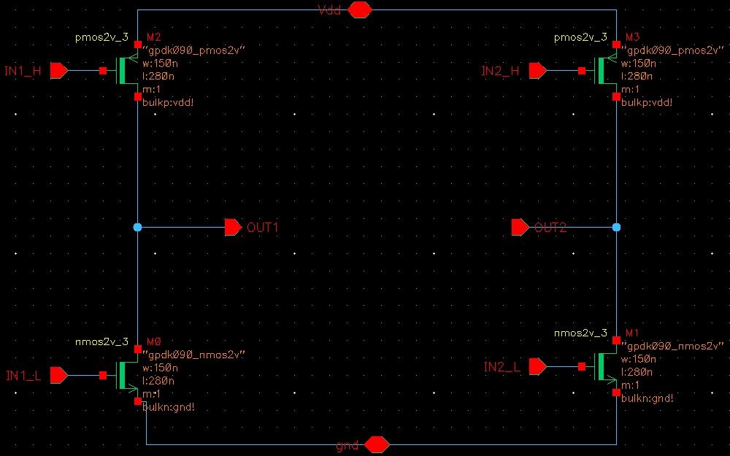
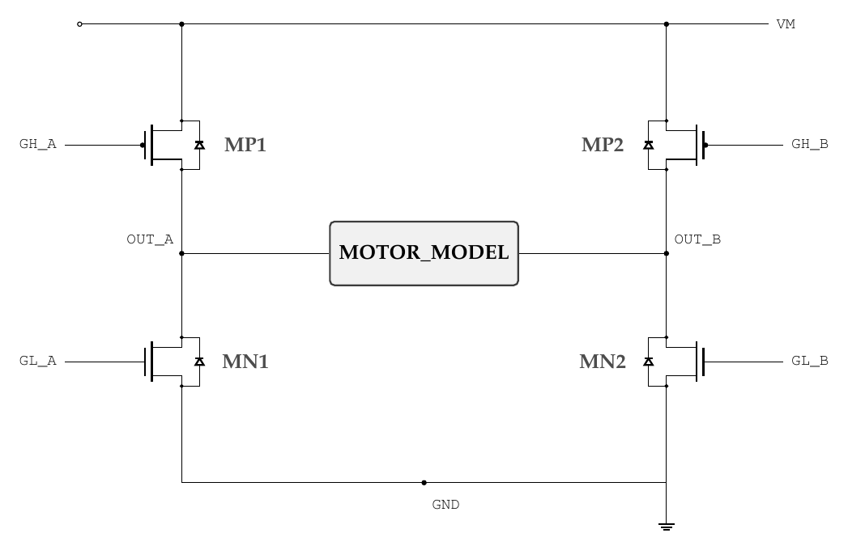
H-bridge power stage
Switch states by mode (gate levels)
Mode | GH_A | GL_A | GH_B | GL_B
Forward | 0 | 0 | 1 | 1
Reverse | 1 | 1 | 0 | 0
Brake | 1 | 1 | 1 | 1
Coast | 1 | 0 | 1 | 0
PMOS conducts when its gate is low; NMOS when high
Leg 1: M2 (PMOS) over M0 (NMOS) to OUT1; leg 2: M3 over M1 to OUT2
Never drive GH = 0 with GL = 1 on one leg (shoot-through)
gpdk090 2 V devices, W = 150 nm, L = 280 nm; PMOS bulk to Vdd, NMOS bulk to gnd (confirmed from schematic)
Notes:
Four-switch bridge: two PMOS high side, two NMOS low side. Truth table is for the gate signals produced by GATE_DRIVER. Device models must come from the PDK; sizes are not yet chosen.

Slide 14
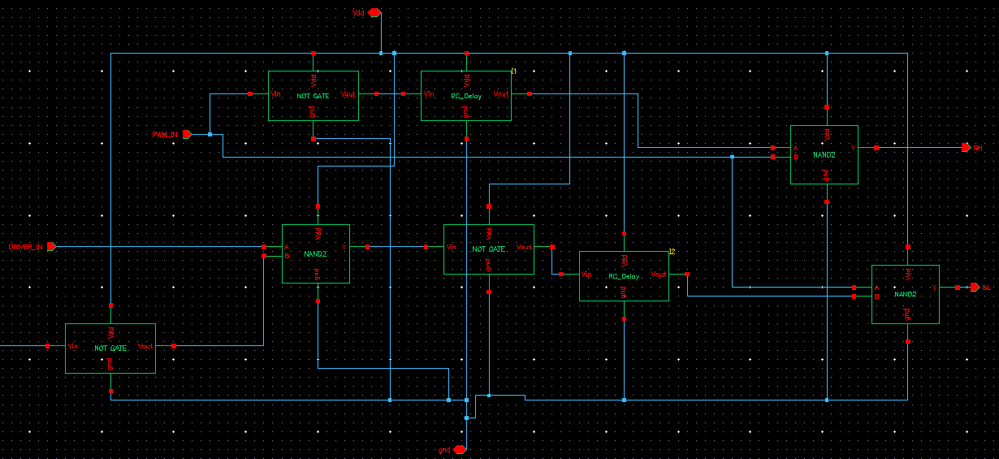
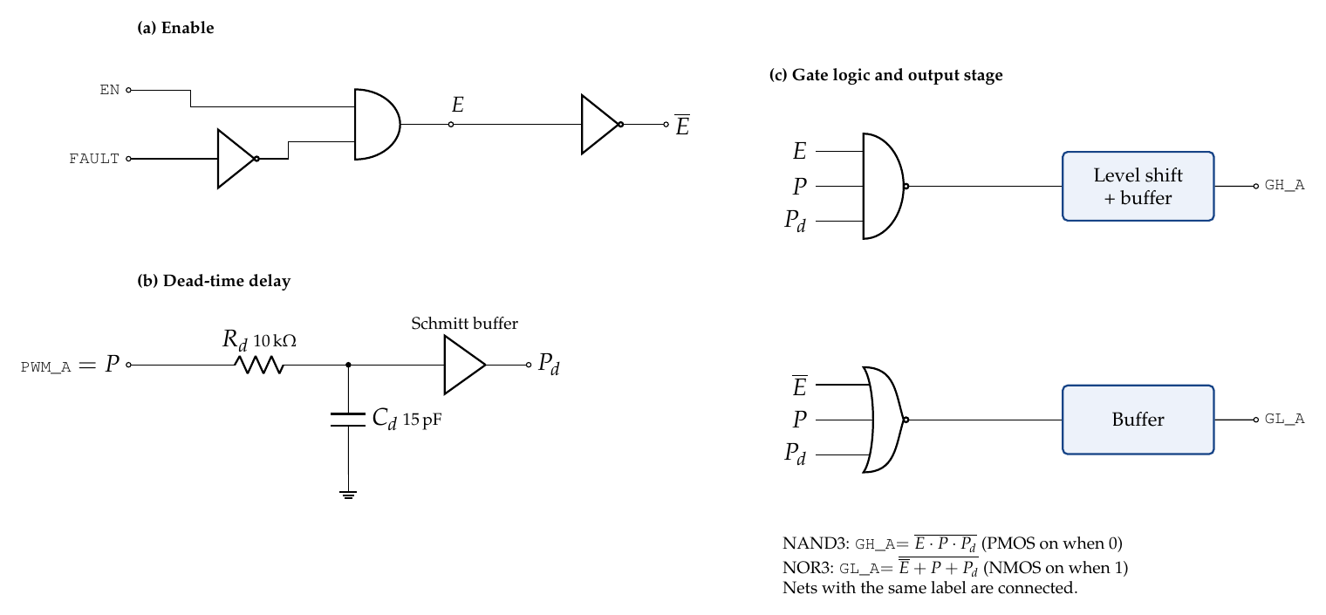
Gate driver: enable, delay and gate logic
Enable
FAULT is inverted and combined with DRIVER_IN in a NAND2
Dead-time delay
Two RC_Delay cells delay the PWM path to set the dead-time
Gate logic
Two NAND2 outputs form GH and GL; no level shifter is drawn
Dead_Time cell (Cadence), one per leg. Gate_Driver instantiates two of them plus four Output_Buffer cells.
Notes:
Leg A shown; leg B is identical with PWM_B. The delayed copy of the PWM (Pd) is combined with the original so each transition waits one delay before the incoming device turns on. Values are assumed, not simulated.

Slide 15
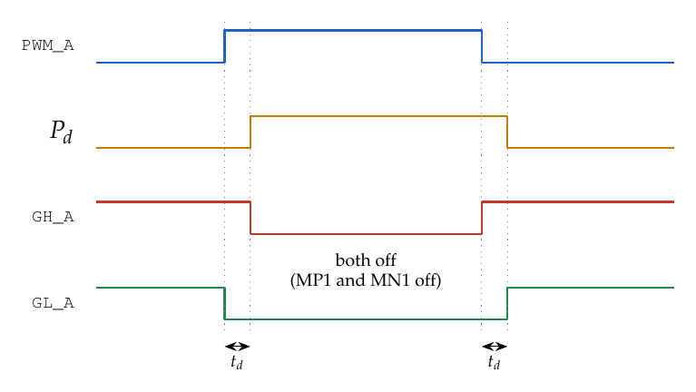
Gate driver: dead-time operation
Conceptual timing diagram of the dead-time scheme
What the waveform shows
Rising edge: low side turns off at once; high side turns on after t_d
Falling edge: high side turns off at once; low side turns on after t_d
GH_A is active-low because MP1 is a PMOS
Design t_d about 100 ns = 0.69 Rd Cd (10 kOhm, 15 pF)
Fixed RC delay, too short to resolve on the 50 us plots; adaptive dead-time (paper 5) is future work
Notes:
During the dead-time both devices of the leg are off, which prevents shoot-through. The delay must be matched to the real switching time of the chosen MOSFETs.

Slide 16
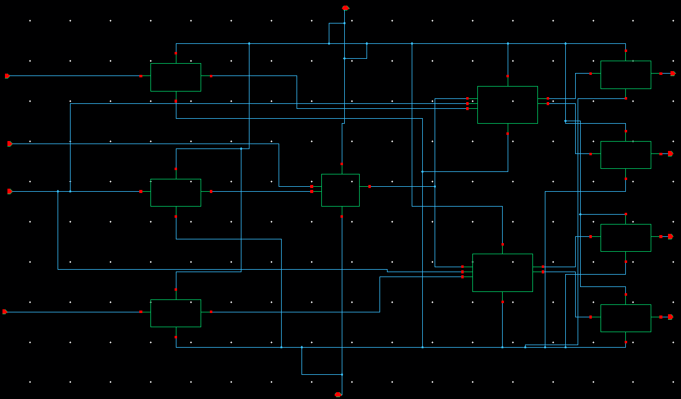
Gate_Driver hierarchy (Cadence)
As drawn
Two Dead_Time cells, one per leg
Four Output_Buffer cells drive GH_A, GL_A, GH_B, GL_B
Two Schmitt_Trigger cells, a CMOS_Inv and a NAND2 condition the inputs
DRIVER_EN and FAULT enter the gate logic

Slide 17
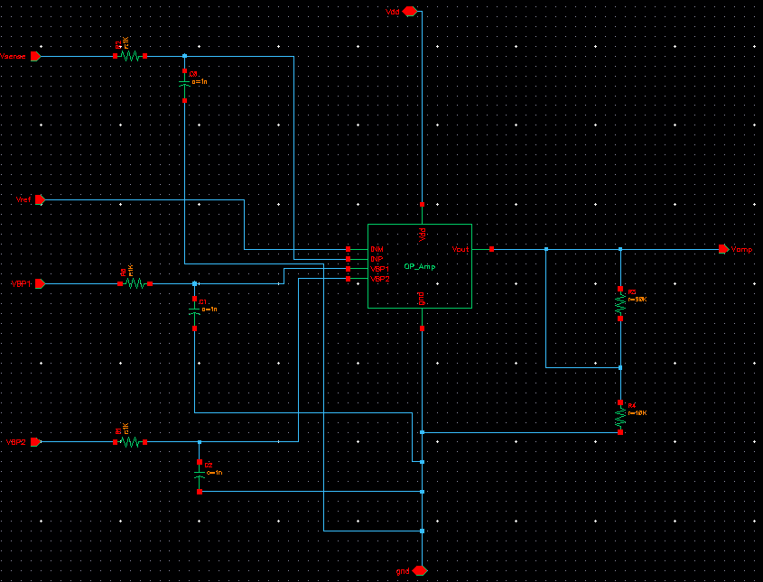
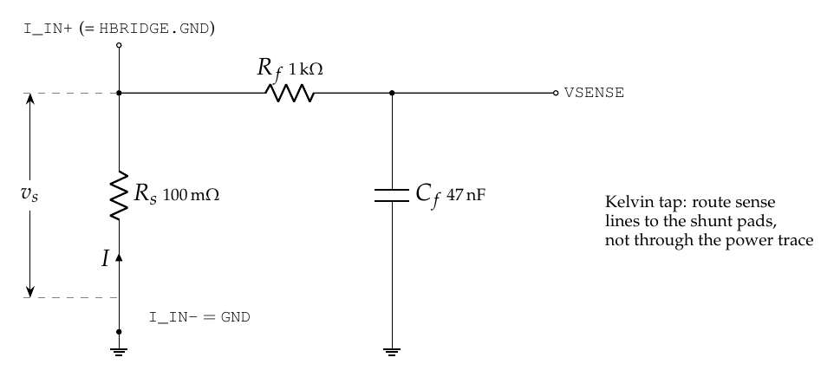
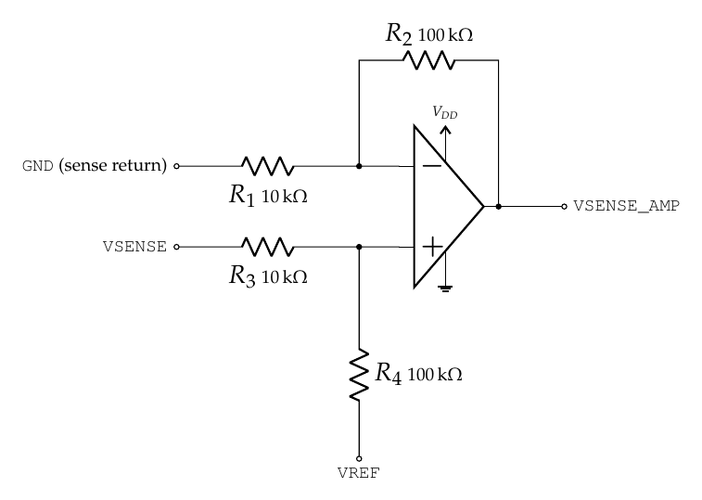
Current sensing and amplification
Left: Current_Sense concept. Right: Cadence Sense_Amplifier
Current_Sense Design values: V_SENSE = I x Rs with Rs = 100 mOhm (0.1 V per amp). Shunt loss 0.27 W at 1.65 A. RC filter about 3.4 kHz.
Sense_Amplifier OP_Amp with RC-filtered inputs and a resistor feedback network that scales the shunt voltage into ISENSE_OUT and the feedback to Adaptive_PWM.
Notes:
The shunt sits in the bridge ground return with a Kelvin tap. The passive filter delays overcurrent detection by about 47 microseconds. The amplifier needs a rail-to-rail single-supply op-amp whose input range includes ground.

Slide 18
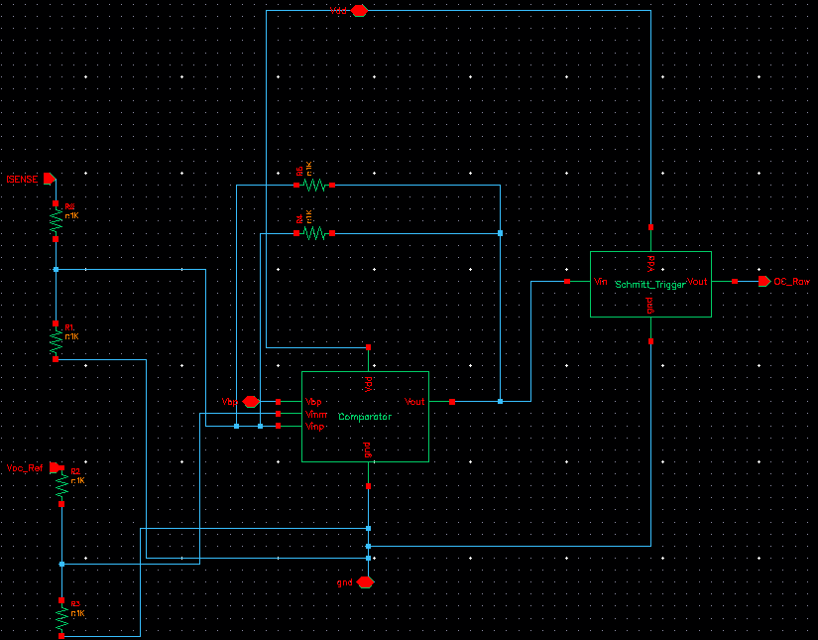
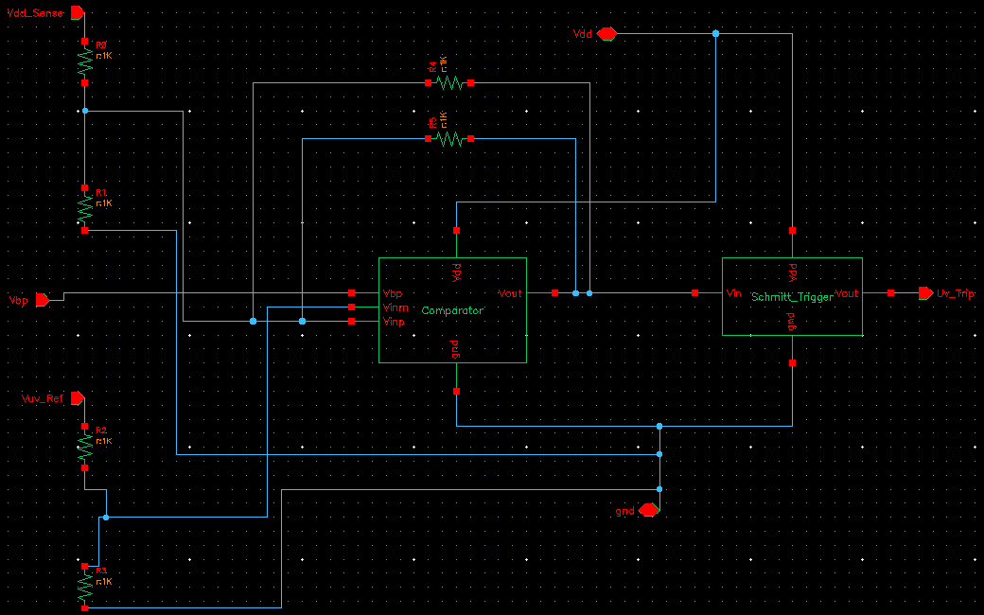
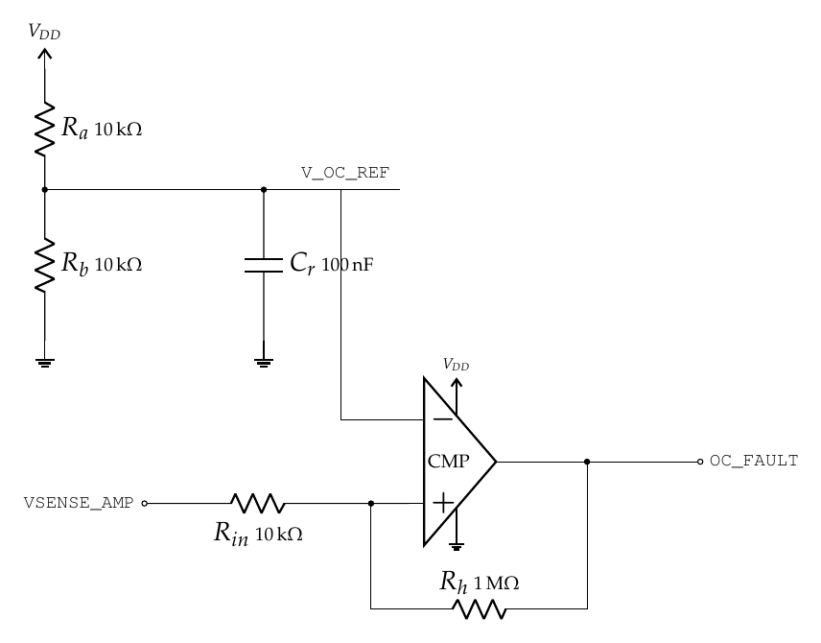
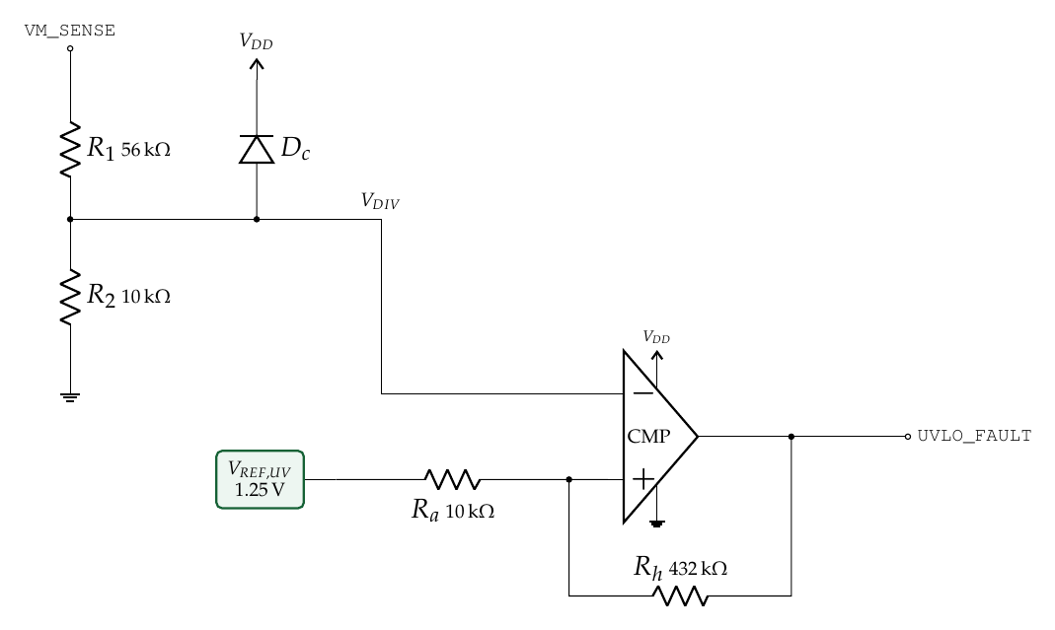
Overcurrent and undervoltage protection
Overcurrent_Protection ISENSE and Voc_Ref dividers, Comparator with feedback resistors and Schmitt_Trigger give OC_Raw. The trip level is set by Voc_Ref (design target 1.65 A).
Undervoltage_Lockout Vdd_Sense and Vuv_Ref dividers, Comparator with feedback and Schmitt_Trigger give Uv_Trip. The thresholds are set by the dividers and Vuv_Ref.
Notes:
Both comparators use positive feedback for hysteresis. UVLO needs a clamp diode because the divider node would exceed VDD at 24 V. Check: the 8 V lockout conflicts with the 6-24 V supply target.

Slide 19
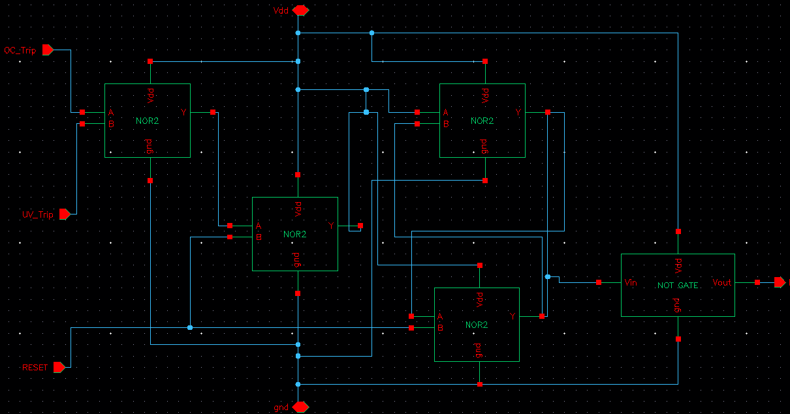
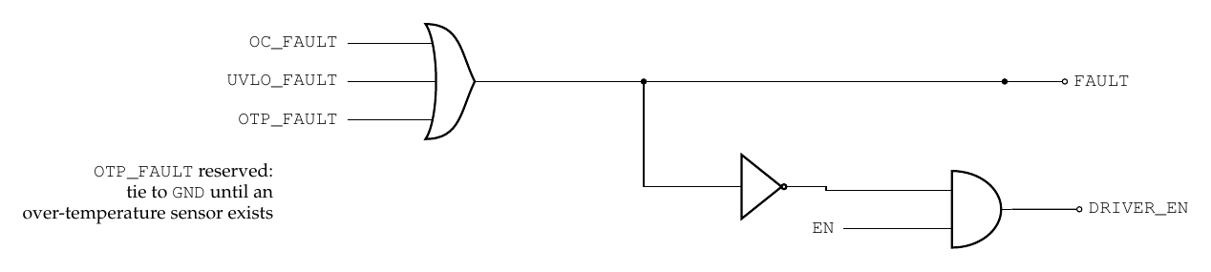
Fault logic: latch with RESET
FAULT
SR-type latch of cross-coupled NOR2 gates: set by OC_Trip or UV_Trip, cleared by RESET
FAULT and DRIVER_EN
Both enter Gate_Driver; FAULT is gated with DRIVER_IN inside Dead_Time
Behavior
In the top-level run FAULT_OUT asserts once, about 58 to 62 us, then clears. No OTP input: OTP is future work.
Notes:
OTP_FAULT is reserved: no temperature sensor exists yet, so it is tied low. Latching is a design choice that is not in the supplied schematic file.

Slide 20
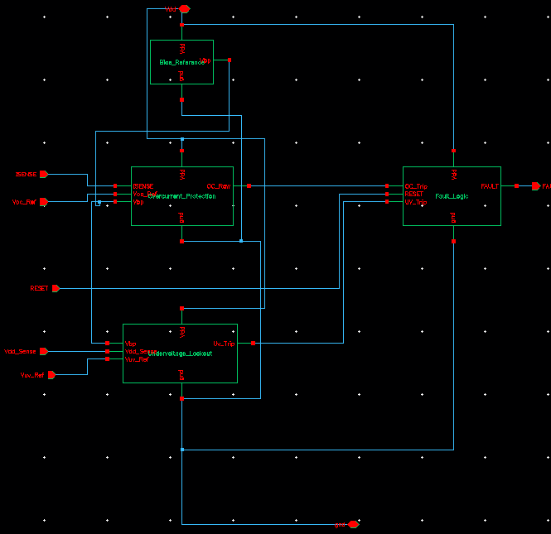
Protection wrapper (Cadence)
As drawn
Wraps Bias_Reference, Overcurrent_Protection, Undervoltage_Lockout and Fault_Logic
Inputs: ISENSE, Voc_Ref, Vdd_Sense, Vuv_Ref, RESET
OC_Raw and Uv_Trip feed Fault_Logic; FAULT is the only output
Voc_Ref and Vuv_Ref are the reference inputs that set the trip points

Slide 21
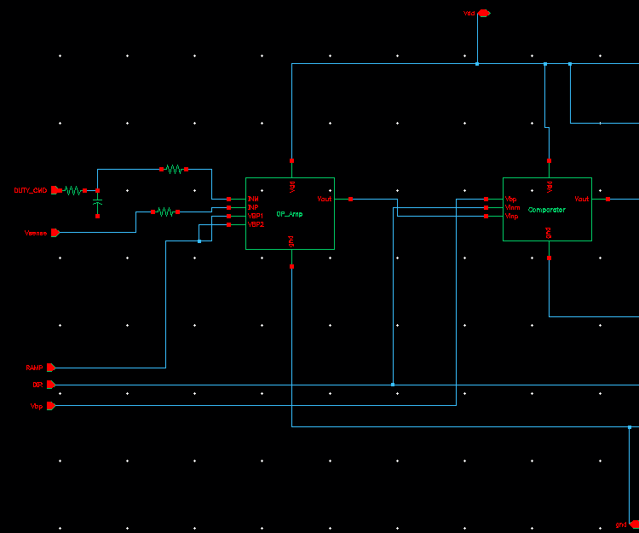
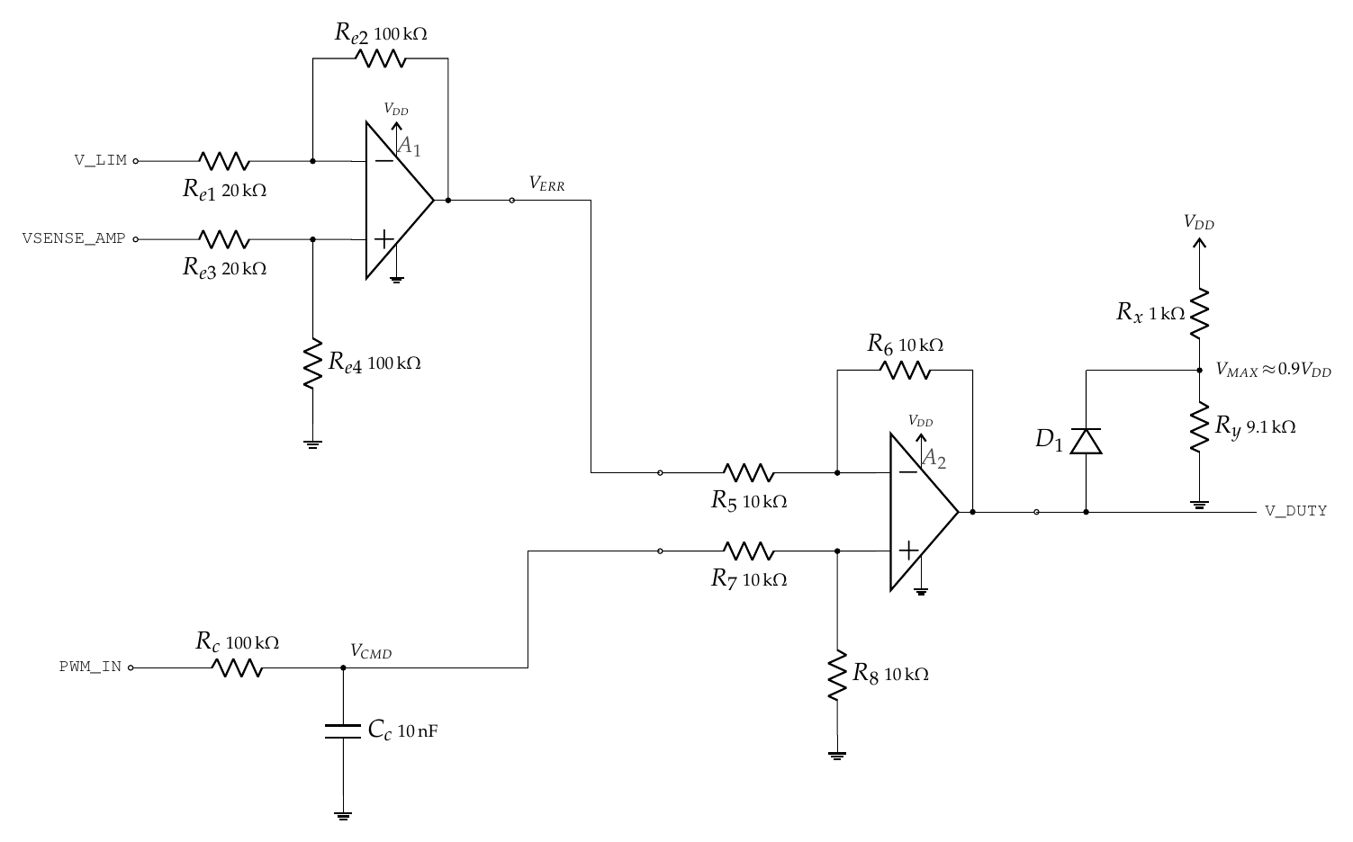
Adaptive_PWM: op-amp stage
What the schematic contains
OP_Amp takes DUTY_CMD (through an RC network) and Vsense (through a resistor); VBP1 and VBP2 are bias pins
Its output feeds the Comparator on the next slide
The effect on PWM duty is shown in the adaptive-response results
Notes:
Stage 1 of ADAPTIVE_PWM. The low-pass converts the input PWM to an average duty command. At the 1.65 A trip level the error has already removed 2.25 V (about 68 % of full scale). The low-pass corner is about 160 Hz, so response to duty changes is slow; a faster duty extraction is possible later. V_LIM and the clamp are assumed values.

Slide 22
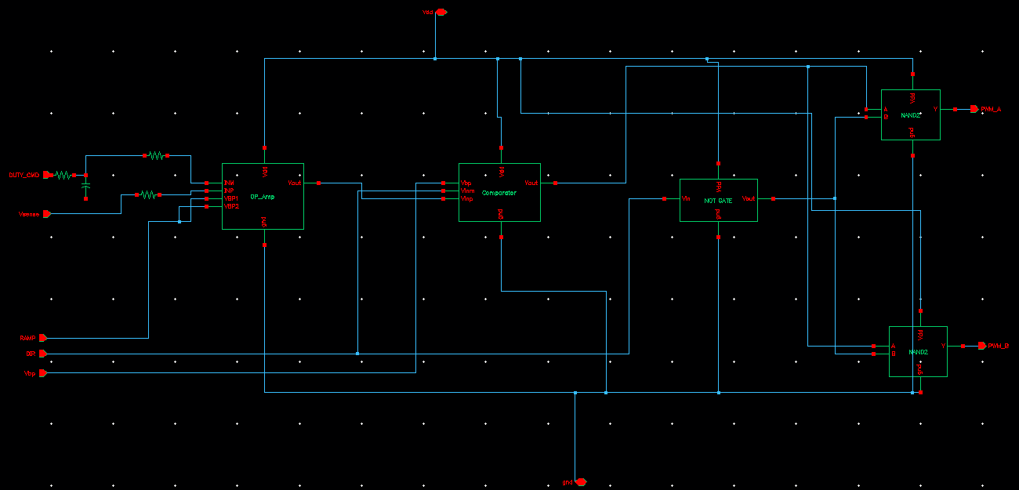
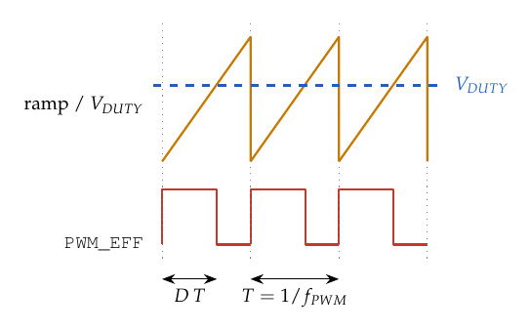
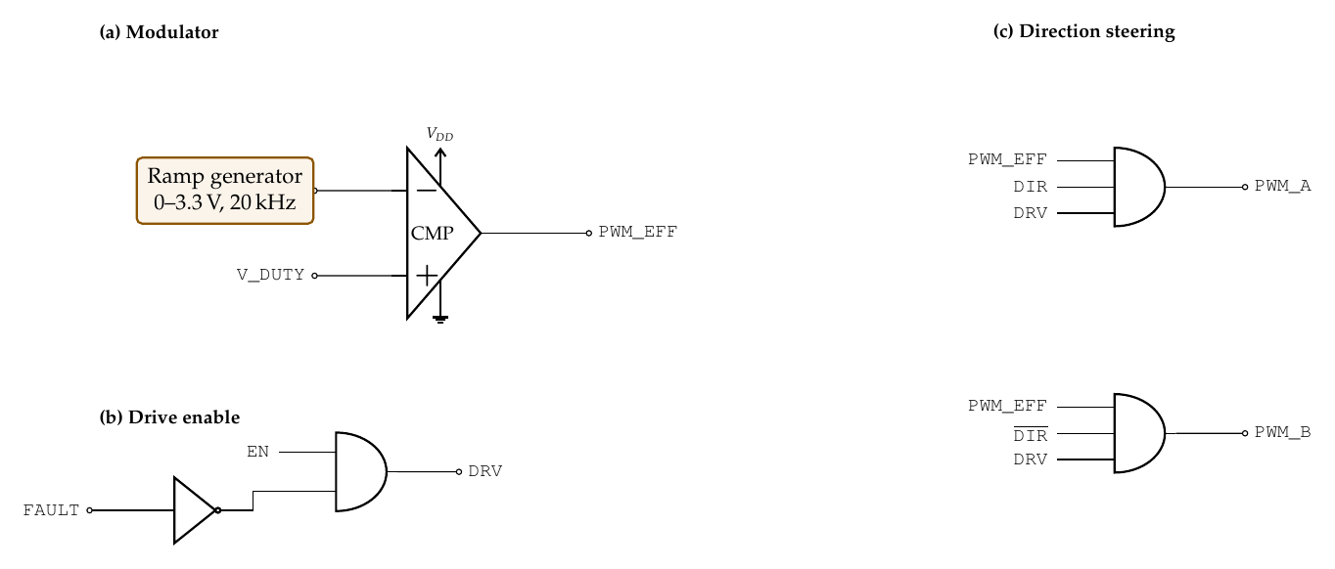
Adaptive PWM: modulator and direction steering
Right: conceptual PWM sketch
Modulator
Comparator output sets the effective PWM; ramp in the top-level testbench is 0 to 1 V, 10 us period
Direction
DIR feeds a CMOS_Inv and two NAND2 gates forming PWM_A and PWM_B
Fault disable
Adaptive_PWM has no FAULT or enable port; disabling happens in Gate_Driver
Notes:
Stage 2: comparator against a ramp produces the effective PWM; steering logic gives sign-magnitude drive with the other leg held low. Dead-time and complementary switching are enforced by the gate driver.

Slide 23
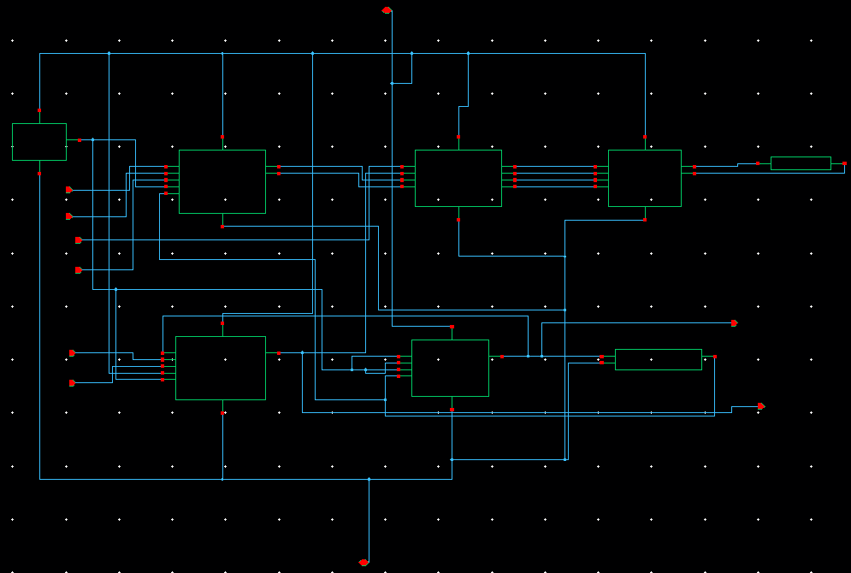
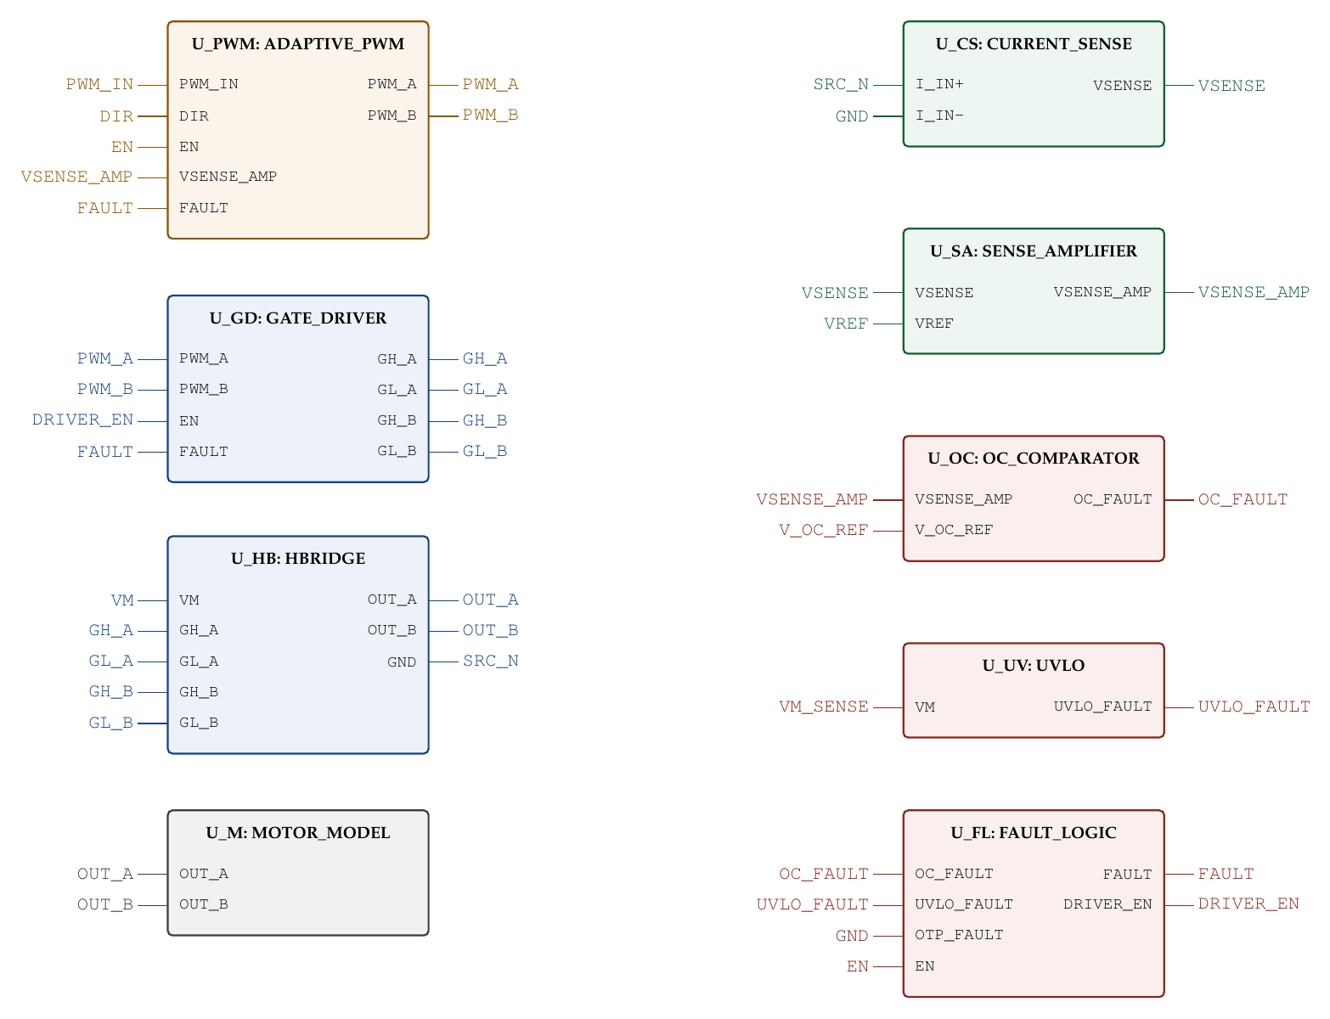
Top-level integration
Top-level ports
Port | Role
DIR | input: direction select
DRIVER_EN | input: driver enable
DUTY_CMD | input: analog duty command
RAMP | input: modulator ramp
RESET | input: fault reset
Vdd_Sense | input: supply sense for UVLO
Outputs: FAULT_OUT (fault flag) and I_SENSE_OUT (sensed current).
Notes:
Symbol-level view of ADAPTIVE_HBRIDGE_TOP: same-name stubs are the same net. The shunt top is the H-bridge ground return.

Slide 24
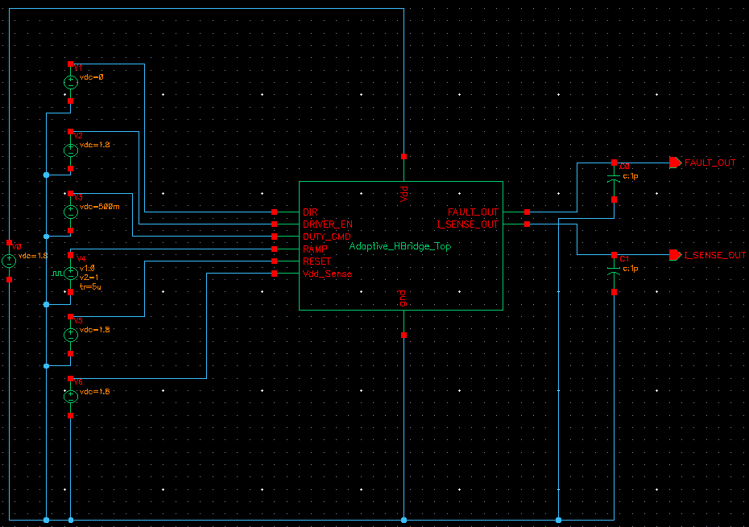
Testbench: TB_Adaptive_HBridge_Top
Sources as drawn
V0: supply, 1.8 V
V1: DIR, 0 V
V2: DRIVER_EN, 1.8 V
V3: DUTY_CMD, DC, about 0.5 V
V4: RAMP, pulse 0 to 1 V
V5: RESET, 1.8 V
V6: Vdd_Sense, 1.8 V
1 pF loads on FAULT_OUT and I_SENSE_OUT

Slide 25
Design parameters
Parameter | Value | Basis
Logic supply VDD | 1.8 V (V0, HBridge Vdd) | Schematic
Power devices | gpdk090 2 V, W = 150 nm, L = 280 nm | Schematic
PWM ramp | 0 to 1 V, 10 us period (top-level run) | Waveform
Duty command | DC, about 0.5 V | Testbench
Simulated current | about 0.6 A to 1.7 A | Waveform
Shunt Rs | 100 mOhm | Design value
Dead-time | about 100 ns (0.69 Rd Cd) | Design value
Overcurrent reference | 1.65 V (1.65 A) | Design target
Current-limit knee | 1.2 A | Design target
PWM duty range | 0-90 % | Design target
Device and supply limits
The design is simulated with gpdk090 2 V devices at a 1.8 V supply, with motor current up to about 1.7 A. The 1-5 A and 6-24 V range needs high-voltage devices and is future work.
Protection thresholds
UVLO thresholds (8.0 V fall / 8.5 V rise) belong to the 6-24 V target. The 1.8 V testbench does not exercise them.
Notes:
Be upfront that documented values come from our files and assumed values were chosen to close the circuits. The two checks are open design decisions to settle before the final review.

Slide 26
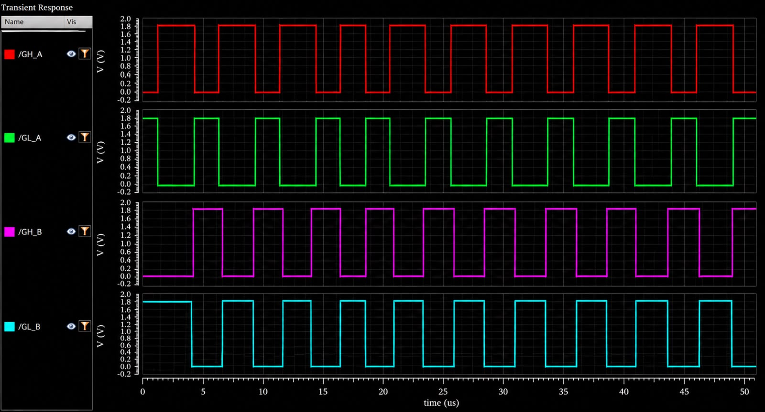
Results: gate driver outputs
What the waveforms show
GH_A, GL_A, GH_B and GL_B all swing the full 0 to 1.8 V logic supply
On each leg GL is the complement of GH, so the two devices of a leg are driven in opposition
Leg B follows leg A by about 3 us (GH_B first rises near 4.2 us, GH_A near 1.3 us)
Switching period is about 5 us in this 50 us run
The 100 ns design dead-time is below the resolution of this plot.
Result The Gate_Driver turns the PWM inputs into full-swing GH / GL drive for both H-bridge legs.
Notes:
Fill the three frames with simulated waveforms only. Annotate measured dead-time and ripple, and compare with the check-against list.

Slide 27
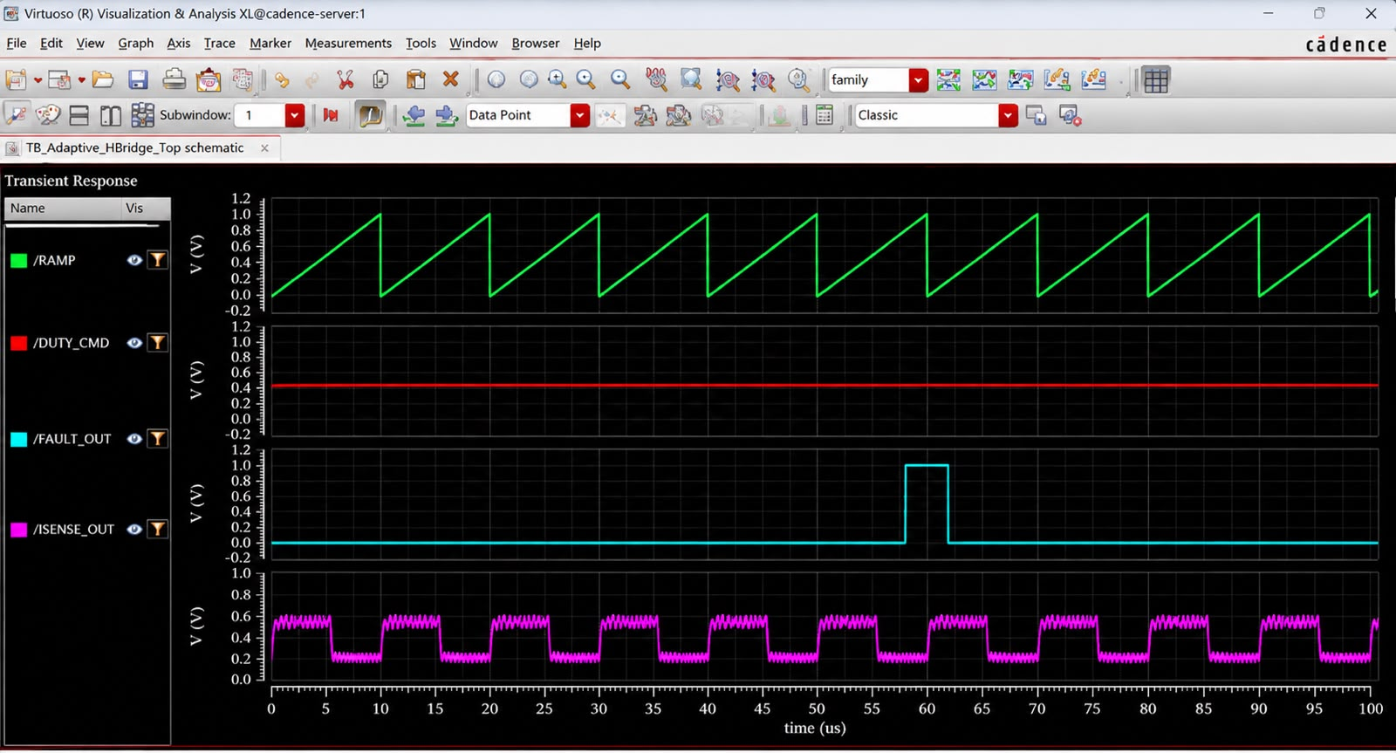
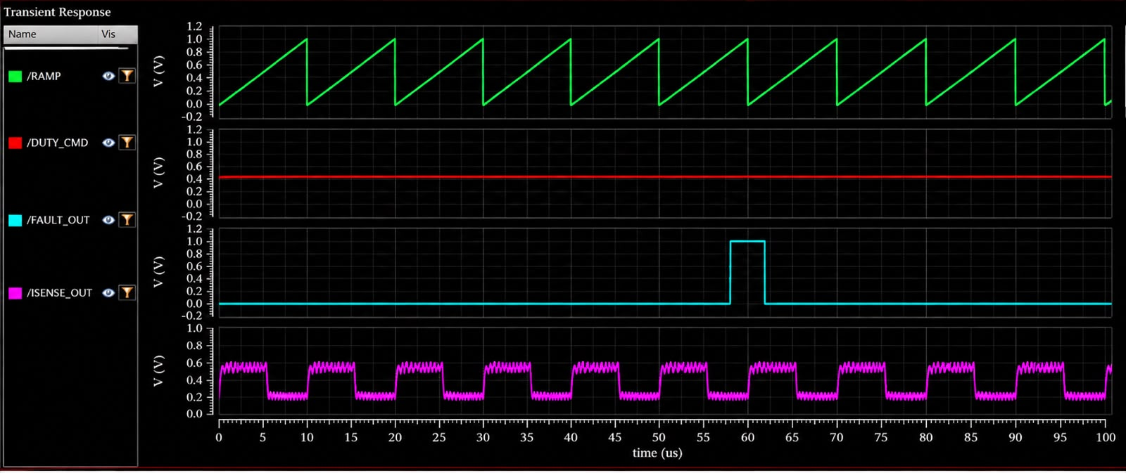
Results: top-level testbench
What the waveforms show
RAMP: 0 to 1 V sawtooth, 10 us period
DUTY_CMD: constant, about 0.45 V
ISENSE_OUT: alternates between about 0.6 V and 0.2 V once per PWM cycle, with ripple on both levels
FAULT_OUT: one pulse to about 1 V from about 58 to 62 us, then clears
Sensed current follows the PWM cycle; the fault flag asserts once and releases.
Result Ramp, duty command, sensing and fault paths run together in the top-level testbench.
Notes:
These are the plots the review email asks for: all simulation results of the proposed work. Add current-limit comparison with and without adaptation if time allows.

Slide 28
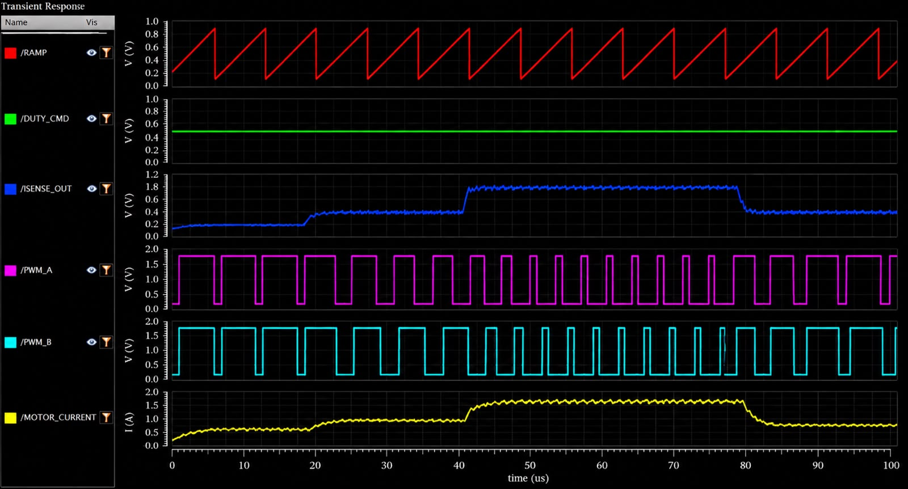
Results: PWM duty versus load current
What the waveforms show
DUTY_CMD stays fixed at about 0.5 V for the whole 100 us run
MOTOR_CURRENT steps from about 0.6 A to 0.95 A (19 us), 1.7 A (41 us), then back to 0.8 A (80 us)
ISENSE_OUT follows each step: about 0.18 V, 0.4 V, 1.8 V, then 0.4 V
PWM_A and PWM_B high-time falls from roughly 85 % to 35 % of the cycle between 41 and 79 us, then widens again
At a fixed duty command, PWM duty drops as sensed current rises.
Duty percentages are read from the plot.
Result The loop cuts PWM duty when sensed load current rises and restores it when the load falls: the load-aware behaviour this project adds.

Slide 29
Comparison with previous work
Feature | 1 Zhang | 2 Xu | 3 Krenzke | 4 Dong | 5 He | Ours
Technology | 0.5 um HV CMOS | 0.18 um CMOS | 0.35 um CMOS | 0.18 um BCD | 0.18 um BCD | GPDK 90 nm (gpdk090), 2 V devices
Motor | DC | BLDC vibration | DC (general) | 2-phase stepper | DC / BLDC | DC robotic actuator
Supply | 2.5-5.5 V | 2-4 V | up to 36 V | 8-40 V | 5.2 V / 24 V in | 1.8 V (simulated)
Max current | 1 A | 300 mA | external FETs | 2 A (1.6 A cont.) | gate driver | about 1.7 A (simulated)
Control | PWM + analog | PWM (Hall) | PWM to 50 kHz | current chopping | adaptive dead-time | load-adaptive PWM (current feedback)
Current sensing | basic | none | protection only | cascode mirrors | none | shunt + amplifier, used for feedback
Dead-time | - | - | fixed | - | adaptive | fixed RC (adaptive: future work)
Protection | UVLO, OCP, OTP | UVLO, thermal | cross-conduction, short | OCP, UVLO, OTP | cross-interlock | UVLO, OCP, FAULT path (OTP: future work)
Robotic DC target | No | No | No | No | No | Yes
Literature columns as summarized from the papers; the Ours column reflects the simulated design at 1.8 V (gpdk090).
Notes:
The review email asks for comparison with previous work. Our differentiator is load-adaptive PWM from sensed current for robotic DC actuators. Note honestly: dead-time is fixed in the current design and OTP is reserved, not implemented.

Slide 30
Conclusions and future work
Conclusions
Future work
Sensing, control, gate drive and protection are integrated in one Cadence hierarchy of eight instances
Built on Dong et al. 2025: its integrated current sensing is extended to a brushed-DC actuator with load-aware PWM
At a fixed duty command, PWM duty falls from roughly 85 % to 35 % as motor current rises from about 0.95 A to 1.7 A
None of the five reviewed papers combines current sensing with load-adaptive drive
1
Scale to 1-5 A and 6-24 V (HV devices)
2
Adaptive dead-time (paper 5 technique)
3
On-chip current sensing (cascode mirrors)
4
Over-temperature protection
5
Real motor and robotic load validation
Notes:
Summarize: the gap, the proposed architecture, what remains: simulation, comparison confirmation, IEEE paper for the final review.

Slide 31
References
1
Zhang et al., "Design of Fully-Integrated H-Bridge for DC Motor Driver IC, 0.5-um HV CMOS," 2010.
2
Xu et al., "Monolithic H-bridge brushless DC vibration motor driver with a highly sensitive Hall sensor," 2012.
3
Krenzke et al., "A 36-V H-bridge driver interface in a standard 0.35-um CMOS process," 2003.
4
D. Dong, J. Leng, Z. Li, B. Lei, "A fully integrated stepper motor driver with a novel integrated current sensing technology," IEICE Electronics Express, vol. 22, no. 10, art. 20250071, 2025, doi:10.1587/elex.22.20250071.
5
J. He, H. Yu, D. Dong, D. Xie, M. Huang, adaptive dead-time high-side gate driver, Microelectronics Journal, vol. 167, 2026, Art. 106937, doi:10.1016/j.mejo.2025.106937.
Notes:
Add venue and DOI for references 1-4 before submission.

