Slide 1

Santa Saviour
“Save Christmas and beat the grinch!”
By: Ashmitha, Bridjette and Arianna

Slide 2
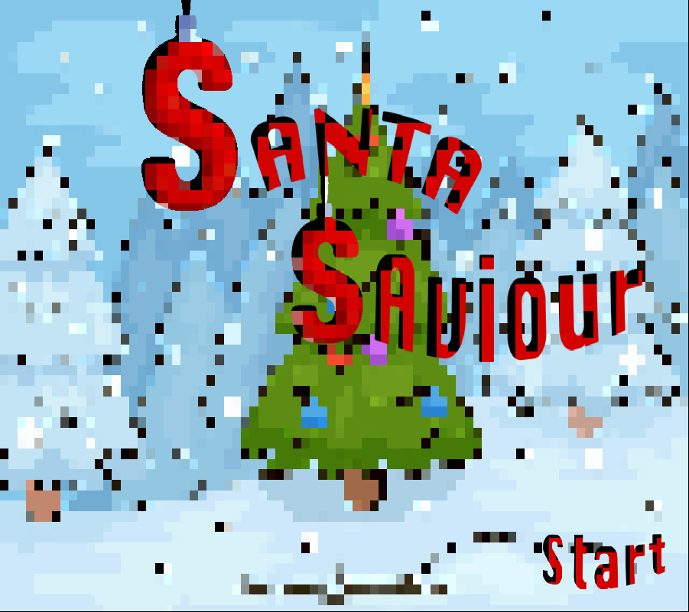

Title screen

Slide 3
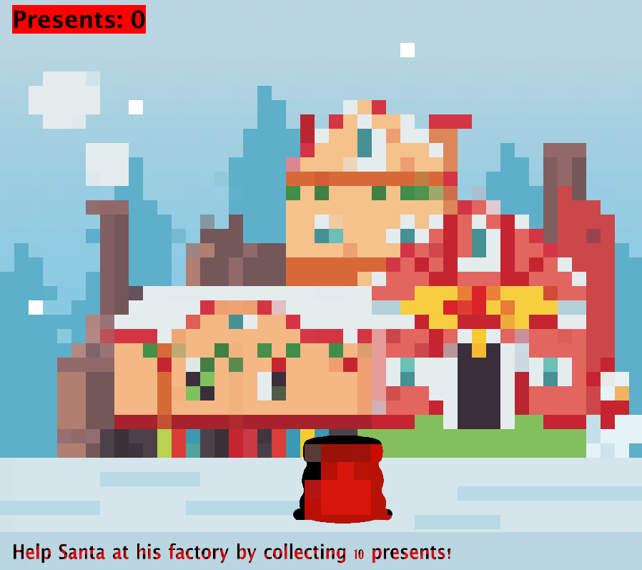
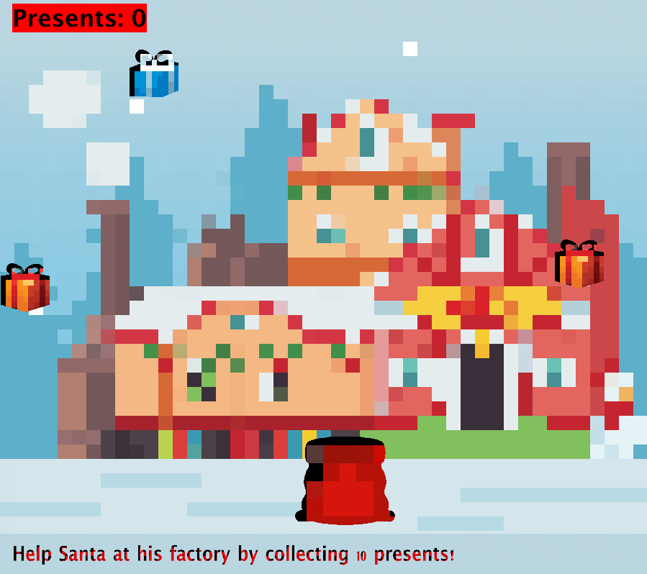
Level 1
How it’s played
Main goal

Slide 4
Level 2
How it’s played
Main goal?
How the player can lose

Slide 5
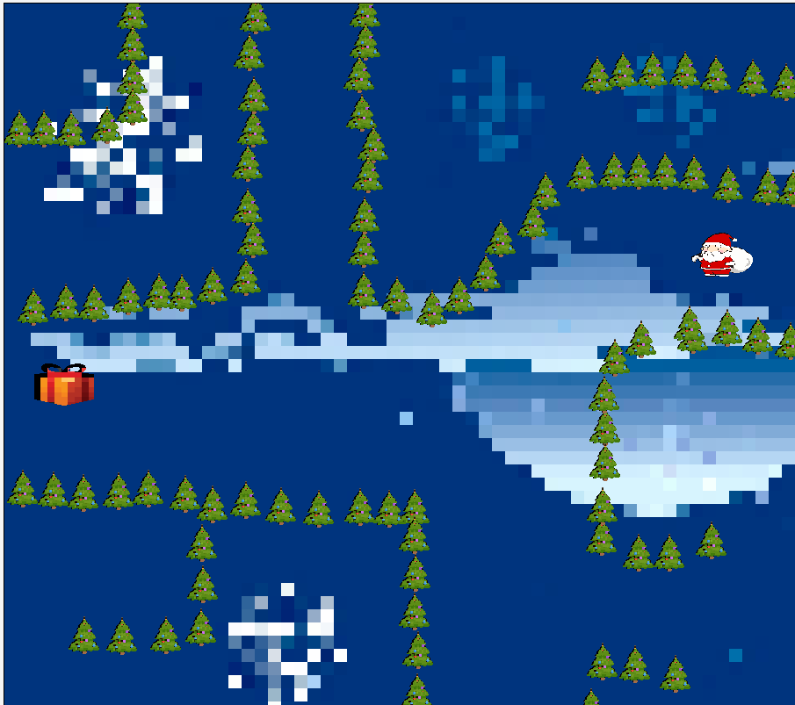
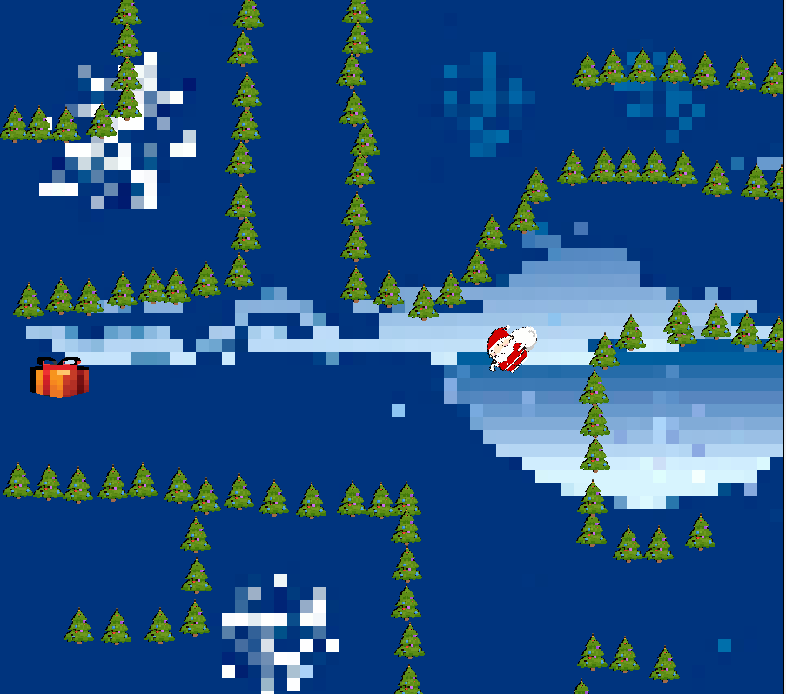
Level 3
How it’s played
Main goal?
How the player can lose

Slide 6
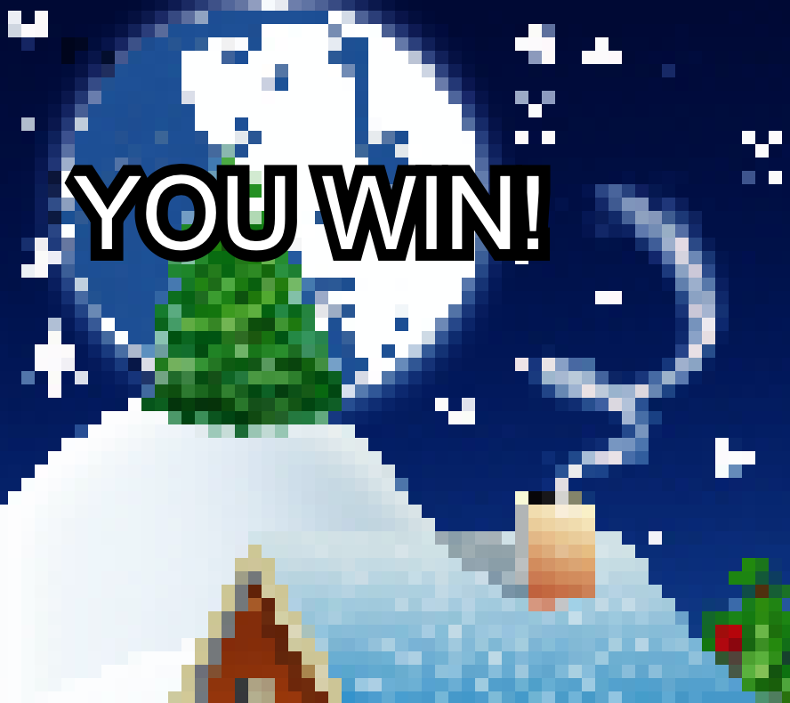
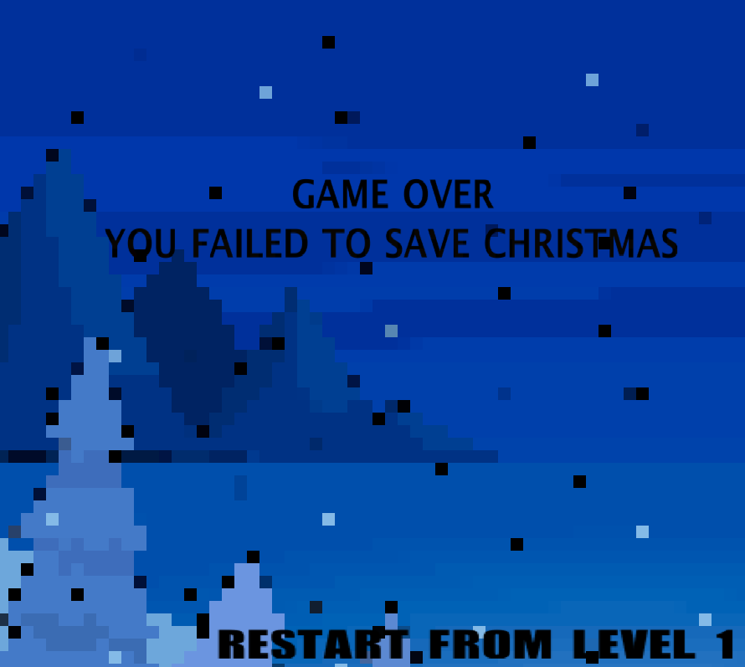
Game won & Game over

Slide 7
Challenges
Time management
Compiling code
Not being able to meet in person

Slide 8
Enhancements?
Include instructions menu
Improve Art style
Create more challenges for player
Make a bonus round

Slide 9
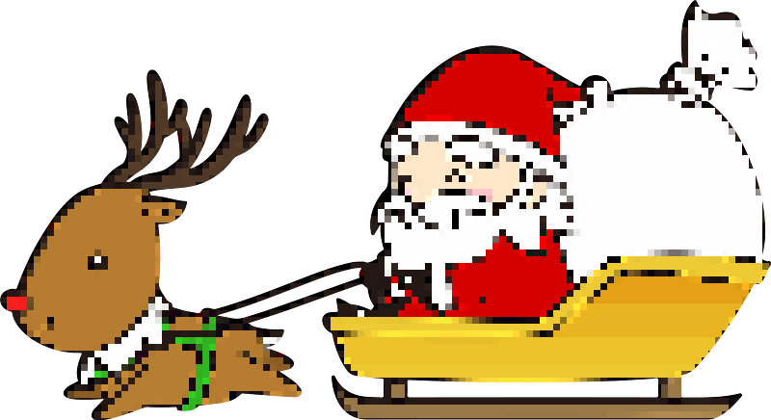
Thank you for listening!

Slide 10
Sources:
https://creazilla.com/
https://opengameart.org/
https://www.shutterstock.com/discover/stock-image-0120?kw=shutterstock%20images&c3apidt=p21290333853&gclid=Cj0KCQiAwf39BRCCARIsALXWETye-ottU0LtCV0cbxo5P-vIMySXXlJ9WXTKS3LYIv6hh2EACeurwh0aAgYdEALw_wcB&gclsrc=aw.ds
https://pinetools.com/pixelate-effect-image

