Slide 1

Event Search Engine CS 410 Final Project
Team Name: Model Behavior
Team Members: Gautam Putcha, Ashna Anil, Kunal Samant, Parth Patel

Slide 2
Problem Statement and Use Case
We will be building a search engine that ranks events/activities in your location based on events from Eventbrite and twitter.
This is a text retrieval and ranking task after parsing information from different sources.
We found this to be an important and interesting task and in today's world there are a lot of events occurring and it is hard to keep track or try to find the right events on social media!
Searching on any one source alone typically does not allow users to find the events they are looking for. This search engine will combine and rank the data and make it easier for users to find all of the events they are interested in from a single source of truth.

Slide 3
Functional Overview
The application will accept a query from the user and return a ranked list of the most relevant events in a given city.
The user can choose from a drop-down menu of cities where events are taking place.
A user's workflow on our application would look as follows:
Open the event ranking engine application.
Type in a query for the events that the user desires to search for. Press "Enter". The ranked list of results is shown.
The user may optionally filter the results for the desired city/location. The ranked list is then updated to include only events in the user's desired city.

Slide 4
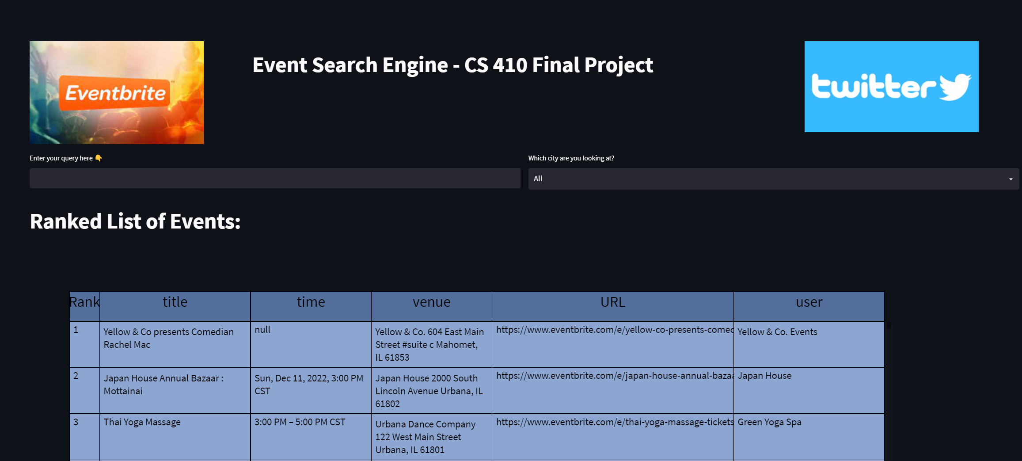
Open the event ranking engine application.
Type in a query for the events that the user desires to search for. Press "Enter". The ranked list of results is shown.
The user may optionally filter the results for the desired city/location. The ranked list is then updated to include only events in the user's desired city.

Slide 5
Implementation
We used Python for the backend
Collection and Combining the Data
Preprocessing the Data (remove stop words, tokenization etc..)
Created a ranked list function using the Okapi BM25 ranker
We used the Streamlit Application for the UI

Slide 6
THANK YOU

