Slide 1



Crop Recommendation System Using Soil and Climate Data
A Machine Learning-Based Predictive Analytics Project
Team Members: Ananthan S
Ashna Jebin
Jeeva B S
Notes:
1

Slide 2


Introduction & Problem Statement
Why This Matters
The Challenge
Agricultural productivity depends critically on soil nutrients (Nitrogen, Phosphorus, Potassium, pH) and climate conditions (temperature, rainfall, humidity). These factors determine which crops will thrive in specific locations.
Traditional crop selection relies on farmer experience rather than data-driven insights. This often leads to suboptimal yields, poor planning, and reduced sustainability.
🚨 Problem: Lack of intelligent systems for accurate crop recommendation
👉 Solution: A Machine Learning-based system for data-driven crop selection
Notes:
2

Slide 3






Project Objectives
Predictive ML Model
Soil & Climate Data
Regional Optimization
Develop a machine learning model for accurate crop recommendation
Use comprehensive soil and climate parameters for predictions
Integrate region-specific optimization for different Indian zones
Mobile Application
Real-Time Predictions
Agricultural Impact
Build a mobile-friendly Streamlit application
Enable real-time and bulk prediction capabilities
Improve agricultural productivity and sustainability
Notes:
3

Slide 4

Dataset & Features
Dataset Source
Dataset sourced from Kaggle Crop Recommendation Dataset with approximately 2,200+ samples covering 22 different crop types.
Input Features
Nitrogen (N) content
Phosphorus (P) content
Potassium (K) content
Temperature (°C)
Humidity (%)
pH value
Rainfall (mm)
Target Variable
Crop label (Rice, Wheat, Maize, etc.) representing real-world agricultural conditions
Notes:
4

Slide 5

Methodology & Workflow
01
Data Pipeline
Data preprocessing including cleaning and normalization, exploratory data analysis (EDA), and train-test split (80:20 ratio)
02
Model Training
Implemented Random Forest Classifier and Decision Tree algorithms for crop prediction
03
Model Evaluation
Assessed using accuracy, precision, recall, and F1-score metrics
04
Model Serialization
Serialized model using Joblib for efficient deployment
Notes:
5

Slide 6





System Architecture
User Input
Soil and weather data collection
Streamlit Interface
Interactive web application layer
ML Model
Random Forest classifier processing
Regional Optimization
Location-based refinement
Final Output
Comprehensive crop recommendations
Notes:
6

Slide 7
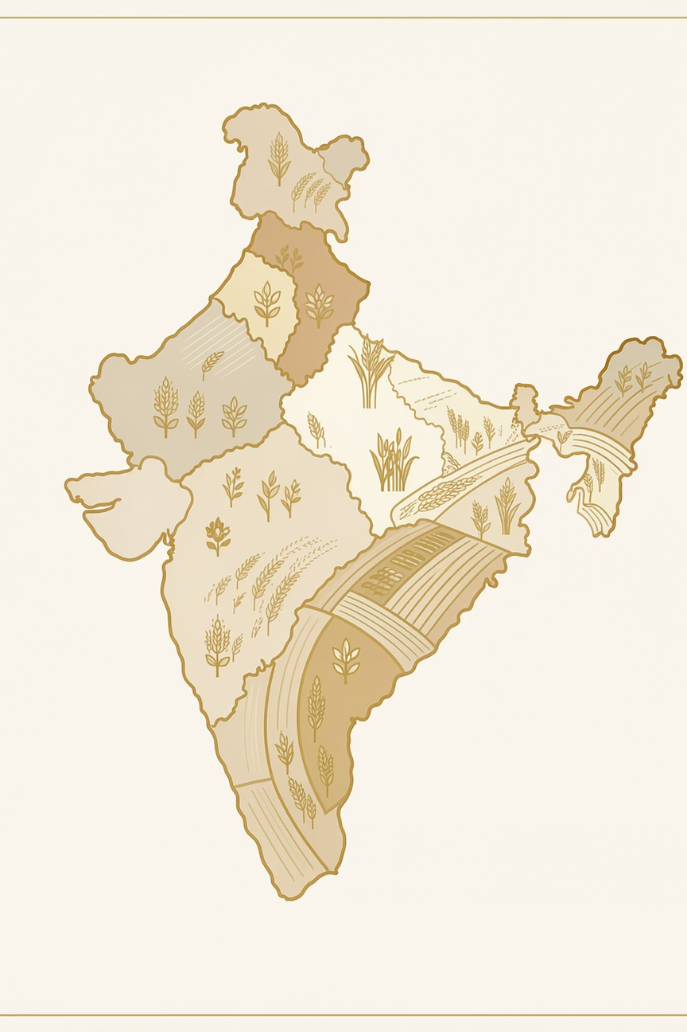
Regional Optimization
Core Innovation
Supports 6 major Indian regions: North, South, East, West, Central, and Hilly zones.
Optimization Factors
Confidence Formula
Crop suitability by region
Soil condition matching (N, P, K, pH)
Seasonal variations
📊 Final Confidence = Base Confidence × Regional Factor
Seasonal Crops
Optimal Soil Conditions
Rabi, Kharif, and Summer crop recommendations
Region-specific soil parameter guidelines
Farming Tips
Customized advice for each region
Notes:
7

Slide 8






Application & Features
Streamlit Web App
Mobile-Friendly UI
Quick Input
Fast predictions under 1 second, works on low-end devices
Manual data entry for immediate results
Weather-Based Prediction
Bulk CSV Prediction
API integration with OpenWeatherMap for real-time conditions
Batch processing for multiple data entries
Region Info Dashboard
Offline Capability
Interactive visualizations and insights
Prediction functionality without internet
Notes:
8

Slide 9
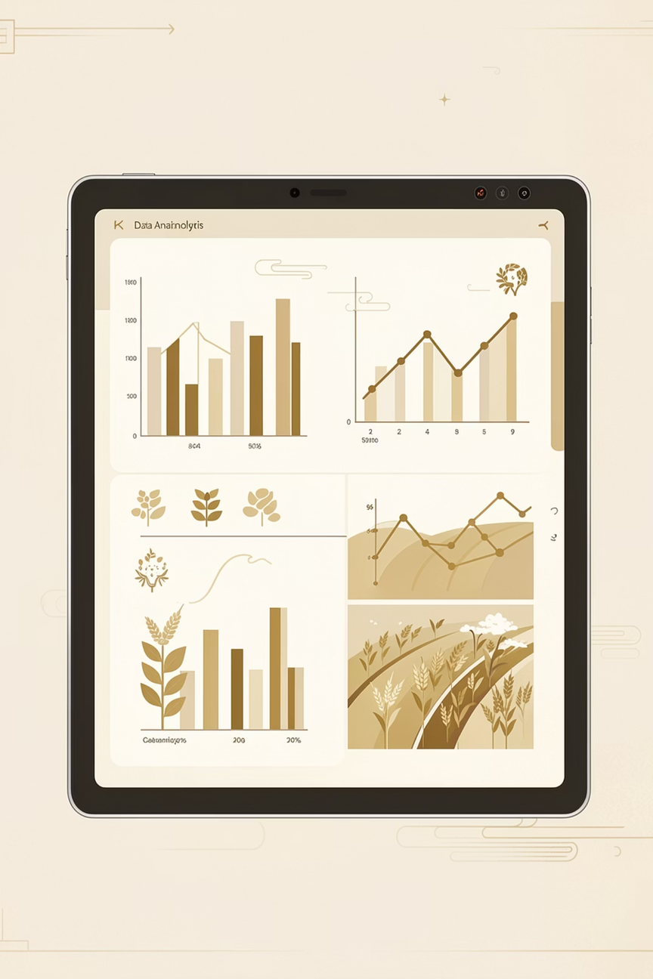
Results & Performance
95%
Accuracy
Overall model accuracy
0.94
Precision
Correct positive predictions
0.93
Recall
Proportion of actual positives identified
0.93
F1-Score
Harmonic mean of precision and recall
⚡ Prediction Time: <100 ms | Model: Random Forest (100 trees)
The model demonstrates reliable performance for real-world agricultural decision support systems.
Notes:
9

Slide 10

Conclusion & Future Scope
Project Conclusion
Future Enhancements
Provides accurate, data-driven crop recommendations
Enhances farmer decision-making processes
Supports precision agriculture initiatives
Regional optimization increases practical value
Deep Learning models (CNN, LSTM)
Image-based soil analysis 📷
Multi-language support 🌐
Market price integration 💰
Climate change impact modeling
Sub-district level optimization
Notes:
10

Slide 11
Thank You
Notes:
11

