Slide 1
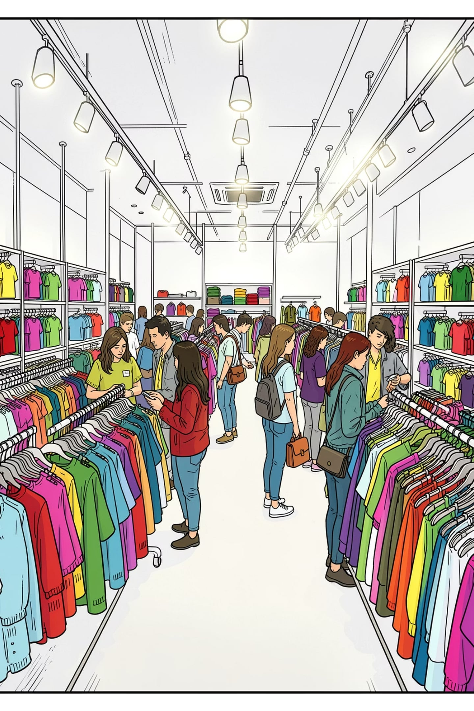
Customer Shopping Behavior Analysis
Uncovering insights from 3,900 transactions across product categories — spending patterns, customer segments, and subscription behavior — to guide strategic business decisions.

Slide 2
Dataset at a Glance
3,900
18
Transactions
Columns
Across all product categories
Demographics, purchases & behavior
37
25
Missing Values
Unique Items
In Review Rating column
Across 4 categories
Key features include customer demographics (Age, Gender, Location, Subscription Status), purchase details (Item Purchased, Category, Purchase Amount, Season, Size, Color), and shopping behavior (Discount Applied, Previous Purchases, Frequency of Purchases, Review Rating, Shipping Type).

Slide 3

Data Preparation in Python
01
Loading & Exploration
Imported dataset via pandas; used df.info() and .describe() for structure and summary statistics
02
Missing Data Handling
Imputed 37 missing Review Rating values using the median rating of each product category
03
Feature Engineering
Created age_group by binning ages; created purchase_frequency_days from purchase data; renamed columns to snake_case; dropped redundant promo_code_used
04
Database Integration
Loaded cleaned DataFrame into PostgreSQL for SQL analysis

Slide 4
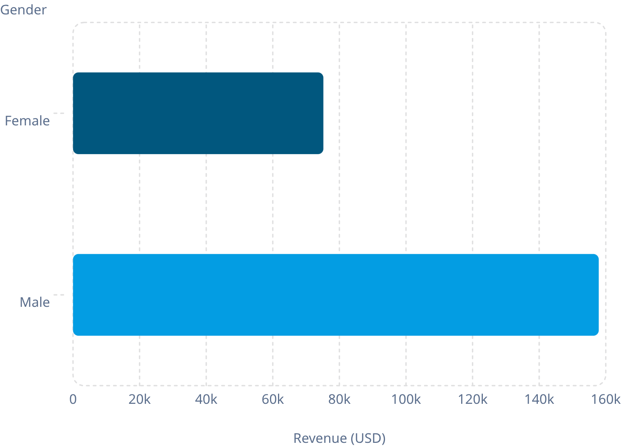
Revenue by Gender
Key Finding
Male customers generated $157,890 in revenue — more than double the $75,191 from female customers.
Male shoppers also comprised the majority of the customer base at 2,652 out of 3,900 transactions, compared to 1,248 female transactions.

Slide 5
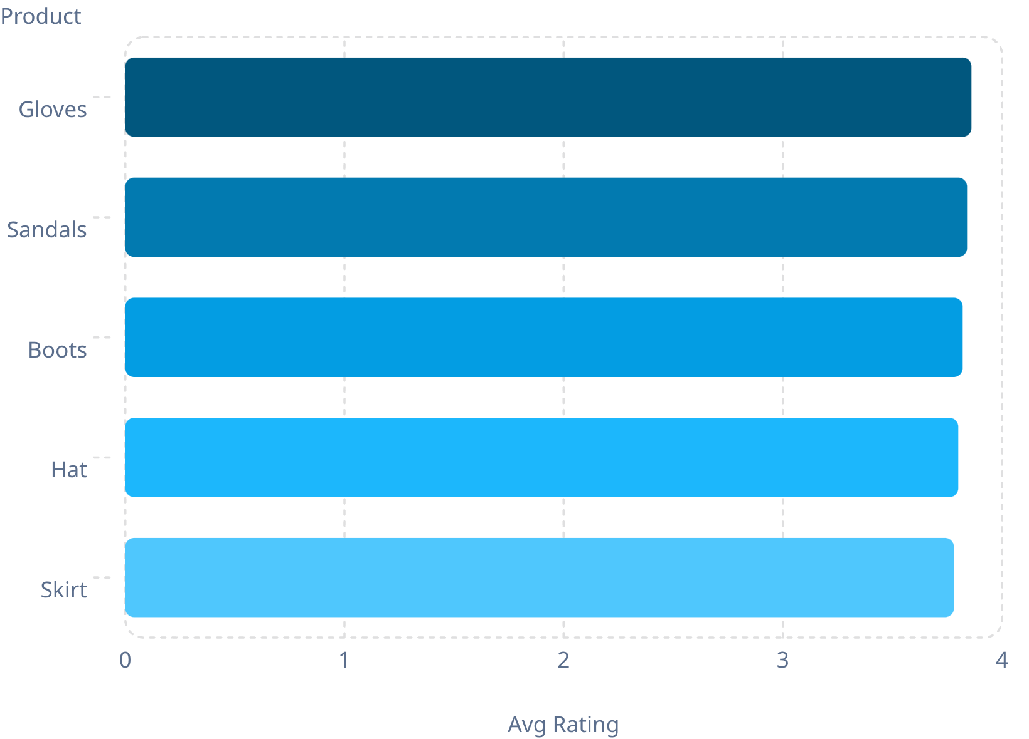
Product Ratings & Discount Patterns
Top 5 Products by Review Rating
Discount-Dependent Products
Products with the highest percentage of discounted purchases:
Hat — 50.00%
Sneakers — 49.66%
Coat — 49.07%
Sweater — 48.17%
Pants — 47.37%
These five products rely most heavily on discounts to drive sales.

Slide 6
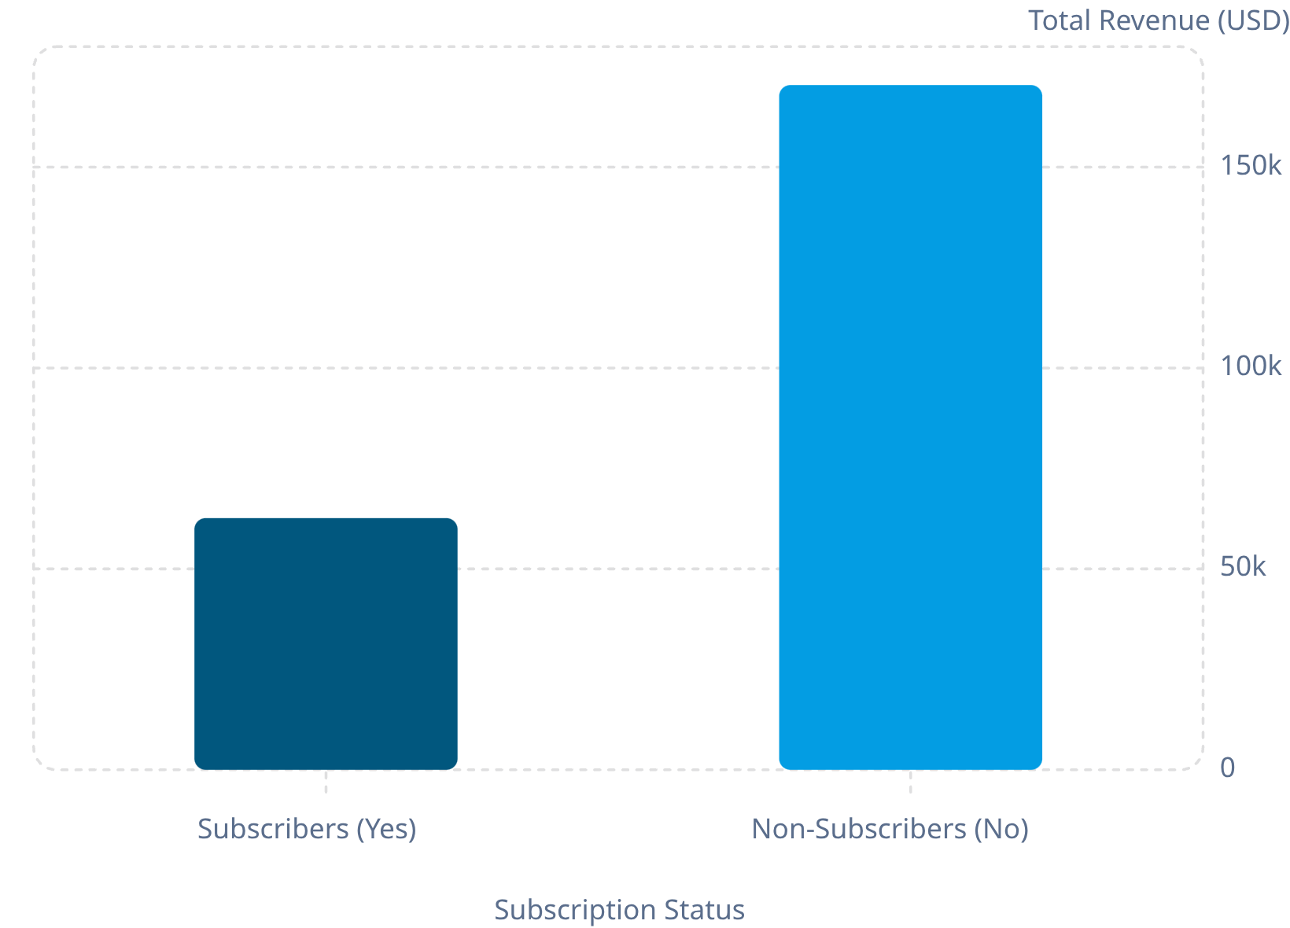
Subscribers vs. Non-Subscribers
Key Insights
73% of customers are non-subscribers (2,847) vs. 27% subscribers (1,053).
Average spend is nearly identical: $59.87 (non-subscribers) vs. $59.49 (subscribers).
However, 958 repeat buyers (customers with more than 5 purchases) hold subscriptions, suggesting strong potential for converting frequent shoppers.

Slide 7

Customer Segmentation
🏆 Loyal
🔄 Returning
3,116 customers — the dominant segment, representing the vast majority of the customer base
701 customers — a middle segment with potential to be converted into loyal buyers
🆕 New
83 customers — a small but important segment for acquisition and growth

Slide 8
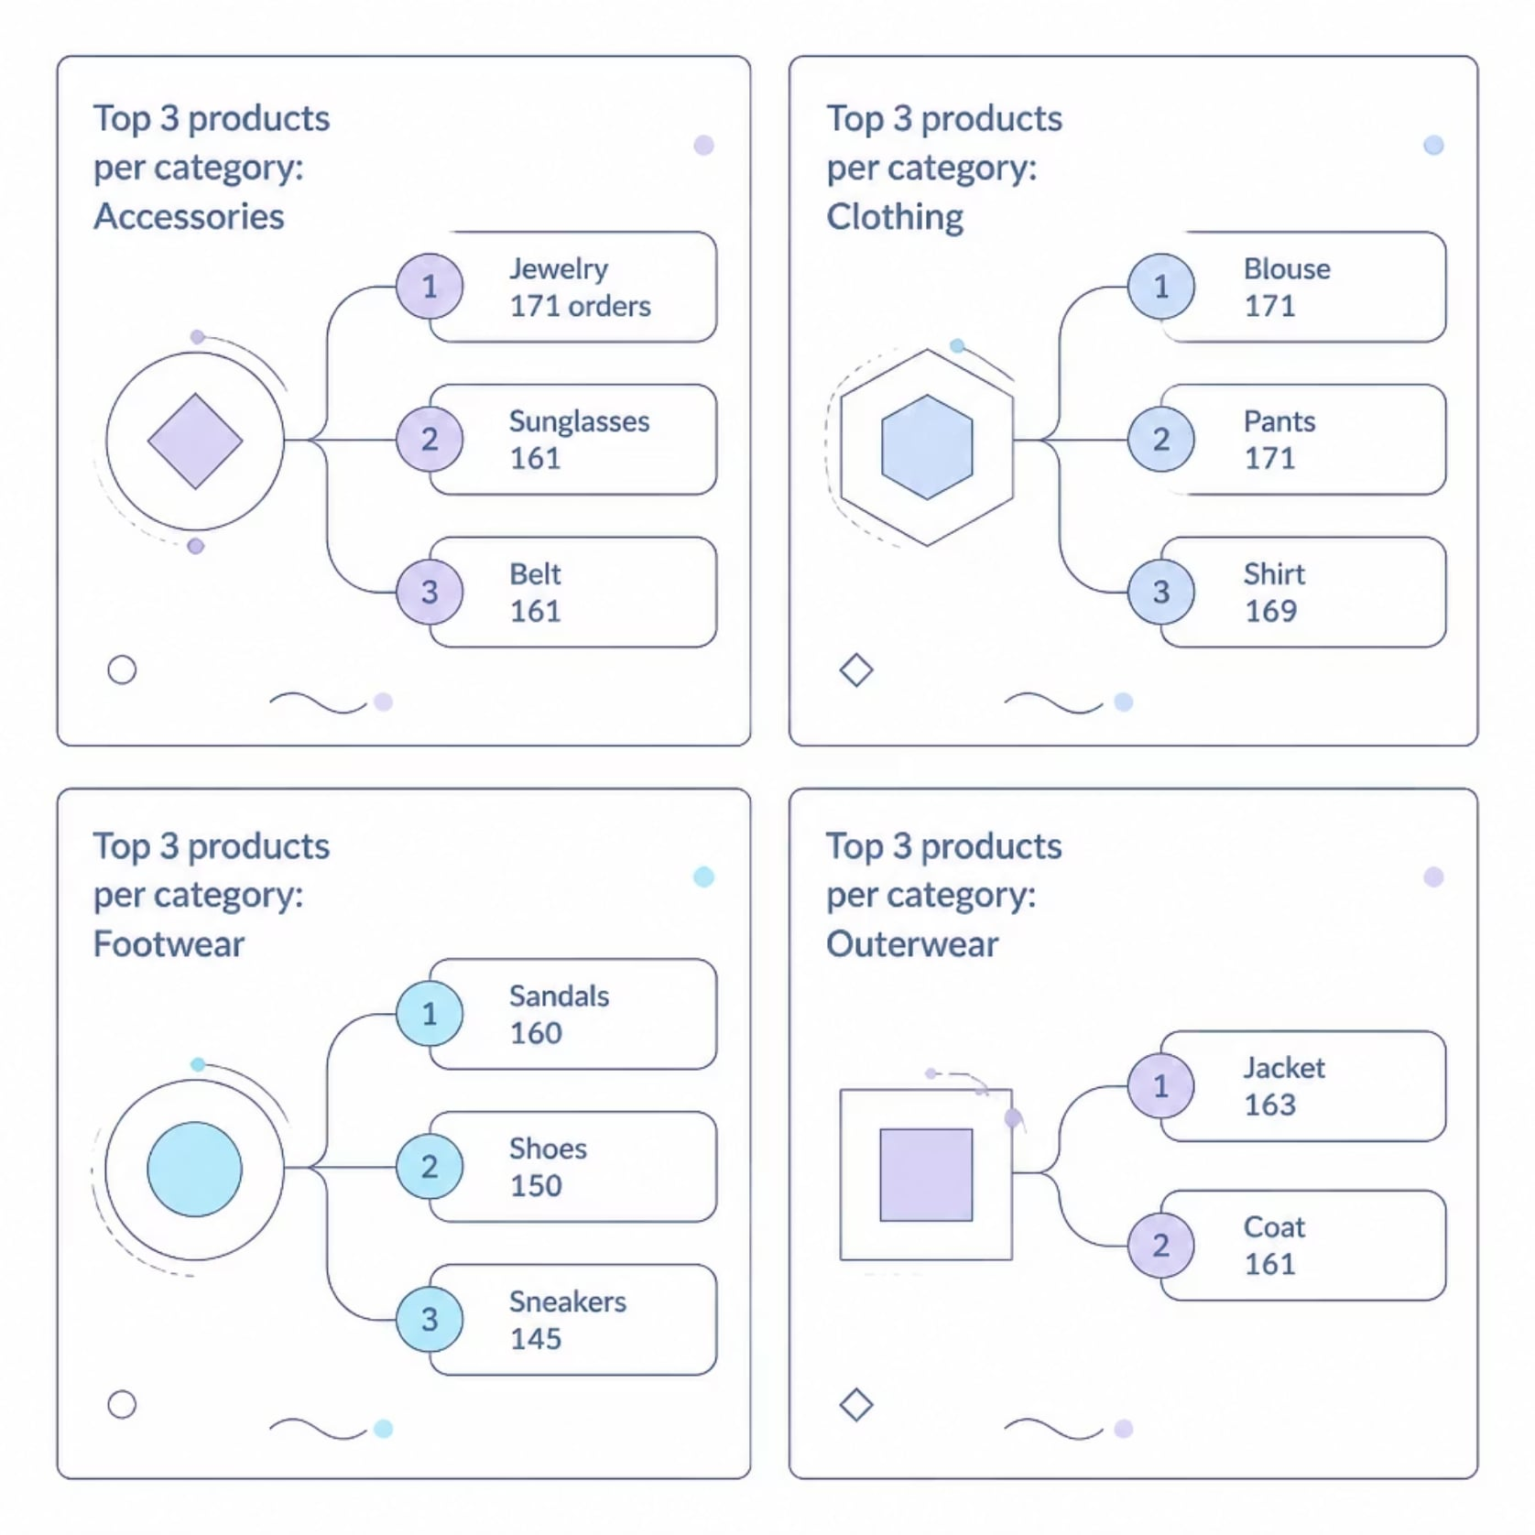
Top Products by Category
Best-Sellers by Category
Clothing leads overall, with Blouse and Pants tied at 171 orders each. In Outerwear, Jacket tops the category with 163 orders. Sandals is the leading Footwear item at 160 orders, while Jewelry leads Accessories at 171 orders.
These top-performing products should be prioritized in marketing campaigns and inventory planning.

Slide 9
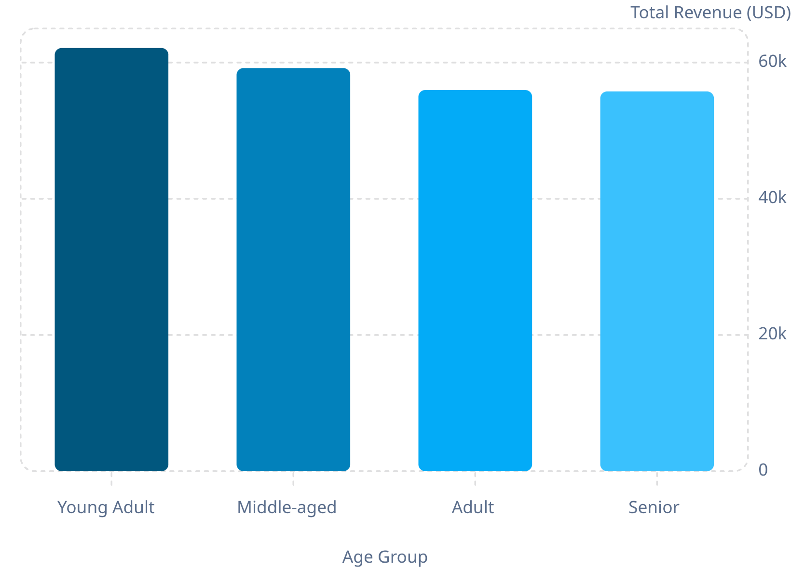
Revenue by Age Group
Age Group Insights
Young Adults are the top revenue contributors at $62,143, followed by Middle-aged ($59,197), Adult ($55,978), and Senior ($55,763).
Revenue is relatively evenly distributed across all four age groups, with Young Adults generating roughly 11% more than Seniors — the lowest-contributing segment.

Slide 10

Power BI Dashboard & Business Recommendations
An interactive Power BI dashboard visualizes all key metrics — 3.9K customers, $59.76 avg purchase, 3.75 avg rating — with filters for subscription, gender, category, and shipping.
Boost Subscriptions
Promote exclusive subscriber benefits
Loyalty Programs
Reward repeat buyers to move them into the "Loyal" segment
Review Discount Policy
Balance sales boosts with margin control
Product Positioning
Highlight top-rated and best-selling products in campaigns
Targeted Marketing
Focus on high-revenue age groups and express-shipping users

