Slide 1
IDP Progress

Slide 2
Parameters Calculated
VAR
Volatility
Beta
EBITDA
ROE
Gearing
Profitability
ROCE

Slide 3
Equations Used
Volatility calculated by taking the standard deviation of the prices after each day, available as quarterly, annually, semi annually as well.
EBITDA value taken directly from the instruments file and is plotted for the fiscal years available.
ROE calculated by using the formula ((Total_Revenue - Cost_Of_Goods_Sold)/EQUITY).
Gearing calculated by (total debt/total equity).
Profitability calculated using the formula EBITDA/Net_sale
ROCE calculated using formula EBIT/(ASSETS-LIABILITY)

Slide 4
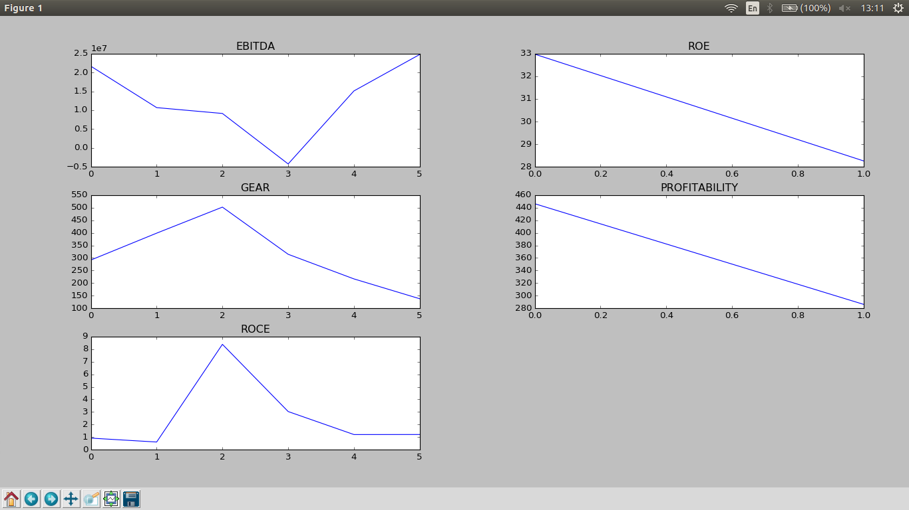
Plotting data

Slide 5
Next steps
Verification of equations and parameters.
To add/remove parameters.
Deciding ML algorithm for running on the results and train the system.
Split data set to perform training and cross validation.
Get more data to test/train.

Slide 6
Organizational
Goal definition for the IDP.
Deadline for the IDP.

