Slide 1

EXECUTIVE
PRODUCTIVITY
AGENT
Transform fragmented workplace communication
into a clear, actionable executive brief.
Presented by Ashna Shalu 23csu060

Slide 2

Problem & Solution
The problem
The solution
Executive commitments are fragmented across multiple workplace sources.
Executive Productivity Agent
Transforms supplied workplace inputs into one structured view of:
• Commitments can be mentioned more than once.
• Ownership may be explicit, shared, or unclear.
• Deadlines and follow-ups can be buried in communication.
• Executives need a concise view of what requires attention now.
Commitments
My actions
Waiting on others
Deadlines / overdue
Ownership
Daily brief

Slide 3
01
Emails & meetings
Commitments, follow-ups, deadlines and context, Statements and commitmentsmade during discussion
Inputs, Sources & Assumptions
02
Calendar & voice notes
Scheduled events and meeting context Personal reminders and
commitment references
03
Key assumptions
• Only the supplied Assignment 1 data pack is used.
• Repeated mentions of the same action are consolidated into one normalized action.
• Ownership is not inferred when the source data does not establish it.
• Scenario date/time controls whether an item is upcoming, due, or overdue.

Slide 4
Architecture & Process Flow
WORKPLACE DATA
NORMALIZATION
COMMITMENT
EXTRACTION
DEDUPLICATION
CLASSIFICATION
Emails • Meeting
Calendar • Voice
Structured source
records
Identify action,
owner, deadline
Merge repeated
mentions
My Action • Waiting
• Unclear Ownership
DEADLINE + STATUS ENGINE
DAILY BRIEF + Q&A
Scenario-aware status • due dates • overdue detection
Grounded answers

Slide 5










Core Agent Logic
Awareness Stage
Evaluate
Detect explicit commitments
made by the executive.
Compare scenario time with
deadlines and known status.
Normalize
Classify
Represent each underlying action
with owner, deadline and evidence.
Separate My Actions,
Waiting and Unclear Ownership.
Deduplicate
01
Merge repeated mentions
from different sources.
05
02
04
03
Grounding rule: the agent uses only supplied evidence and does not invent owners, deadlines or commitments.

Slide 6
Action Classification
MY ACTIONS
WAITING ON OTHERS
UNCLEAR OWNERSHIP
Requires action from Arjun
Blocked by another person / dependency
Ownership not established in supplied data
Send updated vendor list
Q3 campaign deck • waiting on Neha
Mumbai office lease renewal
Review July expense variance
Reconfirm / attend Meridian call

Slide 7
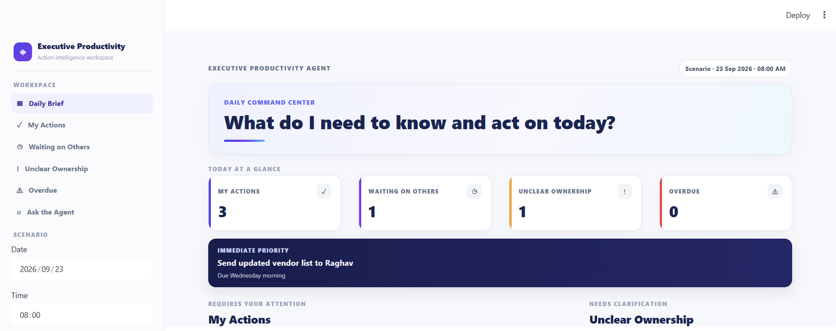
MY ACTIONS
Daily Action Brief
WAITING ON OTHERS
UNCLEAR OWNERSHIP
DEADLINES & PRIORITIES
OVERDUE / TODAY

Slide 8
Natural-Language Q&A
Grounded response
ASK
GROUNDED RESPONSE
Answers are constrained to the supplied Assignment 1 data pack; unsupported facts are not generated.
What you promised Raghav
“What did I promise Raghav?”
You promised to send the updated vendor list to Raghav Sethi.
Latest commitment: Wednesday morning
Status: overdue
The user can ask questions in natural language instead of navigating every source manually.
Evidence
• Leadership Sync — commitment stated
• Vendor List email — commitment moved to Wednesday morning
• Voice Note — reminder to send the vendor list
• Vendor List email — Raghav followed up at 8:45 AM

Slide 9
AI Tools & Development
ChatGPT
Used for , architecture reasoning, code assistance, debugging, and iteration.
Claude AI
Used to refine UI concepts/prompts and explore a polished executive-dashboard presentation for the prototype.
Google Stitch
Used for UI design exploration and visual direction before implementing the Streamlit interface.

Slide 10
Complete Solution & Demo Flow
1
2
3
4
5
Input
Process
Intelligence
Output
Demo
Emails • Meeting
Calendar • Voice
Normalize → Extract
Deduplicate → Classify
Deadlines • Status
Ownership • Evidence
Daily Action Brief
+ Natural-Language Q&A
Change scenario time
and test questions
DEMO CHECKLIST
1. Show Daily Action Brief • 2. Open evidence • 3. Change scenario time • 4. Ask natural-language questions

