Slide 1
⬡
ATHENA
TBM INTELLIGENCE PLATFORM
From messy IT & finance spreadsheets to a governed, ATUM-classified
TBM data model — automated, explainable, and audit-ready.
ATHENA · TBM INTELLIGENCE PLATFORM
01

Slide 2
THE PROBLEM
TBM data readiness is a bottleneck, not a strategy
› Enterprise IT & finance data lives in dozens of disconnected spreadsheets.
Vendor lists, GL cost extracts, CMDBs, resource-tower catalogs — each with its own schema.
› Mapping that data onto a TBM taxonomy (ATUM) is manual, slow, and inconsistent.
Analysts hand-classify thousands of line items with no audit trail.
› Relationships between systems, vendors, and cost centers are invisible.
No one can see how a storage device rolls up to a cost pool without tribal knowledge.
› The result: weeks of spreadsheet wrangling before any real cost transparency work can start.
A TYPICAL INTAKE
Cost_Source_Master_Data.xlsx
1,177 rows
Storage_Master_Data.xlsx
52,838 rows
IT_Resource_Towers_Master_Data.xlsx
355 rows
Storage_Devices_Master_Data.xlsx
26 rows
Data_Centers_Master_Data.xlsx
8 rows
108,808 rows · 9+ formats · zero shared schema
ATHENA · TBM INTELLIGENCE PLATFORM
02

Slide 3
THE SOLUTION
One guided pipeline, five phases, human-in-the-loop
Athena ingests raw spreadsheets and walks them through an automated, reviewable pipeline to a governed TBM data model.
1
2
3
4
5
Import Data
Relationships
Data Quality
ATUM Mapping
Export
›
›
›
›
Catalog & profile
Knowledge graph
Detect & correct
AI classification
Apptio-ready model
ATHENA · TBM INTELLIGENCE PLATFORM
03

Slide 4
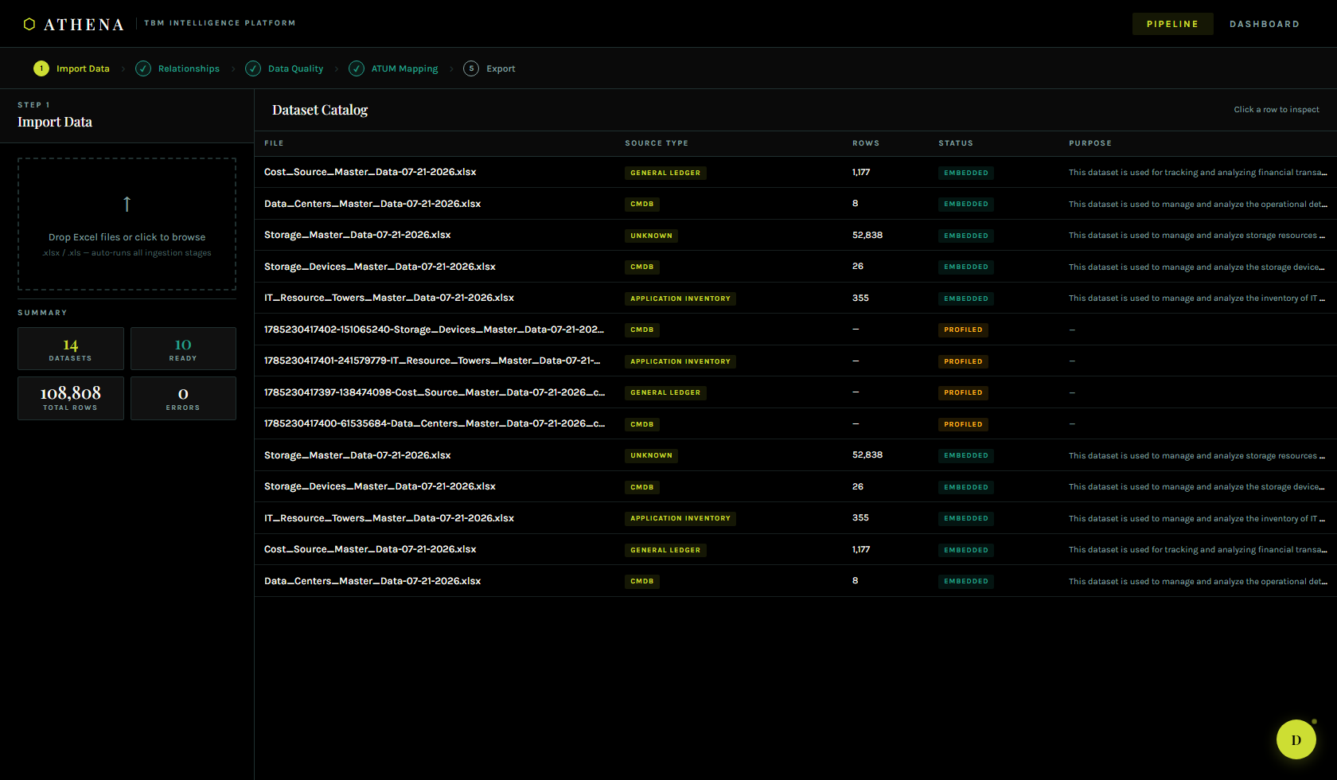
PHASE 1 — IMPORT DATA
Drop spreadsheets in, get a live catalog out
› Drag-and-drop ingestion for Excel/CSV/JSON.
Every file auto-runs the full ingestion pipeline — no manual schema setup.
› Automatic source-type detection.
General Ledger, CMDB, Application Inventory classified on arrival.
› Row-level profiling at scale.
108,808 rows across 14 datasets cataloged and status-tracked in seconds.
› Nothing blocks on a perfect first upload.
Datasets can be corrected and re-embedded later in the pipeline.
Live dataset catalog — 14 datasets, 108,808 rows, auto-classified
ATHENA · TBM INTELLIGENCE PLATFORM
04

Slide 5
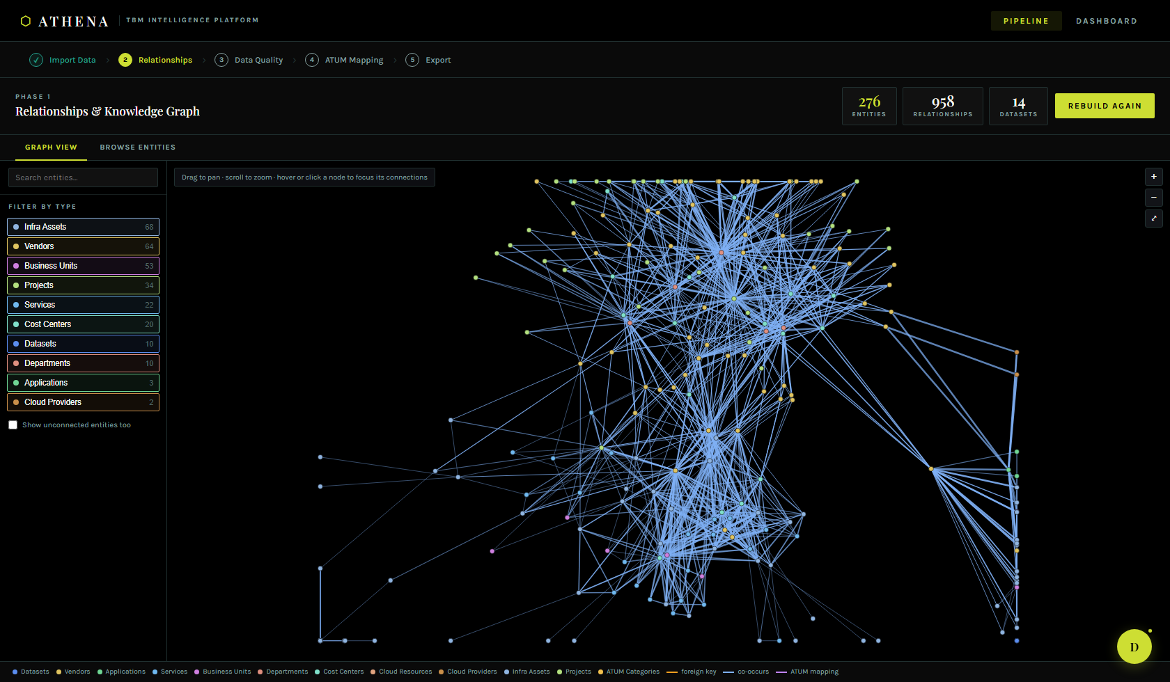
PHASE 2 — RELATIONSHIPS
An enterprise knowledge graph, built automatically
› Cross-dataset entity resolution.
Vendors, cost centers, infrastructure assets, projects — deduplicated and linked.
› Three kinds of evidence, not guesswork.
Structural foreign keys, same-row co-occurrence, and ATUM taxonomy mappings.
› 276 entities, 958 relationships surfaced automatically.
From data that shipped with zero shared schema.
› Built for exploration, not just storage.
Pan, zoom, and click-to-focus turn a dense graph into a readable one.
276 entities · 958 relationships, explored live
ATHENA · TBM INTELLIGENCE PLATFORM
05

Slide 6
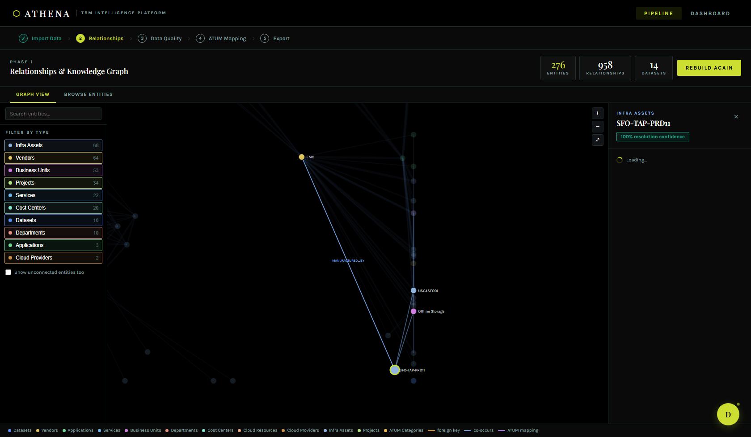
PHASE 2 — RELATIONSHIPS
Click any node, see exactly what it touches
› Focus mode turns a hairball into an answer.
Hover or click dims everything except that entity's direct connections.
› Auto-framing.
A click pans/zooms the camera to fit the node and its neighbors — labels stay readable.
› Full provenance on demand.
Confidence score, source datasets, and every relationship in one side panel.
› From "what is this?" to "what does this connect to?" in one click.
Focused ego-network for SFO-TAP-PRD11 — instant, legible detail
ATHENA · TBM INTELLIGENCE PLATFORM
06

Slide 7
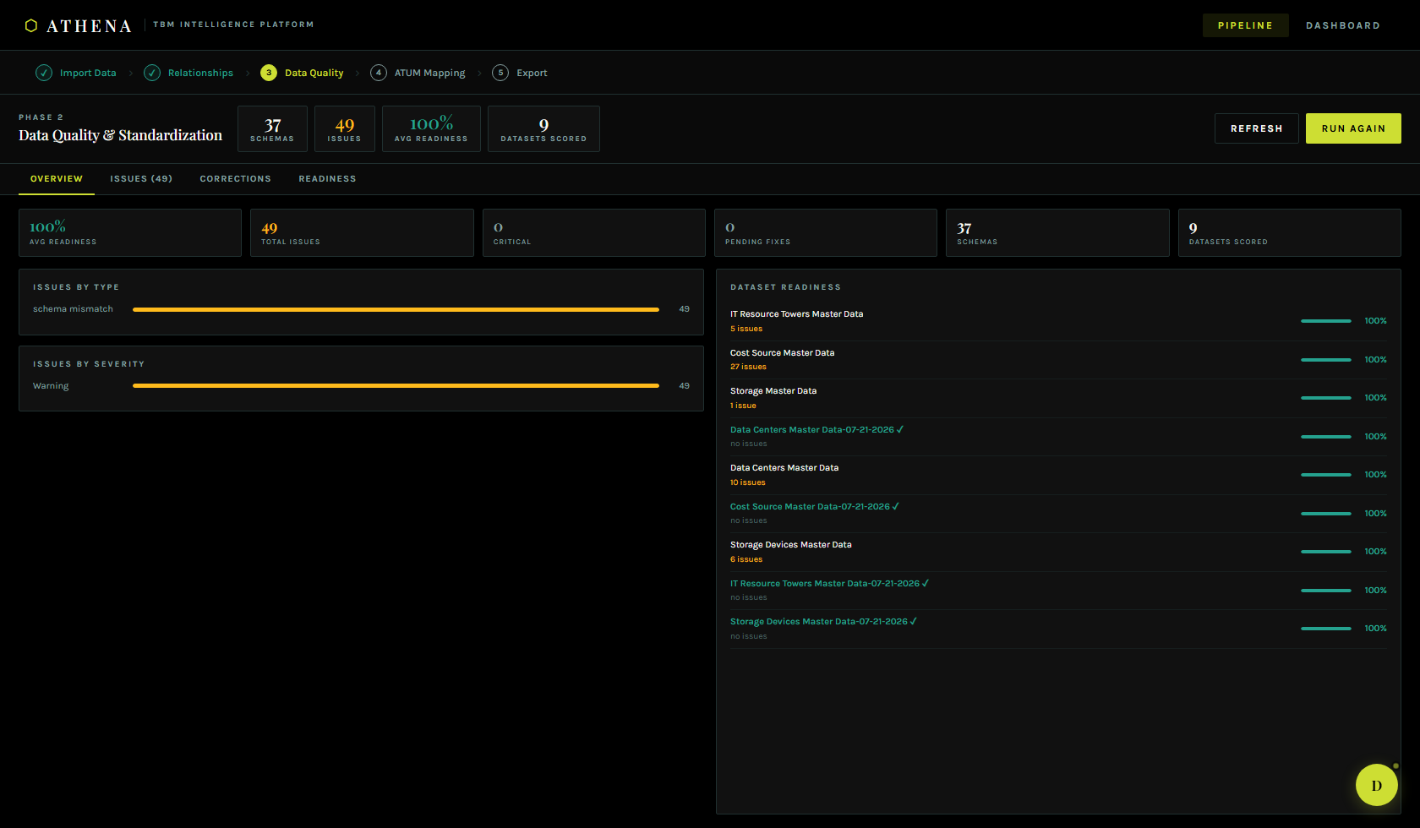
PHASE 3 — DATA QUALITY
Every dataset scored before it goes further
› Four quality dimensions, scored automatically.
Completeness, validity, consistency, uniqueness — per dataset.
› Issues surfaced with severity, not buried in a log.
Schema mismatches and other issues ranked critical → info.
› Readiness score gates downstream phases.
Analysts know exactly which dataset needs attention before ATUM mapping.
› Corrections are suggested, reviewed, and applied — not silently auto-fixed.
Data Quality & Standardization — 37 schemas, 9 datasets scored
ATHENA · TBM INTELLIGENCE PLATFORM
07

Slide 8
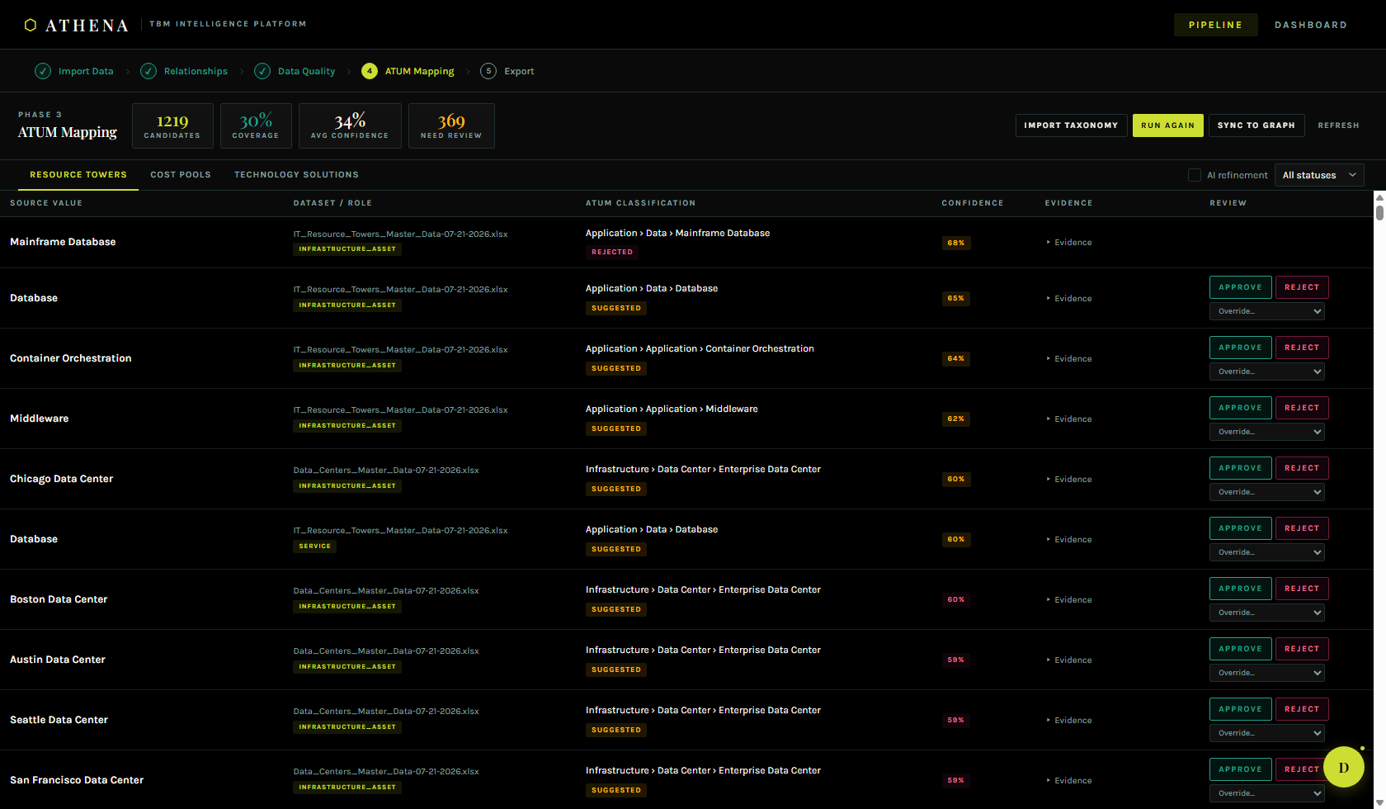
PHASE 4 — ATUM MAPPING
AI-assisted classification against the real TBM taxonomy
› Every entity classified into TBM Taxonomy v5.0.1.
Resource Towers, Cost Pools, and Technology Solutions — all three layers.
› Confidence-scored, with evidence.
Vector similarity + keyword scoring, shown per mapping — nothing is a black box.
› Human-in-the-loop review.
Approve, reject, or override any suggestion; overrides feed back into the graph.
› One click syncs approved mappings straight into the knowledge graph.
1,219 candidates classified against the ATUM taxonomy, live confidence scoring
ATHENA · TBM INTELLIGENCE PLATFORM
08

Slide 9
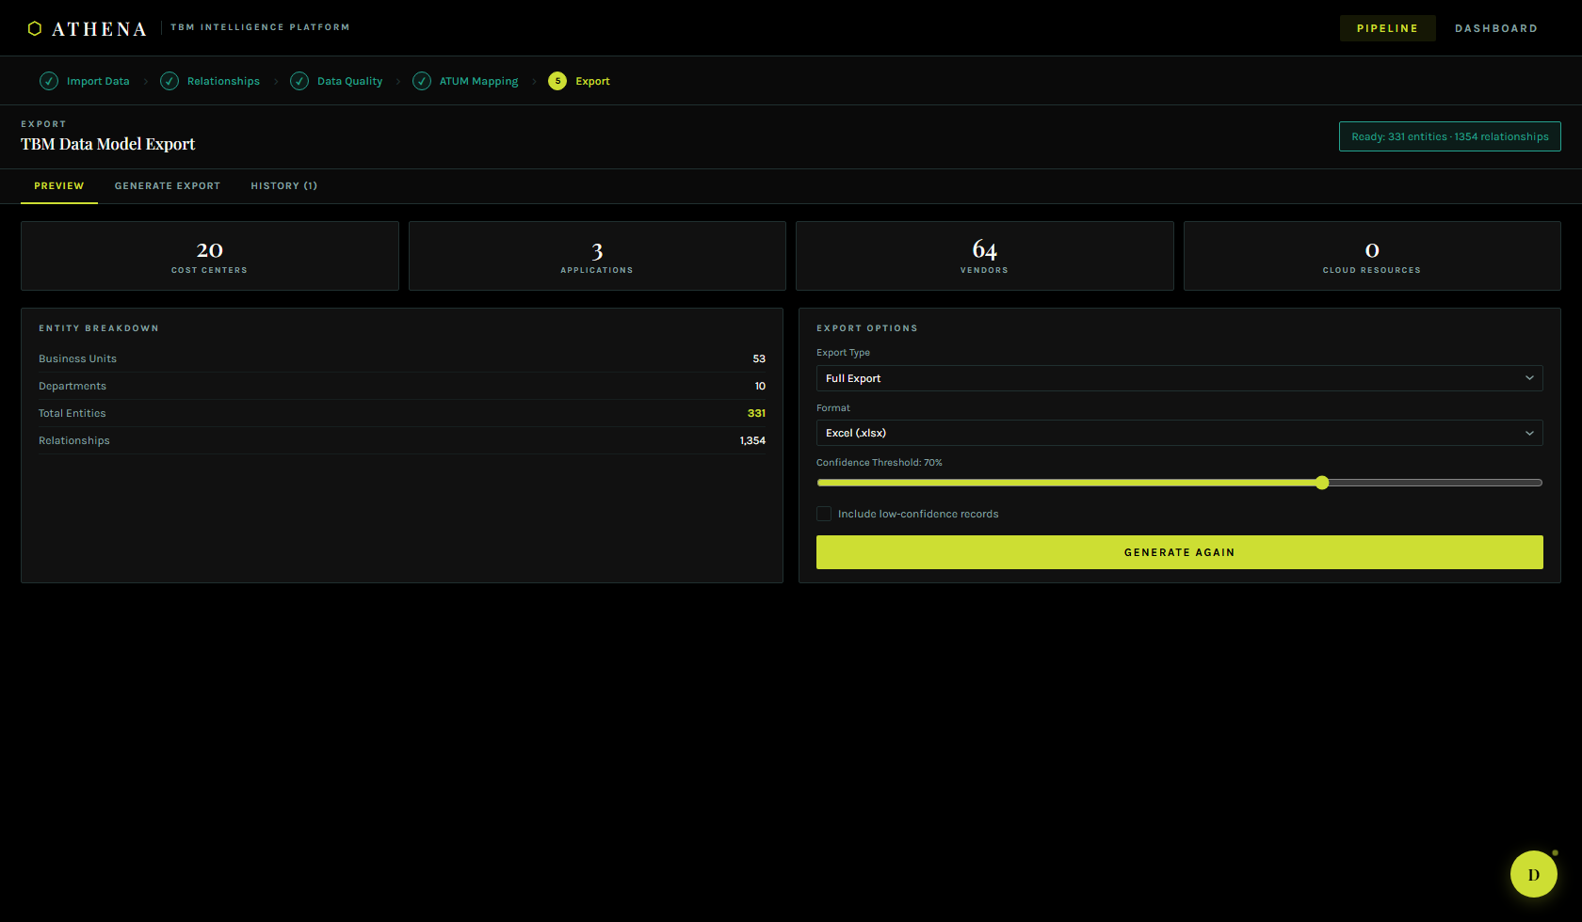
PHASE 5 — EXPORT
A governed model, ready for Apptio
› One-click export of the full TBM data model.
Cost centers, applications, vendors, cloud resources — fully mapped.
› Configurable confidence threshold.
Ship only what's trustworthy, or include low-confidence records with a flag.
› Excel-ready output, versioned history.
Every export is tracked, downloadable, and reproducible.
› 331 entities · 1,354 relationships, export-ready in this run.
TBM Data Model Export — ready: 331 entities, 1,354 relationships
ATHENA · TBM INTELLIGENCE PLATFORM
09

Slide 10
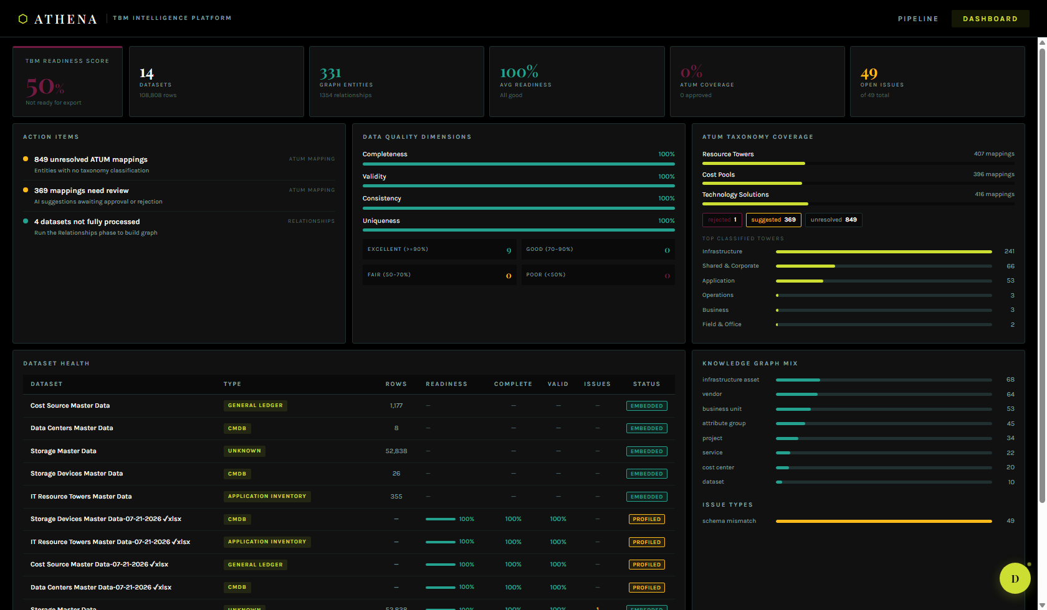
ALWAYS-ON VISIBILITY
One dashboard, the whole pipeline's health
› TBM Readiness Score.
A single weighted number combining readiness, ATUM coverage, and open issues.
› Action items, not just charts.
Unresolved mappings, low-readiness datasets, and unfinished ingestion, ranked.
› Full ATUM coverage breakdown.
By layer, by status, by top classified resource towers.
› Duke — an embedded AI assistant.
Context-aware to whichever phase you're on; answers questions about your own data.
Analytics Dashboard — readiness, quality, ATUM coverage, and dataset health in one view
ATHENA · TBM INTELLIGENCE PLATFORM
10

Slide 11
UNDER THE HOOD
Built for a real enterprise data pipeline
Frontend
Backend & AI
Data Layer
› React + Vite, TypeScript
› Custom force-directed graph viz
› Pan / zoom / focus-mode exploration
› Express API · LangGraph pipelines
› OpenAI embeddings + LLM refinement
› Multi-stage: profile → embed → graph → classify
› Postgres + pgvector
› Semantic similarity search
› Versioned exports & audit history
A monorepo: apps/web (React), apps/api (Express), packages/db (repository layer), packages/langgraph (AI pipeline stages) — 8 stages from raw file to governed TBM model.
ATHENA · TBM INTELLIGENCE PLATFORM
11

Slide 12
WHY IT MATTERS
Weeks of spreadsheet wrangling, compressed to a guided workflow
108,808
958+
1,219
331
rows ingested
automatically
relationships
discovered, not typed
entities classified
against ATUM v5.0.1
entities ready
for export
› From raw spreadsheets to an audit-ready TBM model — no manual mapping spreadsheet, no tribal knowledge required.
› Every classification is explainable: confidence score, evidence, and a human approval step.
› The knowledge graph is reusable infrastructure — the same relationships power quality checks, ATUM mapping, and export.
ATHENA · TBM INTELLIGENCE PLATFORM
12

Slide 13
⬡
Thank you
ATHENA — TBM INTELLIGENCE PLATFORM
Questions, demo requests, or a closer look at the knowledge graph — happy to dive in.
ATHENA · TBM INTELLIGENCE PLATFORM
13

