Slide 1


BUSINESS DATA MANAGEMENT
PROJECT PRESENTATION
EVALUATING SALES DECLINE AND MANAGEMENT ENHANCEMENTS IN PIZZA CAFE.
NAME - ASHUTOSH NARAYAN
ROLL NO. – 21F1003987

Slide 2

ABOUT THE BUSINESS
Pizz The Cafe is a pizza cafe offering variety of pizza types. As a B2C operation, The Café provides its services directly to its customers.
The cafe features a selection of pizzas divided into four categories: Chicken, Classic, Supreme, and Veggie. Each pizza is thoughtfully designed to cater to a diverse range of tastes and preferences. Overall, the menu includes 32 distinct pizzas available in various sizes.
PROBLEM STATEMENT
1.Understanding Revenue Decline: What Are the Principal Factors Contributing to the Continuous Decrease in Revenue Each Quarter, and How Can They Be Addressed?
2. Management issue: In What Ways Can Enhanced Planning of Inventory and Staffing Can Contribute to Improved Business Performance and Efficiency?

Slide 3
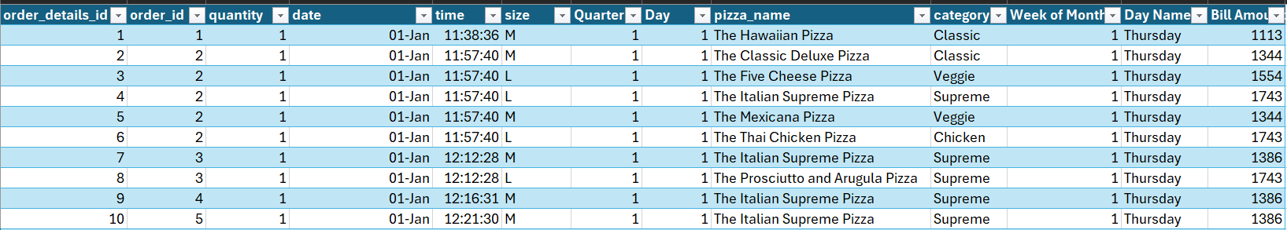
METADATA
The dataset includes four tables: Orders, Pizzas, Pizza Types, and Order Details.
These tables are linked by foreign keys, as shown in the diagram below.
order_id
pizza_id
pizza_type_id
Orders
Order details
Pizzas
Pizzas types
After merging the relevant columns, here are the first 10 rows of the main dataset

Slide 4
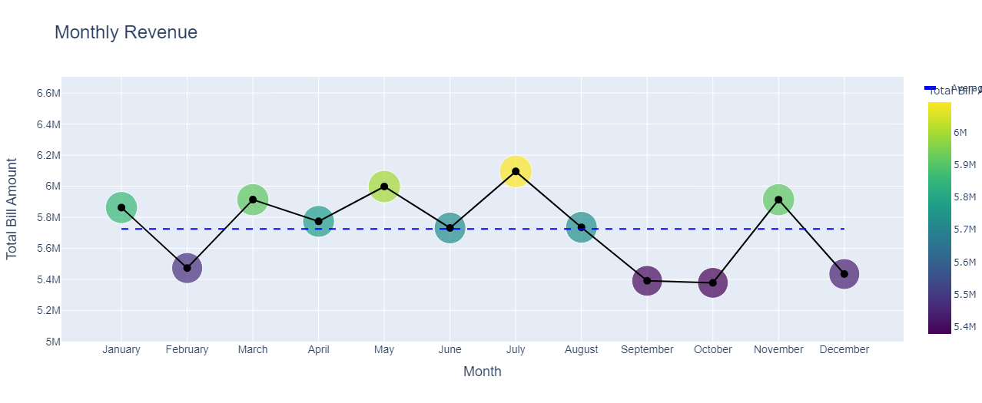
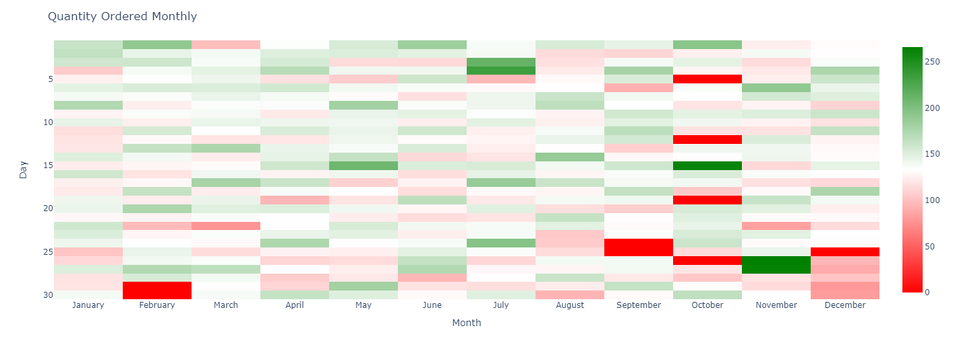
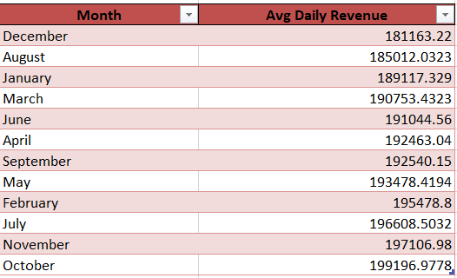
MONTHLY REVENUE ANALYSIS
4 months with revenue less than the average monthly revenue.
Months with low monthly revenue showing high average daily revenue except Dec.
Days with low daily orders in last quarter of the year.

Slide 5
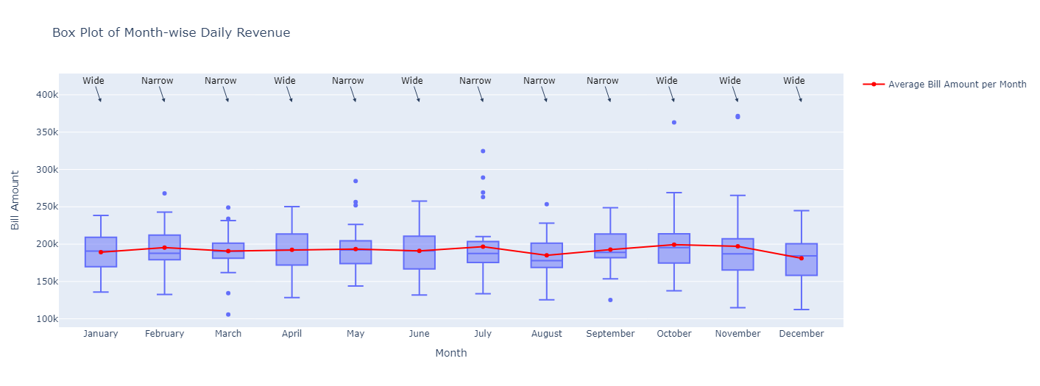
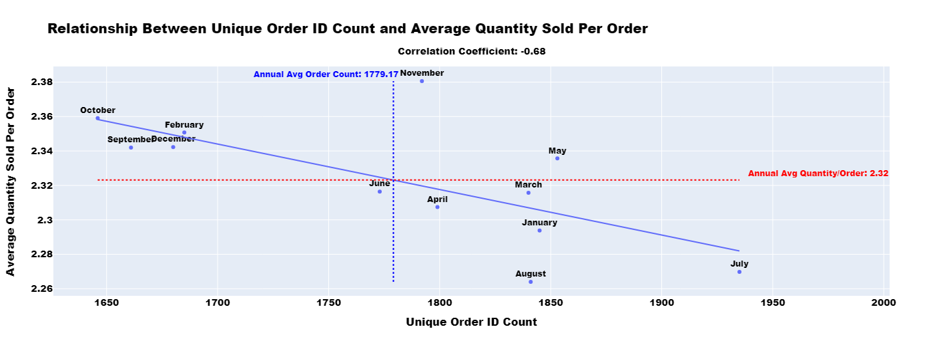
MONTHLY REVENUE ANALYSIS
Months with narrower show higher daily sales variability, while wider IQRs indicate more consistent sales.
June has the highest variability, and March has the lowest.
A moderate negative
correlation of -0.68 exists between unique Order IDs and average quantity sold
per order.
October and November have higher average quantities per order but fewer unique orders
In July and August, more unique orders and lower average quantities suggest customers are making smaller, more frequent purchases.

Slide 6
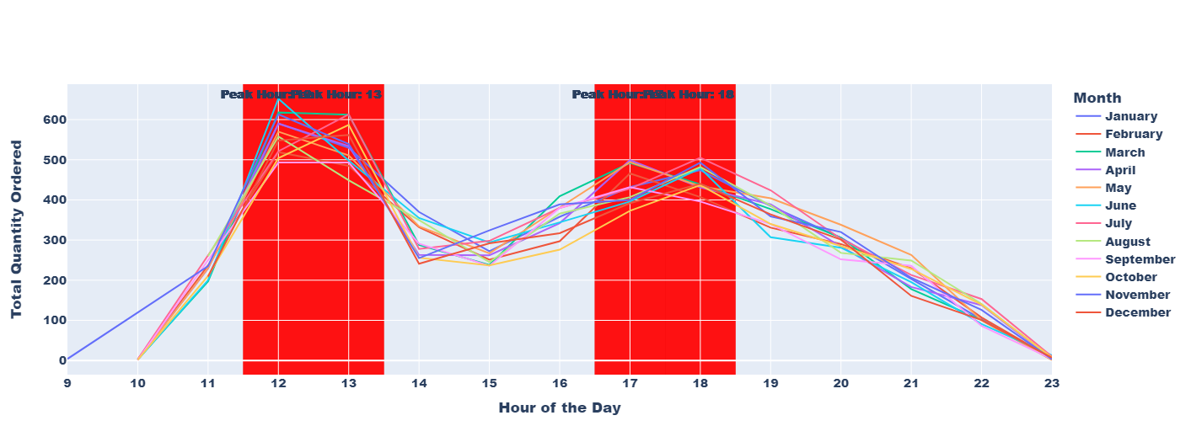
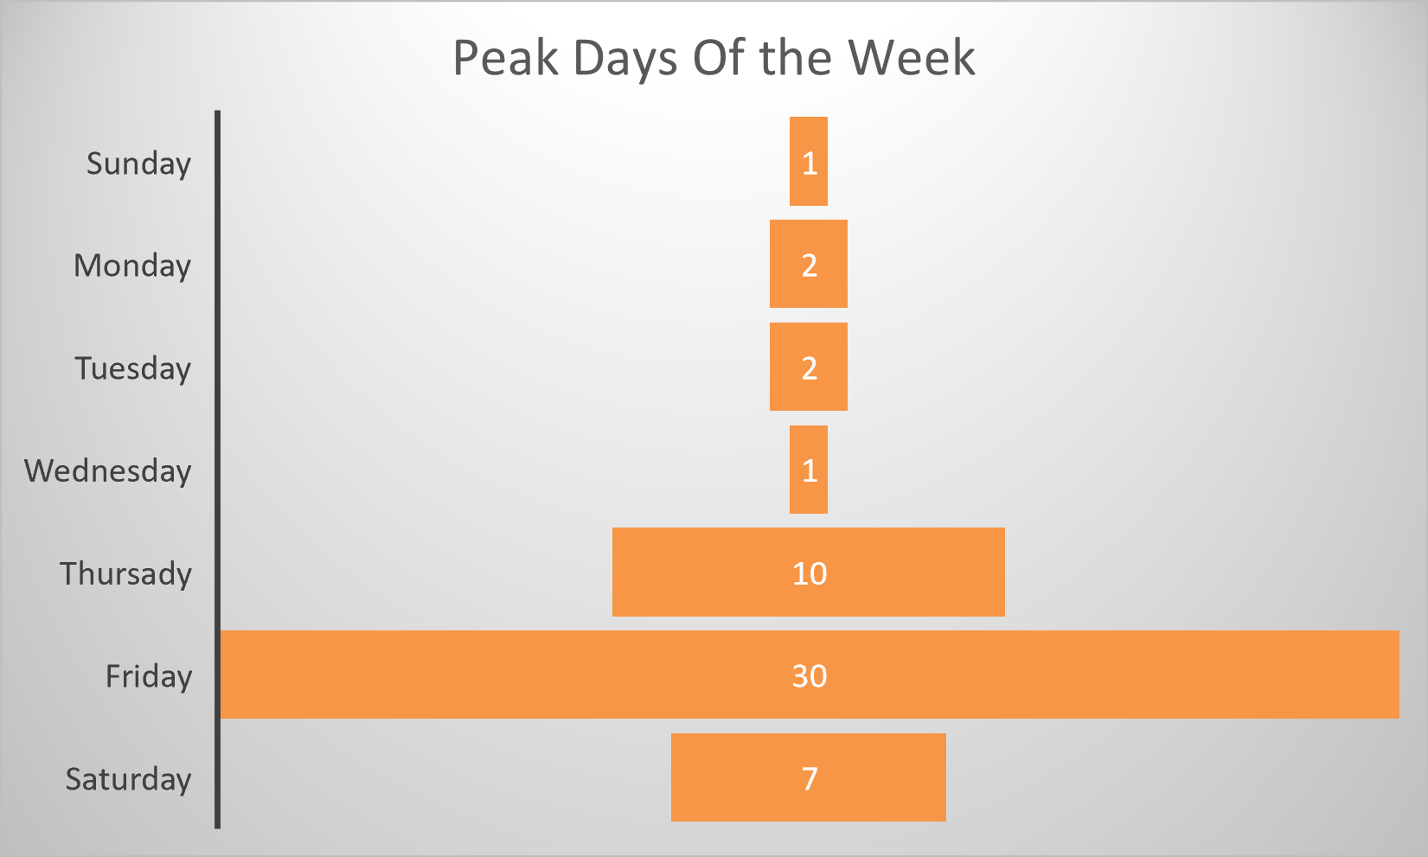
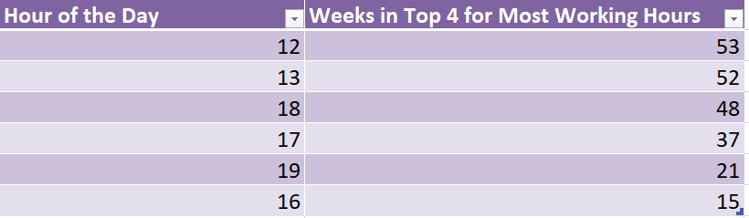
PEAK TIME ANALYSIS
The 12:00 to 13:00 interval is consistently a peak each week, with additional peaks around 13:00, 17:00, and 18:00.
Friday was the peak day for 30 of 53 weeks, and Thursday for 10 weeks. Sunday through Wednesday had fewer peak days.

Slide 7
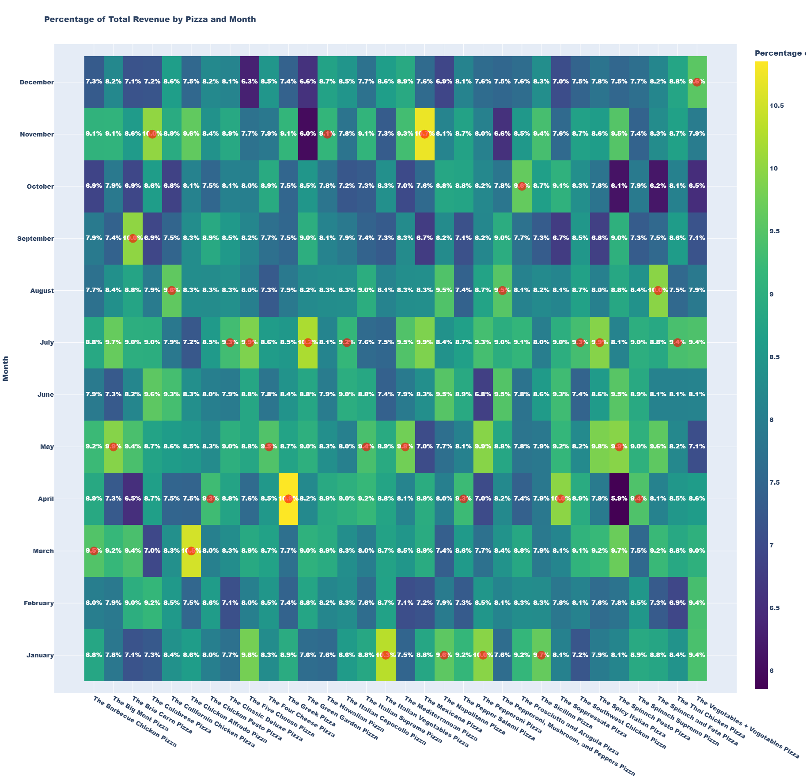
PIZZA ANALYSIS
The red dot highlights the best-selling month for each pizza
Distribution of top-selling months is as follows: January has 4, February 0, March 2, April 5, May 5, June 0, July 7, August 3, November 3, and other months each have 1. July leads with the most top-selling pizzas, while February and June have none.

Slide 8
RECOMMENDATIONS
October has a high daily average revenue, but its overall revenue is lower due to closing days. To maximize potential revenue, the café should ensure it remains open during these high-demand months, as this will help drive revenue even further.
Wider spreads in daily revenue indicate significant variability, with some days showing exceptional performance while others lag. To address this, we can implement targeted marketing efforts or special events on underperforming days to boost sales.
In months with high order volumes but low average quantities per order, focus on upselling and cross-selling. Train staff for upselling and use promotions like 'Buy one, get one half-off.’
To manage peak times and peak days schedule extra staff to handle higher order volumes and ensure customer satisfaction. During quieter times, reduce staff and use part-time or flexible workers to cut costs. Train staff to handle multiple roles for quick reassignment, boosting efficiency and minimizing the need for specialized staff during off-peak periods.
Offer discounts and exclusive combo deals during non-peak hours, such as a “Happy Hour” and value combos like a small pizza, drink, and side at a set price.
Pair less-performing pizzas with top sellers in combo deals to boost interest. Launch a campaign linking the flavors of the less-performing pizza to popular ingredients to attract similar taste fans.

