Slide 1

EXPORT CAPABILITY PROFILE
Coco Palms
Skylanes
and Allied Products
100% organic, sulfur-free coconut oil · edible and bulk grades
Pure in every drop.
ISO 9001 · FSSAI · NABL
Prepared for TO CONFIRM Issue date August 2026
Notes:
Cover. Logo art is the clean plate lifted from 4:45 of the company video. Replace the two TO CONFIRM slots with the buyer's name and the issue date before sending.

Slide 2
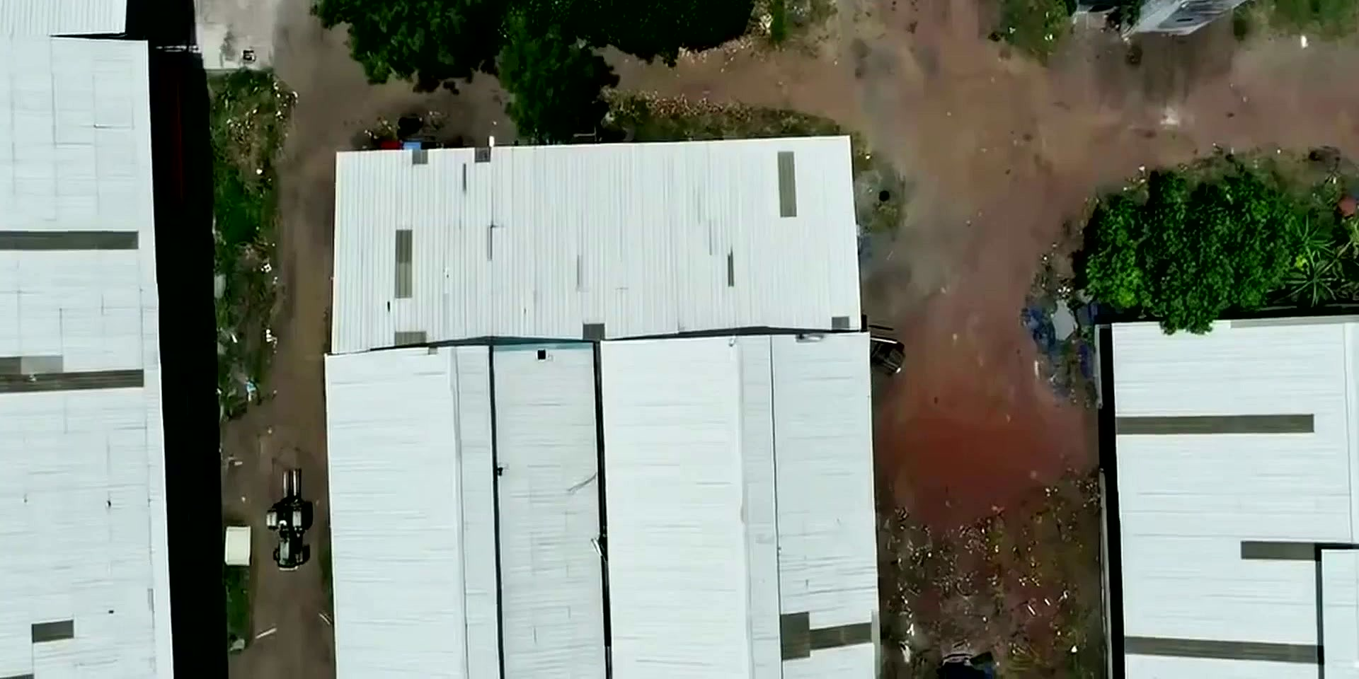
WHO WE ARE
Company at a glance
Coco Palms Skylanes and Allied Products has been trading in coconut and allied products since 2013. In 2026 we commissioned a purpose-built dehydration facility on our four-acre site in Chengalpattu district, Tamil Nadu. Whole nuts are received at our own intake yard, cut and washed on site, dried in a catalytic infrared dehydrator, then pressed and filtered into finished oil. Thirteen years of trade experience now sits behind a drying plant specified to current food-safety standards rather than retrofitted to them.
Trading since
2013
Dehydration facility
Commissioned 2026
Plant location
Chengalpattu, Tamil Nadu
Site area
4 acres
Daily nut intake
100,000 nuts
Drying halls from above - the plant's insulated chamber block
Workforce
30+
100,000 nuts per day
10 tonnes of material dried per 12-hour batch
Quality accreditations
ISO 9001, FSSAI, NABL
Coco Palms Skylanes and Allied Products
2
Notes:
Facts confirmed by the client: trading since 2013, dehydration facility commissioned 2026, Chengalpattu, 4 acres, 100,000 nuts/day, 30+ workforce. The 2013 / 2026 split is deliberate and is a selling point: thirteen years of trade history plus a brand-new plant answers both of a buyer's first two doubts at once. Do not collapse it back to a single date. DEFAULT SUPPLIED BY CLAUDE: the 12-16 MT dried kernel conversion is my calculation at roughly 130-170 g copra per nut. NOTE - the company's own film states 10 tonnes of material per 12-hour batch and about 100,000 litres of oil per month; reconcile these three figures before quoting any of them.

Slide 3
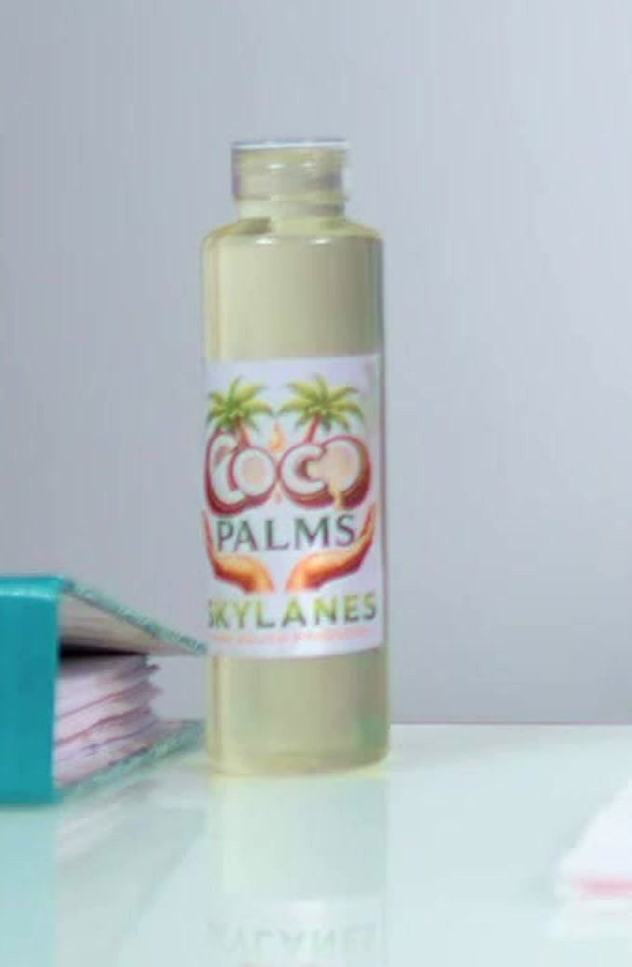
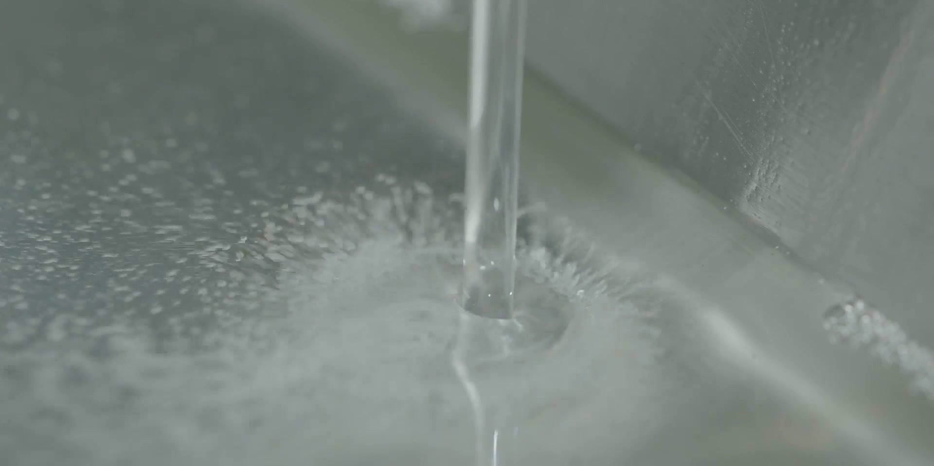
PRODUCT RANGE
What we supply
01
Coconut Oil, Edible Grade
02
Coconut Oil, Bulk
Expeller-pressed from infrared-dried kernel
Sulfur-free - no chemical used at any stage
FFA below 0.5% · moisture below 0.1%
200 ml / 500 ml / 1 L PET · 5 L jerrycan
Same line and same specification, bulk packed
Filtered grade; RBD available on request
For industrial and repacking buyers
15 kg tin · 200 kg HDPE drum · flexitank
Allied products copra cake / de-oiled cake, a direct by-product of oil extraction. Further lines: TO CONFIRM
Coco Palms Skylanes and Allied Products
3
Notes:
Coconut oil is the ONLY finished product. The client has confirmed they do not sell desiccated coconut - the earlier third card has been removed, and the pulverised kernel seen in the film is feedstock for the expeller, not a product. Both cards are the same oil off the same line, differing only in pack format. The sulfur-free claim comes from the company's own film narration and is a genuine differentiator: sulfur is routine in copra drying and importers screen for it. DEFAULTS SUPPLIED BY CLAUDE: the FFA and moisture figures and the pack sizes are standard industry values, not your measured specs. Sign them off before sending.

Slide 4
HOW IT IS MADE
From whole nut to filtered oil
1
2
3
4
Intake
Automated cutting
Trays and trolleys
High-pressure wash
Nuts received and unloaded in our raw material yard
Conveyor cutting system halves every nut evenly
Halves arranged on drying trays and loaded
Water spray removes dust and impurities
5
6
7
8
Infrared dehydration
Tray inspection
Scooping and pulverising
Expelling and filtration
10 tonnes per 12 hours, moisture below 10%
Every tray checked by trained staff and supervisors
Kernel lifted from shell, then reduced for pressing
Mechanical press, then advanced filtration
No sulfur or any other chemical is used at any stage. The dehydration method itself is what makes chemical-free processing possible.
Coco Palms Skylanes and Allied Products
4
Notes:
Dark slide, used as the section break into the process detail that follows. This sequence is taken from the company's own film narration and CORRECTS the earlier version of this slide in three places: washing happens BEFORE dehydration (not after paring); the post-drying step is scooping the kernel from the shell (not paring); and no dehusking is narrated - nuts go straight into an automated cutting system that halves them.

Slide 5
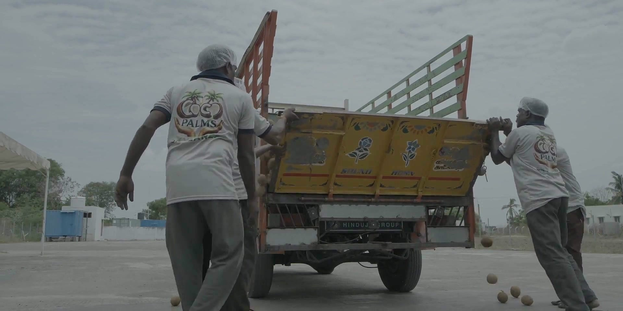
STEP 01
Sourcing and intake
Nuts arrive at the plant by tipper and are offloaded directly onto our spacious raw material yard by our own uniformed crew. From there they are fed into an automated conveyor cutting system that halves every nut evenly, so the nut is opened within the same site it was received on.
Sourcing region
Delta region, Tamil Nadu
Procurement
Direct from growers and regional mandis
Intake per day
100,000 nuts
Nut variety
TO CONFIRM
Coco Palms Skylanes and Allied Products
5
Notes:
Confirmed by the client: delta region of Tamil Nadu, 100,000 nuts per day. DEFAULT SUPPLIED BY CLAUDE: 'direct from growers and regional mandis' is the conventional procurement description - correct it if you buy through agents or on contract. Nut variety is still open; East Coast Tall is the usual delta variety but I did not want to assert it.

Slide 6
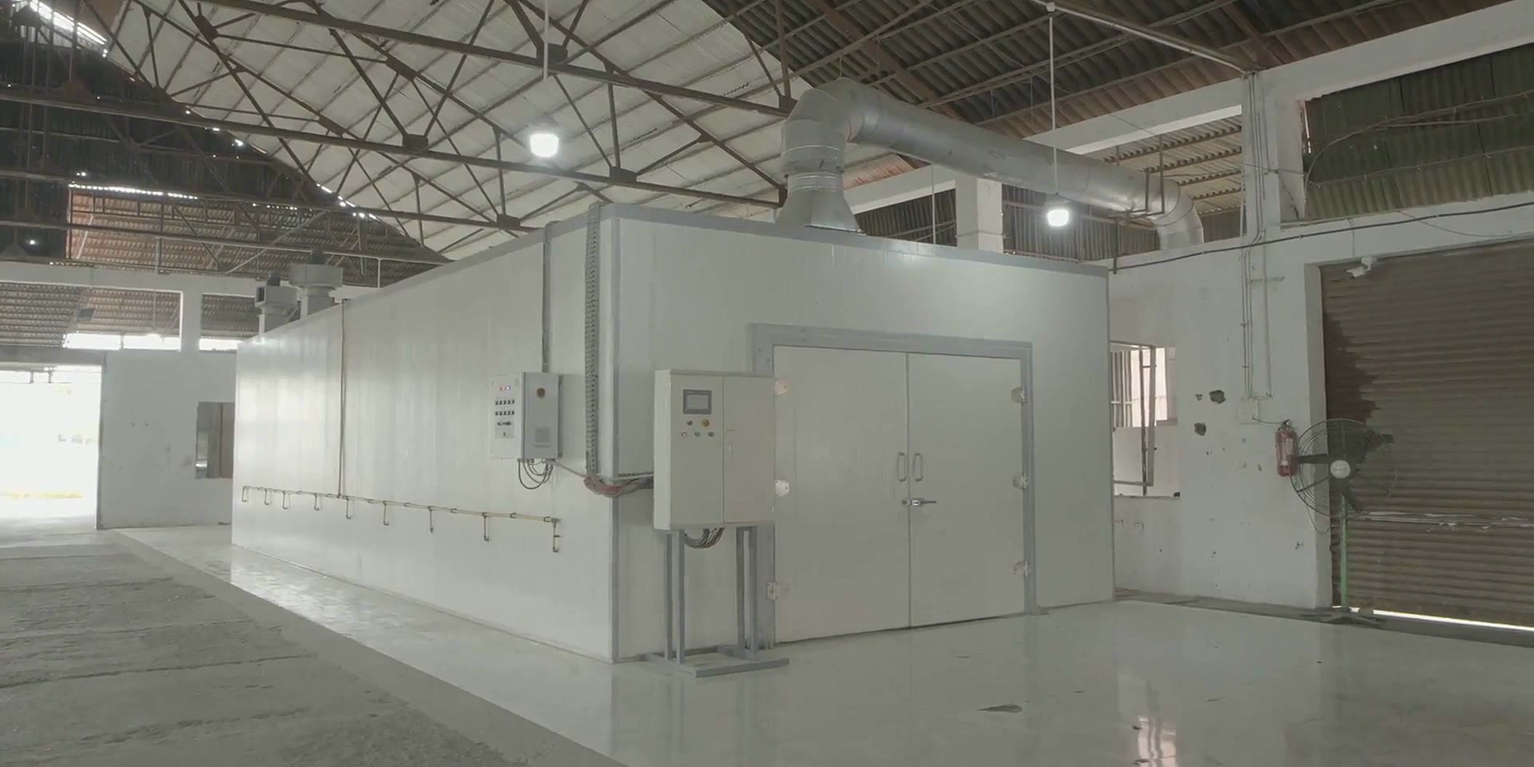
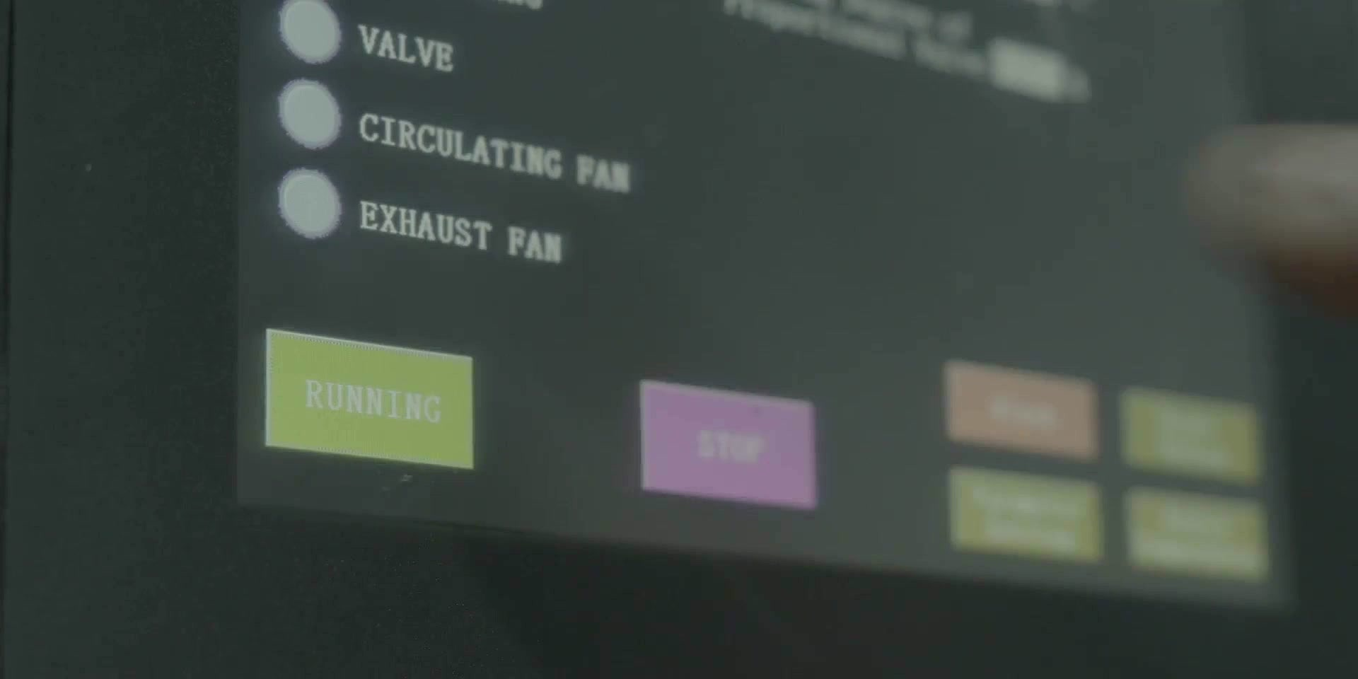
STEP 05 · OUR TECHNICAL DIFFERENTIATOR
Catalytic infrared dehydration
Drying decides the quality of the finished oil, so it is the step we have engineered hardest. Instead of sun drying we use a European catalytic infrared dehydrator - one of the fastest and most efficient methods of coconut dehydration available.
How the chamber works
Infrared-radiating metal infusors generate controlled heat waves
Platinum metal-plated walls, ceiling and doors reflect heat from every direction
A compressor draws atmospheric air through a dehumidification system
Roughly 3,300 sq ft of drying area
The dehydration chamber block inside the main hall
10 tonnes in 12 hours, to below 10% moisture
Sun drying needs five days to reach only 20%
PLC touchscreen holding chamber temperature in any climate
Coco Palms Skylanes and Allied Products
6
Notes:
This is the strongest slide in the deck and every figure on it comes from the company's own film narration - European catalytic IR dehydrator, platinum-plated chamber surfaces, IR-radiating infusors, compressor plus dehumidification, 10 tonnes per 12 hours to below 10% moisture, five days by sun to reach only 20%, ~3,300 sq ft. The earlier version of this slide called it merely 'controlled hot-air drying', which badly undersold it. TWO CLAIMS TO CONFIRM BEFORE SENDING: the film also states the plant is 'among India's largest' coconut dehydration facilities and that output is ~100,000 litres per month. I have left both off the slide - a superlative and a volume figure are exactly what a buyer will test, so use them only if you can substantiate them.

Slide 7
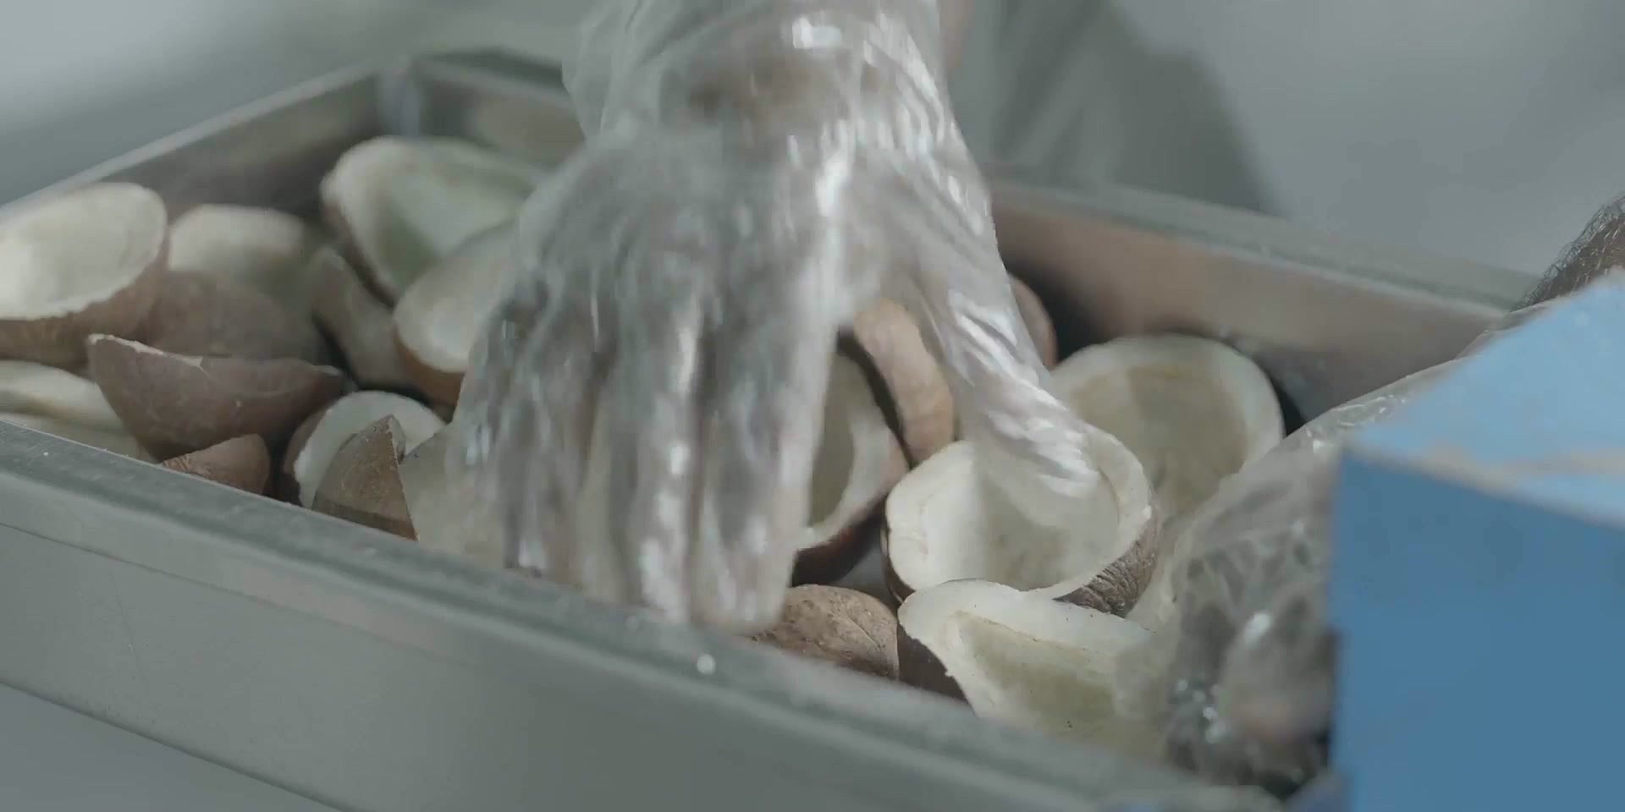
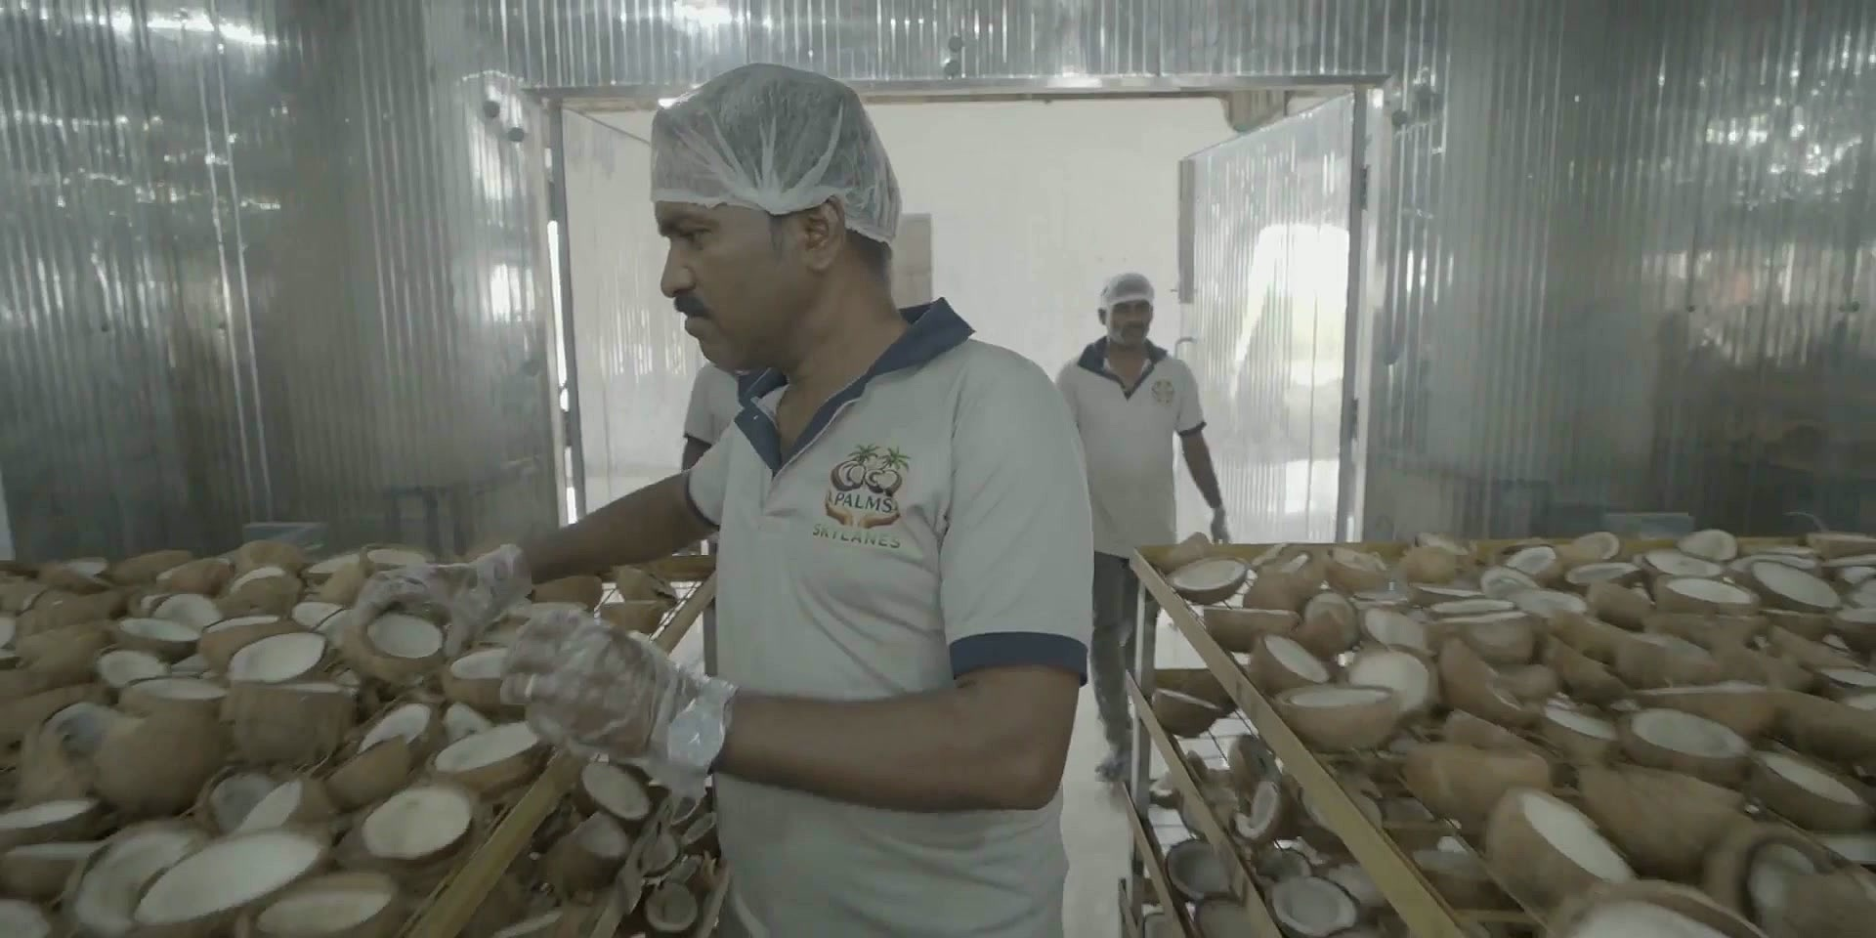
STEPS 04 AND 06
Washing and inspection
High-pressure water spray wash, before dehydration
Every tray inspected by trained staff and supervisors
Personnel hygiene
Plant and surfaces
Hairnets, face masks and gloves on the line
Company-issued uniforms throughout
Food-contact surfaces in stainless steel
Enclosed drying rooms, not open-air yards
Stainless trays and troughs at every wet stage
Sealed washable floors and strip-curtain barriers
Coco Palms Skylanes and Allied Products
7
Notes:
Everything on this slide is directly observable in the footage. The client has confirmed they hold NO HACCP and NO GMP/GHP certification, so the earlier scheme-status form has been removed entirely rather than left implying certification. Both cards now describe practice and plant only - no scheme is claimed anywhere. If HACCP is obtained later this is the slide to update.

Slide 8
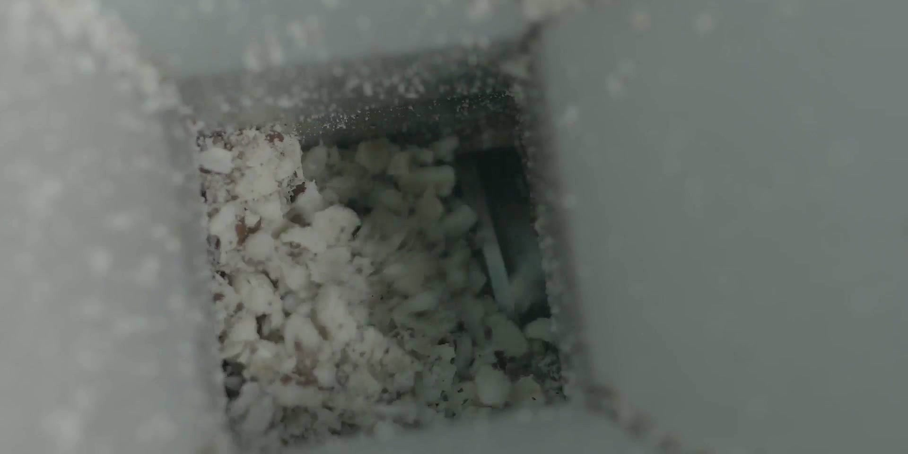
STEPS 07 AND 08
From dried kernel to filtered oil
07
Scooping and pulverising
08
Expelling and filtration
Once dehydration is complete the kernel lifts cleanly away from the shell and is scooped out, then pulverised into smaller pieces ready for pressing.
The pulverised kernel is fed into an expeller and pressed mechanically. The extracted oil then passes through advanced filtration to finished grade.
Moisture at scooping
below 10%
FFA at despatch
below 0.5%
Batch size
10 tonnes per 12 h
Chemical use
None - sulfur-free
Coco Palms Skylanes and Allied Products
8
Notes:
Rewritten from the film narration. The earlier version of this slide presented desiccated coconut as a second finished stream - the client has confirmed they do not sell it, and the narration is explicit that the pulverised kernel is prepared 'for oil extraction'. So this is now one linear finishing line, not two streams. DEFAULT SUPPLIED BY CLAUDE: the FFA below 0.5% figure is a standard trade value.

Slide 9
QUALITY ASSURANCE
Tested, not assumed
Quality is managed under an ISO 9001 system, the plant is FSSAI licensed, and testing is backed by NABL accreditation - the Indian national standard for laboratory competence. Every manufacturing batch is tested by our quality assurance team in our own in-house laboratory before it reaches a customer.
Release specification per batch
Parameter | Method | Limit
Moisture | IS 548 | 0.10% max
Free fatty acid | AOCS Ca 5a-40 | 0.5% max
Peroxide value | AOCS Cd 8-53 | 10 meq/kg max
Total plate count | ISO 4833 | 10,000 cfu/g
Yeast and mould | ISO 21527 | 100 cfu/g max
Foreign matter | Visual | Absent
1
ISO 9001
Quality management system
2
FSSAI
Indian food safety licence
3
NABL
Limits shown are for edible-grade coconut oil, tested per batch in our in-house laboratory before release.
Accredited laboratory testing
Coco Palms Skylanes and Allied Products
9
Notes:
ISO 9001, FSSAI and NABL are confirmed from the video's closing card. DEFAULTS SUPPLIED BY CLAUDE: every method and limit in this table is a standard industry value for edible coconut oil (IS 548, AOCS, ISO methods are real and correctly cited). They are NOT your measured results. Replace them with the figures off your own NABL COA before this table goes to a buyer - an importer will hold you to whatever is printed here.

Slide 10

ACCREDITATIONS
Certifications on file
ISO 9001
Quality management system
FSSAI
Food licence, Government of India
NABL
Laboratory accreditation
BRIT QUALIS
Two certificates held
National Test House
Certification marks as presented in the company profile film
Government test certificate
Still needed for an export pack
Certificate numbers and validity dates for each mark above · organic / Fairtrade status if held · importing-country registrations (US FDA, EU, GCC) as applicable.
Coco Palms Skylanes and Allied Products
10
Notes:
ISO 9001, FSSAI and NABL are from the closing card. BRIT QUALIS and National Test House are read off the framed certificates behind the founder - wall text was only partly legible, so verify both names before printing.

Slide 11

COMMERCIAL
Packaging, logistics and terms
Standard terms below. All are negotiable against confirmed volume and destination.
Item | Detail
Retail pack sizes | 200 ml · 500 ml · 1 L PET · 5 L jerrycan
Bulk pack format | 15 kg tin · 200 kg HDPE drum · flexitank
Minimum order quantity | One 20ft FCL
Units per 20ft / 40ft container | 16-18 MT / 24-26 MT
Port of loading | Chennai / Ennore, Tamil Nadu
Lead time from order | 15-21 days from confirmed order
Incoterms offered | FOB · CFR · CIF
Payment terms | 30% advance, balance vs B/L; or L/C at sight
Private label / OEM | Available
Shelf life | 18 months in original sealed pack
Handling between drying and finishing
Flexible on structure
Tell us your volume, pack format and destination port and we will quote FOB or CIF against it.
Coco Palms Skylanes and Allied Products
11
Notes:
DEFAULTS SUPPLIED BY CLAUDE - every row on this page. These are conventional Indian coconut-export terms, not terms you have agreed to. The commercially sensitive ones are MOQ (one 20ft FCL), payment terms (30% advance / L/C at sight) and container fill (16-18 MT per 20ft). A buyer may treat these as an offer, so review each line with whoever owns pricing before sending. Port of loading assumes Chennai/Ennore as nearest to Chengalpattu.

Slide 12


LEADERSHIP
The people behind the plant
“TO CONFIRM”
A two-line statement on standards, and on why the plant was built the way it was.
Name
TO CONFIRM
Speaking to camera at the plant office
Title
TO CONFIRM
Years in coconut processing
TO CONFIRM
Review meeting with the plant team
Coco Palms Skylanes and Allied Products
12
Notes:
The founder speaks to camera from 3:36 to 4:36 in the video. If you transcribe that segment, his own words are the best possible fill for the quote slot here.

Slide 13
NEXT STEPS
Let's talk specification
Send us your incoming specification and target volume, and we will come back with a costed offer, a sample plan and a certificate pack.
Contact
Share your specification
Mr. Barani
1
Designation
Grade, pack format and annual volume
Operations Head
Telephone
+91 95661 62825
2
Sample and approval
Email
We ship samples against your spec
info@blackboxtraders.in
Website
www.blackboxtraders.in
3
Trial order
Plant address
First container on agreed Incoterms
177 Marakanam Road, Maduranthagam,
Nethapakkam, Chengalpattu,
Tamil Nadu 603301
Coco Palms Skylanes and Allied Products
13
Notes:
Confirmed by the client: Mr. Barani, Operations Head, +91 95661 62825, and the Nethapakkam plant address. Email and website are the only two contact fields still outstanding - a buyer will want an email address, so this is worth closing before the first send.

