Slide 1
PATTERN RECOGNITION · PHASE III
German Document Type Classification using CNNs
An explainable transfer-learning framework that classifies scanned German document pages from visual layout alone.
Ashok Kumar Meena
M.Sc. Software Engineering · University of Europe for Applied Sciences, Potsdam
Supervisor: Raja Hashim Ali
Live demo: https://ashokcse-document-type-classification-framework.hf.space
Code: github.com/ashok-cse/PR_SE26_German_Document_Type_Classification_with_CNNs

Slide 2
Problem & Motivation
• German archives (Bundesarchiv, DDB, EU tender portals) scan millions of pages every year.
• The first routing decision is always: “what kind of document is this?”
• Manual triage is slow, costly, and error-prone; it does not scale.
• OCR + text-rule pipelines are fragile on poor scans and mixed German fonts.
• Idea: classify from the visual layout with a CNN — masthead, columns, tables, whitespace — no OCR.
German Document Type Classification using CNNs
2

Slide 3
The Task: Six Document Types
Given one scanned page image x, predict its functional type y (visual features only):
📊 Financial reports
annual reports, statements
🔬 Scientific articles
research papers
⚖️ Laws & regulations
statutes, regulations
🏛️ Government tenders
procurement notices
📘 Manuals
guides, handbooks
💡 Patents
patent filings
German Document Type Classification using CNNs
3

Slide 4
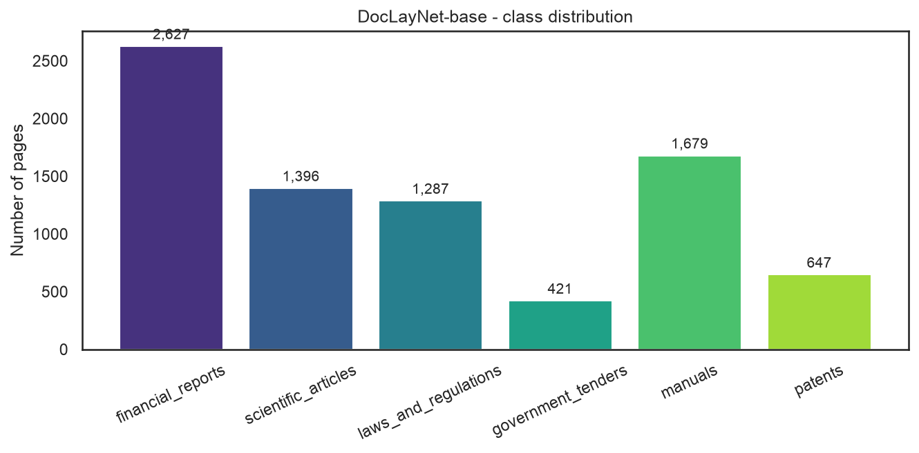
Dataset: DocLayNet-base
• DocLayNet-base (IBM, CDLA-Permissive): 8,057 scanned pages, six classes.
• Persisted as 224×224 RGB JPEGs; stratified 70 / 15 / 15 split.
• Strongly imbalanced → class-weighted loss + augmentation.
• German angle: DocLayNet is ~95% English, only ~2.5% German.
– Strict langdetect filter keeps confidently-German pages (p≥0.90) + yield report.
• Loader gotcha: both HF loaders broken → bypass load_dataset, parse JSON.
German Document Type Classification using CNNs
4

Slide 5
Methodology
• Preprocess → 224×224, normalize (ImageNet stats for ResNet50; [0,1] for CNN).
• Class-weighted categorical cross-entropy; Adam; batch 32; early stopping.
• Custom CNN (baseline): 4 conv blocks (32→256) + GAP + Dense(128) + softmax (~0.42M params).
• ResNet50 (transfer): ImageNet weights, two-stage training.
– Stage A — train head, backbone frozen (10 epochs, lr 1e-3).
– Stage B — fine-tune conv5_* (20 epochs, lr 1e-5).
• Evaluation: accuracy, macro-P/R/F1, ROC/AUC, confusion matrix, Grad-CAM, robustness.
German Document Type Classification using CNNs
5

Slide 6
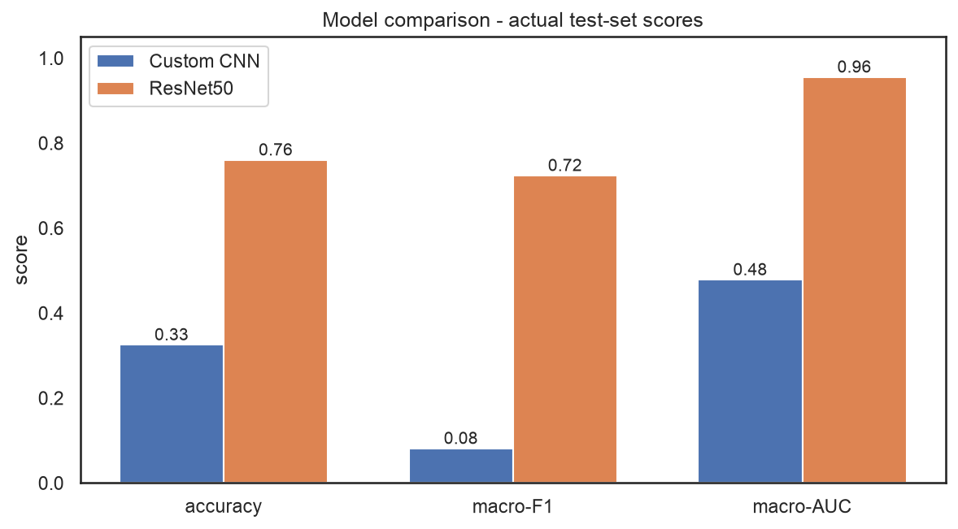
Results — Transfer Learning Wins
Model | Accuracy | Macro-F1 | Macro-AUC
Custom CNN | 0.326 | 0.082 | 0.479
ResNet50 | 0.761 | 0.724 | 0.956
Key finding
Transfer learning isn’t just better — it’s necessary. The from-scratch CNN collapses to near-chance (AUC 0.479) on this small, imbalanced set.
German Document Type Classification using CNNs
6

Slide 7
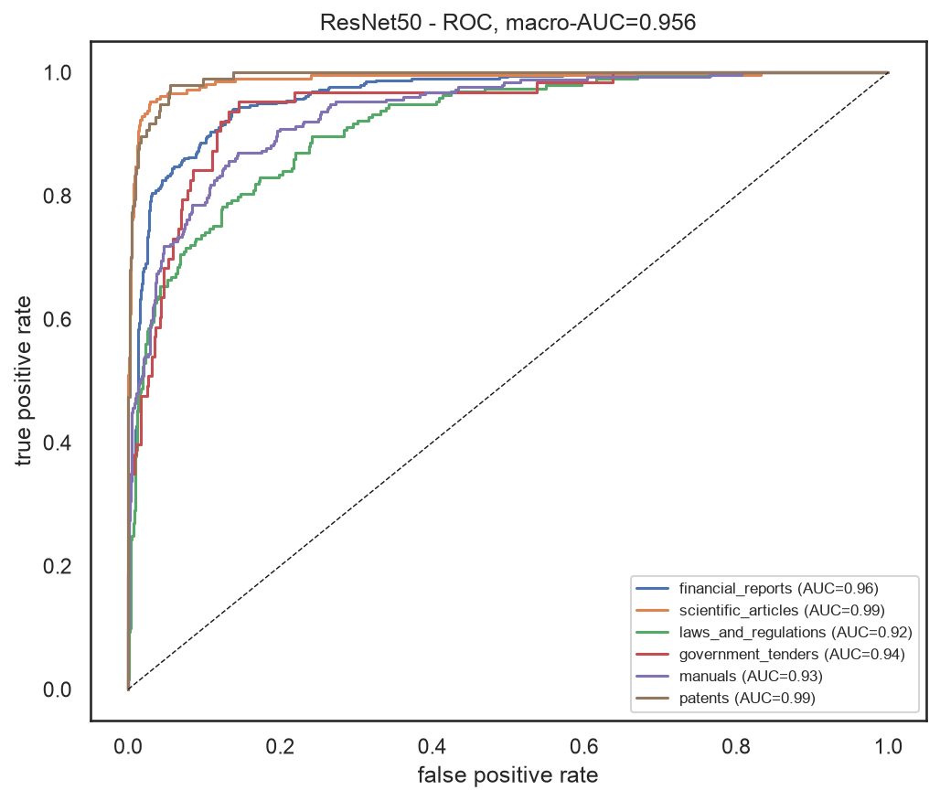
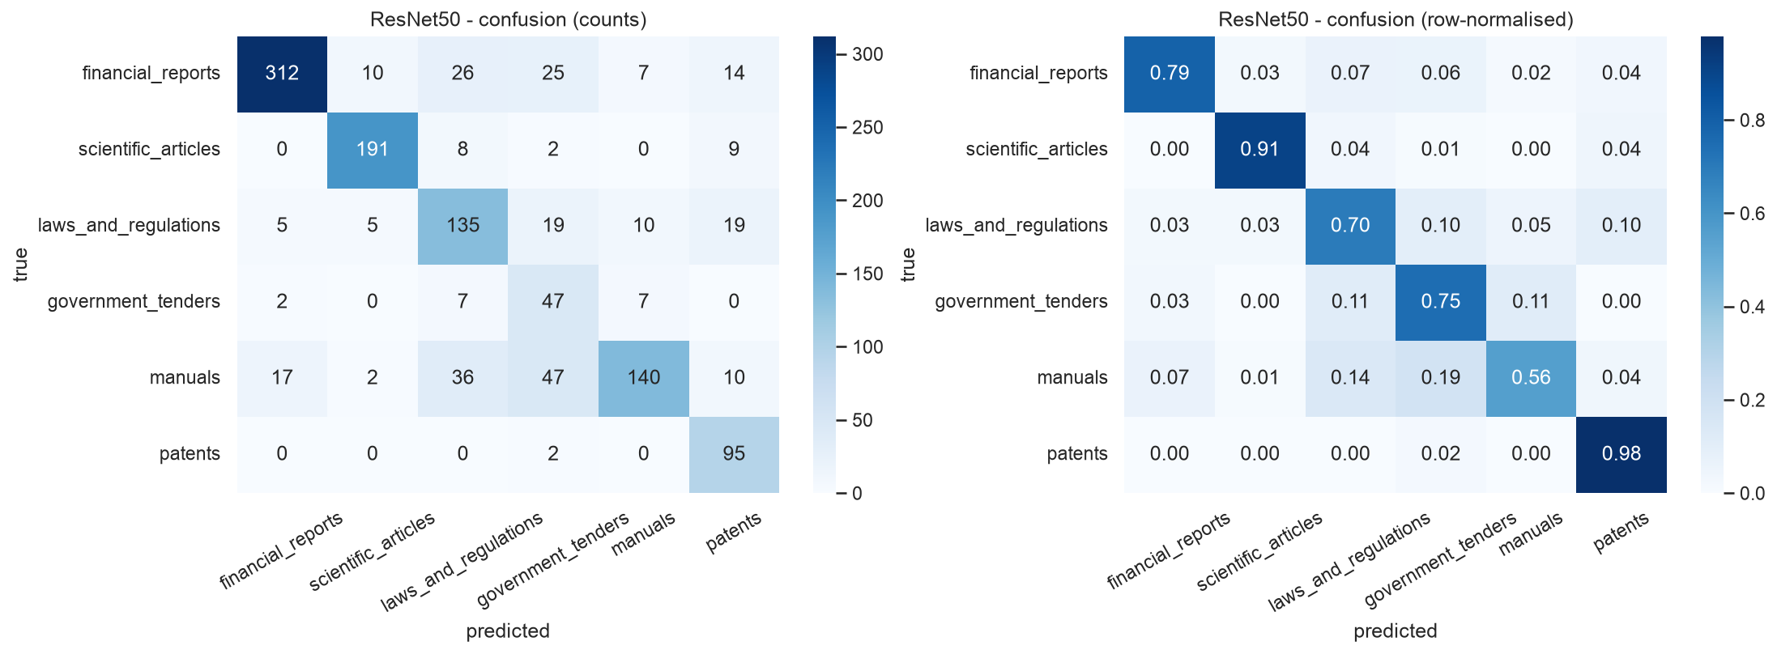
Per-Class Performance (ResNet50)
Strong across classes; residual confusion concentrates in scientific_articles (lowest per-class AUC), confused with text-dense financial/patent pages.
German Document Type Classification using CNNs
7

Slide 8
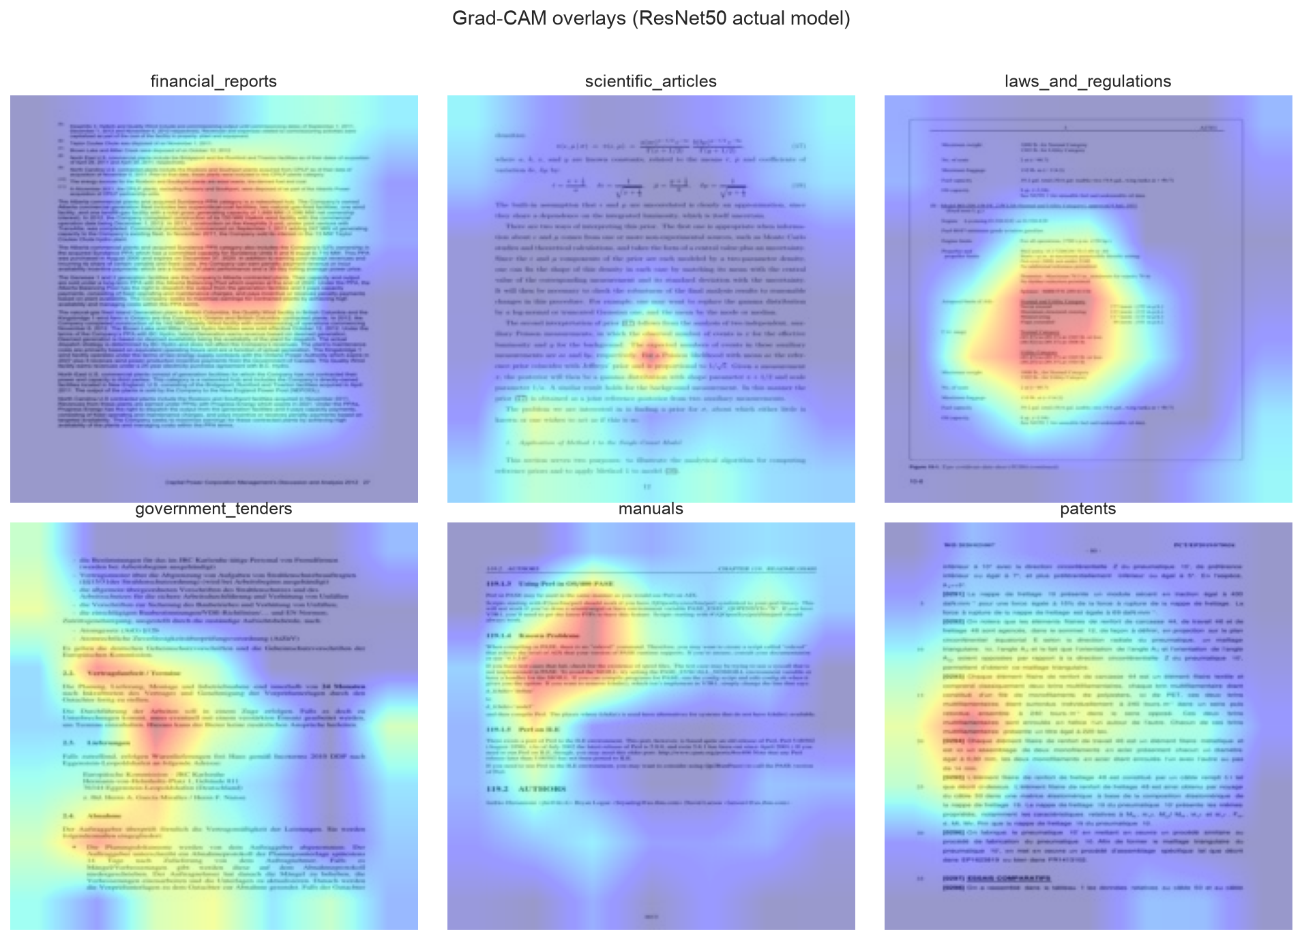
Explainability — Grad-CAM
• Attention falls on mastheads, headers, and structural regions.
• Not arbitrary body text → confirms the layout-based hypothesis.
• Builds trust for document-routing use.
German Document Type Classification using CNNs
8

Slide 9
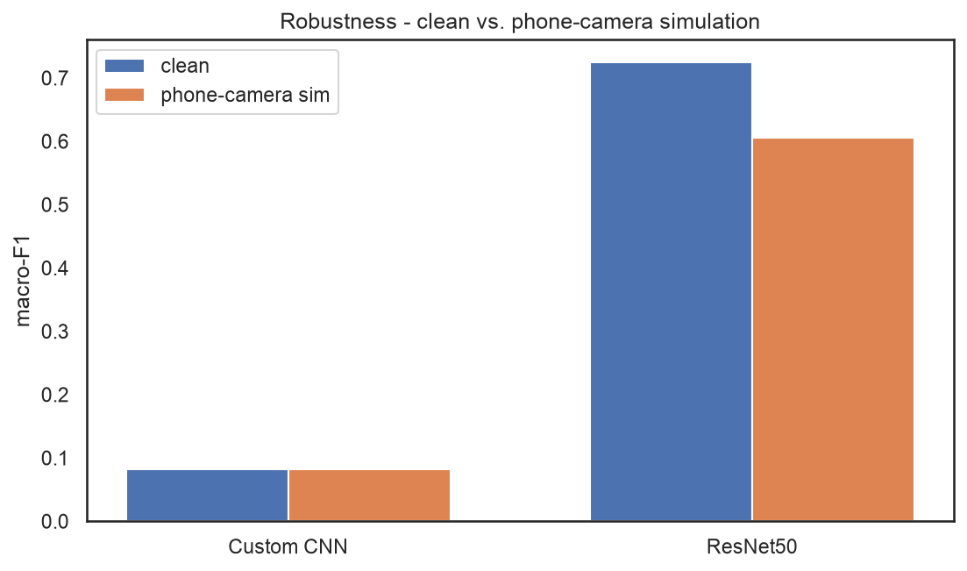
Robustness to Phone-Camera Capture
• Simulated perspective warp, JPEG compression, blur, brightness.
• ResNet50 macro-F1: 0.724 → 0.606 (−0.118) — degrades gracefully.
• Suggests practical viability for mobile captures.
German Document Type Classification using CNNs
9

Slide 10
Deployment — Live Web Service
• Deployed FREE on Hugging Face Spaces (full TensorFlow, ~16 GB CPU).
• Serves the UI + API and a LIVE Grad-CAM overlay + uncertainty per prediction.
• Non-blocking worker-thread inference; FastAPI POST /predict JSON API.
• Also a 512 MB TFLite build for low-RAM hosts — smaller, but no Grad-CAM.
▶ Live demo: https://ashokcse-document-type-classification-framework.hf.space
German Document Type Classification using CNNs
10

Slide 11
Conclusion & Future Work
• Fine-tuned ResNet50 classifies German pages from layout alone: 0.761 acc, 0.956 macro-AUC.
• Decisively beats a from-scratch CNN; robust to camera degradation; deployed publicly.
• Grad-CAM confirms attention on meaningful layout regions.
Future work
• Complete the strictly German-filtered re-training + per-class yield report.
• Add a second transfer model (MobileNetV2/EfficientNet) and SHAP explanations.
• Target the weak scientific_articles class; add a confidence / out-of-distribution gate.
German Document Type Classification using CNNs
11

Slide 12
Thank you
Live demo: https://ashokcse-document-type-classification-framework.hf.space
GitHub: github.com/ashok-cse/PR_SE26_German_Document_Type_Classification_with_CNNs
Kaggle: kaggle.com/code/ashokkrcse/german-document-type-classification-with-cnns

