Slide 1

Customer retention dataset analysis
By Ashok Kumar Sharma

Slide 2
ACKNOWLEDGMENT
I would like to express my deep sense of gratitude to my SME (Subject Matter Expert) Mr. Shubham Yadav as well as Flip Robo Technologies who gave me the golden opportunity to do this data science project on Customer Retention Dataset Analysis, which also helped me in doing lots of research and I came to know about so many new things.
I am very much thankful to Dr. Deepika, Trainer (DataTrained), for their valuable guidance, keen interest and encouragement at various stages of my training period which eventually helped me a lot in doing this project.
I also acknowledge with thanks for suggestion and timely guidance, which I have received from my SME Mr. Shubham Yadav during this project, which immensely helped me in the evaluation of my ideas on the project.
Ashok Kumar Sharma

Slide 3
introduction
Business Problem Framing
Customer satisfaction has emerged as one of the most important factors that guarantee the success of online store; it has been posited as a key stimulant of purchase, repurchase intentions and customer loyalty. A comprehensive review of the literature, theories and models have been carried out to propose the models for customer activation and customer retention. Five major factors that contributed to the success of an e-commerce store have been identified as: service quality, system quality, information quality, trust and net benefit. The research furthermore investigated the factors that influence the online customers repeat purchase intention. The combination of both utilitarian value and hedonistic values are needed to affect the repeat purchase intention (loyalty) positively. The data is collected from the Indian online shoppers. Results indicate the e-retail success factors, which are very much critical for customer satisfaction.

Slide 4
introduction
Conceptual Background of the Domain Problem
Customer retention refers to the ability of a company or product to retain its customers over some specified period. High customer retention means customers of the product or business tend to return to, continue to buy or in some other way not defect to another product or business, or to non-use entirely. Selling organizations generally attempt to reduce customer defections. Customer retention starts with the first contact an organization has with a customer and continues throughout the entire lifetime of a relationship and successful retention efforts take this entire lifecycle into account. A company's ability to attract and retain new customers is related not only to its product or services, but also to the way it services its existing customers, the value the customers actually perceive as a result of utilizing the solutions, and the reputation it creates within and across the marketplace.

Slide 5
introduction
Review of Literature
What is Customer Retention?
Customer retention refers to the ability of a company or product to retain its customers over some specified period.

Slide 6
introduction
Motivation for the Problem Undertaken
Successful customer retention involves more than giving the customer what they expect. Generating loyal advocates of the brand might mean exceeding customer expectations. Creating customer loyalty puts 'customer value rather than maximizing profits and shareholder value at the centre of business strategy'. The key differentiation in a competitive environment is often the delivery of a consistently high standard of customer service. Furthermore, in the emerging world of Customer Success, retention is a major objective.

Slide 7
Analytical Problem Framing
Mathematical/ Analytical Modeling of the Problem
For checking datatypes and null values, padas.DataFrame.info() method has been used. To get the statistical summary overview, pandas.DataFrame.describe() method has been used to infer the following:
Count: to count the number of records.
Mean: to calculate the mean of the feature.
Std: to calculate the Standard Deviation of the feature.
Min: to find the minimum value of the feature.
25% (1st Quartile): to find the first quartile of the feature.
50% (2nd Quartile): to find the median or second quartile.
75% (3rd Quartile): to find the third quartile of the feature.
Max: to find the maximum value of the feature.

Slide 8
Analytical Problem Framing
Data Sources and their formats
The dataset is being provided by Flip Robo Technologies in .xlsx (Microsoft Excel) format and contains 269 records with 71 features.

Slide 9
Analytical Problem Framing
Hardware and Software Requirements and Tools Used
During this project following set of hardware is being used: RAM: 8 GB CPU: AMD A8 Quad Core 2.2 Ghz GPU: AMD Redon R5 Graphics and the following software and tools is being used: Python Jupyter Notebook Anaconda | With following libraries and packages: Pandas Matplotlib Seaborn sklearn

Slide 10
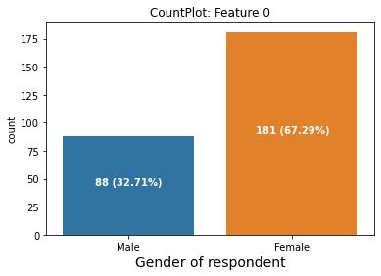
Exploratory Data analysis (eda) & visualization
Univariate Analysis
Univariate analysis is the simplest form of data analysis where the data being analyzed contains only one variable. In this project count plot has been used.
From the above count plot of feature Gender of respondent it is clear that Most of the observations are for Female with 67.29% as compared to Male with 32.71% which indicates dataset is imbalanced and needs to be handled accordingly.

Slide 11
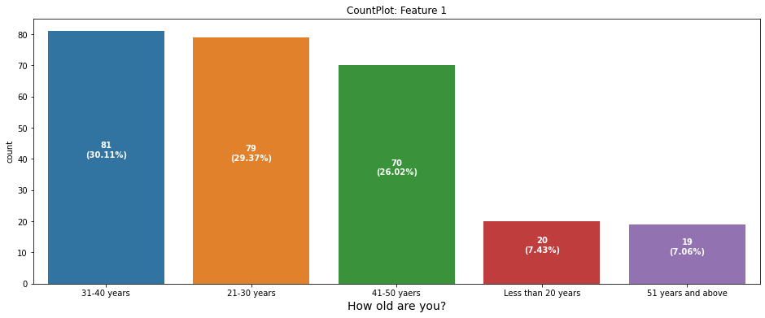
Exploratory Data analysis (eda) & visualization
Univariate Analysis
Remarks:
Most of the records are for ages 21 to 50 years while less number of records are present for ages less than 20 years and greater than 50 years.
Maximum number of records are present for ages 31-40 years while minimum number of records are present for ages 51 years and above.

Slide 12
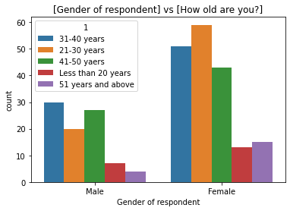
Exploratory Data analysis (eda) & visualization
Bivariate Analysis
Bivariate analysis is one of the simplest forms of quantitative analysis. It involves the analysis of two variables, for the purpose of determining the empirical relationship between them. We have analyzed the data and it’s relationship with features using count plot as shown below:
Remarks:
Majority of Male and Female customers are of ages 21 to 50 years.
Maximum number of Male customers ages from 31 to 40 years.
Maximum number of Female customers ages from 21 to 30 years.
Minimum number of Male and Female customers are of age less than 20 years.

Slide 13
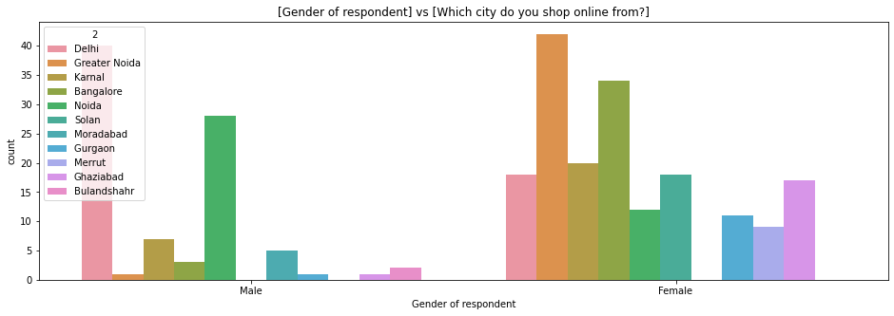
Exploratory Data analysis (eda) & visualization
Bivariate Analysis
Remarks:
Majority of Male customers are from city Delhi and Noida whereas Female customers are from Greater Noida and Banglore.
Maximum number of Male customers are form Delhi whereas Female customers are from Greater Noida.
There are no Male customers from city Solan and Merrut whereas no Female customers are from Moradabad and Bulandshahr.

Slide 14
Exploratory Data analysis (eda) & visualization
Multivariate Analysis
Multivariate analysis is based on the principles of multivariate statistics, which involves observation and analysis of more than one statistical outcome variable at a time.
Heatmap is being used to represent the correlation of features from a scale of -1.0 to 1.0. After going through heatmap it is found that Feature 17 to 28, 47 to 60 and 61 to 68 are positive high correlated to each other while Feature 21 is negatively high correlated to feature 46 to 55.

Slide 15
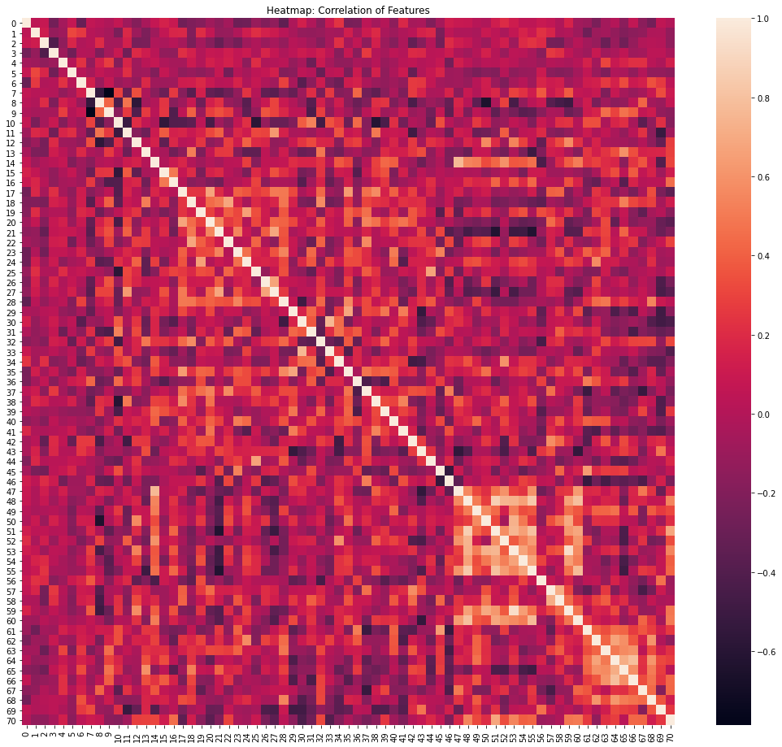
Exploratory Data analysis (eda) & visualization
Multivariate Analysis

Slide 16
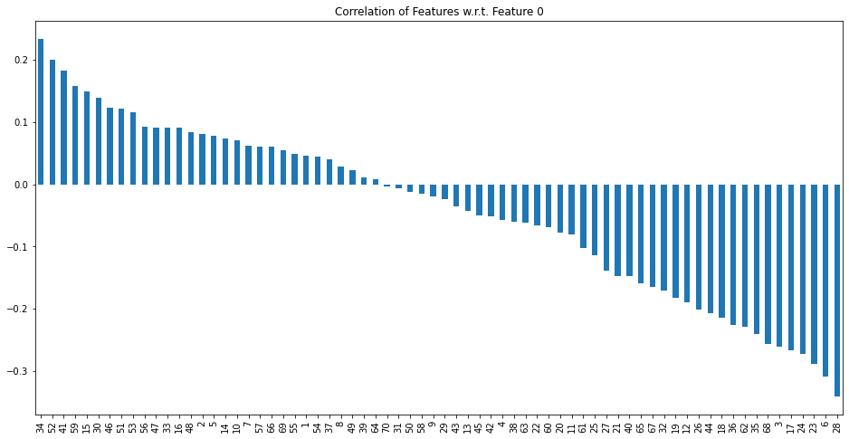
Exploratory Data analysis (eda) & visualization
Multivariate Analysis
For getting more accurate details regarding correlation of features w.r.t. feature 0, we have used bar plot:
With this plot it is clear that Feature 34, 52, 41, 59, 15, 30, 46, 51 and 53 shows good positive correlation with feature 0 while Feature 28, 6, 23, 24, 17, 3, 68,35, 62,36, 18, 44, 26, 12, 19 and 32 shows negatively good correlation with feature 0.

Slide 17
Exploratory Data analysis (eda) & visualization
Concluding Remarks / CONCLUSION
Starting with univariate analysis, we found that dataset is imbalanced by analysing Feature 0: Gender of respondent which consists of 32.71% records of Male and 67.29% of Female. This needs to be handled during the train test spilt part of model training. Moving further with count plot of features, we observed that most of the customers involved are of ages 21 to 50 years from city Delhi, Greater Noida, Karnal, Bangalore and Noida whereas very few involvements was found for city Moradabad, Merrut and Bulandshahr. We also found that for online shopping mostly mobile internet and Wi-Fi was used with Smartphone and Laptop having operating system Windows and Android and most of the time shopping website was accessed in Google Chrome browser. Also, most of the customers arrive to their favorite online store using Search Engine for the first time and then onwards they mostly use Search Engine, Via Application and Direct URL. We also found that most of customers takes more than 6 minutes to make a purchase decision at e-retail store and for the payment they mostly preferred Credit/Debit Cards and Cash on Delivery (CoD) option. Most of the customers abandon their Shopping Cart because of better alternative offer. We also found that most of customers looks for complete information regarding products, related products for comparison and seller. Most of the customers preferred websites which have ease of navigation, speedy loading, user friendly interface, payment convenient, secure transactions, complete privacy, prompt assistance, return & replacement policy and monitory savings. We also found that most of customers preferred Amazon.in, Flipkart.com, Paytm.com, Myntra.com, Snapdeal.com for online shoppings. After this we came up with bivariate analysis which gives us the close look of relationship between features. By using count plot with hue, we found that most of the male and female involved in online shoppings are of ages 21 to 50 years. Also, male in Delhi and Noida are more prominent to online shopping as compare to females while females in Greater Noida and Bangalore are more prominent to online shoppings than males. We also found that use of Wi-Fi in online shopping is more by female as compare to male. After first visit to online retail store, female preferred to access website Via Application while in case of male, it is Search Engine and Direct URL. Also, it was found that female takes more time than male to make a purchase decision on an online store. On all other aspects of online shopping both male and female have same sort of views with certain differences. Moving further with multi-variate analysis, we found that feature 34, 52, 41, 59, 15, 30, 46, 51 and 53 shows good positive correlation with feature 0 while feature 28, 6, 23, 24, 17, 3, 68,35, 62,36, 18, 44, 26, 12, 19 and 32 shows negatively good correlation with feature 0.

