Slide 1
RSA Cryptosystem
Prepared by
Bhukya Tharun
CS20B016
Reference : Algorithms (S. Dasgupta, C. H. Papadimitriou, and U. V. Vazirani )

Slide 2
Private key scheme:
Let us say there are two persons Dhoni and Virat who want to communicate. Rohit is an intruder here. Dhoni wants to send a message to Virat but Rohit wants to know the message.
In this protocol, let us say the message to be sent is encoded in binary and it is x. In order to safe guard this message he encodes it using a function e() and in order to receive message Virat uses another function d() to decrypt it such that
d(e(x)) = x
Rohit unable to detect this until unless he has the decryptor function.

Slide 3
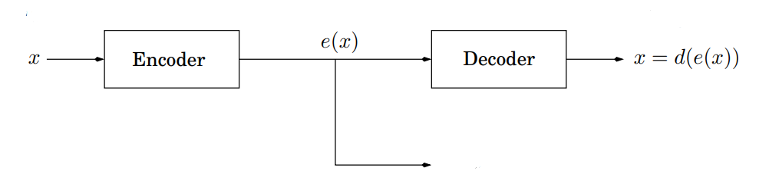
Dhoni
Virat
Rohit
How does this Dhoni get e() function and Virat gets d() function?
Private-key scheme example:
In order to get those functions e() and d() they should have met beforehand and decide upon a private key. For example let us they decided upon a private key r which is binary of 8 bits (10010110). And in this case both e() and d() are same functions i.e xor with r. e(x) = x ^ r = d(x)

Slide 4
Suppose they use the function xor calculator and the message which is encoded in binary is sent in packets of 8 bits.
Let us say the message is x = 10110101
Then e(x) = x ^ r
= (10110101) ^ (10010110)
= 00100011
Suppose Rohit is able to break the message sending system and found out e(x) = 00100011 but it is impossible for him to know the original message unless he knows the private key r.
Now Virat decrypts the message by using the private key r they agreed upon d(e(x)) = e(x) ^ r
= (00100011) ^ (10010110)
= 10110101 (original message)

Slide 5
Here they are using the fact that a ^ a = 0
So d(e(x)) = e(x) ^ r
= x ^ r ^ r
= x ^ (r ^ r)
= x ^ 0 = x
Disadvantages of private-key scheme:
Suppose there are 1000 people. What is the number of private keys we have to give ? (1000000)
What if they were billions of people? It is practically impossible to assigm separate private key for every pair of people ?
It infacts leads to larger private keys and further leads to computation overheads

Slide 6

Public key scheme (RSA) :
Property: Pick any two primes p and q and let N=pq. For any e relatively prime to (p-1)(q-1):
The mapping x -> x^e mod N is a bijection on {0,1…….,N-1}.
Moreover, the inverse mapping is easily realized: let d be the inverse of e modulo (p-1)(q-1). Then for all x ∈ {0,1…,N-1},
Proof: If the mapping x -> x^e mod N is invertible, then proving statement 2 implies statement 1.
It is given that e is relatively prime to (p-1)(q-1) so the inverse modulo always exist since d is the inverse
ed = 1 mod (p-1)(q-1)
So ed can be written as ed = 1 + k(p-1)(q-1)

Slide 7

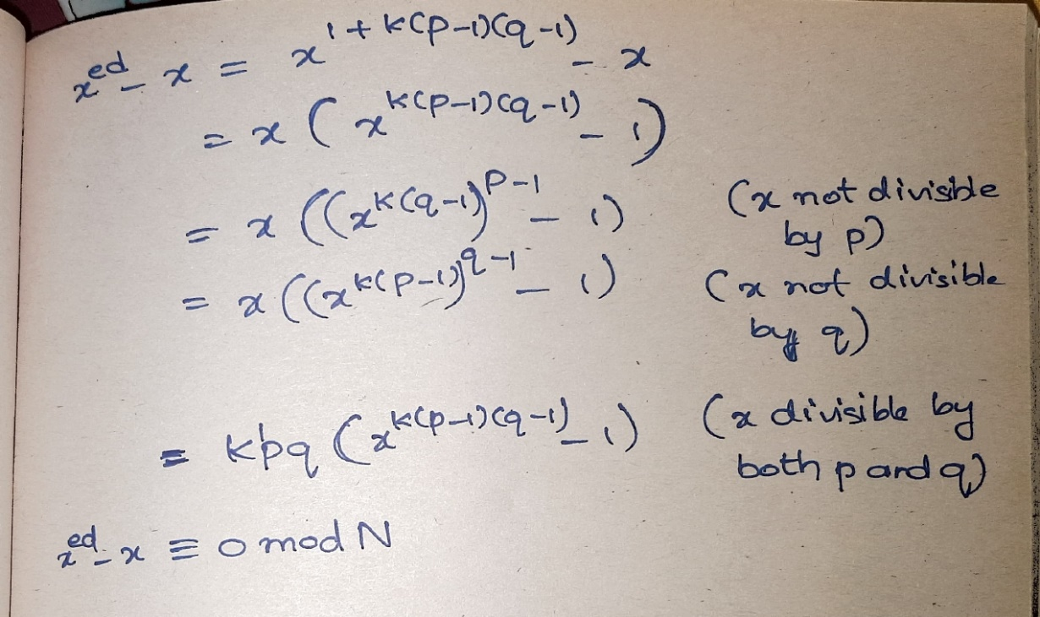
In order to prove
We can prove that ≡ 0 mod N
By Fermat’s little theorem a^{p-1} ≡ 1 (mod p) if p is prime and a is not divisible by p.

Slide 8
How the RSA system works?
Virat chooses his public and secret keys
He starts by picking two large (n-bit) random prime p and q
His public key is (N,e) where N = pq and e is a 2n-bit number relatively prime to (p-1)(q-1).
His secret key is d, the inverse of e modulo (p-1)(q-1), computed using the extended Euclid algorithm
Dhoni wants to send message x to Virat
Dhoni looks up Virat’s public key (N,e) and sends him y = (x^e mod N), computed using an efficient modular exponentiation algorithm
Virat decodes the message by computing (y^d mod N).

Slide 9

Worked out example:
Let N = 55 (5 * 11)
Let encryption exponent e=3
It satisfies gcd(e,(p-1)(q-1)) = gcd(3,40) = 1
The decryption exponent is then d = mod 40 which is 27
So for any message x mod 55
The encryption of x is y = x^3 mod 55
The decryption of y is x = y^27 mod 55
For example if x=13
Then sender side calculation y = 13^3 mod 55 =52
Again on receiver side calculation x = 52^27 mod 55 = 13

