Slide 1
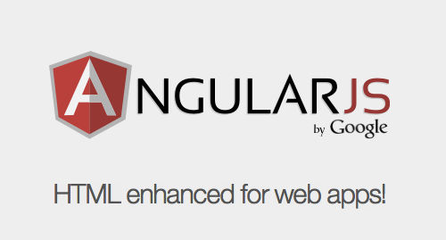
Angular js
20-10-2016
Ashok

Slide 2
agenda
Angular JS Overview

Slide 3
Angular JS Overview
What is Angular JS?
How to get Angular JS?
Why Angular JS ?
Concepts & Philosophy
Architecture Overview
Key Features

Slide 4
What Is angular JS ?
Structural Framework for creating dynamic web applications
Uses JavaScript libraries (JQLite) for DOM Manipulations
Supports SPAs
Client Side MVC

Slide 5
How to get Angular js
Open Source
Miško Hevery, a Google employee, started to work with AngularJS in 2009.
Official Site: https://angularjs.org/
GitHub: https://github.com/angular/angular.js

Slide 6
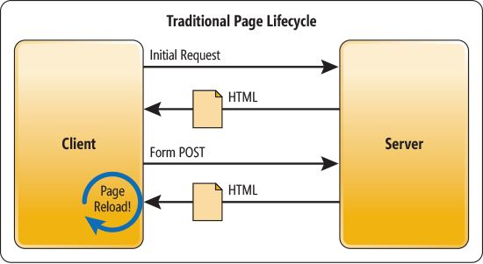
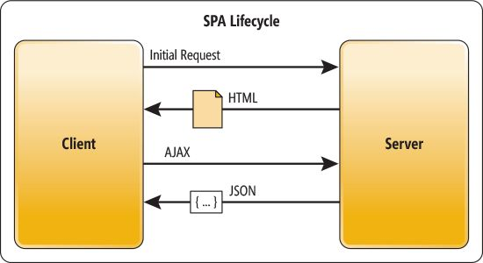
Single page application

Slide 7
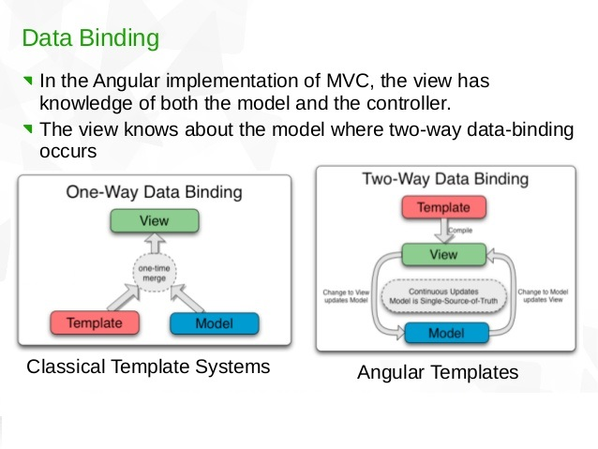
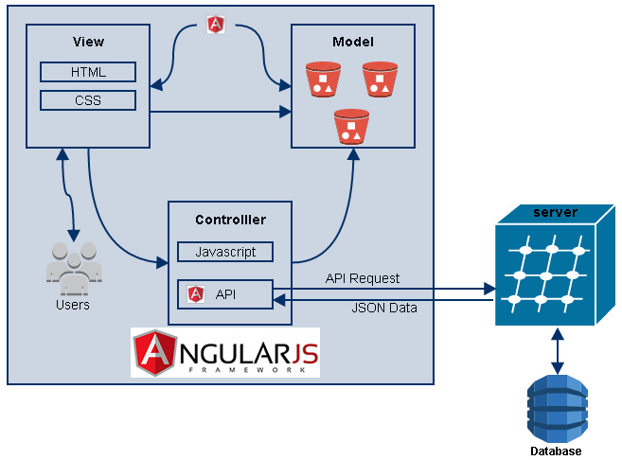
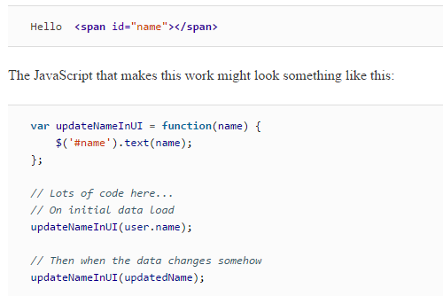
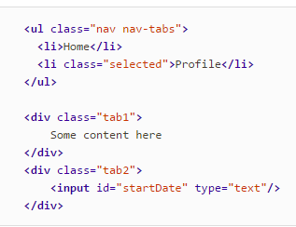
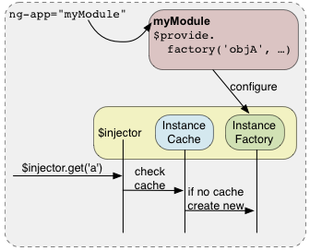
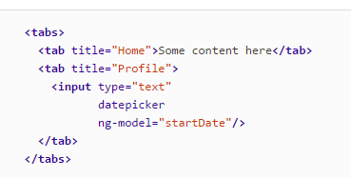

Concepts & Philosophy:
Data-driven
Declarative
Separate your concerns
Dependency Injection
Extensible
Unit Testable

Slide 8
Why angular js?
Frees from Manipulating HTML DOM programmatically
Frees from Registering call backs
No initialization code. Write Less code .
A declarative user interface
Behavior with directives
Reusable
Unit testing ready

Slide 9
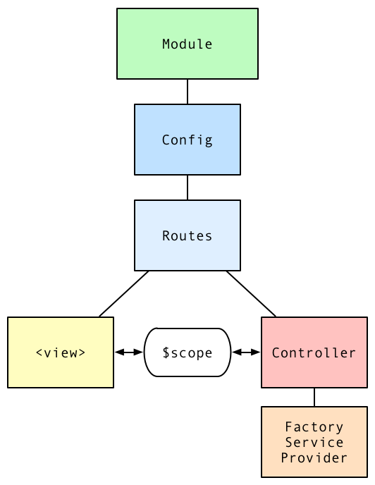
Architecture overview

Slide 10
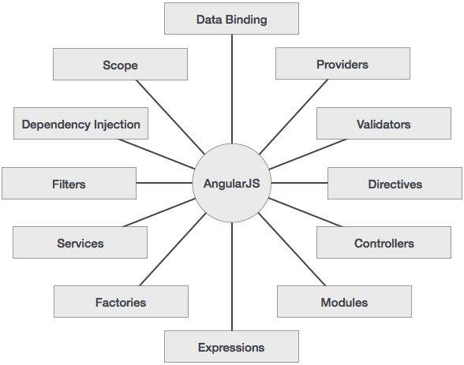
Key Features

Slide 11
Angular JS components
Controller
scope
Service
Dependency Injection
Template
factory
Provider
Filters
Directives

Slide 12
Module
What is module?
- way to organize all your JavaScript code into modules to avoid declaring objects and variables in the global namespace
- A module can be defined by simply calling the angular.module function, where angular is a global namespace exposed by AngularJS and always available to us.
- angular.module function accepts two parameters: the name of the module and an array of dependencies on other modules
Notes:
Why?
Most applications have a main method that instantiates and wires together the different parts of the application.
Angular apps don't have a main method. Instead modules declaratively specify how an application should be bootstrapped. There are several advantages to this approach:
The declarative process is easier to understand.
You can package code as reusable modules.
The modules can be loaded in any order (or even in parallel) because modules delay execution.
Unit tests only have to load relevant modules, which keeps them fast.
End-to-end tests can use modules to override configuration.

Slide 13
Example of module
// A simple module with no dependencies
angular.module("mainModule", [])
.controller("simpleController", function ($scope)
{
……..
})
.service(“serviceName”, function() {
…………
})
});

Slide 14
var myModule = angular.module("mainModule", ['DNM.WizardAppModule',
'DNM.WizardAdminModule', 'Config.BladeFinderModule']);
myModule.controller("simpleController", function ($scope)
{
……..
});
myModule.service(“serviceName”, function() {
…………
});

Slide 15
Module components
controller
Service
Factory
Provider
Value
Dependencies
filter

Slide 16
View and templates
view is a projection of the model through the HTML template
Static & dynamic templates
whenever the model changes, Angular refreshes the appropriate binding points, which updates the view
<html ng-app="phonecatApp">
<head> <script src="bower_components/angular/angular.js"></script>
<script src="js/controllers.js"></script>
</head>
<body ng-controller="PhoneListCtrl">
<ul>
<li ng-repeat="phone in phones"> <span>{{phone.name}}</span> <p>{{phone.snippet}}</p> </li> </ul>
</body>
</html>

Slide 17
Controllers
JavaScript object containing attributes/properties and functions
Facilitates communication between the Model and the view
How it differs from other components?
accepts $scope as a parameter
var myApp = angular.module('myApp',[]);
myApp.controller('GreetingController', ['$scope', function($scope) {
$scope.greeting = 'Hola!'; }]);
<div ng-controller="GreetingController"> {{ greeting }} </div>
Notes:
When a Controller is attached to the DOM via the ng-controller directive, Angular will instantiate a new Controller object, using the specified Controller's constructor function. A new child scope will be created and made available as an injectable parameter to the Controller's constructor function as $scope.
If the controller has been attached using the controller as syntax then the controller instance will be assigned to a property on the new scope.
Use controllers to:
Set up the initial state of the $scope object.
Add behavior to the $scope object.
Note: In general, a Controller shouldn't try to do too much. It should contain only the business logic needed for a single view.

Slide 18
Controller Definition and Assignment
Controllers link the model and the view using the AngularJS service: $scope
HTML Fragment
<div ng-app='myApp' ng-controller="myController"> <p>Hello, {{name}}!</p> <p>{{greet()}}</p> </div>
var module = angular.module('myApp', []); module.controller('myController', [ '$scope', function($scope) { $scope.name = 'John Smith'; $scope.greet = function() { return 'Hello, ' + $scope.name + '!'; }; }]);
JavaScript fragment

Slide 19
Multiple controller
<body ng-app=“myApp”>
<div ng-controller="firstController">
<h2>Model managed by the first controller</h2>
<strong>First name:</strong> {{firstName}}<br />
<strong>Last name:</strong> <span ng-bind="lastName"></span><br />
<strong>Full name:</strong> {{getFullName()}}<br />
<br />
<label>Set the first name: <input type="text" ng-model="firstName"/></label><br />
<label>Set the last name: <input type="text" ng-model="lastName"/></label>
</div>

Slide 20
<div ng-controller="secondController">
<h2>Model managed by the second controller</h2>
<strong>First name:</strong> {{firstName}}<br />
<strong>Middle name:</strong> {{middleName}}<br />
<strong>Last name:</strong> <span ng-bind="lastName"></span><br />
<strong>Full name:</strong> {{getFullName()}}<br />
<br />
<label>Set the first name: <input type="text" ng-model="firstName"/></label><br />
<label>Set the middle name: <input type="text" ng-model="middleName"/></label><br />
<label>Set the last name: <input type="text" ng-model="lastName"/></label>
</div>
</body>

Slide 21
Nested controller
<body ng-app>
<p>
<h2>Nested controllers with model variables defined directly on the scopes</h2>
</p>
<div ng-controller="firstControllerScope">
<strong>First name:</strong> {{firstName}}<br />
<label>Set the first name: <input type="text" ng-model="firstName"/></label><br />
<div ng-controller="secondControllerScope">
<strong>First name (from First):</strong> {{firstName}}<br />
<strong>Last name (new variable):</strong> {{lastName}}<br />
<strong>Full name:</strong> {{getFullName()}}<br />
<label>Set the first name: <input type="text" ng-model="firstName"/></label><br />
<label>Set the last name: <input type="text" ng-model="lastName"/></label><br />
</div>
</div>
Notes:
It is common to attach Controllers at different levels of the DOM hierarchy. Since the ng-controller directive creates a new child scope, we get a hierarchy of scopes that inherit from each other. The $scope that each Controller receives will have access to properties and methods defined by Controllers higher up the hierarchy.

Slide 22
How to create model
angular.module('example', [])
.controller('GreetController', ['$scope', '$rootScope',
function($scope, $rootScope) { $scope.name = 'World'; $rootScope.department = 'Angular'; } ])
.controller('ListController', ['$scope',
function($scope) { $scope.names = ['Igor', 'Misko', 'Vojta']; } ]);
<script src="https://ajax.googleapis.com/ajax/libs/angularjs/1.2.23/angular.min.js"></script>
<body ng-app="example">
<div class="_{show-scope-demo}">
<div ng-controller="GreetController"> Hello {{name}}! </div>
<div ng-controller="ListController">
<ol> <li ng-repeat="name in names">{{name}} from {{department}}</li> </ol> </div>
</div>
</body>

Slide 23
services
Substitutable objects that are wired together using dependency injection (DI)
Where your business logic resides
Lazily instantiated – Angular only instantiates a service when an application component depends on it
Singletons – Each component dependent on a service gets a reference to the single instance generated by the service factory
Examples of AngularJS services - $http, $scope, $window, ect

Slide 24
Example
var module = angular.module('myapp', []);
module.service('userService', function() {
function getUserAuthorities() {
return authorities;
}
function getUserDetails() {
return user;
}
});

Slide 25
factory
Same as service, but will return the output of the factory function
factory will always return a value/object
Example:
module.factory(‘premiumUserService', [“UserModel”, function(UserModel) {
function getPremiumUsers() {
var users = UserModel.getAllUsers();
…….. // filter users
return filteredUsers;
}
return getPremiumUsers();
}]);

Slide 26
Provider
A provider is an object with a $get() method.
The injector calls the $get method to create a new instance of a service.
A provider is actually a configurable factory.
allows you to have a complex creation function and configuration options

Slide 27
var app = angular.module('app', []);
app.provider('movie', function () {
var version;
return {
setVersion: function (value) {
version = value;
},
$get: function () {
return {
title: 'The Matrix' + ' ' + version
}
}
}
});

Slide 28
app.config(function (movieProvider) {
movieProvider.setVersion('Reloaded');
});
app.controller('ctrl', function (movie) {
console.log(movie.title);
});

Slide 29
Filters
What is filter? How it can be used?
- filters can be used to transform data
- filters to search for the data in which user is interested in
- Filters can be applied to expressions in view templates using the following syntax
{{ expression | filter1 | filter2 | ... }}
{{ expression | filter:argument1:argument2:... }}
Example:
"friend in friends | filter:searchText“
{{greeting | reverse | uppercase}}

Slide 30
Filter components in ng
name | description
filter | Selects a subset of items from array and returns it as a new array.
currency | Formats a number as a currency (ie $1,234.56). When no currency symbol is provided, default symbol for current locale is used.
number | Formats a number as text.
date | Formats date to a string based on the requested format.
json | Allows you to convert a JavaScript object into JSON string.
lowercase | Converts string to lowercase.
uppercase | Converts string to uppercase.
limitTo | Creates a new array or string containing only a specified number of elements. The elements are taken from either the beginning or the end of the source array, string or number, as specified by the value and sign (positive or negative) of limit. Other array-like objects are also supported (e.g. array subclasses, NodeLists, jqLite/jQuery collections etc). If a number is used as input, it is converted to a string.
orderBy | Returns an array containing the items from the specified collection, ordered by a comparator function based on the values computed using the expression predicate.

Slide 31
Custom filter
Example
angular.module(‘myModule', [])
.filter('checkmark', function() {
return function(input) { return input ? '\u2713' : '\u2718'; };
});

Slide 32
Directives
What is it?
At a high level, directives are markers on a DOM element (such as an attribute, element name, comment or CSS class) that tell AngularJS's HTML compiler ($compile) to attach a specified behavior to that DOM element or even transform the DOM element and its children. (https://docs.angularjs.org/guide/directive)

Slide 33
Built-In Directives

Slide 34
ngApp
Use this directive to auto-bootstrap an AngularJS application. The ngApp directive designates the root element of the application and is typically placed near the root element of the page
<html ng-app>
<body> </body>
</html>

Slide 35
ngBind
The ngBind attribute tells Angular to replace the text content of the specified HTML element with the value of a given expression, and to update the text content when the value of that expression changes.
<input type="text" ng-model="name">
Hello <span ng-bind="name"></span>!
Hello <span >{{name}}span>!

Slide 36
ngClass
The ngClass directive allows you to dynamically set CSS classes on an HTML element by databinding an expression that represents all classes to be added.
<p ng-class="style">Using String Syntax</p>
<p ng-class="{strike: deleted, bold: important}">Map Syntax Example</p>
<p ng-class="[style1, style2, style3]">Using Array Syntax</p>

Slide 37
ngIf
The ngIf directive removes or recreates a portion of the DOM tree based on an {expression}. If the expression assigned to ngIf evaluates to a false value then the element is removed from the DOM, otherwise a clone of the element is reinserted into the DOM.
<span ng-if="checked" >
This is removed when the checkbox is unchecked.
</span>

Slide 38
ngShow
The ngShow directive shows or hides the given HTML element based on the expression provided to the ngShow attribute. The element is shown or hidden by removing or adding the .ng-hide CSS class onto the element.
<span ng-show="checked" >
This is displayed when the checkbox is checked.
</span>

Slide 39
ngInclude
Fetches, compiles and includes an external HTML fragment.
<div ng-include="template.url"></div>

Slide 40
ngController
The ngController directive attaches a controller class to the view. This is a key aspect of how angular supports the principles behind the Model-View-Controller design pattern.
<body ng-controller="NameCtrl"><body>

Slide 41
CUSTOM Directives
Writing custom directives is not for the faint of heart.
We could easily have a full day discussion just on how to write directives, but we’ll still cover some basics.

Slide 42
$watch
When you create a data binding from somewhere in your view to a variable on the $scope object, AngularJS creates a "watch" internally. A watch means that AngularJS watches changes in the variable on the $scope object. The framework is "watching" the variable. Watches are created using the $scope.$watch() function.
<div ng-controller="x">
<input type="text" ng-model="a">
<div>{{b}}</div>
</div>
watch-a:1
Watch-b:2
app.controller('x',function($scope){
$scope.a=1;
$scope.b=2;
$scope.c=3;
});

Slide 43
$watch
1.Keep track of variables and its value.
2.Watched by angular framework(by digest cycle)
3.If value get changed angular perform necessary updated.
4.Angular can updated our custom function on value change.
5.Angular heavily use watch in case of data binding.
6.We can add our own “watch using $scope $watch function.
$scope.$watch(watchExp, watchlistenerfunction, objectEquality, prettyPrintExpression)

Slide 44
Ex. $scope.$watch(‘a’,function(newVal,oldVal){
If(newVal !== oldVal){
$scope.b=$scope.a * 2;
}
});
Watch Listener function get executed when watched value changed.

