Slide 1
Elliptic Curve Cryptography for securing encoded media storage on cloud
Introduction
Survey Analysis
Current Scenario
Proposed System
Comparison of ECC and RSA

Slide 2
INTRODUCTION
With an exponential increase in the growth of internet, the world is moving towards the usage of cloud even for basic computing.
Cloud is more prominently used for storage purposes as cloud provides wide storage space, reliability, availability along with cost reduction.
With the advantages of using of cloud, comes a plethora of issues and data becomes more and more vulnerable to security threats.
Hence, security becomes a major concern when it comes to utility of cloud services, especially cloud storage.

Slide 3
SURVEY ANALYSIS
To get an insight about the current awareness of security and cloud services from various individuals, a survey was conducted among them.
Analysis is being constructed based upon the responses from various individuals.

Slide 4



Do you think all the data stored and accessed via your device(s) is secure?
Do you think it is essential to secure data of all our devices stored on cloud?

Slide 5


Have you heard of the concept of Elliptic Curve Cryptography (ECC)?
Do you think use of algebraic structures in cryptography algorithms will strengthen security? (As compared to linear ciphers)

Slide 6
CURRENT SCENARIO
The current cloud storage providers provide a lock - key mechanism for all the files uploaded by the user.
This doesn’t ensure file level encryption, which poses a threat to personal data of the user, as potential attacks may expose all the files once the storage is hacked.
One of the reasons, why file level encryption isn’t deployed is, that some of the storage providers thrive on the user’s data, and hence may scan through the files.
This helps the provider deploy target specific actions such as advertisements across all of its services.
This drawback has led to incidents revealing personal user data such as images, which further dispenses fear of security among other users.

Slide 7
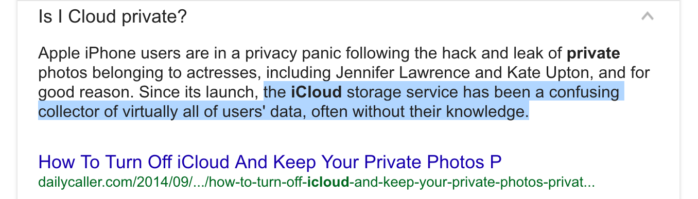
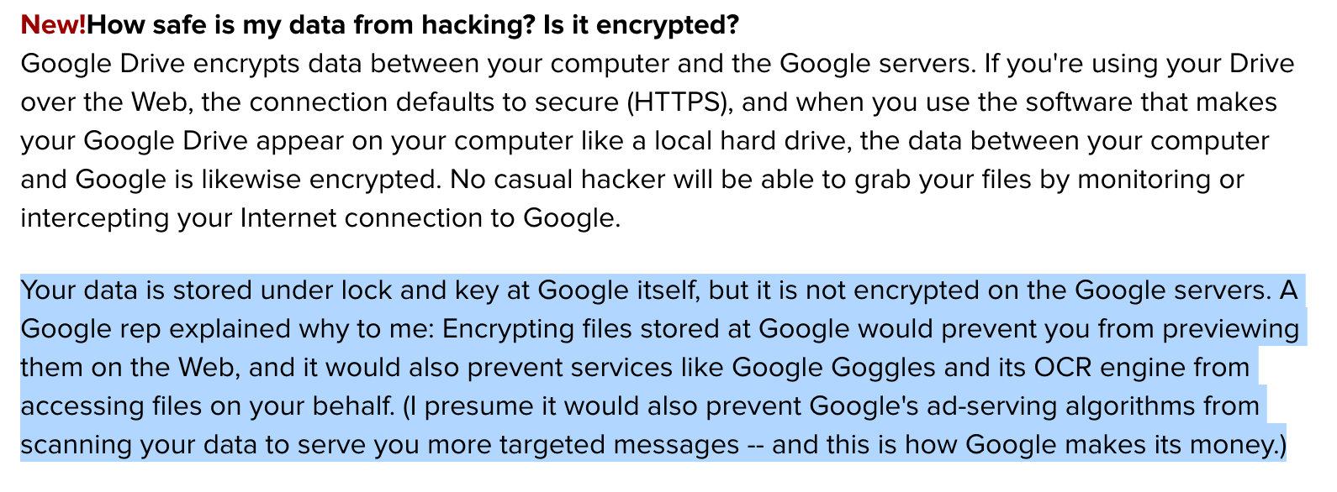

Slide 8
PROPOSED SOLUTION
ECC is capable of providing equivalent or better security for the same or less size of numbers.
For file formats such as images, videos instead of uploading them directly as is, they can be converted into a binary large object string, and then encrypted before uploading.
The conversion is achieved using base64 encoding.
As a performance measure, to compare the efficiency of ECC and RSA algorithms, signature generation by each was taken into consideration.
After encoding 6 large image files (40MB - 100 MB) and generating signatures for 6 sample texts (character length: 3000 to 11000), the following conclusion was arrived.

Slide 9
MORE ON ECC
y² = x³ + ax + b
plot of the same curve with only the whole
number points represented with a maximum of 97:
…(4a³ + 27b² != 0 )

Slide 10
COMPARISON OF ECC AND RSA
Parameter of comparison | Elliptic Curve Cryptography(ECC) | Rivest-Shamir-Adleman(RSA)
Logical definition | ECC is based on complex algebraic structures of ECDLP | RSA is based on factoring the product of two large prime numbers
Key length | ECC provides same level of security as RSA with a smaller key length. | RSA provides security with a larger key length
Computational time | In ECC, the time required to generate key grows linearly with the key size. | In RSA, the time required to generate key grows exponentially.
Complexity | It is comparatively far difficult to break ECC cryptography | Breaking of RSA cryptography is easier than ECC
CPU utilization | It requires low CPU and memory utilization as key length is small. | It requires high CPU and memory utilization as key length is large.

Slide 11
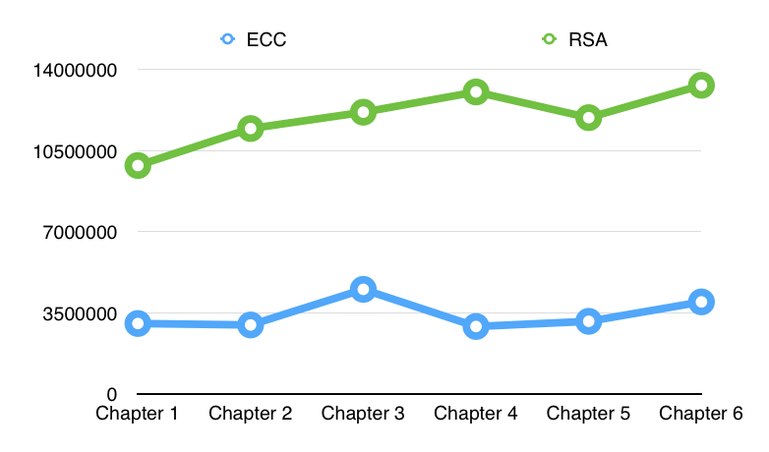
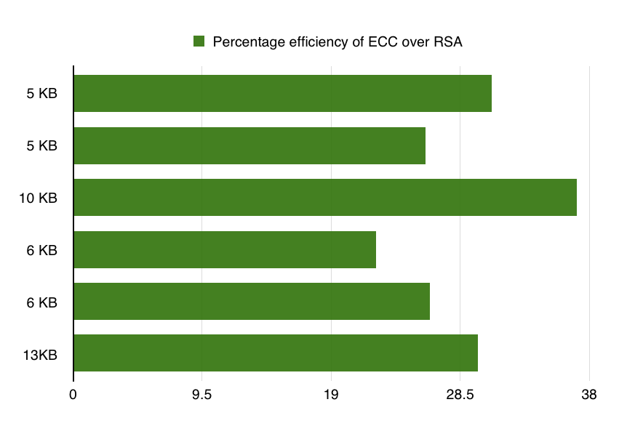

Slide 12
SUMMARY
Prevailing cloud services don’t necessarily employ file level encryption of personal files.
Considering media files such as images, it is highly important to ensure they are kept secure from external intrusions and to give a firm solution to avoid cloud storage providers accessing data from media or any other files.
Use of ECC encryption ensures that the files stored on cloud is secure from external threats and it also prevents the cloud providers from using that data for any purpose.
By overall comparison of ECC with presently employed encryption algorithm(s), it can be concluded that ECC can provide better security with comparatively lesser resources.

