Slide 1
Addastic
Redefining customer on ground experience

Slide 2




Team Addastic
Jodhpur,INDIA
Ashok Chouhan
BHavesh Solanki
Backend developer
Ashish mehta
full stack developer
J2EE Trainee
Arjit Chauhan
Secure and private ai Facebook scholar

Slide 3

Opportunity
First time flyers often need some help to guide them through the Airport.
To reduce hassle of boarding pass and to provide better experience while in Airport
We target people who are comfortable in using smartphones.
If we could provide better experience before boarding flight we could make a lasting impression on our customer.

Slide 4
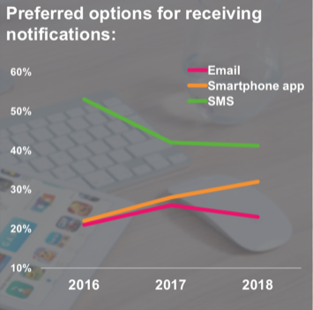
Research and findings
25-54 year old people preferred Electronic Boarding Pass.
45% of Passengers chose biometric as a mode of identification in replacement to passport.
18-64 year old use of electronic bag tag and 65+ wanted airline agent support.
Passenger traffic to double in next 20 years(imm-international).
51% passengers wanted their luggage to be delivered at final destination as long as it is being tracked electronically.

Slide 5
Our idea
We aim to provide virtual boarding pass over user’s smartphone reducing the queue length for boarding pass.
Our project aims to guide user through various checkpoints using an AR based mobile app which would also help SIA to track real time customer’s location.
This app will also fetch information regarding the e-tag of luggage tracking where the luggage in realtime.

Slide 6
Technology

Slide 7
Demo
Gif of the app

Slide 8
Business value
Our main aim is to reduce the hustle for the boarding pass
If the customer uses our app and is unable to board the flight SIA is able to track the current location hence increasing customer satisfaction value.
Using AR in this app will enable user to engage with SIA directly while he is not at the ticket counter or at the departure area increasing possibility for publicity and marketing of SIA.

Slide 9
Project Plan
Research and Survey
Requirement Gathering
Basic Implementation of Application
Testing and Reviewing of Beta Version
Final Implementation and Reviewing

Slide 10
References
2018 Global Passenger Survey by International Airport Transport Association(IATA).
National Academy of Customs, Excise and Narcotics, Mumbai, India
Customer Satisfaction Survey, Jersey Airport(2017 Q4)

