Slide 1

Digital Portfolio
STUDENT NAME : A.pushparaj
REGISTER NO AND NMID : 212403870/
A63B842C8E5AAE8904E492C80E7979F6
DEPARTMENT : BCA
COLLEGE/UNIVERSITY : Tagore College Of Arts & Science , Chrompet, Chennai University of Madras
1
Notes:
1

Slide 2

PROJECT TITLE :
Pushparaj's portfolio
2
Notes:
2

Slide 3




AGENDA
Problem Statement
Project Overview
End Users
Tools and Technologies
Portfolio design and Layout
Features and Functionality
Results and Screenshots
Conclusion
Github Link
3/21/2024 Annual Review
3
Notes:
3

Slide 4

PROBLEM STATEMENT
The lack of a centralized and professional platform makes it challenging for students and professionals to showcase their skills, projects, and achievements. A digital portfolio solves this issue by providing an organized, interactive, and visually appealing way to present personal and professional information.
4
Notes:
4

Slide 5

PROJECT OVERVIEW
This project focuses on creating a digital portfolio that highlights an individual’s educational background, technical skills, projects, and achievements. The portfolio serves as both a personal branding tool and a professional showcase that can be shared with potential employers or collaborators.
5
Notes:
5

Slide 6

WHO ARE THE END USERS?
The primary end users of this project are students, job seekers, and professionals who wish to present their skills and accomplishments effectively. Employers, recruiters, and academic evaluators also benefit from accessing a structured, clear representation of a candidate’s capabilities.
6
Notes:
6

Slide 7

TOOLS AND TECHNIQUES
The portfolio is developed using web technologies such as HTML, CSS, and JavaScript, along with frameworks like Bootstrap for responsive design. Additional tools such as GitHub for version control and deployment platforms like Netlify or GitHub Pages are used to make the portfolio easily accessible online.
7
Notes:
7

Slide 8
POTFOLIO DESIGN AND LAYOUT
The design emphasizes simplicity, readability, and visual appeal. The layout is structured into sections such as introduction, skills, projects, and achievements. A clean navigation system ensures that users can easily explore the portfolio and quickly access relevant information.
8
Notes:
8

Slide 9
FEATURES AND FUNCTIONALITY
Key features include a responsive design for compatibility across devices, interactive navigation, and sections for showcasing projects with links or demos. The portfolio also supports external links to GitHub repositories, LinkedIn profiles, or resumes, making it a versatile tool for professional presentation.
Notes:
9

Slide 10
RESULTS AND SCREENSHOTS
Home Page – Displays name, introduction, and navigation.
Contact Page – Email, phone, address, and form (as shown in screenshots).
Responsive View – Adjusts to different screen sizes.
3/21/2024 Annual Review
10
Notes:
10

Slide 11
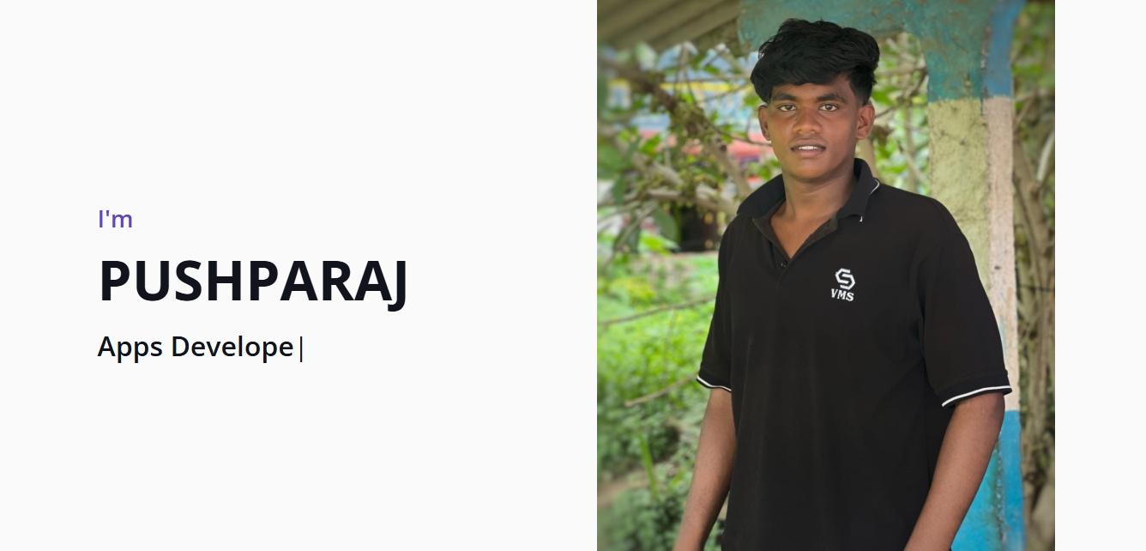

Slide 12
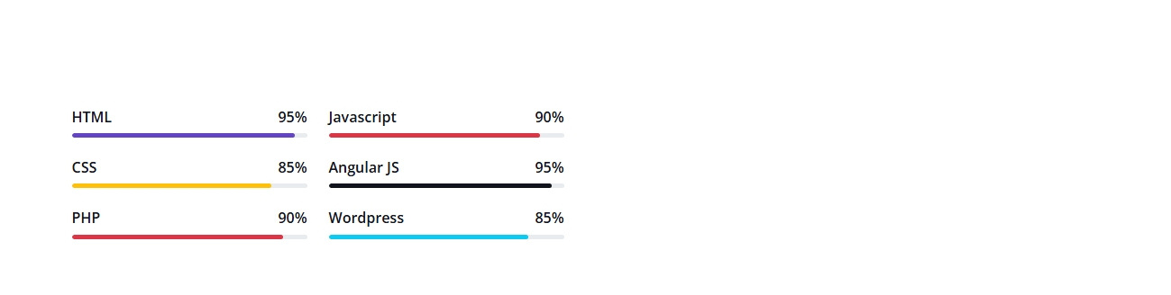

Slide 13
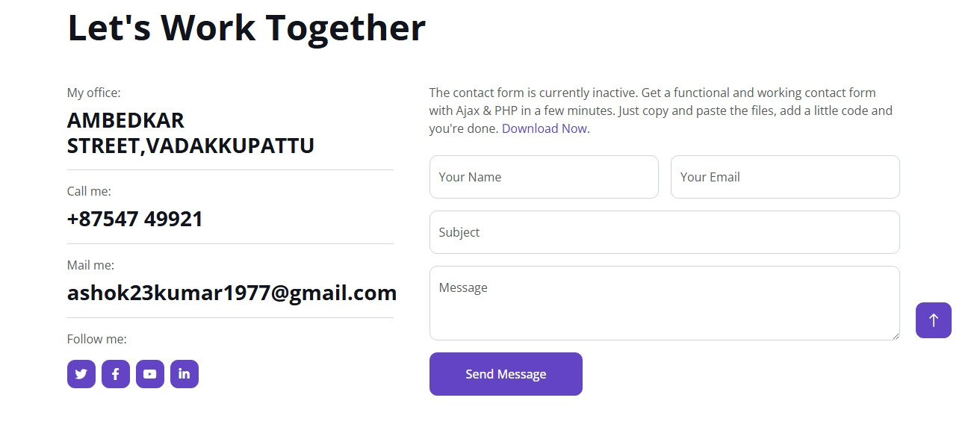

Slide 14
CONCLUSION
This project successfully addresses the challenge of personal branding and digital presentation by offering a modern, interactive portfolio solution. It not only enhances visibility but also builds credibility and professionalism in both academic and professional settings.
16
Notes:
16

Slide 15

Github link
https://ashok23kumar1977-ui.github.io/Pushparaj/

