Slide 1









Technical Architecture Diagram
Dashboards
Manager
Patient details
AI Insights
Admin
Rule Engine powered by deepseek
DataWarehouse

Slide 2
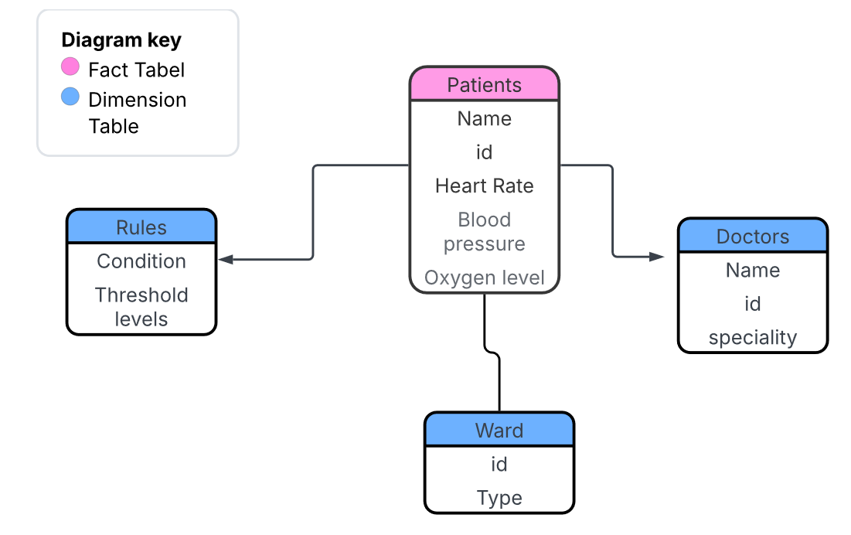
Patient Segmentation Data Model
This model supports a rule-based patient segmentation system where patient vitals are evaluated against predefined medical rules. Supporting tables such as doctors and wards provide additional context for clinical decision-making and triage prioritization.

