Slide 1

Advanced Credit Card
FRAUD DETECTION
using
Machine Learning
R. ASHOK
151221862036

Slide 2

ABSTRACT
Mainly focusses on credit card fraud detection in real world. Initially I will collect the credit card datasets for trained dataset. Then will provide the user credit card queries for testing data set. After classification process of random forest algorithm using to the already analysing data set and user provide current dataset. Finally optimizing the accuracy of the result data. Then will apply the processing of some of the attributes provided can find affected fraud detection in viewing the graphical model visualization. The performance of the techniques is evaluated based on accuracy, sensitivity, and specificity, precision. The results indicate about the optimal accuracy for Decision tree are 98.6% respectively.

Slide 3

EXISTING SYSTEM
Research about a case study involving credit card fraud detection, where data normalization is applied before Cluster Analysis and with results obtained from the use of Cluster Analysis and Artificial Neural Networks on fraud detection has shown that by clustering attributes neuronal inputs can be minimized. And promising results can be obtained by using normalized data and data should be MLP trained. This research was based on unsupervised learning. Significance of this paper was to find new methods for fraud detection and to increase the accuracy of results. The data set for this paper is based on real life transactional data by a large European company and personal details in data is kept confidential. Accuracy of an algorithm is around 50%. Significance of this paper was to find an algorithm and to reduce the cost measure. The result obtained was by 23% and the algorithm they find was Bayes minimum risk.
Disadvantages:
In this paper a new collative comparison measure that reasonably represents the gains and losses due to fraud detection is proposed.
A cost sensitive method which is based on Bayes minimum risk is presented using the proposed cost measure.

Slide 4
PROPOSED SYSTEM
Here applying random forest algorithm for classify the credit card dataset. Decision tree is an algorithm for classification and regression. Summarily, it is a collection of decision tree classifiers. Decision tree has advantage over decision tree as it corrects the habit of over fitting to their training set. A subset of the training set is sampled randomly so that to train each individual tree and then a decision tree is built, each node then splits on a feature selected from a random subset of the full feature set. Even for large data sets with many features and data instances training is extremely fast in random forest and because each tree is trained independently of the others. The Decision tree algorithm has been found to provide a good estimate of the generalization error and to be resistant to overfitting.
Advantage:
Random forest ranks the importance of variables in a regression or classification problem in a natural way can be done by Decision tree.
The 'amount' feature is the transaction amount. Feature 'class' is the target class for the binary classification and it takes value 1 for positive case (fraud) and 0 for negative case (non fraud).

Slide 5

SOFTWARE SPECIFICATIONS
Software
Python
Anaconda
Hardware
OS – Windows 7, 8 and 10 (32 and 64 bit)
RAM – 4GB

Slide 6

MODULES
DATA COLLECTION
DATA PRE-PROCESSING
FEATURE EXTRATION
EVALUATION MODEL
1.DATA COLLECTION
Data used in this paper is a set of product reviews collected from credit card transactions records. This step is concerned with selecting the subset of all available data that you will be working with. ML problems start with data preferably, lots of data (examples or observations) for which you already know the target answer. Data for which you already know the target answer is called labelled data.

Slide 7

MODULES
2.DATA PRE-PROCESSING
Three common data pre-processing steps are:
Formatting: The data you have selected may not be in a format that is suitable for you to work with. The data may be in a relational database and you would like it in a flat file, or the data may be in a proprietary file format and you would like it in a relational database or a text file.
Cleaning: Cleaning data is the removal or fixing of missing data. There may be data instances that are incomplete and do not carry the data you believe you need to address the problem.
Sampling: There may be far more selected data available than you need to work with. More data can result in much longer running times for algorithms and larger computational and memory requirements. You can take a smaller representative sample of the selected data that may be much faster for exploring and prototyping solutions before considering the whole dataset.

Slide 8
MODULES
3.FEATURE EXTRATION
Next thing is to do Feature extraction is an attribute reduction process. Unlike feature selection, which ranks the existing attributes according to their predictive significance, feature extraction actually transforms the attributes. The transformed attributes, or features, are linear combinations of the original attributes.
4. EVALUATION MODEL
Model Evaluation is an integral part of the model development process. It helps to find the best model that represents our data and how well the chosen model will work in the future. Evaluating model performance with the data used for training is not acceptable in data science because it can easily generate overoptimistic and over fitted models. There are two methods of evaluating models in data science, Hold-Out and Cross-Validation. To avoid over fitting, both methods use a test set (not seen by the model) to evaluate model performance.

Slide 9
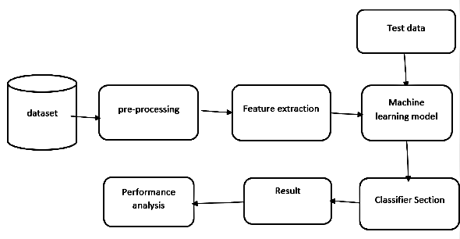
ARCHITECTURE DIAGRAM

Slide 10

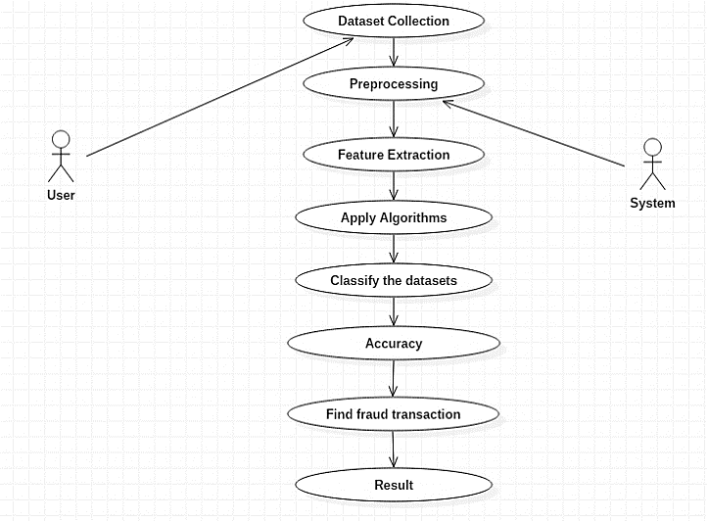
UML DIAGRAMS
Use Case Diagram

Slide 11

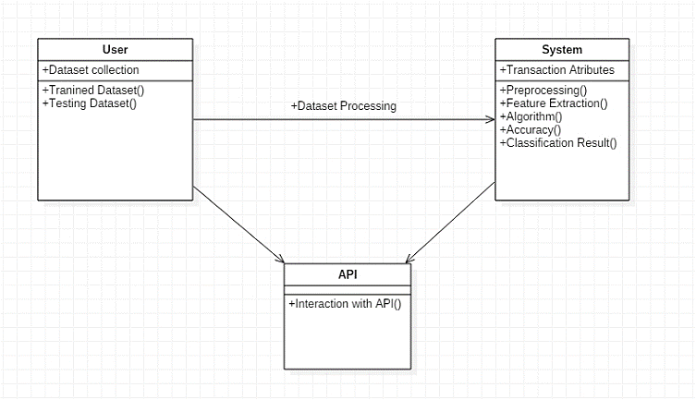
UML DIAGRAMS
Class Diagram

Slide 12

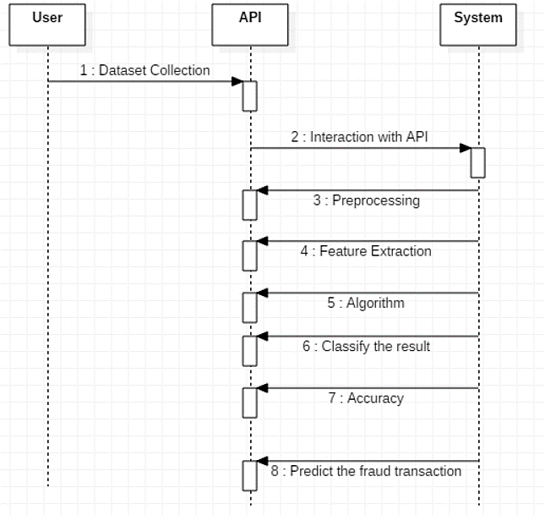
UML DIAGRAMS
Sequence Diagram

Slide 13
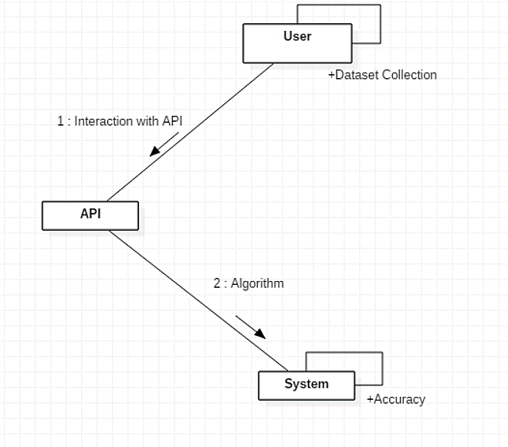
UML DIAGRAMS
Collaboration Diagram

Slide 14

TYPES OF TESTING
Functional Testing: Functional tests provide systematic demonstrations that functions tested are available as specified by the business and technical requirements, system documentation, and user manuals.
Functional testing is centered on the following items:
Functions: Identified functions must be exercised.
Output: Identified classes of software outputs must be exercised.
Systems/Procedures: system should work properly
Integration Testing: Software integration testing is the incremental integration testing of two or more integrated software components on a single platform to produce failures caused by interface defects.
Test Case for Excel Sheet Verification:
Here in machine learning we are dealing with dataset which is in excel sheet format so if any test case we need means we need to check excel file. Later on classification will work on the respective columns of dataset

Slide 15
FUTURE ENHANCEMENT
Debit cards have traditionally been more popular in India than credit cards. Expatriates who were familiar with credit card systems made up the majority of India's early credit card customers. This led to the false belief that credit cards are an expensive foreign consumer good only available to the very rich.
With more knowledge of credit cards and their accessibility, this notion has, however, undergone a substantial adjustment. Credit cards are now widely used in the Indian market. With respect to a rise in credit card transactions and new credit cards issued, India's credit card sector has seen tremendous growth over the last 10 years. The sections that follow in-depth examine this credit card industry expansion pattern.

Slide 16

CONCLUSION
The proposed project evaluated that the Decision tree and support vector machine algorithm will perform better with a larger number of training data comparing to Adaboost classifier, but speed during testing and application will suffer. Application of more pre-processing techniques would also help. The SVM algorithm still suffers from the imbalanced dataset problem and requires more pre-processing to give better results at the results shown by SVM is great but it could have been better if more pre-processing have been done on the data.so, in proposed work I balanced the imbalanced data with up-sampling technique during pre-processing. I review the existing works on credit card fraud prediction in three different perspectives: datasets, methods, and metrics. Firstly, I present the details about the availability of public datasets and what kinds of details are available in each dataset for predicting credit card fraud. Secondly, I compared and contrast the various predictive modeling methods that have been used in the literature for predicting, and then quantitatively compare their performances in terms of accuracy.

Slide 17
REFERENCES
P. Richhariya and P. K. Singh, “Evaluating and emerging payment card fraud challenges and resolution,” International Journal of Computer Applications, vol. 107, no. 14, pp. 5 – 10, 2014.
S. Bhattacharyya, S. Jha, K. Tharakunnel, and J. C. Westland, “Data mining for credit card fraud: A comparative study,” Decision Support Systems, vol. 50, no. 3, pp. 602–613, 2011.
A.DalPozzolo, O.Caelen, Y.-A.LeBorgne, S.Waterschoot, and G.Bontempi, “Learned lessons in credit card fraud detection from a practitioner perspective,” Expert systems with applications, vol. 41, no. 10, pp. 4915– 4928, 2014.
C. Phua, D. Alahakoon, and V. Lee, “Minority report in fraud detection: classiﬁcation of skewed data,” ACM SIGKDD explorations newsletter, vol. 6, no. 1, pp. 50–59, 2004.
Z.-H. Zhou and X.-Y. Liu, “Training cost-sensitive neural networks with methods addressing the class imbalance problem,” IEEE Transactions on Knowledge and Data Engineering, vol. 18, no. 1, pp. 63–77, 2006.

Slide 18

THANK YOU

